Slide 1

BSBSUS301
Implement and monitor environmentally sustainable work practices

Slide 2

Investigate current practices in relation to resource usage
1.1 Identify environmental regulations applying to the enterprise

Slide 3

National Legislation
Environmental Protection and Biodiversity Conservation Act 1999 (EPBC)
Environment Protection (Sea Dumping) Act 1981
National Environment Protection Measures (Implementation) Act 1998.

Slide 4

EPBC: Matters of national environmental significance
World heritage properties
National heritage places
Wetlands of international importance
Nationally threatened species and
ecological communities
Migratory species
Commonwealth marine areas
The Great Barrier Reef Marine Park
Nuclear actions which includes uranium mining
A water resource.

Slide 5

Who does the EPBC affect?
Landowners
Developers
Industry
Farmers
Councils
State and territory agencies
Commonwealth agencies.

Slide 6

Actions
Property development
Industrial processes
Mineral and petroleum resource exploration
Storage and transportation of hazardous materials
Waste disposal
Earthworks
Impoundment
Extraction and diversion of water
Agricultural activities
Etc.

Slide 7

Significant impact
The sensitivity, value and quality of the environment
The intensity, duration, severity and geographic extent
Whether there are any matters of national environmental significance located in the area
Whether there is potential for impacts on matters of national environmental significance
at the broadest scope of the proposed
action
Whether there are any proposed
measures to avoid or minimise impacts.

Slide 8

National Environment Protection Measures (Implementation) Act 1998
Air toxics
Ambient air quality
Assessment of site contamination
Diesel vehicle emissions
Movement of controlled waste
between states and territories
National pollutant inventory
Used packaging materials.

Slide 9
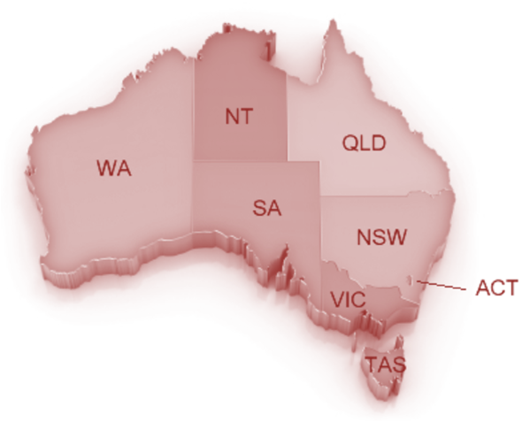
State and territory legislation
Australian Capital Territory
New South Wales
Northern Territory
Queensland
Tasmania
Victoria
South Australia
Western Australia.

Slide 10

Organisational regulations
Use of sustainable resources
Recycling
Waste reduction measures
Use of energy saving technology
Consideration of environmental
factors in strategic decision-making.

Slide 11

Activity 1A

Slide 12
Investigate current practices in relation to resource usage
1.2 Analyse procedures for assessing compliance with environmental/sustainability regulations

Slide 13
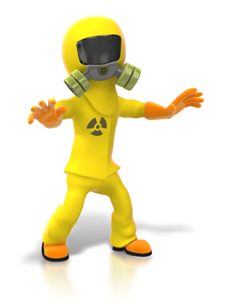
Compliance with environmental regulations
Meeting relevant laws, by‑laws and regulations or best practice or codes of practice to support compliance in environmental performance and sustainability at each level as required (such as Environmental Protection or Biodiversity Conservation Act):
  international
  commonwealth
  state/territory
  industry
  organisation.

Slide 14
Activity 1B

Slide 15
Investigate current practices in relation to resource usage
1.3 Collect information on environmental and resource efficiency systems and procedures, and provide to the work group where appropriate

Slide 16

Environmental and resource efficiency systems
Carbon management
Waste assessment
Improve purchasing
Improve storage
Energy conservation
Water conservation
Preserving waterways
Improving information
Reducing odour and air emissions.

Slide 17
Activity 1C

Slide 18
Investigate current practices in relation to resource usage
1.4 Collect, analyse and organise information from a range of sources to provide information/advice and tools/resources for improvement opportunities

Slide 19

Range of sources
Organisation specifications
Regulatory sources
Relevant stakeholders
Resource use.

Slide 20
Activity 1D

Slide 21
Investigate current practices in relation to resource usage
1.5 Measure and document current resource usage of members of the work group

Slide 22

Resources
Utilities
Business equipment and machinery
Raw materials
Disposables:
  food
  plastic
  paper
  cardboard
  glass.

Slide 23

Measuring usage
Total amount of resource used over fixed period(s) of time
Total cost of resource used
Total cost of resource used in comparison to cost of wastage
Total cost of resource used in
comparison to relevant profits
made
Amount of resource used in
comparison to regulatory
guidelines or limits.

Slide 24
Activity 1E

Slide 25
Investigate current practices in relation to resource usage
1.6 Analyse and document current purchasing strategies

Slide 26

Sustainable procurement
Environmental
Social
Economic.

Slide 27

Supply chains
In order to make informed decisions about purchasing strategies it is important to understand the supply chain of the product.
Some products have very long supply chains that are often global
It is important to find out whether or not the same environmental protection
and/or human rights
that we enjoy in Australia are
being adhered to throughout
the supply chain.

Slide 28
Activity 1F

Slide 29
Investigate current practices in relation to resource usage
1.7 Analyse current work processes to access information and data to assist in identifying areas for improvement

Slide 30

Work processes
Design of product and/or service
Manufacture of product
Delivery of product and/or service
Storage
Disposal
Supply chain management
Administration.

Slide 31

Analyse work processes
Identify a single process
Break the process down into steps
Gather information about environmental impact
Ask for suggestions on ways to improve the process
Identify areas for improvement
Ensure compliance with relevant
regulations.

Slide 32
Activity 1G

Slide 33
Set targets for improvements
2.1 Seek input from stakeholders, key personnel and specialists

Slide 34

Stakeholders
Customers
Employees at all levels of the organisation
Government
Investors
Local community
Other organisations
Suppliers.

Slide 35
Activity 2A

Slide 36
Set targets for improvements
2.2 Access external sources of information and data as required

Slide 37

Online information
Federal and state/territory websites
ECOS magazine
CSIRO (Commonwealth Scientific and Industrial Research Organisation)
Australian Conservation Foundation
The Nature Conservancy.

Slide 38
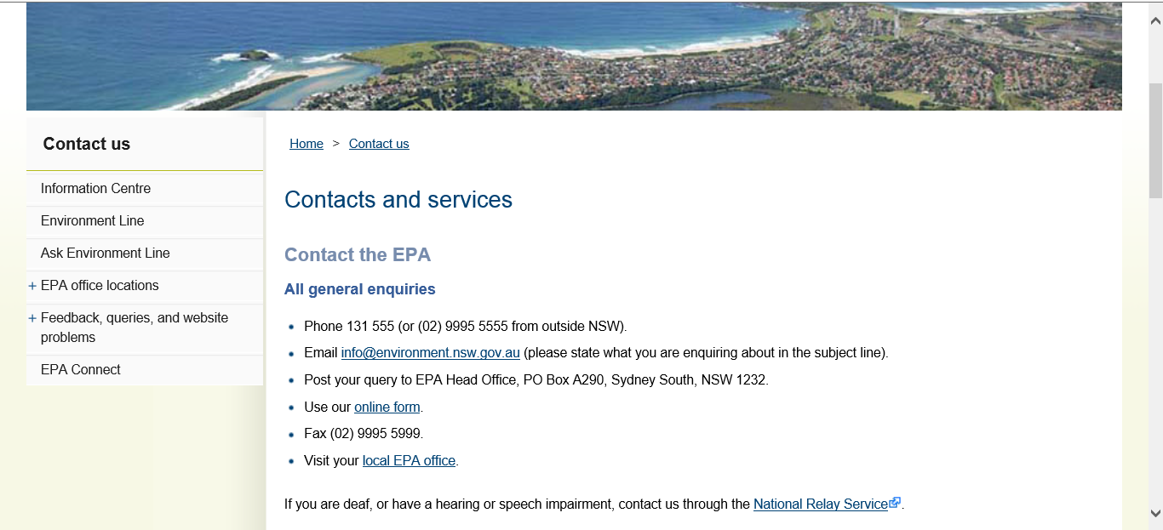
Local government support

Slide 39
Activity 2B

Slide 40
Set targets for improvements
2.3 Evaluate alternative solutions to workplace environmental issues

Slide 41

Alternative solutions
Carbon management
Waste reduction
Improve purchasing
Improve storage
Improve information
Energy conservation
Water conservation
Preservation of waterways
Reducing odour and air emissions.

Slide 42

Evaluate alternative solutions
Financial cost in terms of the initial outlay
Objective/goal of the intended improvement
The organisation’s objectives as a whole
Time scale of the improvement
How the improvements will be managed,
monitored and reported and by whom
The effect it will have on other
processes, procedures and systems
Whether specialist support is required.

Slide 43

Evaluate alternative solutions
Coincide with the environmental management plan
Already started making small improvements
Effect on employees’ current roles
Staff training required
Effect on customers
Expected impact on the environment
Positive publicity
Overall financial cost of implementing
the improvements.

Slide 44
Activity 2C

Slide 45
Set targets for improvements
2.4 Set efficiency targets

Slide 46

SMART targets
S - specific, significant
M - measurable, meaningful
A - attainable, achievable, acceptable,
action-oriented, agreed upon
R - realistic, relevant, reasonable,
rewarding, results-oriented
T - time-based, time-bound,
timely, tangible, trackable.

Slide 47
Activity 2D

Slide 48
Implement performance improvement strategies
3.1 Source and use appropriate techniques and tools to assist in achieving efficiency targets

Slide 49

Techniques and tools
Examination of invoices from suppliers
Examination of relevant information and data
Measurements made under different conditions
Others as appropriate to the specific industry context.

Slide 50
Activity 3A

Slide 51
Implement performance improvement strategies
3.2 Apply continuous improvement strategies to own work area of responsibility, including ideas and possible solutions to communicate to the work group and management

Slide 52

Continuous improvement
Ongoing effort to highlight and resolve root causes of problems to make processes more efficient.
Small steps by every member in the organisation rather than one ground-breaking idea
Over time they make a huge contribution to the smooth running and improvement of the organisation.
Continuous improvement is the
responsibility of every member of
the organisation in their endeavour
to find and remove wastes in every
process.

Slide 53

Waste
Design and production methods
Materials
Technology, machinery and equipment
Energy
Labour
Management
Storage
Methods of reporting
Administration.

Slide 54
Activity 3B

Slide 55
Implement performance improvement strategies
3.3 Implement and integrate environmental and resource efficiency improvement plans for own work group with other operational activities
3.4 Supervise and support team members to identify possible areas for improved practices and resource efficiency in work area

Slide 56

Environmental and resource efficiency improvement plans
Green office programs
Waste management hierarchy
Waste treatment
Operational energy consumption
Reducing non-renewable resources
Referencing standards, guidelines
and approaches.

Slide 57

Green office programs
Use 100 per cent recycled paper and chlorine free paper
Recycle all products that can be recycled
Switch to a green energy provider
Recycle old technological equipment and replace with more energy efficient models
Use energy efficient lightbulbs
Employ timed power off for
power points and computers
Put computers to sleep.

Slide 58

Green office programs
Use indoor plants to clean air
Open windows for ventilation to minimise use of air conditioning use
Program air conditioning to turn off at the end of the day and over periods of inactivity
Use real time energy monitoring to get an understanding of your business power consumption
Set printers and photocopiers to print
double sided
Turn off lights when not in use
and/or have sensors fitted so they
turn off automatically.

Slide 59
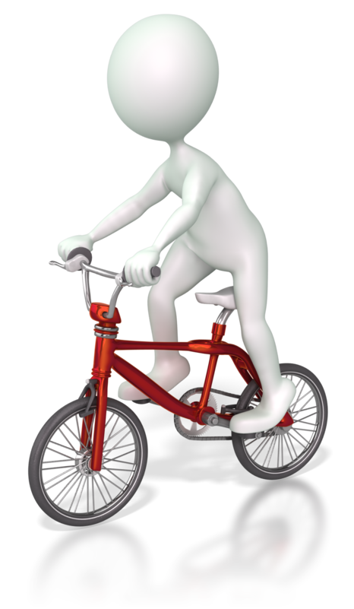
Green office programs
Refill toner and ink cartridges instead of buying new ones or recycle them
Have incentives and rewards for staff buy-in
Use laptops instead of old desktop computers
Just use cold water
Replace disposable products with
reusable ones
Use non-toxic cleaning products
Encourage/reward employees to car
pool, walk/cycle to work or use
public transport
Use teleconferencing.

Slide 60
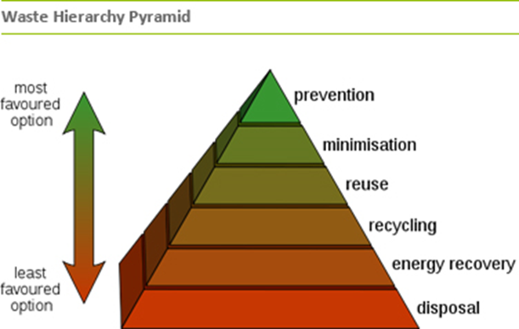
Waste management hierarchy

Slide 61

Waste treatment
Waste to landfill
Recycling
Re-use
Recoverable resources
Wastewater treatment.

Slide 62

Reduce fuel consumption
Walk or cycle to work
Use public transport
Car pool
Drive less aggressively
Keep vehicles in optimum working
order to improve their efficiency
Drive lighter and more
aerodynamic vehicles
Combine trips.

Slide 63

Reduce use of non-renewable resources
Economic use
Use solar power
Use local suppliers.

Slide 64

Referencing standards, guidelines and approaches
Ecological foot-printing
Global Reporting Initiative
Green purchasing
ISO 14040:2006 Environmental management systems life cycle analyses
Product stewardship
Supply chain management
Sustainability covenants/compacts
Triple bottom line reporting.

Slide 65
Activity 3C

Slide 66
Implement performance improvement strategies
3.5 Seek suggestions and ideas about environmental and resource efficiency management from stakeholders and act upon where appropriate

Slide 67

Ideas to improve environmental and resource efficiency
Strategies to offset or mitigate environmental impacts:
  purchasing carbon credits
  energy conservation
  reducing chemical use
  reducing material consumption
Expressing purchasing power through the selection of suppliers with improved environmental performance
Eliminating the use of hazardous and toxic materials.

Slide 68
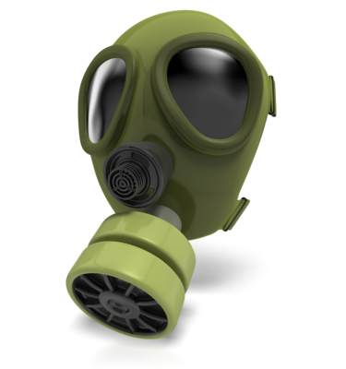
Reduce use of chemicals
Keep chemical containers well maintained to avoid leakages
Only buy as much chemical product as you need so it does not go to waste
If chemical products are nearing their expiry date, donate them to other businesses who will use them to avoid disposing of them as waste
Limit the use of motor vehicles
Use non-toxic cleaning products.

Slide 69

Reduce material consumption
Purchase only what you need for that specific period of time, project, production run so nothing is left over that cannot be used for other purposes
Buy products that can be reused
Buy products with little packaging
Sell or donate unwanted items
Cancel unwanted mail and use
electronic correspondence
wherever possible to reduce
paper waste.

Slide 70
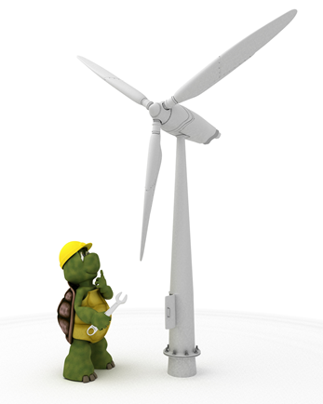
Purchasing renewable energy
Waste
Solar
Water
Wind
Biogas
Biofuel
Green building and biomaterials
Transport technologies
Geothermal
Carbon
Wave/ocean.

Slide 71

Hazardous and toxic materials
Solids
Liquids
Gases
Mists
Fumes generated by the
use of a hazardous material.

Slide 72
Activity 3D

Slide 73
Implement performance improvement strategies
3.6 Implement costing strategies to fully utilise environmental assets

Slide 74
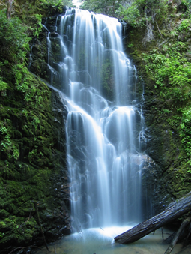
Environmental assets
Biological assets
Land
Water areas with their ecosystems
Subsoil
Air.

Slide 75

Costing strategies
Direct use value – how the resource is used in production or consumption
Indirect use value – how its use benefits other functions or environmental assets
Option value – willingness to pay for a resource that is not currently needed but that may not be available in the future.
The non-use value is the willingness to
pay for a resource that is totally
unrelated to your activity but having
the satisfaction that it exists.

Slide 76

Other costs to consider
What consumers are willing to pay for your product or service - if the production method uses environmentally sustainable work practices, people may be more likely to pay more for it and vice versa
Replacement costs – what will it cost to replace the environmental asset in monetary terms and impact on the environment
Shadow projects – if the activity is
damaging to the asset how much will it
cost to set up a shadow project that
negates the activity and replenishes the
asset.

Slide 77
Activity 3E

Slide 78
Monitor performance
4.1 Use and/or develop evaluation and monitoring, tools and technology
4.2 Document and communicate outcomes to report on efficiency targets to key personnel and stakeholders

Slide 79

Monitoring efficiency targets
Are policies being followed?
Are policies working?
Are targets still relevant?
Are targets likely to be met or exceeded?
Are effects as predicted?
What impacts are the policies having?
Gather accurate information for future
plans.

Slide 80
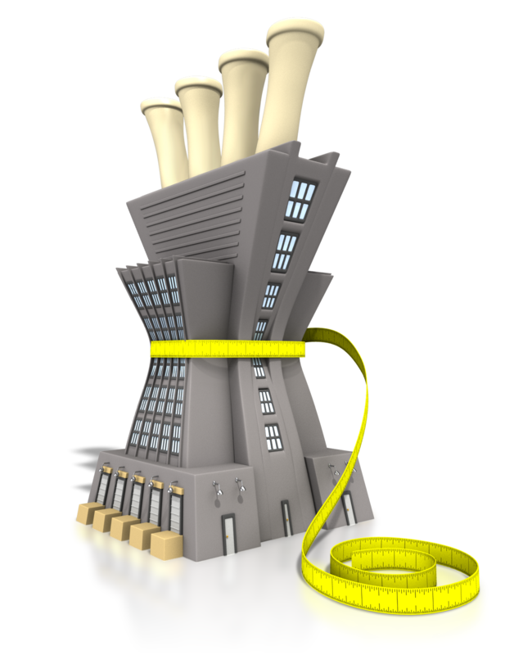
Technology and tools
Energy management software (EMS)
  utility bill tracking
  real-time metering
  lighting control systems
  carbon and sustainability reporting
  it equipment management
  demand response
  energy audits
Automatic metering systems (AMS).

Slide 81
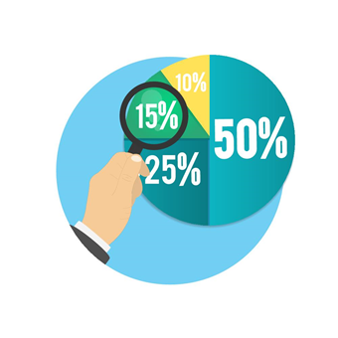
Communicate reports
Written report
PowerPoint presentation to key personnel
Team meeting
Press conference/release
Staff forums
Formal presentation to large
audience
Regulatory reports.

Slide 82
Activity 4A

Slide 83
Monitor performance
4.3 Evaluate strategies and improvement plans

Slide 84

Evaluation best practice
Well-planned and conducted
Specific to your program
Include input from all key personnel and stakeholders involved directly and indirectly with the improvement plan
Honest and transparent
Rigorous
Conducted by one designated
person or team.

Slide 85

Evaluate
Activity you implemented
Procedure used to undertake the activity
Outcomes of the activity
Impacts of the activity on the environment.

Slide 86
Activity 4B

Slide 87
Monitor performance
4.4 Set new efficiency targets, and investigate and apply new tools and strategies

Slide 88

Set new efficiency targets
Continuations
New initiatives from government or within organisation
Reflect local activity
Related to new technology or
machinery
Reflect the results of your
evaluation
Continuous improvement.

Slide 89
Activity 4C

Slide 90
Monitor performance
4.5 Promote successful strategies and reward participants where possible

Slide 91

Promoting successful strategies
Press release
Newsletter to clients and stakeholders
Information on organisation’s website
Through staff training
Celebratory events for stakeholders
and participants.

Slide 92

Rewarding participants
Saying thank you
Financial bonuses or discounts
Corporate hospitality
Shares in the organisation.

Slide 93
Activity 4D

Slide 94
Summative Assessments
Summative assessments consist of:
Skills assessment
Knowledge assessment
Performance assessment.
Your assessor will provide you with further guidance on how and where to complete these assessments.

Slide 95

Summary and Feedback
Did we meet our objectives?
How did you find this session?
Any questions?

