Slide 1

Confined Spaces
Under Work Health and Safety Regulations 2011 –
A confined space means an enclosed or partially enclosed space that—
(a) is not designed or intended primarily to be occupied by a person; and
(b) is, or is designed or intended to be, at normal atmospheric pressure while any person is in the space; and
(c) is or is likely to be a risk to health and safety from—

Slide 2
(i) an atmosphere that does not have a safe oxygen level; or
(ii) contaminants, including airborne gases, vapours and dusts, that may cause injury from fire or explosion; or
(iii) harmful concentrations of any airborne contaminants; or
(iv) engulfment; but does not include a mine shaft or the workings of a mine.

Slide 3
Legal and Organisational requirements
Work Health and Safety Regulations 2011 confined spaces;
(a) are entered by any person; or
(b) are intended or likely to be entered by any person; or
(c) could be entered inadvertently by any person.
A person conducting a business or undertaking must ensure, so far as is reasonably practicable, that a worker does not enter a confined space before this division has been complied with in relation to that space.

Slide 4
Hazard identification tools and techniques
A duty holder, in managing risks to health and safety, must identify reasonably foreseeable hazards that could give rise to risks to health and safety.
Consulting workers when identifying hazards and assessing risks to health and safety arising for the work carried out or to be carries out by the business or undertaking.

Slide 5
Confined space hazards
Lack of oxygen – occurs when the space has a limited supply of fresh air or the air is contaminated and cannot sustain human life.
Toxic atmospheres – inhaled toxic gases, vapours or dust can cause serious health problems. Chemicals, rotting organic material, or waste products.
Engulfment – spaces where workers can be buried or trapped in sand, water or grain

Slide 6
Risk Assessment of Confined Space
Assess whether the space is partially enclosed or totally enclosed space?
Is it designed to intended to be occupied by a person?
Is the space designed intended to be a normal atmospheric pressure?
Does it contain or likely to contain an unsafe oxygen level?
Is there any contaminants, airborne gases, vapours or dust that may cause injury from a fire or an explosion?
Can a person be engulfed e.g. inrush of water?

Slide 7
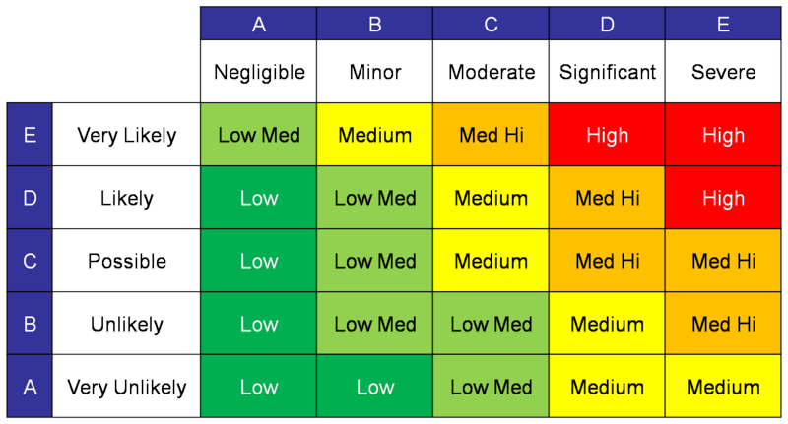
Risk Assessment Matrix
This Photo by Unknown Author is licensed under CC BY-NC-ND

Slide 8
Duty Holder/s responsibilities
A duty holder, in managing risks to health and safety, must—
(a) eliminate risks to health and safety so far as is reasonably practicable; and
if it is not reasonably practicable to eliminate risks to health and safety—minimise those risks so far as is reasonably practicable

Slide 9
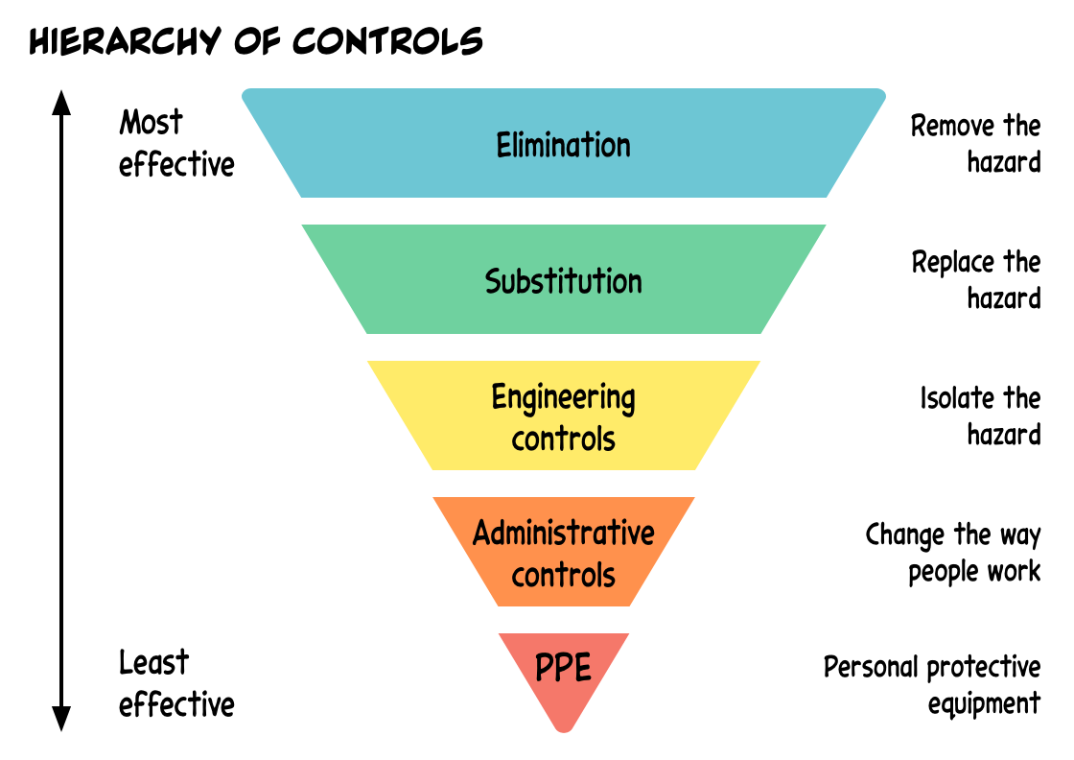
Hierarchy of controls
This Photo by Unknown Author is licensed under CC BY

Slide 10
Elimination: The most effective control. This involves completely removing the hazard from the confined space. For example, if toxic gases are present, eliminating the source of these gases would be ideal.
Substitution: If elimination isn’t possible, substitute the hazard with something less dangerous. For instance, replacing a toxic substance with a non-toxic one.
Engineering Controls: These involve isolating people from the hazard. Examples include installing ventilation systems to remove harmful gases or redesigning the space to prevent hazardous atmospheres from developing.
Administrative Controls: These are changes in the way people work. This includes implementing entry permits, training, and safe work procedures to ensure that workers follow safety protocols.
Personal Protective Equipment (PPE): The last line of defence. When other controls can’t fully mitigate the hazard, workers must use PPE such as respirators, gloves, and protective clothing.

Slide 11
Risk Management, Controls and Review
Management of risks in confined spaces would be;
Training for workers on emergency procedures
Completion of Confined Space Entry Permit
Consultation with workers at all times in regards to monitoring and reviewing controls

Slide 12
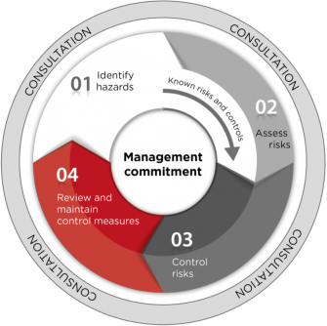
Risk Control

