Slide 1

Changes at Simply Clothing

Slide 2
Agenda
Slide 3 – new mission fast fashion
Slide 4 – what this means for you

Slide 3
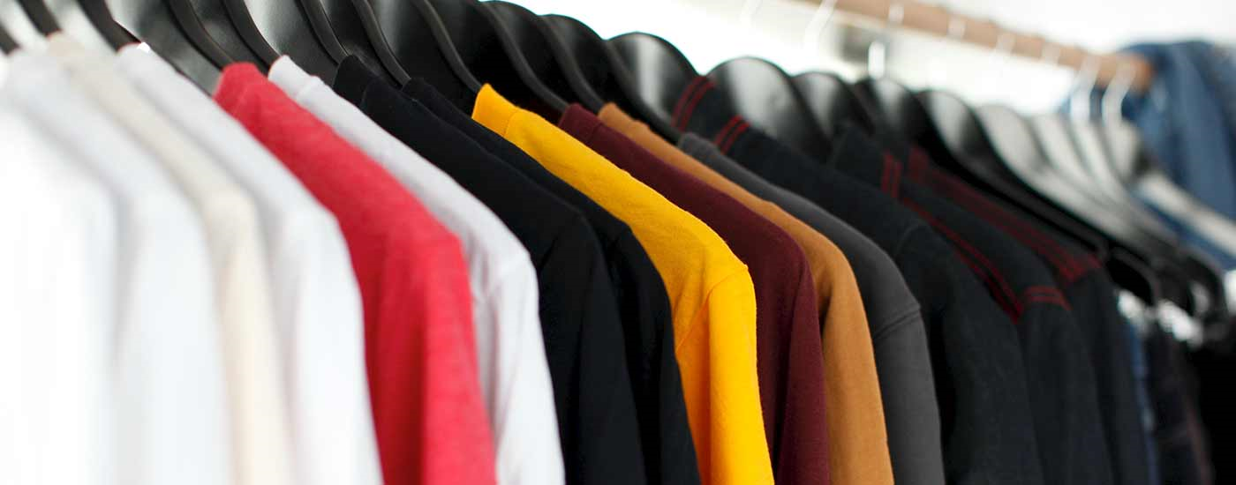
New mission – Fast Fashion
  We’re switching suppliers to those who provide better ethically sourced products
  Prices will be rising because of this

Slide 4
What this means for you
Prices

