Slide 1
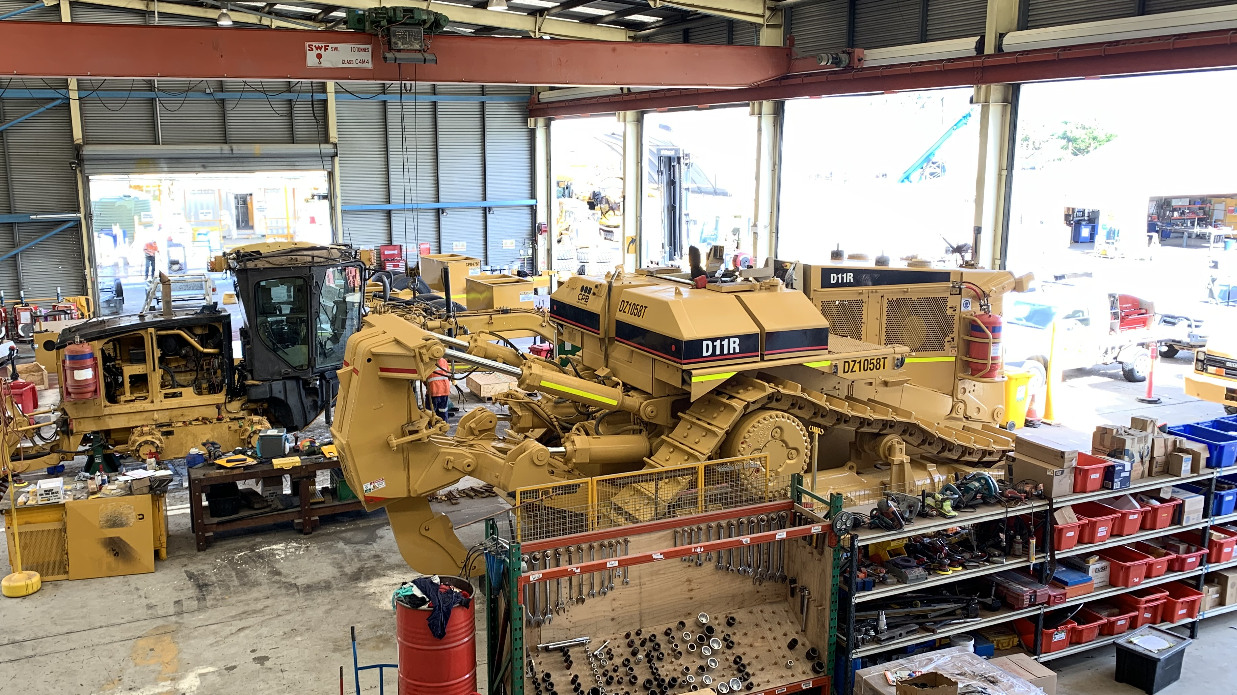
Work Health and Safety
Consultation and Participation

Slide 2
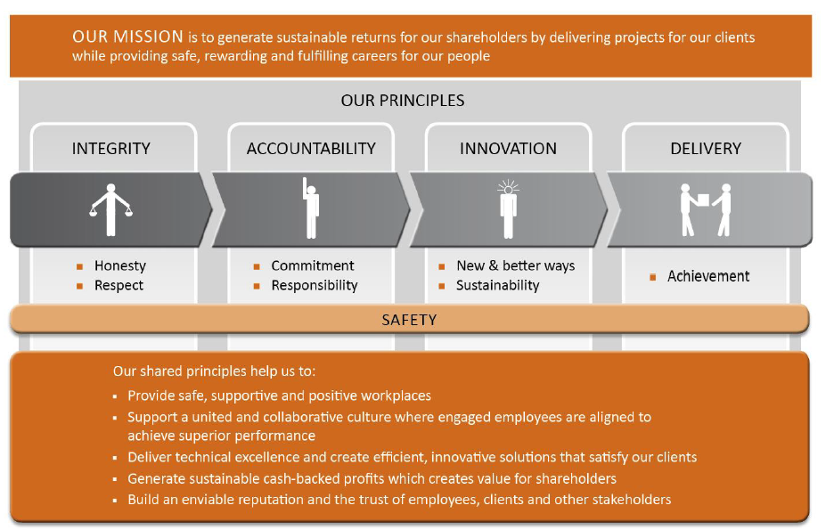
Our Mission and Principles

Slide 3
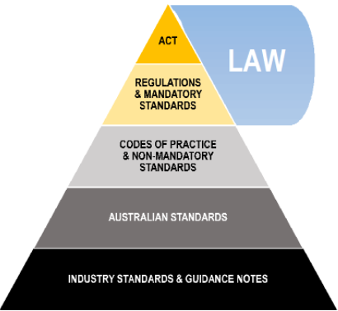
Legislative Framework

Slide 4
References
Work Health and Safety Act 2011: https://www.legislation.qld.gov.au/
Work Health and Safety Regulations 2011: https://www.legislation.qld.gov.au/
Work Health and Safety (Construction Work) Code of Practice 2015: https://www.legislation.qld.gov.au/
How to manage work health and safety risks – Code of Practice – SafeWork Australia: https://www.safeworkaustralia.gov.au/
Work health and safety consultation, co-operation and coordination Code of Practice 2021
https://www.worksafe.qld.gov.au/
Guidance: Health and Safety Representatives, Worksafe Qld: https://www.worksafe.qld.gov.au/
Guidance: Information for employers and company executives, Worksafe Qld: https://www.worksafe.qld.gov.au/
Worker Representation and Participation Guide, SafeWork Australia: https://www.safeworkaustralia.gov.au/
Work health and safety consultation, co-operation and coordination Code of Practice 2021
https://www.worksafe.qld.gov.au/
Guidance: Health and Safety Representatives, Worksafe Qld: https://www.worksafe.qld.gov.au/
Guidance: Information for employers and company executives, Worksafe Qld: https://www.worksafe.qld.gov.au/
Worker Representation and Participation Guide, SafeWork Australia: https://www.safeworkaustralia.gov.au/
Communication, Co-operation and Consultation Policy, knowledge document – CMS internal policies and procedures

Slide 5

Workers Duties– Where to find them
Workers Duties:
Take reasonable care for their own health and safety
Take reasonable care for the health and safety of others
Follow the guidance of the PCBU where reasonably practicable to do so
An operator must, within a specified time implement and identify major incidents and major hazards, consider control measures and conduction a review. They must also facilitate and implement a safety role for workers to enable them to contribute to the conduct of reviews
Keep communication open – Consultation between workers
Work Health and Safety Act 2011, Part 5, section 47- 49, 50-54, 55-59, 61-65 https://www.legislation.qld.gov.au/
Work Health and Safety Regulations 2011, Chapter 2, Division 1, 16 – 17, 20, 32-38, 297 https://www.legislation.qld.gov.au/
Work Health and Safety Regulations 2011, 9.5, 574 – 576 https://www.legislation.qld.gov.au/
Work Health and Safety (Construction Work) Code of Practice 2015, 1.8 https://www.legislation.qld.gov.au/
How to manage work health and safety risks – Code of Practice – SafeWork Australia https://www.safeworkaustralia.gov.au/
Work health and safety consultation, co-operation and coordination Code of Practice 2021
https://www.worksafe.qld.gov.au/
Guidance: Health and Safety Representatives, Worksafe Qld https://www.worksafe.qld.gov.au/
Guidance: Information for employers and company executives, Worksafe Qld https://www.worksafe.qld.gov.au/
Worker Representation and Participation Guide, SafeWork Australia https://www.safeworkaustralia.gov.au/
Communication, Co-operation and Consultation Policy, knowledge document – CMS internal policies and procedures

Slide 6
Workers Rights – Where to find them
Workers Rights:
Cease work if unsafe
Consulted during the preparing of Safe Work Method Statements (SWMS) and during the review stages
Be represented in consultation by a health and safety representative (HSR) who has been elected by their work group
Be consulted at all steps of the risk management process
Workers must be allowed reasonable time with their HSRs to discuss WHS matters
Workers elect the HSRs and determine how the election will be conducted
Workers must be informed by the PCBU of the election outcome
If workers request for a HSR, the PCBU has 14 days to negotiate with workers and settle on the number of work groups and how many HSRs will represent each work group
Workers can request a variation to change work groups at any time and must be notified of the outcome from the PCBU as soon as is practicable to do so
If the majority of workers in the work group write a declaration, they can remove a HSR they no longer want to represent them.
Work Health and Safety Act 2011, Part 5, section 47- 49, 50-54, 55-59, 61-62. https://www.legislation.qld.gov.au/
Work Health and Safety Regulations 2011, Chapter 2, Division 1, 16 – 17, 20, 32-38, 297https://www.legislation.qld.gov.au/
Work Health and Safety Regulations 2011, 9.5, 574 – 576 https://www.legislation.qld.gov.au/
Work Health and Safety (Construction Work) Code of Practice 2015, 1.8 https://www.legislation.qld.gov.au/
How to manage work health and safety risks – Code of Practice – SafeWork Australia: https://www.safeworkaustralia.gov.au/
Work health and safety consultation, co-operation and coordination Code of Practice 2021 https://www.worksafe.qld.gov.au/
Guidance: Health and Safety Representatives, Worksafe Qld: https://www.worksafe.qld.gov.au/
Guidance: Information for employers and company executives, Worksafe Qld: https://www.worksafe.qld.gov.au/
Worker Representation and Participation Guide, SafeWork Australia: https://www.safeworkaustralia.gov.au/
Communication, Co-operation and Consultation Policy, knowledge document – CMS internal policies and procedures

Slide 7
Workers Responsibilities - Where to find them
Workers Responsibilities:
Take reasonable care for their own health and safety
Take reasonable care for others health and safety
Follow WHS instructions
Follow workplace WHS polices and procedures
Work safely
Comply with all reasonable instructions, policies and procedures set out by the PCBU
If a HSR is removed, a member of the work group, who is nominated by the workers must inform the workers the HSR has been removed and inform the PCBU. Only then does the removal of the HSR take effect
Work Health and Safety Act 2011, Part 5, section 47- 49, 50-54, 55-59, 61-62. https://www.legislation.qld.gov.au/
Work Health and Safety Regulations 2011, Chapter 2, Division 1, 16 – 17, 20, 32-38, 297https://www.legislation.qld.gov.au/
Work Health and Safety Regulations 2011, 9.5, 574 – 576 https://www.legislation.qld.gov.au/
Work Health and Safety (Construction Work) Code of Practice 2015, 1.8 https://www.legislation.qld.gov.au/
How to manage work health and safety risks – Code of Practice – SafeWork Australia: https://www.safeworkaustralia.gov.au/
Work health and safety consultation, co-operation and coordination Code of Practice 2021
https://www.worksafe.qld.gov.au/
Guidance: Health and Safety Representatives, Worksafe Qld: https://www.worksafe.qld.gov.au/
Guidance: Information for employers and company executives, Worksafe Qld: https://www.worksafe.qld.gov.au/
Worker Representation and Participation Guide, SafeWork Australia: https://www.safeworkaustralia.gov.au/
Communication, Co-operation and Consultation Policy, knowledge document – CMS internal policies and procedures

Slide 8
PCBUs Duties– Where to find them
PCBUs Duties:
Share information with workers
Give workers the opportunity to share their ideas, views and raise issues
Give workers the opportunity to contribute and make decisions
Build positive relationships with HSRs
Communicate changes
Keep a record of covered topics, noting all feedback
Monitor how effective the meeting / talks are and if measures are implemented and working
Provide training to all workers
To assist HSRs to be available during working hours to discuss WHS matters.
Work Health and Safety Act 2011 section 46-49, 50-54, 55-59, 70-72: https://www.legislation.qld.gov.au/
Work Health and Safety (Construction Work) Code of Practice 2015, Section 1.8: https://www.legislation.qld.gov.au/
Work Health and Safety Regulations 2011, 18- 21, 32-38, 39.https://www.legislation.qld.gov.au/
How to manage work health and safety risks – Code of Practice – SafeWork Australia: https://www.safeworkaustralia.gov.au/
Work health and safety consultation, co-operation and coordination Code of Practice 2021
https://www.worksafe.qld.gov.au/
Guidance: Health and Safety Representatives, Worksafe Qld: https://www.worksafe.qld.gov.au/
Guidance: Information for employers and company executives, Worksafe Qld: https://www.worksafe.qld.gov.au/
Worker Representation and Participation Guide, SafeWork Australia: https://www.safeworkaustralia.gov.au/
Communication, Co-operation and Consultation Policy, knowledge document – CMS internal policies and procedures

Slide 9
PCBUs Rights – Where to find them
Rights:
To let a worker go if they aren’t following all policies and procedures set out by the PCBU
To let a worker go if they are causing harm to themselves or others
The facility to employ a Work Health Safety Officer (WHSO), and can act as evidence that a PCBY has taken action to moderate health and safety risks
The Person Conducting Business or Undertaking (PCBU) must prepare a Work Health and Safety (WHS) Management plant, identifying all workers and their positions, roles and responsibilities regarding health and safety
The PCBU must, where reasonably practicable, consult all workers carrying out the business or are directly affected by a work health or safety matter
A PCBU must cooperate and coordinate activities between themselves, workers and any work health and safety representative
A PCBU still has the right to make the final decision on how to manage the business.
Work Health and Safety Act 2011 section 46-49, 50-54, 55-59, 70-72: https://www.legislation.qld.gov.au/
Work Health and Safety (Construction Work) Code of Practice 2015, Section 1.8: https://www.legislation.qld.gov.au/
Work Health and Safety Regulations 2011, 18- 21, 32-38, 39.https://www.legislation.qld.gov.au/
How to manage work health and safety risks – Code of Practice – SafeWork Australia: https://www.safeworkaustralia.gov.au/
Work health and safety consultation, co-operation and coordination Code of Practice 2021
https://www.worksafe.qld.gov.au/
Guidance: Health and Safety Representatives, Worksafe Qld: https://www.worksafe.qld.gov.au/
Guidance: Information for employers and company executives, Worksafe Qld: https://www.worksafe.qld.gov.au/
Worker Representation and Participation Guide, SafeWork Australia: https://www.safeworkaustralia.gov.au/
Communication, Co-operation and Consultation Policy, knowledge document – CMS internal policies and procedures

Slide 10
PCBUs Responsibilities - Where to find them
Responsibilities:
The PCBU has 14 days to negotiate with workers and settle on the number of work groups and how many HSRs will represent each work group after a request has been made
Create procedures and policies for reporting hazards and WHS issues
Create procedures for participation and consultation
Communicate and consult with workers and HSR regarding about work health and safety
Communicate and consult with workers and HSR regarding Personal Protective Equipment (PPE)
Establish a WHS committee
Sharing of information
Provide mandatory training for workers, with refresher training every 3 years (CPB Contractors policy is every 2 years)
The PCBU must provide Workplace Health and Safety QLD a list of all HSRs and deputy HSRs for each work group
A PCBU must pay the HSRs when they are using their authority or functions as an HSR or doing HSR training at their rate of pay, including shift and allowances that they are entitled to
If workers request a variation to change to their work groups, the PCBU must notify them as soon as is practicable to do so
Conduct WHS activities such as inspections and audits with worker, manager and supervisor involvement
Provide relevant information to the HSR regarding hazards that may affect the work group
Provide assistance, resources, and facilities to the HSR for the work group they represent
Allow a worker that is assisting a HSR to have access to the workplace when necessary
Work Health and Safety Act 2011 section 46-49, 50-54, 55-59, 65, 70-72: https://www.legislation.qld.gov.au/
Work Health and Safety (Construction Work) Code of Practice 2015, Section 1.8: https://www.legislation.qld.gov.au/
Work Health and Safety Regulations 2011, 18- 21, 32-38, 39.https://www.legislation.qld.gov.au/
How to manage work health and safety risks – Code of Practice – SafeWork Australia: https://www.safeworkaustralia.gov.au/
Work health and safety consultation, co-operation and coordination Code of Practice 2021 https://www.worksafe.qld.gov.au/
Guidance: Health and Safety Representatives, Worksafe Qld: https://www.worksafe.qld.gov.au/
Guidance: Information for employers and company executives, Worksafe Qld: https://www.worksafe.qld.gov.au/
Worker Representation and Participation Guide, SafeWork Australia: https://www.safeworkaustralia.gov.au/
Communication, Co-operation and Consultation Policy, knowledge document – CMS internal policies and procedures

Slide 11
Work Health and Safety Representatives (HSRs) Duties – Where to find them
HSRs Duties:
Represent the workers in the work group regarding work health and safety issues
Monitor the procedures and measures put in place by the PCBU
Investigate complaints from workers in the work group regarding work health and safety
Query any issues that may be a risk to health or safety of workers in the work group
To help consulate to ensure WHS risk is lowered and improved by communication with workers and encourage them to have input into discissions and planning
Identify any training that is needed
Recognise any barriers that may affect consultation and participation regarding WHS
Conduct training needs analysis to find any gaps in workers WHS knowledge / roles
Listen to workers
Work Health and Safety Act 2011, Sections, 46-49, 50- 59, 60 - 67, 68 – 69, Division 6 & 7: https://www.legislation.qld.gov.au/
Work Health and Safety Regulations 2011, Chapter 2, Division 2, section 18-21: https://www.legislation.qld.gov.au/
Work Health and Safety (Construction Work) Code of Practice 2015, 4.2, https://www.legislation.gov.au/
SafeWork Australia: Code of Practice: How to manage work health and safety risks: https://www.safeworkaustralia.gov.au/
Work health and safety consultation, co-operation and co-ordination Code of Practice 2021, WorkSafe Qld, https://www.worksafe.qld.gov.au/
Guidance: Health and Safety Representatives, Worksafe Qld: https://www.worksafe.qld.gov.au/
Guidance: Information for employers and company executives, Worksafe Qld: https://www.worksafe.qld.gov.au/
Worker Representation and Participation Guide, SafeWork Australia: https://www.safeworkaustralia.gov.au/
Communication, Co-operation and Consultation Policy, knowledge document – CMS internal policies and procedures

Slide 12
Work Health and Safety Representatives (HSRs) Rights – Where to find them
HSRs Rights:
Be provided with a 5 day HSR training course within three months of being elected to the role, with refresher training every 3 years (CPB Contractors policy is every 2 years)
Be given support and during their working hours to be available to discuss WHS matters with PCBU
HSRs must be paid, including shift and allowances that they are entitled to,
when they are using their authority or functions as an HSR or doing HSR training
A HSR can stop work under certain circumstances if the matter is not resolves with the PCBU and if there is no attempt to resolve the issue. The only exception to this is if the risk is imminent that consultation cannot take place before ceasing work
Issue provisional improvement notices (PIN)
A HSR has the responsibility to act on matters that affect workers in their work group, however, they have a responsibility to other work groups if they notice a serious risk to health or safety, exposure to a hazard or if another representative asks for assistance regarding a different work group.
A HSR can hold the term of office for 3 years and may be re-nominated for election when this expires
Be given information relating to hazards that may affect the work group
Be provided with any resources, facilities and assistance for their work group
A HSRs term of office is 3 years, they can be re-elected at the end of each 3 year term
They can resign in written notice to the manager / supervisor or if they cease to work for the PCBU
Work Health and Safety Act 2011, Sections, 46-49, 50- 59, 60 -67, 68 – 69, Division 6 & 7: https://www.legislation.qld.gov.au/
Work Health and Safety Regulations 2011, Chapter 2, Division 2, section 18-21: https://www.legislation.qld.gov.au/
Work Health and Safety (Construction Work) Code of Practice 2015, 4.2, https://www.legislation.gov.au/
SafeWork Australia: Code of Practice: How to manage work health and safety risks: https://www.safeworkaustralia.gov.au/
Work health and safety consultation, co-operation and co-ordination Code of Practice 2021, WorkSafe Qld, https://www.worksafe.qld.gov.au/
Guidance: Health and Safety Representatives, Worksafe Qld: https://www.worksafe.qld.gov.au/
Guidance: Information for employers and company executives, Worksafe Qld: https://www.worksafe.qld.gov.au/
Worker Representation and Participation Guide, SafeWork Australia: https://www.safeworkaustralia.gov.au/
Communication, Co-operation and Consultation Policy, knowledge document – CMS internal policies and procedures

Slide 13
Work Health and Safety Representatives (HSRs) Responsibilities - Where to find them
Workers Responsibilities:
Conduct and inspection of the workplace where a worker in the worker group works either by giving notice to the PCUB or without notice if it relates to an incident or serious risk to health or safety
Attend an inspection with an inspector where a worker in the worker group works
If the worker consents, a HSR can be present at an interview regarding work health and safety with an inspector and or a PCBU
Create a safety committee
Consulted during the preparing of Safe Work Method Statements (SWMS) and during the review stages
If failure to negotiate happens between the PCBU and the work groups / HSR, a regulator can be appointed
Work Health and Safety Act 2011, Sections, 46-49, 50- 59, 60 -67, 68 – 69, Division 6 & 7: https://www.legislation.qld.gov.au/
Work Health and Safety Regulations 2011, Chapter 2, Division 2, section 18-21: https://www.legislation.qld.gov.au/
Work Health and Safety (Construction Work) Code of Practice 2015, 4.2, https://www.legislation.gov.au/
SafeWork Australia: Code of Practice: How to manage work health and safety risks: https://www.safeworkaustralia.gov.au/
Work health and safety consultation, co-operation and co-ordination Code of Practice 2021, WorkSafe Qld, https://www.worksafe.qld.gov.au/
Guidance: Health and Safety Representatives, Worksafe Qld: https://www.worksafe.qld.gov.au/
Guidance: Information for employers and company executives, Worksafe Qld: https://www.worksafe.qld.gov.au/
Worker Representation and Participation Guide, SafeWork Australia: https://www.safeworkaustralia.gov.au/
Communication, Co-operation and Consultation Policy, knowledge document – CMS internal policies and procedures

Slide 14

Daily Prestart - Process

Slide 15
Daily Prestart
The daily prestart is designed to provide workers at CPB Contractors Plant Yard with relevant information regarding works that are to be conducted that day, before commencing work.
It is a relaxed environment where workers can provide feedback and discussions can take place about how works should be approached for the day.
All relevant information from the leadership team is complied into a PowerPoint template every afternoon. This is then emailed to the leadership team and printed the following morning where it is presented to all workers.
Once the information has been passed along to the workers, the floor is opened up for workers to discuss concerns, raise questions and offer advice or support to others. This information is captured by a supervisor for reference throughout the day and for improvements on how works are conducted. If any changes are made, these are shared with workers the following day.
The daily prestart, along with the discussions are saved onto our network drive for review at any time.

Slide 16
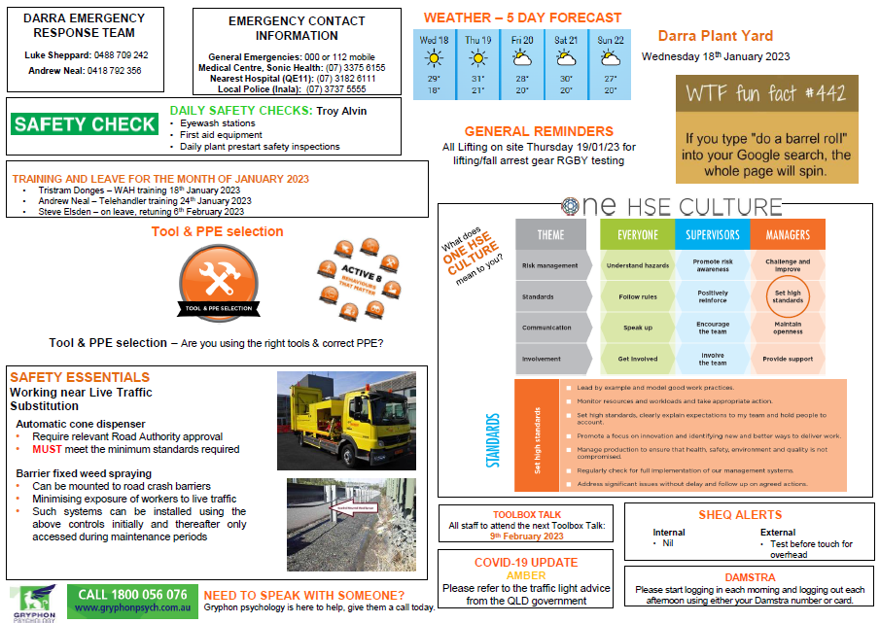
Daily Prestart – Break down
The date, weather and a funny / fun fact are included daily.
The general reminders are for anything that workers may be forgetting to do or information that supervisors feel is needed to be shared.
This can be anything from a reminder that subcontractors are on site to wearing glove and glasses or completing paperwork.

Slide 17
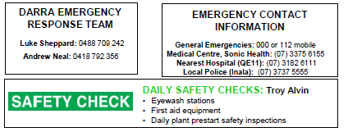
Emergency Response
Emergency response team and contact information is always included in our Daily Prestart. The local medical centre, hospital and police station are also listed.
Daily safety checks are conducted by a different worker each week.
The Legal Obligations
All workers, visitors and members of the public who may be within a building or site at CPB are obligated under State & Federal Acts to comply with ALL instructions given to them by any member of an Emergency Response Team (ERT) during an evacuation or containment.
ERT have authority under the following Legislative Acts, Regulations and Standards:
  Work Health & Safety Act 2011
  Fire & Rescue Act
  Building Fire Safety Regulation
  AS/NZS 3745

Slide 18

Emergency Response
Emergency response drills are often conducted either during Daily Prestart or toolbox talks. CPB Contractors follow the below in an emergency situation:
In the event of an emergency the site emergency procedure shall be followed:
Stop work, ensure your safety.
Call "emergency, emergency, emergency" on your radio over the UHF work channel or using the PA system on the fire alarm.
Await a response, and give the following information:
  Your name
  Your location
  The nature of the emergency
  Number of people involved
  Resources required
  Any other hazard information
Stay on the radio and await further instructions.
Other people onsite stop work, maintain radio silence and be prepared to evacuate or offer assistance pending instruction from CPB supervisors.

Slide 19
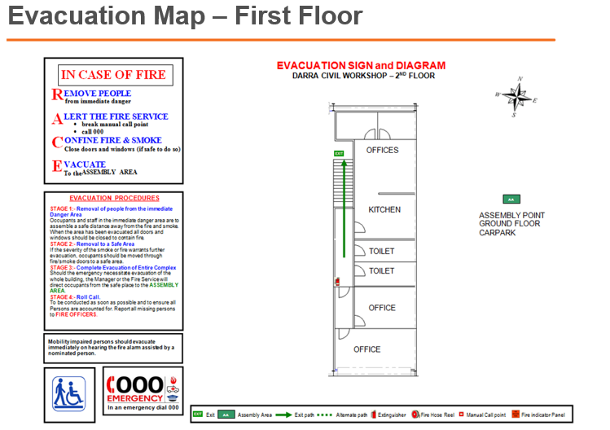
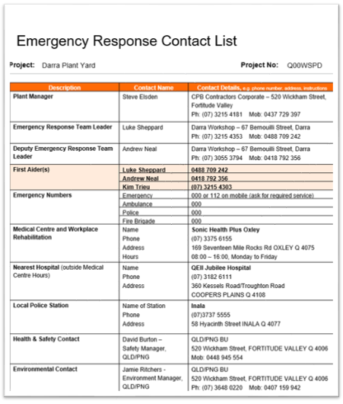
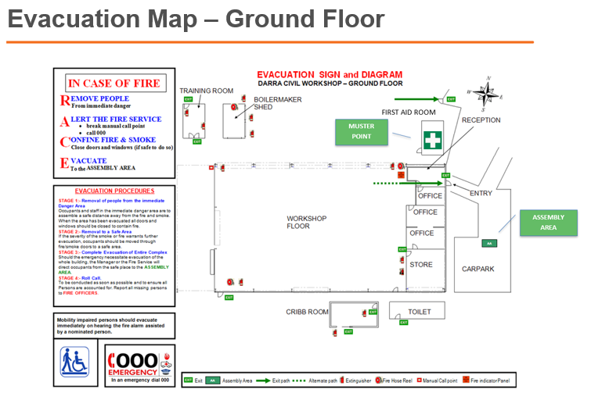
Emergency Response
CPB Contractors always updates the emergency contacts and evacuation maps which can be found all over the Plant Yard. During our emergency drills, workers must point these out.

Slide 20
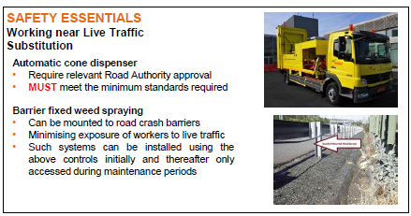
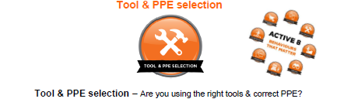
Safety Essentials – CPB Contractors Policies
CPB Contractors has 6 high-risk Safety Essentials that we rotate for the workers, they include;
Electrical work
Mobile cranes and lifting operations
Work near mobile plant
Working near live traffic
Working with live services
Working at heights
CPB Contractors have also created the Active 8 which is also rotated for workers and includes;
Eyes on hands
Tool & PPE selection
Eyes on path
Assess area
Line of fire
Communication
Look before moving
Controlled physical movement

Slide 21
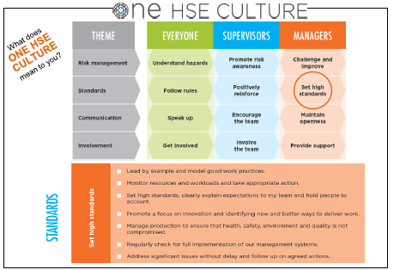
Safety Essentials – One HSE Culture
CPB Contractors created One HSE Culture to guide all workers behaviour and create a positive culture within CPB Contractors. It is designed to highlight the roles and expectation for workers, supervisors and managers.
We rotate each point on a weekly basis, going through each of the points listed under the different subheadings.

Slide 22

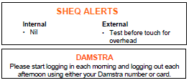
Information Sharing
Toolbox talks are listed in the Daily Prestart every day for the month leading up to the meeting.
COVID-19 information is shared and updated regularly form the Queensland Government website.
Any SHEQ alerts are attached to the email when the Daily Prestart is sent each day. These are printed off for workers and reviewed each morning.
The Plant Yard is now set up as a “site” which means workers now log in and off via the Damstra terminals in the main reception area. This is a great way of knowing who is on site and the time they arrived / left.
CPB Contractors is registered with Gryphon Psychology and is available for all workers, subcontractors and their families.

Slide 23
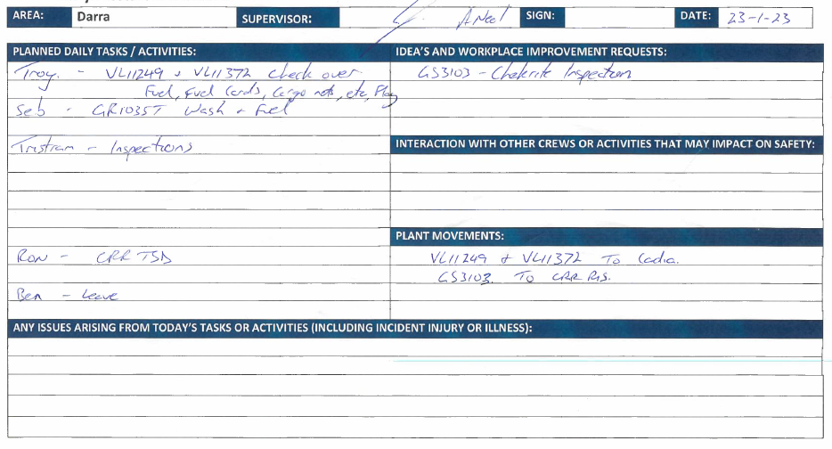
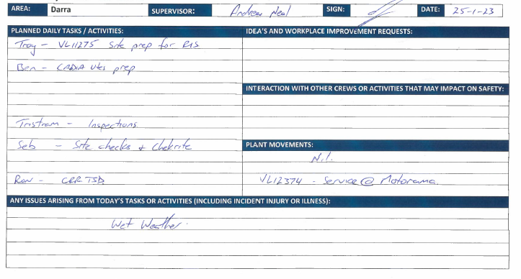
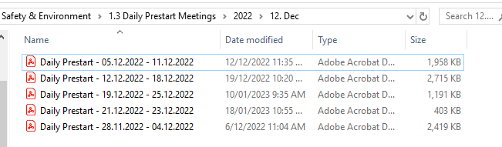
Saving Documentation
All hand written documentation captured from the Daily Prestart, is scanned.
It is then saved on our network drive in date order.

Slide 24

Toolbox Talk - Process

Slide 25
Toolbox Talk
The monthly toolbox talk is designed to be a more formal, more in depth meeting that takes place at CPB Contractors Plant Yard once a month. The purpose of the toolbox talk is to communicate and reinforce safety procedures and practices with workers to help prevent accidents and injuries and to discuss the data from the pervious month.
A Power Point presentation is created each month with the data from the QLD Plant teams and QLD WHS teams. This is then sent to the supervisors for review and input before being finalised and presented to all workers at the toolbox talk.
Calendar invitations are sent out 6 months in advance and all workers must attend. Reminders are set for the toolbox talks in our Daily Prestart each day, so workers won’t forget. All workers that work from home are expected to be in the office whenever a toolbox talk is to take place. If a worker is unable to attend, they are provided with the information discussed at the meeting at a later time.
The toolbox talk is typically presented by a supervisor or a designated safety representative. The presenter will discuss the safety topic (CPB Contractors Safety Essentials) and explain any hazards that may be associated with the work being performed. The emergency evaluation plan is also tested, whereby all workers walk the Plant Yard together and point out where the evaluation assembly areas are. We run through fictional situations that may arise and senior management will ask all workers, for scenarios on the best way to deal with the problem/s. These scenarios are written down along with photos to show what was discussed.
After the presentation, workers are encouraged to ask questions and engage in a discussion about the topic. This is an opportunity for workers to share their experiences, concerns, and ideas about how to work safely.
A record of who attended the meeting, the topics discussed, and any questions or concerns raised during the discussion are scanned and saved to our network drive.
Overall, the toolbox talk is an important tool for promoting safety in the construction industry in Australia. By taking the time to communicate and reinforce safety practices, workers can stay safe and avoid accidents and injuries on the job site.

Slide 26
Toolbox
Lag indicators (Reactive)
Lead indicators (Proactive)
Month | Output |  | Incidents |  |  |  | Incidents
 | Total Number Personnel (Inc. Staff) | Total Hours Worked | #LTIs | #RWIs | #MTIs | #FAIs | No injury
September-22 | 10 | 1,741 | 0 | 0 | 0 | 1 | 1
October-22 | 11 | 2,183 | 0 | 0 | 0 | 0 | 0
November-22 | 10 | 1,819 | 0 | 0 | 0 | 0 | 0
Safety incidents and performance are discussed based on previous months
Month | Scheduled |  |  | Unscheduled
Action Type | Job Observations | Workplace Inspections | Audits / Reviews | Hazard Reports | Project Initiated Actions | Global Actions
September-22 | 1 | 3 | 0 | TBA | 3 | 1
October-22 | 2 | 5 | 0 | TBA | 1 | 0
November-22 | 1 | 3 | 0 | TBA | 7 | 1

Slide 27
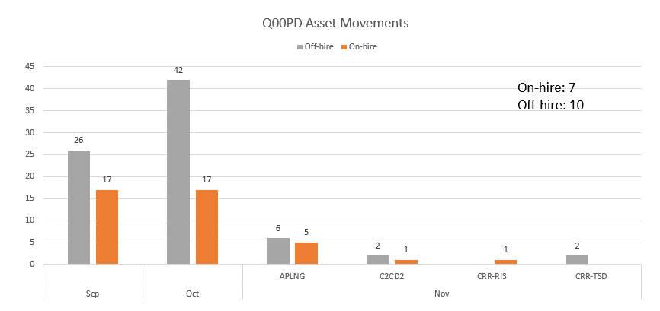
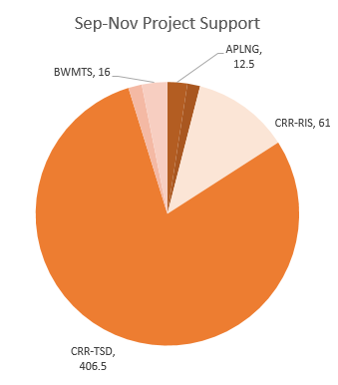
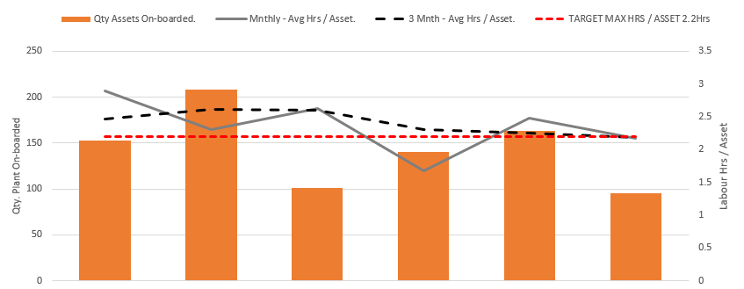
Toolbox
Internal assess statistics are shown, including off hired light vehicles
Hours relating to project support is discussed compared with plant equipment inspected (below).
Plant and equipment that has been inspected is discussed compared to project supported hours (above).

Slide 28
Topical Issues / Open Discussion
Good bits, bad bits
Business update
Any praise that may have been given over the previous month is delivered to the workers.
Information is shared with workers regarding projects (all over Australia) that are being tendered for, projects that have been obtained and projects that works may be underway and how this affects the Plant Yard.

Slide 29
Safety and Environment
Working near Live Traffic – Safety Essential Update
Safety Committee Meeting – Following toolbox
  DRAFT Darra Plant Yard SWMS – Working near Live Traffic
A different CPB Contractors Safety Essential is spoken each month.
A safety Committee Meeting is held each quarter following toolbox talks.
Changes to SWMS are presented to workers for consultation.

Slide 30
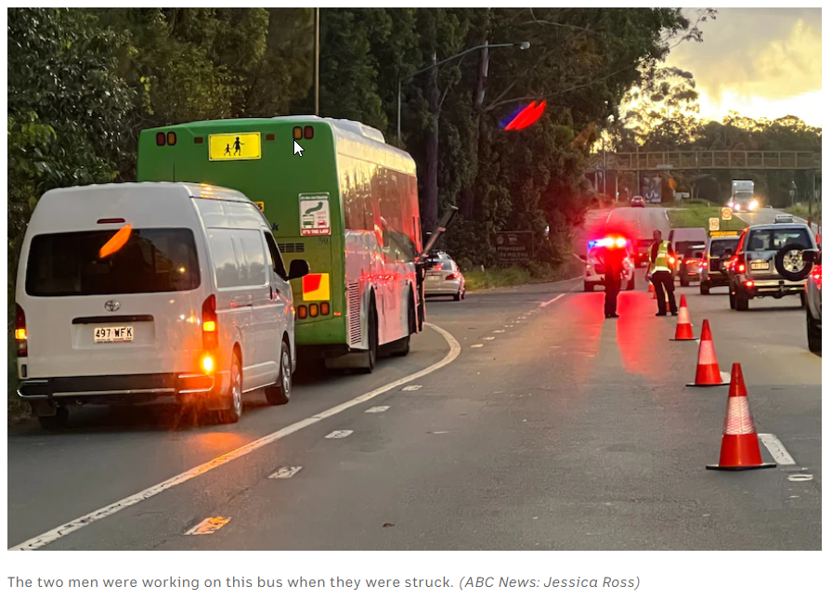

Working Near Live Traffic
Relevance to the CPB Contractors Safety Essentials - Any incidents that occur of a serious nature are reflected on during toolbox talks each month.

Slide 31
Emergency Response
Emergency response drills are often conducted either during Daily Prestart or toolbox talks. CPB Contractors follow the below in an emergency situation:
In the event of an emergency the site emergency procedure shall be followed:
Stop work, ensure your safety.
Call "emergency, emergency, emergency" on your radio over the UHF work channel or using the PA system on the fire alarm
Await a response, and give the following information:
  Your name
  Your location
  The nature of the emergency
  Number of people involved
  Resources required
  Any other hazard information
Stay on the radio and await further instructions.
Other people onsite stop work, maintain radio silence and be prepared to evacuate or offer assistance pending instruction from CPB supervisors.

Slide 32
Emergency Response
CPB Contractors always updates the emergency contacts and evacuation maps which can be found all over the Plant Yard. During our emergency drills, workers must point these out.

Slide 33
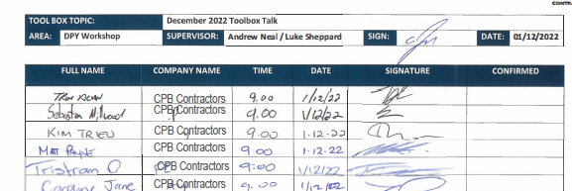

Saving Documentation
All hand written documentation captured from the Daily Prestart, is scanned.
It is then saved on our network drive in date order.

Slide 34

Feedback & Recommendations

