Slide 1

WORKPLACE BULLYING
WORK HEALTH AND SAFETY OFFICER

Slide 2
Assessment criteria
Describe the legislative requirements relating to workplace bullying.
Understand the unacceptable behaviours that can cause bullying to occur.
Understand what is not workplace bullying.
Understand processes for preventing and responding to workplace bullying.

Slide 3
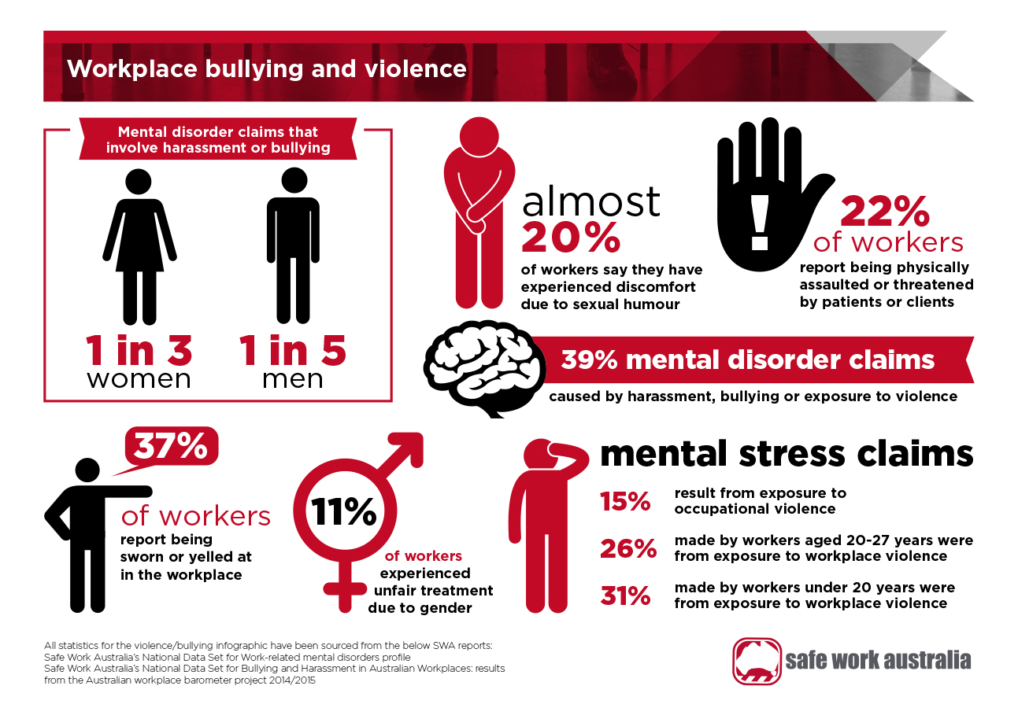

Slide 4
Workplace bullying - defined
Repeated and unreasonable behaviour, directed towards a worker or group of workers, that creates a risk to health and safety.

Slide 5
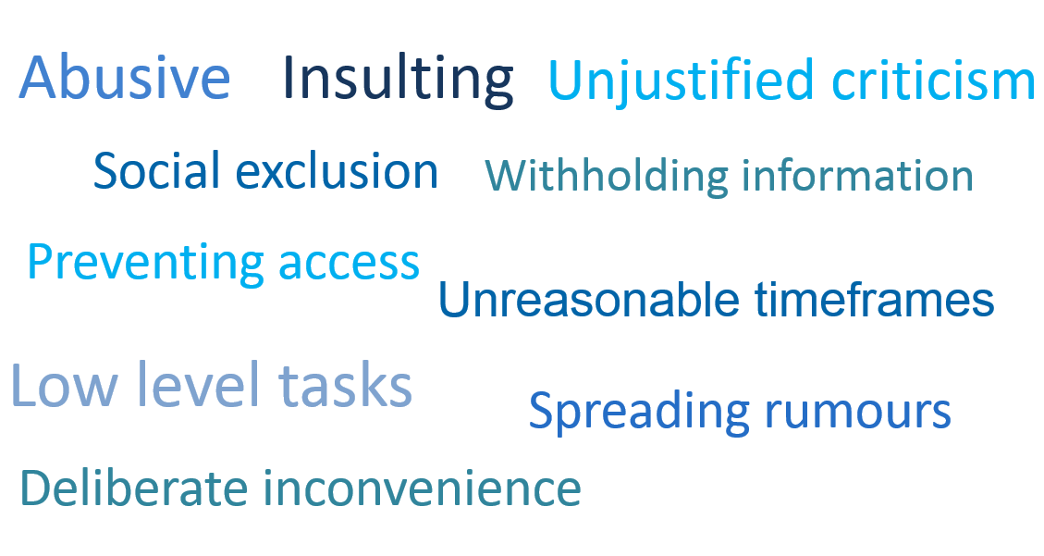
Examples of bullying behaviour

Slide 6
This is NOT workplace bullying
A single incident of unreasonable behaviour
Reasonable management action taken in a reasonable way
Workplace conflict
Discrimination and sexual harassment

Slide 7
Reasonable management actions
Setting realistic and achievable performance goals, standards and deadlines
Fair and appropriate rostering and allocation of working hours
Transferring a worker to another area or role for operational reasons
Deciding not to select a worker for a promotion where a fair and transparent process is followed

Slide 8
Reasonable management actions
Informing a worker about unsatisfactory work performance in an honest, fair and constructive way
Informing a worker about unreasonable behaviour in an objective and confidential way
Implementing organisational changes or restructuring
Disciplinary action including suspension/terminating employment

Slide 9
Bullying and the WHS Act
A PCBU has the primary duty under the WHS Act to manage risks associated with exposure to hazards arising from work that could result in physical or psychological harm.
Workers have a duty to take reasonable care of their own health and safety and not adversely affect other people’s health and safety.

Slide 10
How can workplace bullying occur?
Between workers – one to many, one-on-one, group on group
Top down
Bottom up
Other sources: clients, customers, members of the public.

Slide 11
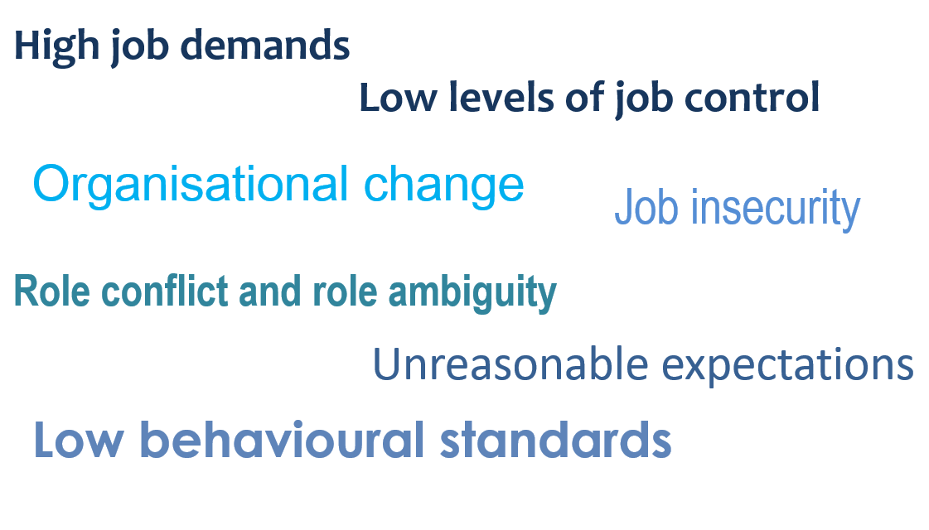
Contributing factors

Slide 12
Contributing factors
Leadership styles
Autocratic leadership behaviours
Inappropriate delegation of responsibilities
Inappropriate systems of work
Resources, training, rostering, performance measures or timeframes
Workplace relationships
Poor communication, isolation, low levels of support or work group hostility
Workforce characteristics
Vulnerable workers – young workers, minority groups, casuals, return to work workers, volunteers, work experience

Slide 13
Role of external agencies
Workplace Health and Safety Qld
Make enquiries related to workplace systems for managing workplace bullying
Assess workplace compliance
Take action/s necessary to secure compliance for managing ongoing risks at the workplace.

Slide 14
Role of external agencies
Fair Work Commission
Allows an eligible worker who believes they have been bullied at work to apply for an order to stop the workplace bullying
The focus is on resolving the matter and enabling normal working relationships to resume.

Slide 15


