Slide 1
Plan building or construction work
CPCCBC4007A

Slide 2
Plan building or construction work
In this session you will learn how to:
Topic One
Appraise contract documentation to identify operational requirements
Implement strategies for construction operations
Prepare project schedule
Determine required resources
Prepare and submit condition reports
Topic TWO
Topic three
This resource refers to Brisbane City Council and Queensland legislation in its examples.
Ensure to refer to your applicable Council’s requirements and region’s legislation.
Topic four
Topic five

Slide 3
Appraise contract documentation to identify operational requirements
Topic One

Slide 4
1. Identify and evaluate the properties of building materials
In this chapter you will learn how to:
  Identify any unusual aspects of construction use of materials or penalties within the contract documentation
  Determine the availability of selected subcontractors to suit the job requirements
  Assess and confirm the availability of materials with suppliers
  Identify site access requirements and limitations and actions taken to facilitate entry
  Prepare documentation for authorities controlling construction work and determine the project commencement date
  Implement the procedures for controlling and recording site deliveries

Slide 5
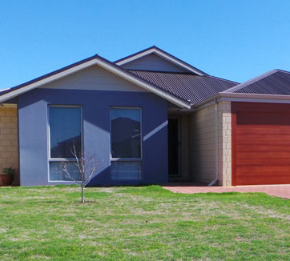

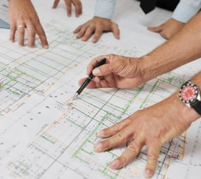

1. Appraise contract documentation to identify operational requirements
Let's talk about…
Identifying any unusual aspects of construction use of materials or penalties within the contract documentation

Slide 6
  1.1 Identify any unusual aspects of construction within the contract documentation
Unusual aspects of the contract
You should always check your contract documentation to ensure that you are fully aware of your obligations, including any unusual aspects relating to construction.
For example: While there are some projects deemed to be ‘accepted development’ and do not need City Council approval, other types of project may need development or building approval or have specialist requirements (e.g. heritage listed properties).
Refer to your Local Council and CPCCBC4026A for further detail.
You should always refer to project plans specifications to ensure that you understand any particular requirements for the use of materials.
In some cases the NCC details the way in which the material is able to be used (e.g. through the Australian Standard).
In other cases you are expected to go to the websites of particular manufacturers and access the fixing and safety details for yourself.

Slide 7
  1.1 Identify any unusual aspects of construction within the contract documentation
Penalties under the contract
It is also important to be aware of your legal obligations and associated penalties, as per the contract and other documentation.
For example, penalties are associated with each of the following acts under the Queensland Building and Construction Commission Act 1991 (Qld):
Receiving deposits larger than a regulated contract allows
Unlawful carrying out of building work;
Carrying out building work without a nominee;
Unlawful carrying out of fire protection work; and
A licensed contractor who engages or directs an unauthorised person for fire protection work

Slide 8
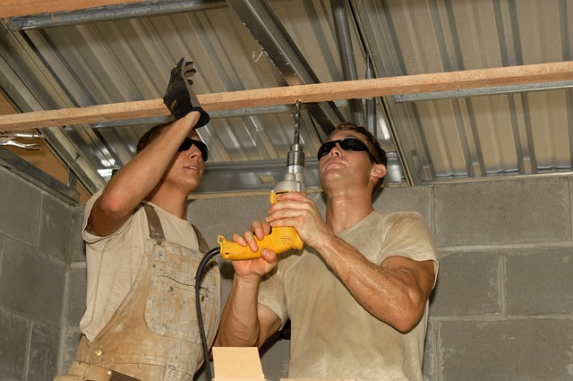
1. Appraise contract documentation to identify operational requirements
Let's talk about…
Determining the availability of selected subcontractor to suit the job requirements

Slide 9
  1.2 Determine availability of selected subcontractors to suit job requirements
Introduction
  Project plans and specifications
In the building industry, workers may be employed for the entire job or subcontracted for a specific task as part of a project. The latter is a more common scenario. The benefits of subcontractors include:
  High quality workmanship of the subcontractors. Subcontractors specialise in a single trade and are generally more efficient and knowledgeable about their work than a jack-of-all-trades
  Subcontractors are readily available
  They can be used for small tasks, rather than paying a worker for an extended period (during which their skills may not be used the whole time)
Planning of the labour requirements is of utmost importance and trades must be logically organised.
For example, don’t organise for the painter if the plasterer has not started the walls!
The quickest way to determine a subcontractor’s availability is to speak to them directly.

Slide 10
  1.2 Determine availability of selected subcontractors to suit job requirements
Main trade components of construction
There are a number of trades that need to be organised for a construction project. These will differ depending on the type of work to be completed, but the following trades are commonly utilised:
Trade | Description
Excavation | Prepares the site for building by removing all vegetation and excavating footings.
Electrician | Arranges electricity to be connected; places wiring for lighting and power cables; Fixes switches, installs power points, wires electrical systems.
Plumbing | Organises water supply; installs pipes and drains; installs roof and guttering; fits taps, hot water systems and toilets; ensures that downpipes are fitted and the sewer is connected.
Steelfixing | Installs reinforcing steel to improve the strength of concrete.
Gas fitting | Places gas pipes to appliances.
Concreting | Installs formwork and boxing; pours concrete (e.g. slabs).

Slide 11
  1.2 Determine availability of selected subcontractors to suit job requirements
Main trade components of construction
There are a number of trades that need to be organised for a construction project. These will differ depending on the type of work to be completed, but the following trades are commonly utilised:
Trade | Description
Carpentry | Installs flooring, wall frames, roof trusses, windows, external doors and frames, decking and steps; attends to joinery and mouldings.
Bricklaying | Installs brick base (sub-base brickwork, dwarf walls and piers); installs walls.
Waterproofing | Prepares wet area surfaces.
Plastering | Installs internal linings.
Tiling | Completes wall and floor tiling.
Painting | Paints areas, such as walls and ceilings.
Landscaping | Installs paving and external drainage.

Slide 12
  1.2 Determine availability of selected subcontractors to suit job requirements
Finding labour
  Project plans and specifications
The necessary labour may be:
Chosen directly to work on-site from workers known to the builder
Found through an agency or through the quoting process.
There are several ways of obtaining the necessary labour:
Use workers known to the builder
Place an advertisement in newspapers (major and local) and/or in trade magazines
Engage a recruitment agency to carry out the search for staff
Use 'word of mouth' processes
Phone known sub-contractors
Use trades staff from other companies - persons known to people already working for the builder
Sub-contractors often call in looking for work after the work has started on-site

Slide 13

1. Appraise contract documentation to identify operational requirements
Let's talk about…
Assessing and confirming the availability of materials with suppliers

Slide 14
  1.3 Assess and confirm the availability of materials with suppliers
Introduction
Material pre-planning
To organise the materials for a building project you first need to know what materials are required.
Look through your site files (drawings and specifications) and identify all materials and fixtures.
Decide how you plan to purchase the materials:
  Construction of materials on site (e.g. timber for framing), or
  Purchase prefabricated components (e.g. wall frames, roof trusses)
Work out the quantities and lengths of required materials:
Decide where you will source the materials

Slide 15
  1.3 Assess and confirm the availability of materials with suppliers
Suppliers
Check for materials availability
To check materials availability:
  Phone around to find out who has good supplies
  Liaise with known suppliers that are resourceful and reliable
Obtaining quotes from suppliers
It is best to invite at least three quotes from various suppliers to obtain a fair and competitive price. If you are working in a new area, you may like to try an additional supplier from the local area for an extra quote. However, you need to be mindful of any imported materials which need to be transported from interstate or overseas.

Slide 16
  1.3 Assess and confirm the availability of materials with suppliers
Suppliers
Assess and confirm materials with suppliers
Once you have made enquiries into suppliers you need to:
Choose a supplier who will never let you down in terms of supplies, their quality, quantity and timeliness
Find a supplier who is reliable as reliability is more critical than price. This is because a constant and timely supply of the right materials every time is what makes or breaks the efficiency of the whole building project.
Remember you can opt for a cheaper price for materials but when the materials come late or of a poor quality, it will be a lot more expensive in the long run.

Slide 17
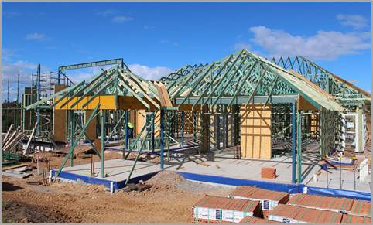
1. Appraise contract documentation to identify operational requirements
Let's talk about…
Identifying site access requirements and limitations and action taken to facilitate entry

Slide 18
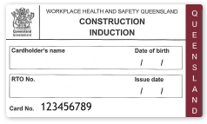
  1.4 Identify site access requirements and limitations and actions taken to facilitate entry
Introduction
It is a safety requirement that all building and construction workers undergo safety induction training with a Registered Training Organisation to develop a general understanding of site safety and are familiar with the risks and hazards that may be present on-site.
In order to access a site you must ensure your sub-contractors:
  Have a Construction Induction Card (White Card)
  Undergo a site induction
Work Health and Safety Regulation 2011 (Qld) Section 40: The layout of the work area must allow for persons to enter, exit and move about without risk to health and safety

Slide 19
  1.4 Identify site access requirements and limitations and actions taken to facilitate entry
Site induction
Site induction is the process by which workers become familiar with specific hazards and risks on a particular building site.
When a building project is different from a standard residential project, (e.g. is an industrial or commercial project), then a job specific induction will need to be carried out for all personnel to be employed on this site.
This induction will cover the basic areas plus other additional matters which are of prime importance on a larger construction project:
  You must induct every person who is to work on the site
  If a sub-contractor has several staff you must induct the contactor
  A written record must be kept on-site and signed off by the contractor and every employee on-site

Slide 20
  1.4 Identify site access requirements and limitations and actions taken to facilitate entry
Site induction
What is included within a site induction?
  Site safety rules and policies
  Site amenities and welfare facilities
  Emergency procedures
  Site specific hazards and control measures
  How safety issues and disputes are resolved
  How to report hazards or unsafe work practices
  How to report accidents, incidents, dangerous occurrences
  What to do if you are injured
  First aid provisions
  Workers’ compensation
  Details of the consultative processes that are on-site
While every employee, sub-contractor and their staff must be inducted through the full induction program, every person who enters the site must also be inducted.
This can be done by reading through a one page document.

Slide 21
  1.4 Identify site access requirements and limitations and actions taken to facilitate entry
Access
As part of determining access, you must also consider physical access:
Ensure there is adequate room for trucks to stop and use lifting equipment such as forklifts from the side of the road onto the site.
Check access for cranes on-site, taking into account their height and length and requirements for setting up space.
Check if excavation works need to be undertaken to enable access for machinery.
  If this is the case, barriers may be required for additional protection of footpaths against water, mud and soil.
Check if traffic control is required, especially if large pieces of equipment such as cranes are required.
Check there is adequate control over vehicles entering and leaving the site. Is there enough room to allow for their turning circles?
Check provision of parking for workers adjacent to the site, in on-site parking or via parking controls in the street (this is often a problem with neighbours).

Slide 22
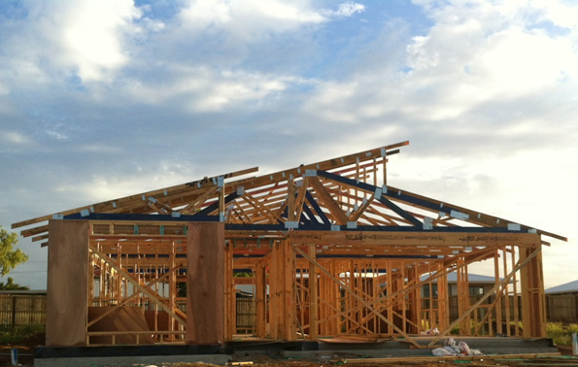
1. Appraise contract documentation to identify operational requirements
Let's talk about…
Preparing documentation for authorities controlling construction work and determining the project commencement date

Slide 23
  1.5 Prepare documentation for authorities and determine project commencement date
Preparing contract documents
There are additional documents that may need to be organised as part of the contract, including building approvals and permits:
  In Queensland, building approval is required for development that involves carrying out of building work under the Planning Act 2016 (Qld), as well as under specific building legislation and documentation, including:
    The Building Act 1975 (Qld)
    The Building Code of Australia
    Queensland’s Building and Plumbing Regulations
    Industry Standards
  Permits may be required for activities such as electricity supply, water and sewerage, and rubbish/waste disposal
Refer to CPCCBC4026A and CPCCBC4029B for further detail

Slide 24
  1.5 Prepare documentation for authorities and determine project commencement date
Preparing contract documents
There are additional documents that may need to be organised as part of the contract, including certification from local authorities:
  There are some development functions that a building certifier cannot handle. You must arrange these approvals through Council. Examples include:
    Any town planning matters that are not accepted development, subject to requirements under Brisbane City Plan
    Houses more than 9.5 metres in height from the natural ground level in the majority of residential zones
    Redevelopment or removal of heritage and character buildings
Refer to CPCCBC4026A and CPCCBC4029B for further detail

Slide 25
  1.5 Prepare documentation for authorities and determine project commencement date
Commencement date
While the date of contract signing might be the starting point of the construction period, most contracts specify that the construction period does not commence until a short time after all necessary approvals and licenses are obtained.
  Alternatively the construction period could be deemed to commence when on-site work begins. Check your documents thoroughly to determine your starting reference point.
Under the QBCC New Home Construction contract, builders must give homeowners a copy of a commencement notice before work starts. This notice confirms the date the work is the commence and the date for practical completions within 5 business days of entering the contract.
  However, it is important to note that the builder is usually entitled to claim extensions of this construction period should unforeseen circumstances arise that are beyond the builder’s control and which could not be anticipated at contract signing.

Slide 26

1. Appraise contract documentation to identify operational requirements
Let's talk about…
Implementing the procedures for controlling and recording site deliveries

Slide 27
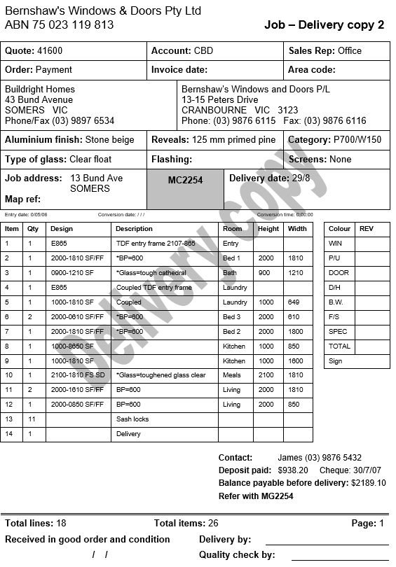
  1.6 Implement the procedures for controlling and recording site deliveries
Introduction
Usually site deliveries are controlled and recorded using a delivery sheet and diary entries. It is important to physically check each delivery against the delivery sheet at the earliest possible opportunity. Further, all orders received on site must be checked against your original order.
A delivery sheet is the detailed list of materials which are being delivered to the site. Every item on the delivery sheet should be located and ticked off on the sheet.
The process is similar for larger builders but often they have a delivery acceptance slip to be filled in by the site supervisor which is then forwarded to the site office.

Slide 28

  1.6 Implement the procedures for controlling and recording site deliveries
Introduction
If some items are missing from the delivery, you need to phone the supplier. A subsequent delivery is then organised.
Sometimes a company representative will be sent with the missing supplies.
Occasionally, another order needs to be sent, quoting the same order number with an 'S' added to indicate that a delivery has been 'short' in the goods received (e.g. order number 1160S).

Slide 29
Summary – Topic One
So far through this session you have learnt how to:
TOPIC 1: Appraise contract documentation to identify operational requirements
  1.1 Identify any unusual aspects of construction, materials or penalties within the contract documentation
  1.2 Determine the availability of selected subcontractors to suit the job requirements
  1.3 Assess and confirm the availability of materials with suppliers
  1.4 Identify site access requirements and limitations and actions taken to facilitate entry
  1.5 Prepare documentation for authorities controlling construction work and determine the project commencement date
  1.6 Implement the procedures for controlling and recording site deliveries
TOPIC 2: Implement strategies for construction operations
TOPIC 3: Prepare project schedule
TOPIC 4: Determine required resources
TOPIC 5: Prepare and submit condition reports
☑
◻
◻
◻
◻

Slide 30
Implement strategies for construction operations
Topic TWO

Slide 31
2. Implement strategies for construction operations
In this chapter you will learn how to:
  Identify organisational strategies for implementing construction operations
  Implement procedures for recording the hire of plant and equipment
  Implement organisational WHS policy and procedures including hazard and risk management
  Implement procedures for the removal of existing services and hazardous materials in accordance with Environment Protection Agency requirements
  Follow procedures for the control of multiple projects

Slide 32
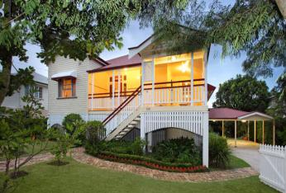
2. Implement strategies for construction operations
Let's talk about…
Identifying organisational strategies for implementing construction operations

Slide 33
  General overview – Organisational strategies
Introduction
Organisational strategies
When planning for building and construction work the you may implement a variety of strategies to implement construction operations, such as:
  Appointing project managers and construction supervisors
  Advertising for tradespersons and other employees
  Calling for tenders for subcontract operations
  Briefing organisational personnel
  Purchasing processes for building supplies or construction materials

Slide 34
  2.1 Identify organisational strategies for implementing construction operations
Project management
The objective of a project manager is to enable a project to run as smoothly as possible based on a predicted sequence of events and activities that has been carefully compiled and analysed.
The day-to-day supervision of construction tasks (to ensure the meet the overall predicted sequence) are then observed by the Construction Supervisor.
Project Management software can be used to assist in these process, assisting with:
  Coordination of project activities
  Prediction of purchasing requirements
  Arranging for timely delivery of materials
  Planning for efficient use of resources
  Predicting cash flow for the duration of the project
  Monitoring costs, performance and overall progress.

Slide 35

  2.1 Identify organisational strategies for implementing construction operations
Advertising for workers
There are many avenues in the job market to find tradespersons and other employees.
Recommended avenues include:
  Master Builders Association (MBA)
  Housing Industry Association (HIA)
  Unions and their respective member journals and their websites
  Your own website, if you have one
Advertising options
Place job and tender opportunities in:
State and local newspapers
Work and job placement agencies
Online job search engines
Local shopping centre bulletin boards can also be a good source and place to promote work and job opportunities
Industry networks by word of mouth

Slide 36
  2.1 Identify organisational strategies for implementing construction operations
Tenders
As an alternative to seeking out specific subcontractors yourself, you can put out an invitation to tender, which allows interested subcontractors to offer their services to you.
An invitation to tender will include information describing the goods or services required in sufficient detail to enable the tenderer to prepare an accurate tender that is in a prescribed format so that it is easy to compare with other tenders.
What should be considered is how the tenders that are received will be evaluated. It might be decided to accept the lowest priced tender that meets the requirements, but it is common practice to define a set of criteria by which the most economically advantageous tender can be identified.

Slide 37
  2.1 Identify organisational strategies for implementing construction operations
Personnel briefing
Workers should be briefed so they fully understand what they are required to do. Workers may be briefed in a range of different ways, including:
  Ad-hoc on-the-run briefings with sub contractors, works and others
  Formal and informal phone briefings and discussions with major contractors and sub-contractors
  Work orders and directions given by site supervisors, foreman and leading hands
  Toolbox meetings (daily) on-site before any work commences
  Oral and written notices in the form of work bulletins
  If a ‘crib room’ on site then a notice board in the crib room can be used or a conspicuous place on a nominated wall of the build/project
  Emails and text messages to site supervisors

Slide 38
  2.1 Identify organisational strategies for implementing construction operations
Purchasing processes
The builder can gather the information needed to make up a purchase order for a task from:
A take-off sheet which contains the quantity for the material provided
The project schedule for delivery date
Suppliers for the lead-in time
Nominated supplier list
Quotes
The purpose of producing a purchase order is to provide an audit trail that can be followed by anyone.
Purchase orders should contain the following information:
Order date and delivery date
Purchase order number
Supplier details
Delivery details
Supplier contact information
Project manager details

Slide 39

2. Implement strategies for construction operations
Let's talk about…
Implementing procedures for recording the hire of plant and equipment

Slide 40
  2.2 Implement procedures for recording the hire of plant and equipment
Introduction
Hiring plant and equipment is not dissimilar to purchasing materials for the build.
Plant refers to the larger mechanical pieces of machinery which may be used on-site, such as a tower lift or compressor.
Equipment describes the smaller non-mechanical tools such as ladders and wheelbarrows.
Your procedures and accounting systems will be very similar to purchasing materials:
You order the hire of equipment and then you have the options of either picking it up or having it delivered.
You will be invoiced and a payment will be required
  However, unlike with materials (which are not returned), a refundable deposit and insurance may be required along with insurance
  Keep records of the invoices and receipts associated with the hire of plant to ensure you receive deposits back

Slide 41
  2.2 Implement procedures for recording the hire of plant and equipment
Introduction
Some tips for hiring out construction plant and equipment:
Prior to placing orders, obtain and keep written confirmation that the items have been designed, constructed and tested in compliance with applicable WHS legislation and relevant Australian Standards, and will be supplied with the necessary safe-use information in English
Inspect plant/equipment with the hire company upon arrival to site and record the details of the inspection.
  This ensures that you have appropriate documentation of the condition of the plant before your use of it
At the end of the period of hire, inspect the plant/equipment with the supplier and record the detail of the inspection.

Slide 42
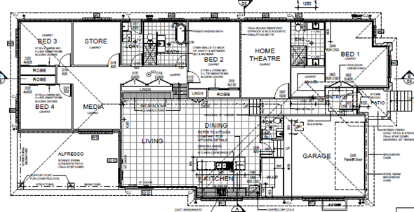
2. Implement strategies for construction operations
Let's talk about…
Implementing organisational WHS policy and procedures including hazard and risk management

Slide 43
  2.3 Implement organisational WHS policy and procedures (hazard & risk management)
Introduction
When a contractor takes possession of a building site there are several steps that need to be taken to meet work health and safety (WHS) obligations, including ensuring the safety of workers who will be employed on the site.
Ensuring WHS policies and procedures are in place and followed is a key component to ensuring safety in the workplace.
Policies are general documents that describe organisational aims regarding risk management.
Procedures support workplace policies and processes, providing even more specific detail as to how the organisation intends to manage risks (i.e. the steps required to complete the process).

Slide 44
  2.3 Implement organisational WHS policy and procedures (hazard & risk management)
Hazards and risks
Policies and procedures must be implemented around hazard and risk management.
The risk management process is a cycle of identifying hazards, assessing risks, applying risk control measures and evaluating the effectiveness of these measures.
Hazards, risk and risk control are defined by Safe Work Australia as follows:
Term | Definition
Hazard | A situation or thing that has the potential to harm a person. Hazards at work may include: noisy machinery, a moving forklift, chemicals, electricity, working at heights, a repetitive job, bullying and violence at the workplace.
Risk | The possibility that harm (death, injury or illness) might occur when exposed to a hazard.
Risk control | Taking action to eliminate health and safety risks so far as is reasonably practicable, and if that is not possible, minimising the risks so far as is reasonably practicable. Eliminating a hazard will also eliminate any risks associated with that hazard.

Slide 45
  2.3 Implement organisational WHS policy and procedures (hazard & risk management)
Obligations
There are a range of documents that you are required to comply with. Externally, there are:
Document | Summary
Act | The Work Health and Safety Act 2011 (Qld) places duties on various individuals and parties within the workplace. Sections 17-18 of the Act indicates that risks should be identified and eliminated, so far as is reasonably practicable (or otherwise minimised so far as is reasonably practicable).
Regulation | The Work Health and Safety Regulation 2011 (Qld) provides more specific detail about the requirements of the Act and outlines types workplace risks.
Codes of practice | These provide a guide for commonly accepted practice within particular industries (e.g. How to manage work health and safety risks Code of practice 2011 (Qld)).
Guidance notes | These can include notes and alerts issued by the WHS regulator. Other guidance material can be provided to explain the legislative requirements.
Standards | These set out specifications and procedures to ensure that products, services and systems are safe, reliable and consistently perform as intended. They are based on sound industrial, scientific and consumer experience.

Slide 46
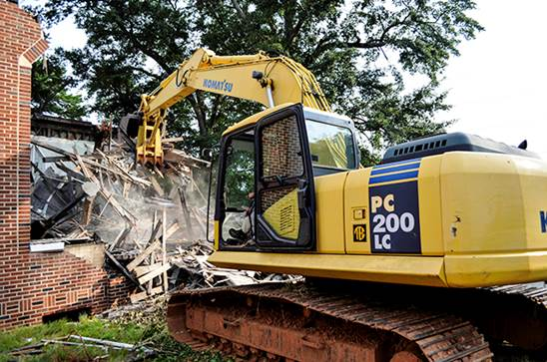
2. Implement strategies for construction operations
Let's talk about…
Implementing procedures for the removal of existing services and hazardous materials in accordance with Environment Protection Agency requirements

Slide 47

  2.4 Implement procedures for the removal of existing services and hazardous materials
Hazardous materials
When handling and disposing of hazardous materials, it is essential to follow any Safety Data Sheets (SDS), where applicable.
Further, under the Environmental Protection Regulation 2019 (Qld) waste handlers must submit waste tracking information when transporting regulated waste or waste residues. A complete list of trackable regulated wastes can be found in Schedule 11 of the Environmental Protection Regulation 2019 (Qld).

Slide 48
  2.4 Implement procedures for the removal of existing services and hazardous materials
Hazardous materials
To conduct licensed asbestos removal work, you must:
Prepare an asbestos removal control plan and Safe Work Method Statement (SWMS)
Obtain asbestos register for the workplace
Prepare asbestos removal control plans
Inform people before asbestos removal Erect signage and barricades
Have decontamination facilities available
Dispose of asbestos waste properly
Notify Workplace Health and Safety Queensland five days prior
Removing less than 10m² does not require a licence or an asbestos removal control plan, but safety precautions are essential (e.g. SMWS)
There will be occasions when an owner/developer takes possession of land when there is an existing building on the site. This will generally be the case in older suburbs.
Should a significantly sized structure (i.e. more than 10m²) need to be removed, an investigation needs to be carried out to assess if asbestos is present. Special procedures need to be implemented to remove such hazardous materials, including obtaining an Asbestos Removal Licence.

Slide 49
  2.4 Implement procedures for the removal of existing services and hazardous materials
Existing services
The following assessments may be required:
Site assessment: Necessary when contamination is known or likely to be present. This involves checking the site's history and taking soil samples to identify the contaminants and their concentrations.
Risk assessment: Necessary when a site assessment indicates the presence of contaminants that may be a risk to the health of workers on site.
As well as existing buildings there may be structures or services that need to be removed from the site, such as:
  Septic tank
  Sludge pit
  Oil or petrol tanks
Sometimes areas of ground (both surface and substrata soil) become contaminated by leeching from tanks or chemical spills from neighbouring properties. Land may have been contaminated by lead which can be left behind from industry or old service stations.

Slide 50

2. Implement strategies for construction operations
Let's talk about…
Following procedures for the control of multiple projects

Slide 51
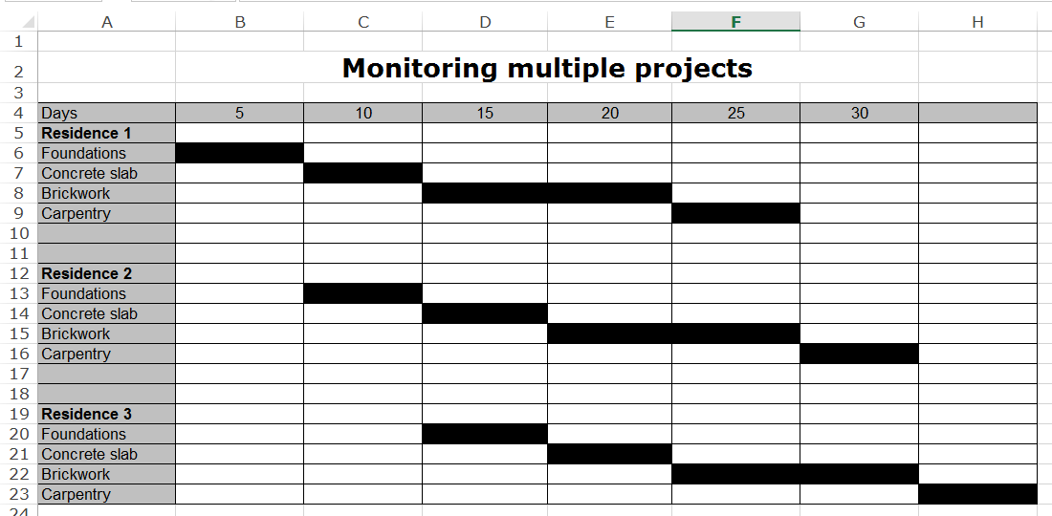
  2.5 Follow procedures for the control of multiple projects
Introduction
If you have multiple projects on the go you can use a Gantt chart to track and control these additional tasks.
This simple Gantt Chart represents the construction of three similar houses in a new residential estate.
It demonstrates how a concreter may complete the pouring of a concrete slab on one house and then move to the next house requiring similar work. There is a similar process for the other tasks shown in the chart.
You should try to minimise skilled labour from moving off-site when there is work to be done on nearby constructions. This can save a great deal of time. If sub-contractors move to another location it can be difficult to ensure their return for the next stage of the project.

Slide 52
  2.5 Follow procedures for the control of multiple projects
Introduction
If you have multiple projects on the go you can use a Gantt chart to track and control these additional tasks.
You should try to minimise skilled labour from moving off-site when there is work to be done on nearby constructions. This can save a great deal of time, as the subcontractors can work on the next job while waiting for another to complete.
If sub-contractors move to another location it can be difficult to ensure their return for the next stage of the project.
This simple Gantt Chart represents the construction of three similar houses in a new residential estate.
It demonstrates how a concreter may complete the pouring of a concrete slab on one house and then move to the next house requiring similar work. There is a similar process for the other tasks shown in the chart.

Slide 53

  2.5 Follow procedures for the control of multiple projects
View this video to learn how to: How to Make a Gantt Chart for Multiple Projects in Excel (3:19 mins)

Slide 54
Summary – Topic Two
So far through this session you have learnt how to:
☑
TOPIC 1: Appraise contract documentation to identify operational requirements
TOPIC 2: Implement strategies for construction operations
  2.1 Identify organisational strategies for implementing construction operations
  2.2 Implement procedures for recording the hire of plant and equipment
  2.3 Implement organisational WHS policy and procedures including hazard and risk management
  2.4 Implement procedures for the removal of existing services and hazardous materials in accordance with
  Environment Protection Agency requirements
  2.5 Follow procedures for the control of multiple projects
TOPIC 3: Prepare project schedule
TOPIC 4: Determine required resources
TOPIC 5: Prepare and submit condition reports
☑
◻
◻
◻

Slide 55
Prepare project schedule
Topic Three

Slide 56
3. Prepare project schedule
In this chapter you will learn how to:
  Sequence construction operations
  Manually or electronically enter operations details into a project schedule or computer-based software package
  Define and revise the project’s critical path
  Adjust project timeframes to account for anticipated delays

Slide 57
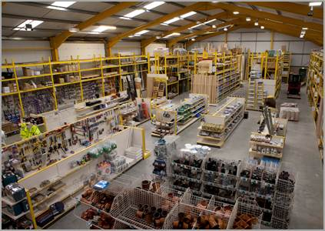
3. Prepare project schedule
Let's talk about…
Sequencing construction operations

Slide 58
  General overview – Prepare project schedule
Introduction
Project schedule
Now that we have covered off contract documentation and implementing construction strategies you need to prepare your project schedule.
When preparing your project schedule you must have an understanding of:
  Human resource schedules
  Materials delivery schedules
  Project critical path
  Project timeframes
  Schedules of plant and equipment

Slide 59
  3.1 Sequencing construction operations
Project schedule
A project schedule is a plan of all the tasks and activities that need to be completed on your building project. It is a living document that:
  Shows order of tasks
  Provides a timescale
  Can be tracked and revised
When you prepare a schedule you will plan and produce:
  Material sourcing and ordering, planning on-site material delivery
  Sequence of trades
  Labour and materials schedule
  A cash flow chart
  And continue to revise and update your schedule

Slide 60
  3.1 Sequencing construction operations
Sample construction activities list
1. Clear and establish site
2. Arrange temporary services (e.g. electricity, water)
3. Arrange sub-contractors and approximate dates
4. Arrange materials and approximate delivery dates
5. Set out
6. Bulk and detailed excavation for footings
7. Plumber to install pipes and drains
8. Formwork to ground slab
9. Vapour barrier/Termite treatment
10 Notice to council for inspection
11. Fix reinforcement
12. Place and finish concrete to slab
13. Cure slab
14. Erect wall frames
15. Arrange for inspection
1 6. Erect roof trusses
17. Install windows and external door frames
18. Roof plumbing
19. Attach roof covering
20. Construct external walls (brick veneer)
21. Install external doors, decking and steps
22. Electrical rough-in
23. Plumbing rough-in
24. Brick cleaning
25. Wet area waterproofing
26. Install wall insulation
27. Fix internal linings
28. Joinery and fit-out
29. Wall and floor tiling
30. Painting
31. Plumber final fit-out
32. Electrician final fit-out
33. Install ceiling insulation
34. Complete landscaping and erect fences

Slide 61
  3.1 Sequencing construction operations
Sample construction activities list
1. Clear and establish site
2. Arrange temporary services; electricity, water, etc
3. Arrange sub-contractors and approximate dates
4. Arrange materials and approximate delivery dates
5. Set out
6. Bulk and detailed excavation for footings
7. Plumber to install pipes and drains
8. Formwork to ground slab
9. Vapour barrier/Termite treatment
10 Notice to council for inspection
11. Fix reinforcement
12. Place and finish concrete to slab
13. Cure slab
14. Erect wall frames
15. Arrange for inspection
1 6. Erect roof trusses
17. Install windows and external door frames
18. Roof plumbing
19. Attach roof covering
20. Construct external walls (brick veneer)
21. Install external doors, decking and steps
22. Electrical rough-in
23. Plumbing rough-in
24. Brick cleaning
25. Wet area waterproofing
26. Install wall insulation
27. Fix internal linings
28. Joinery and fit-out
29. Wall and floor tiling
30. Painting
31. Plumber final fit-out
32. Electrician final fit-out
33. Install ceiling insulation
34. Complete landscaping and erect fences
Notice that the list is in the order in which the activities need to occur.
It allows for a break up of activities where trades are required on more than one occasion – such as electrical, for the initial wiring, and then later, after the internal linings and finishes have been installed, for the final fix (e.g. power points, switches, light fittings, etc).
Attempts have been made to be inclusive of all activities. Omitting an activity could be disastrous for the progress of the project.

Slide 62
  3.1 Sequencing construction operations
Sequencing operations
Following is a list of some of the tasks that need to be completed in the internal fittings stage of a residential construction. The list has been designed using a 'network diagram' which illustrates the tasks as the must occur in sequence.
The task on the left is the first to be completed, followed by the next task to the right and so on.
1
Plastering
2
Tiling: wall, floor
3
Elec fit-off
4
5
6
7
Plumbing
Fit-off
Painting
Floor finishing

Slide 63
  3.1 Sequencing construction operations
Sequencing operations
However, this is not the most efficient way to do these jobs. The next diagram shows that the plumbing and electrical fit-offs can be done at the same time. This has the advantage of saving total job time and therefore saving money.
Note: All the electrical work needs to be finished before painting starts but the plumbing needs to be completed prior to the floor finishing job.
Plastering
Tiling: wall, floor
Elec fit-off
Painting
Floor finishing
1
2
3
4
6
7
Plumbing
Fit-off
5

Slide 64
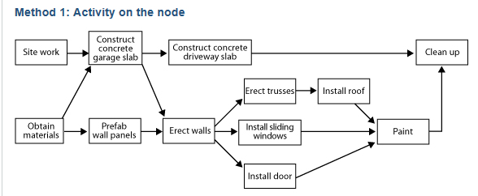
3. Prepare project schedule
Let's talk about…
Manually or electronically entering operation details into a project schedule or computer-based software package

Slide 65
  3.2 Enter operations details into a project schedule/computer software package
Introduction
Scheduling tasks
A network diagram is also known as a PERT Program Evaluation and Review Technique is a project management tool which is used to schedule tasks within a project. A PERT chart considers the relationships between tasks and assists in sequencing tasks which are dependent on others. A PERT chart may be drawn by hand or by computer using a software package such as Microsoft Project.
There are two different ways these diagrams can be presented:
  Activity on the node
  Activity on the arrow

Slide 66
  3.2 Enter operations details into a project schedule/computer software package
Activity on the Node
In this diagram the activities are written inside the boxes and are linked by arrows. These arrows may or may not have the number of days to complete the task written on them.

Slide 67
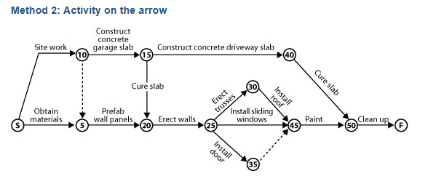
  3.2 Enter operations details into a project schedule/computer software package
Activity on the Arrow
The more common method in use is Activity on the arrow.
Each of the numbered nodes (the circles) represents an activity which has been completed
Each arrow represents an activity that has taken place.
Times can be added to the arrows to give an overview of the total job time.

Slide 68
  3.2 Enter operations details into a project schedule/computer software package
Scheduling tasks on a chart
There are a number of things you need to consider, including:
  Preceding events (a initial task before the current task)
  Can some proceeding events occur simultaneously?
  How do you plan to draw your chart (hand or by computer using a software package such as Microsoft Project)?
  Estimate task duration (0.5, 1, 4 days) based on:
    Your own construction experience
    The advice of a tradesperson
  Start dates (from the earliest to the latest start date, referred to as the ‘float’)
  The ‘critical path’ – the longest sequence of activities in a project (which determines the shortest possible completion time if all events are to be completed)
    Depending on the path you take will depend on how much float is in the job
    Delays in your critical path can cause an increase in time and money

Slide 69
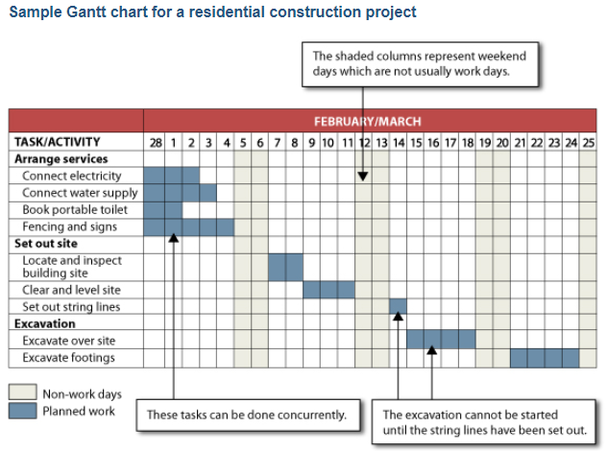
  3.2 Enter operations details into a project schedule/computer software package
Project schedules
You can graphically represent a project schedule using a Gantt Chart.
A typical chart consists of rows and columns, with tasks in the first column followed by time intervals.
Relationships and dependencies between tasks are shown graphically by the positioning of the bars. For example, two parallel bars indicate that two tasks will be done at the same time. One bar following another indicates that the task associated with the first bar must be completed before the task belonging to the second bar can be started.

Slide 70
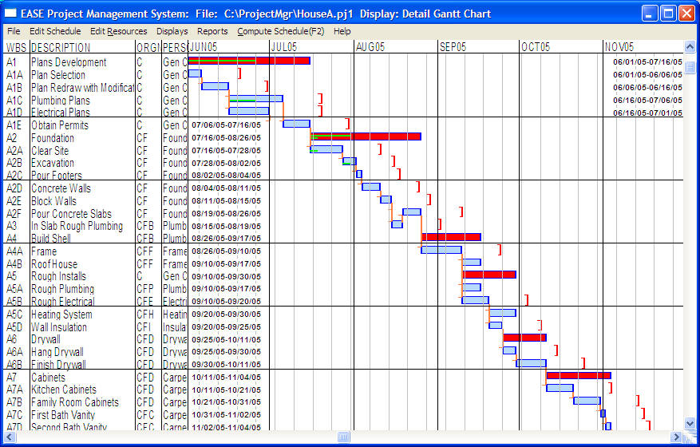
  3.2 Enter operations details into a project schedule/computer software package
Project schedules
Where resources (e.g. labour and equipment) allow, project managers often aim for work to be done on two or more tasks at the same time in order to shorten the overall duration of the project.

Slide 71

  2.5 Follow procedures for the control of multiple projects
View this video to learn how to: Create a Gantt Chart in Excel (9:56mins)

Slide 72
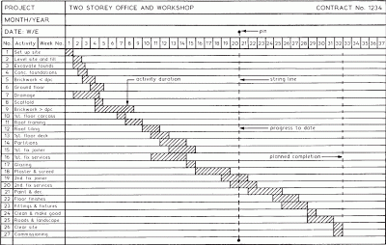
3. Prepare project schedule
Let's talk about…
Defining and revising the project’s critical path

Slide 73
  3.3 Define and revise the project’s critical path
Introduction
The ‘critical path’ is defined as the shortest completion time possible to complete a job. Critical path information:
Sets out the build and its stages
Details and records the build timelines
Shows when sub contractors are due on site and for how long
Structures the supply chain of materials
Allows for delays and other supply chain problems
Caters for things like inclement weather cycles, other unpredictable problems and issues causing deferment and changes in the timelines, deferring supply of materials and labour
    Depending on the path you take will depend on how much float is in the job.
    Delays in your critical path can cause an increase in time and money.
It is a daily exercise to manage the project critical path for it is a living working document for the entire life cycle of the build.
Remember to keep the client well informed when things go awry in order to avoid any possible dispute/s down the track when contract timeframes fall behind and are not being met.

Slide 74
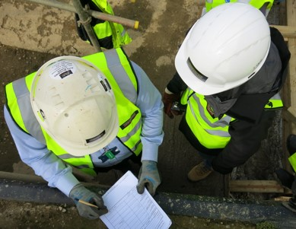
3. Prepare project schedule
Let's talk about…
Adjusting project timeframes to account for anticipated delays

Slide 75
  3.4 Adjust project timeframes to account for anticipated delays
Project monitoring
When monitoring your start and finish dates refer to your project schedule. You will get a very clear idea as tasks are falling behind of the impact it will have on your schedule.
Delays are inevitable so you must be ready for them! The most common types of delays include:
  Poor project management: Issues with planning and time management
  Material delivery: Too many or too few materials on-site
  Resources: Unreliable labour or poor workmanship
  Unexpected delays: Strikes, illness, mistakes
  Building inspections: Failing inspections
  Weather: Can spend time waiting for weather to pass or for the site to recover

Slide 76
Summary – Topic Three
So far through this session you have learnt how to:
☑
TOPIC 1: Appraise contract documentation to identify operational requirements
TOPIC 2: Implement strategies for construction operations
TOPIC 3: Prepare project schedule
  3.1 Sequence construction operations
  3.2 Manually or electronically enter operations details into project schedule or computer software package
  3.3 Define and revise the project’s critical path
  3.4 Adjust project timeframes to account for anticipated delays
TOPIC 4: Determine required resources
TOPIC 5: Prepare and submit condition reports
☑
☑
◻
◻

Slide 77
Determine required resources
Topic four

Slide 78
4. Determine required resources
In this chapter you will learn how to:
  Determine and document temporary services and site accommodation requirements
  Determine and document plant requirements and availability dates with reference to contract documentation
  Determine and document on-site labour requirements with reference to contract documentation

Slide 79

4. Determine required resources
Let's talk about…
Determining and documenting temporary services and site accommodation requirements

Slide 80
  4.1 Determine and document temporary services and site accommodation
Services
The following temporary services should be supplied from the start of the building process:
Temporary electrical pole or power box built into its permanent position. If a slab is being poured on the ground, the power is brought on-site and the power board is put into its permanent place. Sometimes the location of the existing service will determine this. The set back distance and overhead or underground supply need to be considered
Water tapping to supply water to the site. This may be a short tapping (on the same side of the street) or a long tapping which requires piping under the road (if supply is on the other side of the street)
Temporary fencing around the site so that the public does not have access
Barricades to meet the local municipal by-laws. If the site cut is over one metre, a barricade is erected to prevent public access. If the site cut is less than one metre, a temporary fence is erected.
Waste bin
Seepage barriers (in some cases) across the front of the site to stop water and soil running onto the footpath
'Tiger strips' if work is to take place close to overhead powerlines

Slide 81
  4.1 Determine and document temporary services and site accommodation
Amenities
Under work health and safety requirements, principal contractors are to provide various amenities for those performing construction work. Under Schedule 5A of the Work Health and Safety Regulation, this includes:
Amenity | Requirements
Toilets | There must be at least 1 toilet for each 15 construction persons. If there are at least 15 persons, each toilet must be connected (if a sewerage or septic connection is available) For workplaces at least four levels high, a toilet must be at ground level, fourth level (not counting ground), each third level after the fourth level.
Area to eat meals | A room or sheltered area to eat meals and take breaks in, that is hygienic and separated from work activity If there are at least 15 construction persons, appropriate facilities for washing and storing utensils, boiling water and storing food in a cool place.

Slide 82
  4.1 Determine and document temporary services and site accommodation
Amenities
Under work health and safety requirements, principal contractors are to provide various amenities for those performing construction work. Under Schedule 5A of the Work Health and Safety Regulation, this includes:
Amenity | Requirements
Hand and face washing facilities | Adequate clean water for washing hands and face
Drinking water | Adequate supply of potable, clean and cool drinking water Water supply must not be located in toilets
Refer to Managing the work environment and facilities Code of Practice (Qld) for more detail

Slide 83
  4.1 Determine and document temporary services and site accommodation
Accommodation
If a business has workers working in regional and remote areas, accommodation may need to be provided while the work is being carried out. An example of such arrangements would be where accommodation is provided to workers engaged in construction work at a remote location.
Where reasonably practicable, the accommodation should be separated from any hazards at the workplace likely to adversely affect the health and safety of a worker using the accommodation.
The accommodation facilities should:
Be lockable, with safe entry and exit
Meet all relevant structural and stability requirements
Meet electrical and fire safety standards
Have a supply of drinking water
Have appropriate toilets, washing and laundry facilities
Be regularly cleaned and have rubbish collected
Be provided with suitable sleeping quarters shielded from noise and vibration
Have crockery, utensils and dining facilities
Have adequate lighting, heating, cooling and ventilation
Have storage cupboards and other suitable furniture
Be provided with a refrigerator or cool room
Have all fittings, appliances and equipment in good condition.

Slide 84

4. Determine required resources
Let's talk about…
Determining and documenting plant requirements and availability dates with reference to contract documentation

Slide 85
  4.2 Determine and document plant requirements and availability dates
Sample materials list
Introduction
When organising plant for hire, it is essential to refer back to project management documentation, such as the Gantt Chart, to establish the dates they are required on site.
In much the same way as you plan your materials order supply and arrival to site, so too will you need to do the same for your plant and equipment requirements.

Slide 86
4. Determine required resources
Let's talk about…
Determining and documenting on-site labour requirements with reference to contract documentation

Slide 87
  4.3 Determine and document on-site labour requirements in contract
Sample materials list
Sample materials list
Introduction
As part of the project planning, the site supervisor would have read through the site files (including contract and specifications) to determine the type of labour required to carry out the construction of the project.
Referring to the Gantt Chart, it is able to determine exactly when subcontractors need to be on site. Check that your contractors are available when you need them. Even if a contractor suits your requirements there is no point in employing them if they are not available to work in the timeframe required.

Slide 88
  4.3 Determine and document on-site labour requirements in contract
Sample materials list
Sample materials list
Introduction
The following methods may be used to let orders of contracts for labour:
A written quote is signed and this authorises it as a contractual agreement
A formal purchase order is provided
A formal letter of request is provided confirming the quote
A sub-contract agreement is signed (standard forms - these are available from Master Builders Association (MBA) or Housing Industry Association (HIA)).

Slide 89
Summary – Topic Four
So far through this session you have learnt how to:
☑
TOPIC 1: Appraise contract documentation to identify operational requirements
TOPIC 2: Implement strategies for construction operations
TOPIC 3: Prepare project schedule
TOPIC 4: Determine required resources
  4.1 Determine and document temporary services and site accommodation requirements
  4.2 Determine and document plant requirements and availability dates with reference to contract
  documentation
  4.3 Determine and document on-site labour requirements with reference to contract documentation
TOPIC 5: Prepare and submit condition reports
☑
☑
☑
◻

Slide 90
Prepare and submit condition reports
Topic five

Slide 91
5. Prepare and submit condition reports
In this chapter you will learn how to:
  Complete reports on the condition of existing buildings and structure on adjacent site boundaries
  Commence construction after copies of condition reports are forwarded to the owners of adjacent buildings

Slide 92
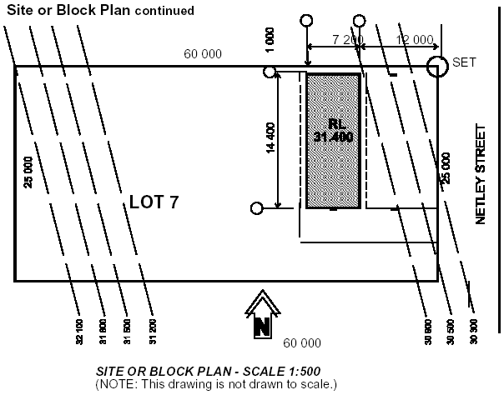
5. Prepare and submit condition reports
Let's talk about…
Completing reports on the condition of existing buildings and structure on adjacent site boundaries

Slide 93
  5.1 Complete reports on the condition of existing structures on site boundaries
Introduction
If work is to affect neighbouring properties, you are required to compile a report on the condition of existing buildings and structures on adjacent site boundaries. Take photos to support your report – it will be helpful in the event of a dispute with a neighbour.
As part of this process:
Take note of fences and structures on the boundary line (e.g. garage walls) – observing height, length, general condition and any defects.
Sketch the location of each adjacent residence, taking note of window positions, front and side setbacks, wall length dimensions and taking note of window positions.
Sketch and dimension the location of any significant trees within three meters of the fence line.
Sketch the location of any swimming pools, spas and special gardens between the adjacent house and the boundary.

Slide 94

5. Prepare and submit condition reports
Let's talk about…
Commencing construction after copies of condition reports are forwarded to the owners of adjacent buildings

Slide 95
  5.2 Commence construction after forwarding condition report to neighbours
Sample materials list
Introduction
Condition reports should be forwarded onto owners of adjacent buildings prior to commencing construction. That way, all parties are aware of the site status before work commences, and can easily identify if any damage has occurred through the construction process.

Slide 96
Summary – Topic Five
So far through this session you have learnt how to:
☑
TOPIC 1: Appraise contract documentation to identify operational requirements
TOPIC 2: Implement strategies for construction operations
TOPIC 3: Prepare project schedule
TOPIC 4: Determine required resources
TOPIC 5: Prepare and submit condition reports
  5.1 Complete reports on the condition of existing buildings and structure on adjacent site boundaries
  5.2 Commence construction after copies of condition reports are forwarded to the owners of adjacent
  buildings
☑
☑
☑
☑

Slide 97
This completes your study session for CPCCBC4007A
Plan building or construction work

