Slide 1

WORKPLACE AMENITIES
WORK HEALTH AND SAFETY OFFICER

Slide 2
Assessment Criteria
Describe the statutory requirements relating to workplace amenities.
Describe at least five topics that are listed under the Work Health and Safety Regulations 2011 Schedule 5A regarding amenities.
Discuss the principles of the General Workplace Management requirements of Part 3.2 of the WHS Regulations 2011.

Slide 3
Duties
PCBU
Officers
Workers

Slide 4
Identifying what facilities are needed
Decisions about facilities and work environment depend on:
The industry the business is operating in
The nature of the work carried out
The size and location of the workplace
The number and composition of workers at the workplace
Consult with workers and other duty holders

Slide 5
Nature of the Work
Does the work involve exposure to infectious material or contaminants? If so, workers may need access to shower facilities before they leave the workplace.
Do workers need to change out of their clothes? If so, they may need change rooms and appropriate personal storage.
Is the work mostly conducted standing or seated? If so, floor coverings and seats should be considered.
Is the work sedentary or physically active? If so, this may affect the ideal comfortable air temperature.
Is the work done in shifts? If so, cleaning and maintenance schedules may need to take into account the times when the facilities are used.

Slide 6
Size, location and nature of the workplace
Does the workplace cover an extensive area, or is work undertaken in a single location?
Do the workers travel between workplaces, to numerous work sites or to other locations?
Is the workplace permanent or temporary?
Is the workplace close to appropriate welfare facilities?
Will the facilities be available at the times workers need to use them, for example during a night shift?
Is the means of access safe?
Number and composition of the workforce
The number of workers at the workplace will determine the size and type of facilities required.

Slide 7

Maintaining the work environment and facilities
The work environment should be maintained so that it remains in a clean and safe condition.

Slide 8
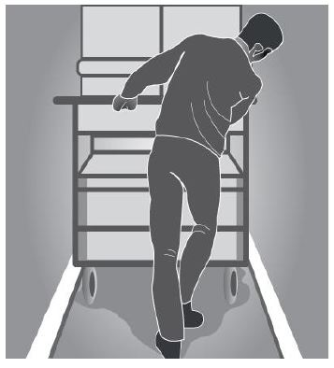
Entry and exit
The means of entry and exit to and from the workplace must be safe. This may include ensuring that workers with special needs or disabilities can safely enter and leave the workplace.

Slide 9
Housekeeping
An untidy workplace can cause injuries in particular, injuries resulting from slips and trips, therefore good housekeeping practices are essential for all workplaces.
For example:
spills on floors should be cleaned up immediately
walkways should be kept clear of obstructions
work materials should be neatly stored
any waste should be regularly removed.

Slide 10
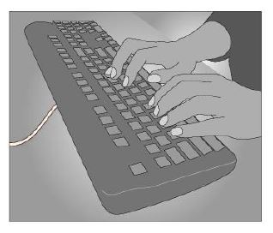
Work areas
The layout of work areas should be designed to provide sufficient clear space between furniture, fixtures and fittings so that workers can move about freely without strain or injury and also evacuate quickly in case of an emergency.

Slide 11
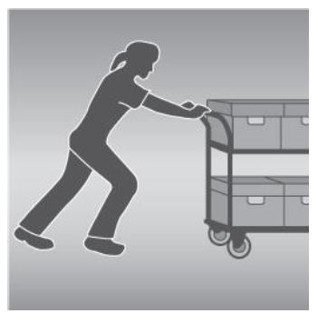
Floors and other surfaces
Floor surfaces should be suitable for the work area. The choice of floor surfaces or coverings will depend on the type of work carried out at the workplace, as well as the materials used during the work process, the likelihood of spills and other contaminants, including dust, and the need for cleaning.

Slide 12
Workstations
Workstations should be designed so that workers can carry out their work in a comfortable, upright position with shoulders relaxed and upper arms close to the body.

Slide 13
Lighting
Sufficient lighting must be provided, whether it is from a natural or artificial source, to allow safe movement around the workplace and to allow workers to perform their job without having to adopt awkward postures or strain their eyes to see.
The following factors should be taken into account:
the nature of the work activity
the nature of hazards and risks in the workplace
the work environment
illumination levels, including both natural and artificial light
the transition of natural light over the day
glare
contrast
reflections.

Slide 14
Air quality
Workplaces should be adequately ventilated. Fresh, clean air should be drawn from outside the workplace, uncontaminated by discharge from flues or other outlets, and be circulated through the workplace.

Slide 15
Heat and cold
Thermal comfort
Hot environments
Cold environments

Slide 16
Access to facilities
Workers, including those who have particular needs or disabilities, must have access to the facilities.

Slide 17
Drinking Water
An adequate supply of clean drinking water must be provided free of charge for workers at all times. The supply of the drinking water should be:
positioned where it can be easily accessed by workers
close to where hot or strenuous work is being undertaken to reduce the likelihood of dehydration or heat stress
separate from toilet or washing facilities to avoid contamination of the drinking water.

Slide 18
Toilets
Access to clean toilets must be provided for all workers while they are at work.

Slide 19
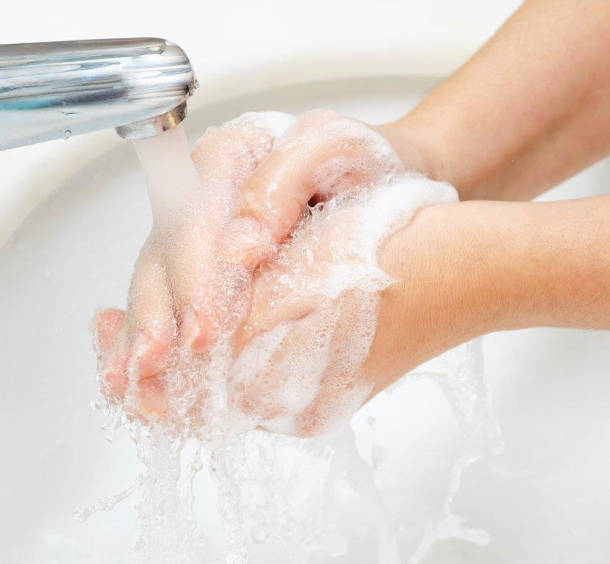
Washing Facilities
Showers
Hand Washing

Slide 20
Dining
Dining area should be provided for the consumption of food during meal and rest breaks.
A separate dining room should be provided if:
10 or more workers usually eat at the workplace at the same time
there is a risk of substances or processes contaminating food.

Slide 21
Personal Storage
Accessible and secure storage should be provided at the workplace for personal items belonging to workers.
Where any work involves the use of tools provided by a worker, provision should be made for secure and weatherproof storage of those tools during non-working hours.

Slide 22
Change Rooms
A change room should be provided if workers have to change in and out of clothing due to the nature of their work.
This includes workers who need to:
Wear personal protective clothing or uniforms while they are working
Leave their work clothing at the workplace

Slide 23
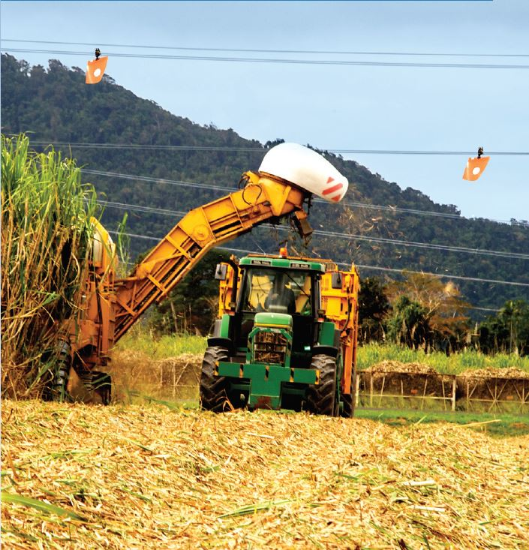
Outdoor work
Outdoor workers should have access to shelter for eating meals and taking breaks, and to protect them in adverse weather conditions.

Slide 24
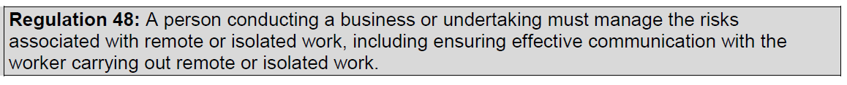
Remote or isolated work
Remote or isolated work is work that is isolated from the assistance of other people because of the location, time or nature of the work being done. Assistance from other people includes rescue, medical assistance and emergency services.

Slide 25


