Slide 1
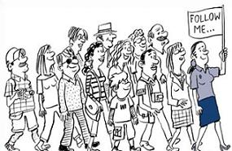
Conducting a Tour
Erin Bailey

Slide 2

Meet and Greet
Smile
Assess your group
Brief outline of program
Good body language
Notes:
When you first greet customers
Take in nationalities and disabilities/injuries
Make them feel welcome

Slide 3

Workplace Health and Safety
Sign in of guests
Closed in shoes
Evacuation points
Dress codes

Slide 4

Emergencies
Fire
Lock down
Ambulance on call
Bad weather

Slide 5
Age and needs of Clients
Spilt into age groups
SEP program
Intensive English Unit
No wheelchair access

Slide 6
Thankyou for attending
Any questions please don’t hesitate to ask

