Slide 1

HEALTH AND HYGIENE
WORK HEALTH AND SAFETY OFFICER

Slide 2
Assessment criteria
Describe the role of at least three occupational health and safety professionals involved in the assessment, identification, evaluation, monitoring and control of work caused illness.
Describe basic toxicological principles.
Describe concepts in relation to the workplace exposure standard.
Describe the type, effects and controls of at least three health hazards commonly encountered in the workplace.
Describe at least two techniques used to monitor workplace exposure to health hazards.

Slide 3
What is health and hygiene?
Occupational health involves maintaining a state of well-being and freedom from occupationally related disease or injury.
Occupational hygiene is described as the recognition, the identification, the evaluation and the control of situations involving workplace hazards.

Slide 4
What is health and hygiene?
Basic Toxicology
Toxicological Principles
Routes of entry
Toxic Effects of Hazardous Substances
Occupation Hygiene
Types, health Effects and Control of a Worker’s Exposure to a Health Hazard
Methods of Controlling Workplace Hazards
Biological Monitoring

Slide 5
Legislation
WHS Regulation s351 – Management of risks to health and safety
WHS Regulation s 32 – 38 Managing risks to health and safety
The Managing Risks of hazardous Chemicals in the Workplace COP 2018
Managing Risks of Hazardous Chemicals in the Workplace COP 2018

Slide 6
Health hazards in the workplace
Physical agents
Noise
Vibration
Light (radiation)
Heat
Cold
Biological agents
Bacterial
Fungal
Viral

Slide 7
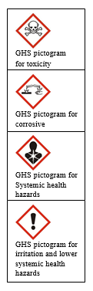
Hazardous chemicals and health
Hazardous chemicals that can harm health may be stored, handled or generated in a workplace.
Hazardous chemicals may be found in a variety of forms including:
Solids
Dusts
Fumes
Liquids
Vapours
Mists
Gases

Slide 8
Routes of entry
Inhalation
Skin contact
Ingestion
Injection

Slide 9
Common workplace hazardous chemicals
  organic solvents
  adhesives
  paints and paint thinners
  dusts such as asbestos and respirable crystalline silica
  heavy metals such as lead, cadmium and mercury
  welding fumes
  acids, alkalis and other corrosives
  pesticides
  gases such as ammonia and chlorine
  cement

Slide 10
Assessing health risks
super toxic
extremely toxic
very toxic
moderately toxic
slightly toxic
practically non-toxic

Slide 11
Basic toxicology
Toxicology is the study and description of the adverse effects of chemical and physical agents on living organisms.
There are three important differences between injury and disease:
TIME
DAMAGE
DOSE

Slide 12
Time
Occupational diseases mostly, but not always, require multiple exposures to the causative agent over a variable period of time.
Disease may take from minutes to many years to develop.

Slide 13
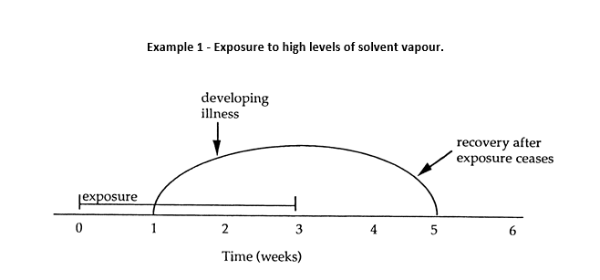
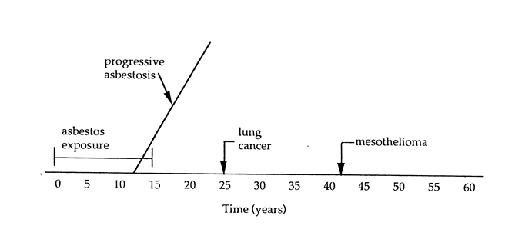
Example 2 – Asbestos related disease

Slide 14
Damage
An accident may injure many tissues but only where the energy of the accident is applied, eg. a part of the body such as the head or the arm, etc.
With disease, the tissue affected may be remote from where the causative agent is applied. For example, inhaling solvent vapours through the lung can produce effects on the brain such as headaches, drowsiness and so on.

Slide 15
Dose
The term dose means the amount of a substance which is absorbed. In particular, it depends on:
concentration of exposure; and
duration of exposure

Slide 16
Exposure in the workplace
Which agents in use at the workplace are hazardous
How much exposure is hazardous
What procedures are necessary to monitor the workplace exposure; and
How exposure can be controlled

Slide 17
Toxic effects of hazardous chemicals
Local effects
Systematic effects
Acute effect
Chronic effect
Interactive effect

Slide 18
Workplace exposure standards
Workplace Exposures Standards relate to how much of a hazardous material a worker can be exposed to during his or her working day without suffering any adverse effect.

Slide 19
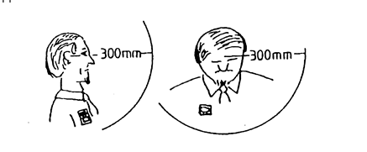
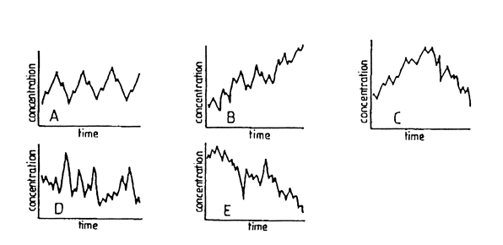
Breathing zone
Time weighted average

Slide 20
Sources of Toxicology data
Animal experimentation
Accident/major event investigation
Epidemiology
Exposure standards
SUBSTANCE | WES-TWA
XYLENE | 100 parts per million
QUARTZ | 0.1 mg/cubic m (respirable fraction)
CROCIDOLITE (blue asbestos) | 0.1 fibres/mL
LEAD (inorganic dust and fumes as Pb) | 0.15 mg/cubic m

Slide 21
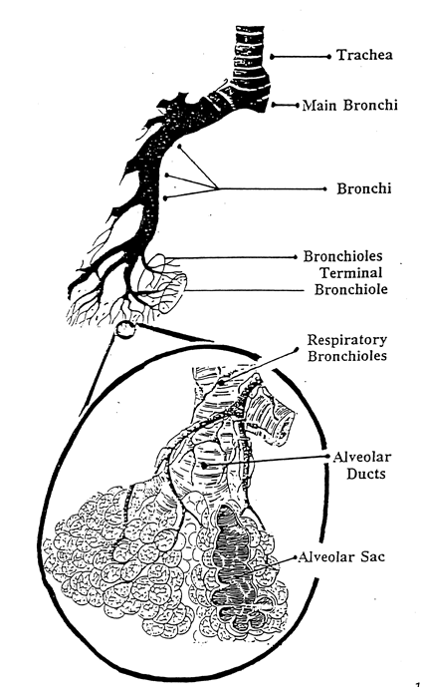
Dusts
most particles which are larger than 15 micrometers in diameter are deposited in the nose and throat.
particles in the 10-15 micrometer range are deposited in the tracheobronchial tree (larger air passages down to about the 10-15th branches).
particles in the 0.5-5.0 micrometer range are deposited in the alveoli and respiratory and terminal bronchioles.
particles less than about 0.1 micrometers tend not to be deposited.

Slide 22
Gases
Irritant Gases:
High solubility irritant gases
Low solubility irritant gases
Asphyxiants:
Simple asphyxiants
Chemical asphyxiants
Miscellaneous

Slide 23
Solvents
Local effects:
Eyes and upper respiratory tract
Skin
Systemic effects
Acute effects
Chronic effects

Slide 24
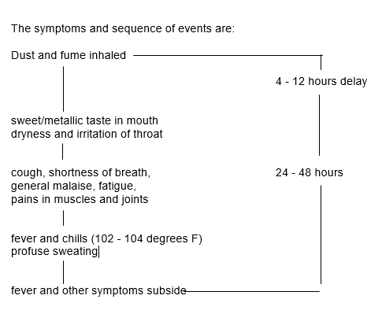
Metals
Metal fume fever
Systemic toxicity
Skin effects
Carcinogenic effects

Slide 25
Controlling workplace health hazards
Substitution
Engineering
Ventilation
Administrative
Personal Protective Equipment

Slide 26
Monitoring
Monitoring of the workplace
Personal monitoring
Area monitoring
Health monitoring
Biological monitoring

Slide 27


