Slide 1

CHCECE006
Support behaviour of children and young people

Slide 2

Contribute to a safe and supportive environment
1.1 Use safe, supportive and equitable practices appropriate to the development stage and needs of the child and/or young person

Slide 3

Safe and supportive practices
Ensuring that children and young people feel safe and supported is a key factor in guiding their behaviour in the right direction.
You should be aiming to incorporate strategies into your working practices which aim to ensure that children and young people feel safe and supported at all times.

Slide 4

Safe and supportive practices
You can promote a safe and supportive environment by incorporating practices such as:
Value diversity
Practice communication
Have non-negotiable rules in place
Have bullying protocols in place
Make contact with the relevant professionals available.

Slide 5

Equitable practices
Equitable practices refer to ensuring that children and young people are treated fairly. You can ensure that you are facilitating an equitable environment by incorporating practices into your work which are dedicated to minimising bias, prejudice, and discrimination.

Slide 6
Equitable practices
You can incorporate equitable practices into your role by doing things such as:
Role-model positive behaviours and attitudes that challenge discrimination and prejudice
Provide a diverse range of images about the lifestyles of families, gender roles, cultural background and human ability
Acknowledge and promote the presence of diverse staff
Challenge biases with children, for example, discussing evidence of bias and prejudice in children’s play, interactions and relationships…

Slide 7

Equitable practices
Avoid negative comparisons between children
Review and provide resources in the environment which promote positive messages about difference and diversity
Engage in training to develop skills in treating children equitably.

Slide 8

Appropriate practices
The best way to ensure that practices are appropriate is to ensure that they are catered for children and young people individually. Children will respond differently to different things and you should be acknowledging of this in the way that you engage with them as individuals.

Slide 9

Appropriate practices
You may ensure that practices are appropriate by:
Getting to know the children
Assess children’s learning
Work in collaboration with families.

Slide 10

Activity 1A

Slide 11
Contribute to a safe and supportive environment
1.2 Recognise any developmental challenges or mental health issues of child or young person that may have potential impacts on behaviour

Slide 12
Recognising challenges and issues
A part of your role will be working to recognise the specific challenges that children or young people may be facing as they learn, develop, and grow into adults.
Many children and young people will not be able to recognise their own challenges or potential issues so it is really important that they have people looking out for their best interests and identifying when they may need extra help or support.

Slide 13

Developmental challenges
Children and young people may face challenges in their learning, physical or social development.
You should be working to identify any instances where children are at risk of not reaching their full potential within any area of development.

Slide 14

Developmental challenges
You might be able to recognise development challenges by:
Monitoring social and emotional skills
Be aware of any learning disabilities
Recognise personality traits
Look for any differences in comparison to other children of similar ages.

Slide 15
Mental health issues
Unfortunately, mental health issues are not rare for children and young people to experience. In fact, it is thought that around half of serious mental health issues begin before the age of 14.
It is really important that mental health is a prevalent topic in your workplace, and that you and your colleagues are aware of the things to look for which indicate that a child may be experiencing mental health issues.

Slide 16
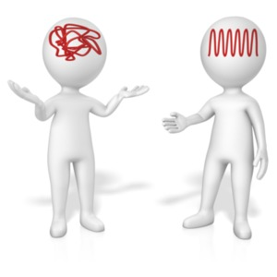
Mental health issues
There is no set way that a person who is suffering mentally will behave, but there are some common behaviours which you may want to consider following up if you see them displayed.

Slide 17

Mental health issues
Internal effects of mental health issues might include:
Nervous/anxious temperament
Excessive worrying
Pessimistic thinking
Withdrawn behaviour
Peer relationship difficulties.

Slide 18
Mental health issues
External effects of mental health issues might include:
Challenging temperament
Reduced problem-solving skills
Attention difficulties, hyperactivity
Oppositional behaviour (e.g. doesn’t like to be told what to do; won’t follow rules)
Aggressive behaviour.
(https://www.kidsmatter.edu.au/sites/default/files/public/KMP_C4_CMHD_HowMentalHealthDifficultiesAffectChildren.pdf)

Slide 19

Mental health issues
You might be able to recognise mental health issues by:
Doing lots of research
Monitor any mood/behaviour changes
Be aware of children’s home life.

Slide 20
Communicative function of behaviour
All types of behaviour can be a form of communication. How children and young people behave can often show how they are really feeling. Challenging behaviour, for example, often means that children and young people have needs that are not being met.
There are two key behaviours to look for which indicate that children may need extra support:
Disruptive behaviours
Behaviours of concern.

Slide 21
Activity 1B

Slide 22
Contribute to a safe and supportive environment
1.3 Identify contributing environmental factors

Slide 23
Identify contributing environmental factors
The environment around us can have a huge impact on how we feel and how we behave.
In order to prevent environmental factors from having a negative effect on a young person’s behaviour, you should aim to identify anything which you think may have an impact so that you can put control measures in place wherever possible.

Slide 24
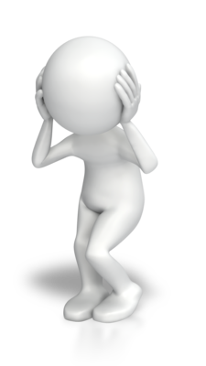
Identify contributing environmental factors
For example, environmental factors which might affect children and young people include:
An unfamiliar environment
The way that space is used
The dynamics of the environment
Noise levels
Activity levels
Inconsistency.

Slide 25
Internal factors
Internal factors can often combine with environmental factors and cause a child’s behaviour to change. For example, if a person practices specific cultural rituals different to the rest of the group this is an internal factor. But if other people are not accepting to this behaviour this is an external factor which could have a negative impact on the person.

Slide 26
Culture
Culture is something that you will need to be particularly aware of within your role. Australia is a country made up of many different beliefs, values, and practices.
In order to show respect and protect the cultural differences of children and young people, you should be aware of how cultural factors may have an impact on how individuals engage with the environment.

Slide 27

Culture
For example, cultural factors might include:
Placing value on different things
Adaptation to different ways of behaving.

Slide 28
Activity 1C

Slide 29
Use positive support techniques
2.1 Establish expectations for behaviour in consultation with supervisor and in line with work role

Slide 30

Why establish expectations for behaviour?
Setting well-defined guidelines for how you expect children and young people to behave is crucial in ensuring consistency in behaviour and discipline. Behaviour expectations will also help to ensure that respect is shown between children and staff as well as between the children themselves.

Slide 31

Establishing expectations in consultation with your supervisor
If you are unsure or worried about how to implement effective expectations of behaviour, your supervisor should be able to point you in the right direction.
Don’t be afraid to ask for help where you need it. Whether we are novices or experts, we all sometimes need some guidance!

Slide 32
Establishing expectations in consultation with your work role
Depending on your specific role within your organisation you may not be able to enforce expectations without having them discussed as a team.
Whilst having to run your ideas past others can sometimes seem like a barrier to getting work done, it is a good idea to discuss anything as a team anyway as this promotes consistency within all practices and ensures that everyone is on the same page.

Slide 33
Activity 2A

Slide 34
Use positive support techniques
2.2 Provide instructions in a manner appropriate to the child or young person’s needs and context of the work environment and activity

Slide 35

Providing instructions
The ability to follow instructions is a key skill that all children will need to learn. To aid their ability to follow instructions, you should be looking at how you present the instructions children and young people.

Slide 36
Be clear
No matter the age, development stage or individual needs of a child/young person, if you are not clear and concise in your provision of an instruction, they are likely to not to follow it.
Minimise your words
Provide eye contact
Provide one instruction at a time if necessary
Don’t ask.

Slide 37

Ensure that the provision of instructions is appropriate
When you provide instructions to children and young people, you should be aiming to ensure that they are appropriate for the individual and the specific moment. This means that children/young people should be able to understand what you are telling them to do in terms of what is going on around them.

Slide 38

Individual needs
The skills and abilities of an individual can have an effect on how well they are able to follow instructions. You should be able to adapt the way that you provide instructions to them based on this.
Children who have learning difficulties, minor or more severe, they may find it more difficult to interpret instructions and remember them, for example.

Slide 39
Environment and activity
When you provide instructions you should also be considering any relevant surrounding factors and the specific activity taking place.
For example, if you are walking along a road with children or young people, you are in an environment which is potentially dangerous and the way that you provide instructions should reflect this.

Slide 40
Activity 2B

Slide 41
Use positive support techniques
2.3 Use positive reinforcement and clear verbal and non-verbal communication strategies to acknowledge responsible behaviour

Slide 42
Why should you acknowledge responsible behaviour?
Acknowledging responsible behaviour will show children and young people that they have done something well, and will hopefully encourage them to repeat this behaviour in the future.
If you spend a lot of time with children, whether they admit it or not, your acknowledgement is likely to be important to them.

Slide 43

Positive reinforcement
Positive reinforcement refers to the process of encouraging good behaviour in order to increase the likelihood of it being repeated.
As well as encouraging us to repeat something, positive reinforcement can help to improve our self-esteem and confidence in our abilities.

Slide 44

Verbal communication
You can practice positive reinforcement through verbal communication with children and young people. Verbal communication will tend to be praise. Saying things such as ‘well done’ or ‘I saw how you behaved and I’m proud of you’ will let children know that they have behaved in a positive way and will encourage them to repeat this.

Slide 45
Non-verbal communication
In some cases, verbal communication may not be an appropriate way to let children know that they have behaved in a positive way. This may be because they are too far away from you, or they may feel embarrassed if you point this out in front of a group.
There are non-verbal strategies which can be just as effective in communicating with children when they have behaved in a responsible way.

Slide 46
Activity 2C

Slide 47
Use positive support techniques
2.4 Employ appropriate strategies to redirect behaviour and defuse situations

Slide 48
Redirecting behaviour
When children and young people behave in an undesirable way, you will be responsible for ensuring that they recognise this and help to guide their behaviour in the right direction going forward.
This means that you should be focusing on not just letting children/young people know how to behave better in the future, but also on ensuring that they understand why they should change their behaviour.

Slide 49

Redirecting behaviour
In order to redirect behaviour effectively, you will need to show children an alternative way to behave.
You might do this by:
Verbally explaining why behaviour is wrong and provide an alternative
Modelling positive behaviour yourself
Moving the child away from the cause of the behaviour.

Slide 50

Defusing situations
It is likely at some point in your practice that you will experience intense, emotional or even aggressive situations and you will need to know how to defuse these situations should they arise.
You can defuse situations by:
Remaining calm
Separate children
Giving children space
Acknowledging their feelings .

Slide 51
Activity 2D

Slide 52
Element title
3.1 Collect data and record observations as a basis for gaining understanding of the child/young person’s behaviour
3.2 Use data to demonstrate the frequency, intensity and duration of behaviours requiring support

Slide 53

Collecting data
Carrying out research regarding how strategies are working and how children and young people are responding to them can really help to improve your working practice.
Within your research, you should be looking at gaining an understanding of children and young people’s behaviour and how they are responding to you, your team and the environment.

Slide 54
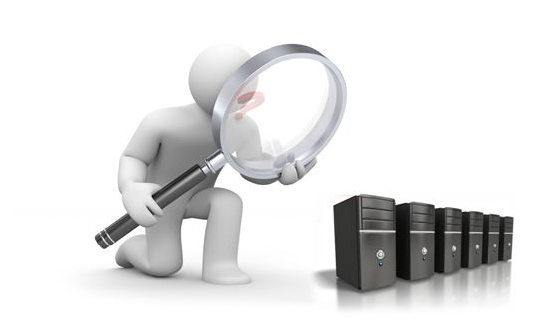
Observations
Arguably, the best method of data collection when working with children/young people is observation.
The main benefit of observations, as opposed to other data collection techniques, is that they can take place during daily routines and activities, without creating an artificial environment.

Slide 55

How to collect data
When you are carrying out an observation, you will need to be specific in the things that you are looking for. To do this, you will need to have a specific outcome for your research.
This will encourage you to focus your observations on something specific and give you a point to draw back to whenever you begin to stray.

Slide 56

How to collect data
You will also need to decide whether you will be carrying out qualitative or quantitative observations.
Qualitative observations will be descriptive and based on more in-depth findings. Alternatively, quantitative observations will be based on factors which can be measured or counted. For example, you may be counting the amount of times a certain behaviour occurs throughout the day.

Slide 57
Recording observations
When you perform observations, you will need to be recording your results. This will allow you to refer back to them, identify any patterns and gain an overall understanding of the observations you have made.
Most of the time when performing observations, the most appropriate mode of recording results is written notes. If you are observing children in their natural activities, you don’t want to be sat with a laptop typing out what you see in essay form. It’s just not realistic.

Slide 58

Frequency, intensity, and duration
When you are recording your observations, the key things to look for are frequency, intensity and duration. These three factors will help you to determine when extra support may be required and identify how this can be implemented effectively going forward.

Slide 59
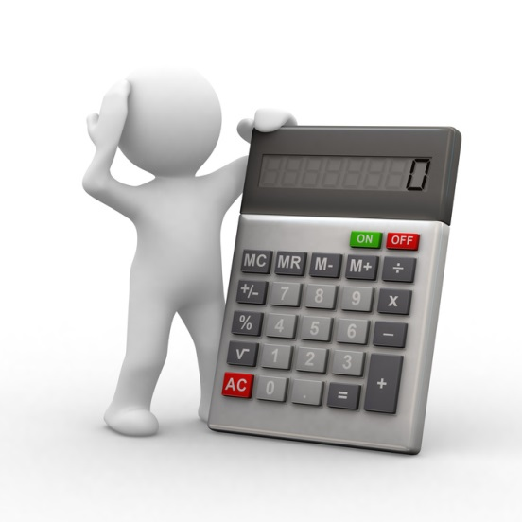
Frequency
The frequency of behaviour refers to how often it occurs. This will be determined by counting the number of times you observe a specific type of behaviour or action. Often, the frequency of behaviour can determine whether intervention is required by showing whether something is a ‘one off’ or whether it is something that is occurring on a regular basis.

Slide 60

Intensity
The intensity of behaviour refers to how severe it is and whether it poses a danger to the child themselves or anybody else around.
Of course, your main concern should be the safety of the children and young people you are working with. If you identify behaviour which is severe in intensity and poses direct danger you should take immediate action to protect the child and any others around them.

Slide 61

Duration
The duration of behaviour refers to how long it lasts for. For example, if a child/young person gets distracted often but only for a few seconds at a time this is likely to be less concerning than if they are getting distracted for five minutes at a time.

Slide 62

Using data
Once you have collected the relevant data, you should then be using this in order to improve your practices.
Your observations will be based on identifying certain behaviours which will require support. If the frequency, intensity, or duration of a behaviour is high – this gives a clear indication that there is a need for intervention.

Slide 63
Activity 3A

Slide 64
Implement strategies to support children or young people who require additional support
4.1 Implement strategies to support child or young person with guidance from supervisor or as designed by a specialist

Slide 65

Implementing strategies for support
In order to support children and young people who have additional needs, you will need to implement specific strategies which are catered for their requirements.
It is a good idea to have accepted strategies across the scope of your organisation in order to promote consistency in practice.

Slide 66
Working with guidance
If you are unsure about the appropriate strategies which you should be implementing or how to put them in place, you may have a supervisor who can help to guide you in the right direction.
If you are planning to implement your own strategies, it might be a good idea to work alongside your supervisor anyway. Two heads are always better than one!

Slide 67
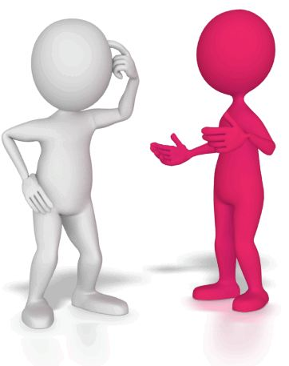
Specialists
Some of the strategies which you adopt may be determined by a person who specialises in the field. Working with strategies designed by a specialist can be beneficial as you will know that they will be competently designed, and they will likely be tried and tested. It will also save you time which you would spend creating new strategies yourself.

Slide 68
Activity 4A

Slide 69
Implement strategies to support children or young people who require additional support
4.2 Identify areas of concern for discussion with supervisor

Slide 70
Identifying areas of concern
When you are working with children and young people, you will be expected to identify any areas of concern in their behaviour. Areas of concern can range from anything from needing encouragement to concentrate or requiring support due to a learning disability.

Slide 71

Identifying areas of concern
When you spend a lot of time with children, it should be fairly easy to identify any dramatic changes in their behaviour which may indicate that something is wrong.
However, spending a lot of time with children can also mean that you become accustomed to their particular way of behaving and fail to recognise that these behaviours may be a concern to their development or their general well-being.

Slide 72

Discussing areas of concern
When you identify any area of concern you should be looking at how to ensure that the child/young person receives the support that they need. In order to do this, it is a good idea to discuss anything of concern with your supervisor.

Slide 73
Activity 4B

Slide 74
Implement strategies to support children or young people who require additional support
4.3 Contribute effectively to implementation of personalised support plans

Slide 75
What is a support plan?
A support plan is a document which will outline the additional needs and goals of a child or young person. As you will be aware, all children and young people have different requirements and needs, and a support plan is a resource which should be used to document this and ensure that strategies are put in place to support individualised progress.

Slide 76

Contributing to the implementation of support plans
Contributing to the implementation of a support plan will have many benefits. It can help you to understand the process of the plan and allow you to work consistently with other members of your team when providing care for the child/young person. Your contribution will also ensure that the child is getting the support that they need which will be outlined in the plan.

Slide 77
Activity 4C

Slide 78
Monitor and review strategies
5.1 Monitor new strategies and record responses of child or young person in accordance with organisational policy and procedures

Slide 79

Why should you monitor new strategies?
When you implement new strategies into your work, you will need to ensure that they are effective and achieving what you had hoped. There’s no point in continuing to do something if it is not gaining the results that you want.

Slide 80
Ask yourself…
Is the strategy gaining the results that you wanted?
Are your goals realistic?
Are your goals related directly to the strategy?
Considering end goals and strategies can often seem too much like a business.
But, having specific goals and strategies in place will help you to direct your support in a more organised way, hopefully resulting in effective practices

Slide 81
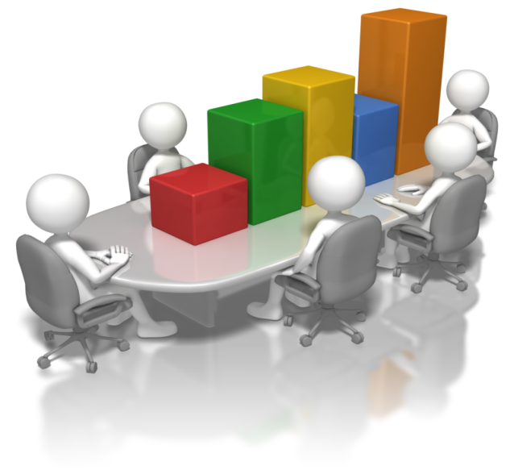
Record responses of children/young people
There a number of ways in which you can record responses. For example, you may produce a written report after observing responses, or you may produce a log which documents whether children/young people have responded positively or negatively to a strategy.

Slide 82

Organisational policies and procedures
All work that you do should be carried out in adherence to the policies and procedures of your organisation. If you are unsure about anything or have any questions, you should talk to the relevant person(s), i.e. a supervisor or a manager.
Don’t do anything that you are unsure of, it’s always better to be safe than sorry!

Slide 83
Activity 5A

Slide 84
Monitor and review strategies
5.2 Adapt levels of support required and provided, based on need and response of child or young person, after consultation with supervisor

Slide 85
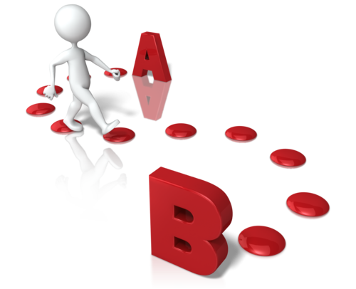
Adapting level of support
When you have monitored strategies and determined how children/young people are responding to them, you may find that you will need to adapt the support which you are giving.
Don’t be afraid to start the process over again, in all fields, it is normal practice to try and test different strategies until you find out what works best.

Slide 86
You may adapt your support by…
Working in cooperation with the family of the child
Working with additional members of staff
Considering isolation from the rest of the group during intense activities
Considering communicating with professionals to rule out the possibility of any behavioural or learning difficulties or mental health issues.

Slide 87

Consulting with supervisor
Consulting with your supervisor will also provide you with an opportunity to communicate any concerns that you may have and clear up your own ideas. It will also provide your supervisor with the opportunity to give you guidance as well as just generally keep up to date with your progress.

Slide 88
Activity 5B

Slide 89
Monitor and review strategies
5.3 Document observations and offer feedback to supervisor as additional support

Slide 90
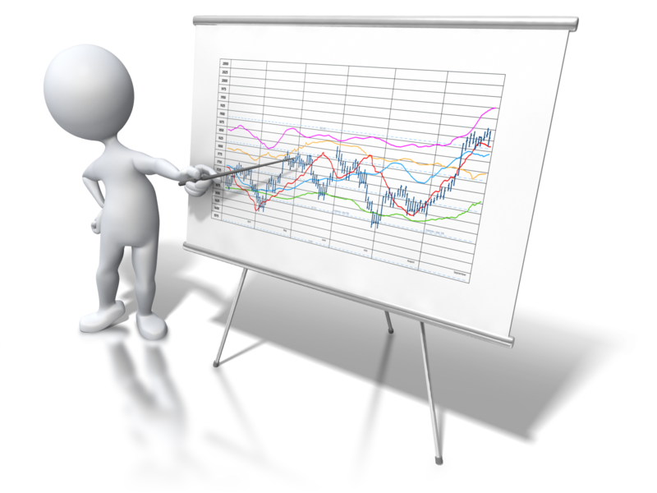
Documenting observations
All observations that you make will need to be documented. The purpose of documenting observations is to allow you to refer back to your findings, identify any patterns and gain an overall understanding of the observations you have made.

Slide 91

There are four main ways that you can document what you see:
Audio recording
Photographs
Video recording
Written documents.

Slide 92

Selecting what to document
You should be trying to be relatively selective with what you choose to document. You don’t want to end up with so much documentation that you don’t know what you are looking for or how to guide your work going forward. Reconsider the reasons for your observations and select your documentation based on this.

Slide 93

Offer feedback to supervisor
You may want to discuss the observations that you have made with your supervisor. Giving them feedback on the work that you are carrying out will help to keep them on track with what you’re doing, how the children/young people are developing and the strategies which are currently in place.

Slide 94
Activity 5C

Slide 95
Summative Assessments
Summative assessments consist of:
Skills Activity
Knowledge Activity
Performance Activity.
Your assessor will provide you with further guidance on how and where to complete these assessments.

Slide 96

Summary and Feedback
Did we meet our objectives?
How did you find this session?
Any questions?

