Slide 1
RIICWM402D
Supervise civil works contractors

Slide 2
1.0 Plan and prepare to supervise civil works contractors

Slide 3
1.1 Access, interpret and apply civil works documentation and ensure the work activity is compliant
Documentation is an essential aspect of the work site
Contains procedures, policies and legislations
Must be compliant and readily accessible
Many site plant and resource management related documents may be subject to audit, review, monitoring or examination

Slide 4

1.2 Obtain, read, interpret, clarify and confirm work requirement
All work needs to follow worksite, environment and company safety procedures. Procedures help to make sure that all work is done in a safe way, without damaging equipment or putting people in unsafe situations.

Slide 5
Project plans and drawings
Provide and overview of the project site
  Location of the site and earth works
  Traffic management
  Position of structures
Drawings may be very detailed or simple sketches, may include
  Identification of viable options
  Implementation of procedures and techniques for safe, effective and efficient construction of flexible pavement
  Implementation of site plant and resource management plans

Slide 6
Confirm work requirements
The supervisor must be able to interpret compliance documentation as well as any members of the working team
All work must be carried out, including the testing, must comply with Australian standards
Use of key words like Should, Consider as Must/requires/mandatory are essential to get the point across to workers

Slide 7
1.3 Identify and address potential risks, hazards and environmental issues, and implement control measures.
The four risk management steps:
Identifying hazards
Assessing the hazard
Controlling the hazard
Reviewing the control measure

Slide 8
Identifying the hazard
It is important to work closely with workers and look at every task in the workplace to help identify all potential hazards. Some hazards may include:
Uneven or unstable terrain
Excavation pits and mounds
Traffic and traffic control measures
If someone has been injured during a particular task, then a hazard exists that could hurt someone else

Slide 9
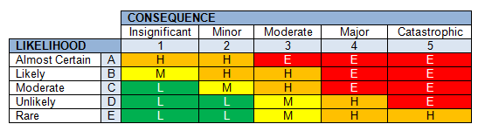
Assessing the hazard
A risk assessment is used to determine:
The severity of a risk
Whether any existing control measures are effective
What actions should be taken to control the risk
How urgently those actions should be completed

Slide 10
When to do a risk assessment
When there is uncertainty about how the hazard may result in an injury or illness
When the work activity involves a number of different hazards and there is a lack of understanding about how the hazards may interact with each other
When there are changes at the workplace that may impact the effectiveness of control measures

Slide 11
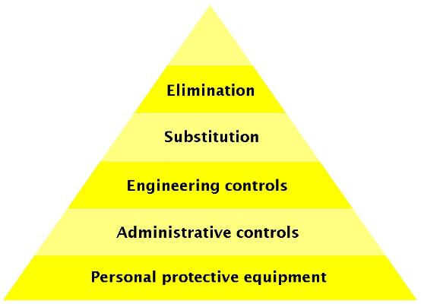
Controlling the risk
Controlling a risk or hazard is best done by implementing the hierarchy of control:

Slide 12
When a review and or revision is needed
When the control measure does not control the risk it was implemented to control
Before a change at the workplace which is likely to give rise to a new or different health safety risk that the control measure may not effectively control
If a new hazard or risk is identified
If the results of consultation indicate that a review is necessary
If a heath and safety representative requests a review and they reasonably believe that a situation referred to above affects or may affect the health and safety of a member of the work group they represent

Slide 13
Important steps to reduce environmental impacts
Walk the construction route to identify the limit of vegetation clearance, significant vegetation, ‘no go’ areas, locations for stockpiles, plant compounds and access roads.
Clearly identify the extent of the construction area and those areas to remain undisturbed
Ensure machinery and equipment is clean before bringing to site
Keep work and vehicles within the construction area
Keep machinery and stockpiles on cleared areas
Use the appropriate machinery for the task
Plan vegetation removal (do not clear vegetation unnecessarily).
Topsoil should be stripped and stockpiled for use as soon as practicable

Slide 14
Important steps to reduce environmental impacts continued
Protect and maintain site erosion control measures
Ensure the works drain to the erosion/ sedimentation control structures.
Ensure waste is controlled and disposed of correctly
Clean equipment before moving to another site.
If unsure about any environmental controls contact the Site Supervisor

Slide 15
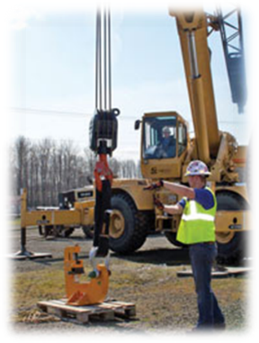
1.4 Select and wear personal protective equipment appropriate for work activities
Personal protective equipment (PPE) is clothing, equipment or substances designed to be worn by someone to protect them from risks of injury or illness. PPE can include:
Hearing protective devices
Respirators
Eye and face protection
Safety helmets and sun hats
Gloves and safety boots
High visibility clothing

Slide 16
PPE continued
PPE is the least effective method of controlling a safety risk and does not control the hazard at the source. Because of this, the control of exposure to risks should be secured by one or more measures other than the provision of personal protective equipment. PPE should only be used:
Where there are no practical higher order control measures available
As temporary measure until more effective control measure is used
To supplement higher level control measures (back up)

Slide 17
1.5 Ensure the contractor has a job plan available and ensure best use of the available resources that meet the task requirement
The Job Management Plan provides a ‘roadmap’ for the project team to follow – as well as it being one of the Project Managers main communications and control tools throughout the project. Information may include:
Task requirements
Human resource requirements
Plant and machinery requirements
Construction materials requirements

Slide 18

1.6 Identify resources required to complete the tasks
There are many individual resources needed to complete a project. In a road construction project, the major resource groups are:
Manpower
Equipment
Materials

Slide 19
2.0 Ensure appropriate initiation of tasks is carried out

Slide 20
2.1 Confirm that the contractor has the required resources
It is important to have adequate resources that meet the requirement of the task before beginning. These requirements can include:
Personnel and Labour
Plant, Machinery and Equipment Construction materials
Co-ordination
Estimation of Materials is an essential practice when calculating quantities of materials.

Slide 21
2.2 Ensure the contractor has communicated clear and timely instructions to team members and others involved
Communication techniques
  Verbal
  Written
  Key questions
  Methods
Approval processes/protocols
  Document management plan

Slide 22
2.3 Set out tasks as required for the effective completion of the civil works
Developing work plans and setting out task needs to be done in such a way that ensures effective completion of the required tasks without creating a hazard.
Task outlines may include:
Establishing Fixed and Flexible deadlines
Establishing control lines
Establishing the cleared width
Determining batters
Establishing offsets

Slide 23
3.0 Oversee the execution of task

Slide 24

3.1 Monitor civil works contractor’s performance and ensure they achieve the required outcomes
Monitoring tasks that should be considered:
Ongoing risk assessments
Engineering and survey monitoring
Sampling and testing
Maintaining construction records
Supervising personnel
Monitoring equipment use
Monitoring the relationship between different civil works

Slide 25
3.2 Ensure the safe, effective and efficient conduct of the tasks
Situations where a WHS management plan may be reviewed include:
Changes of critical personnel, for example project manager, site supervisor, site safety manager
If safety rules on site change
Changes in legislation, regulations or codes practice
Where there are significant changes to the site conditions that result in changes to persons with responsibility for health and safety or additional persons with responsibility for health and safety

Slide 26
3.3 Initiate adjustments to work practices or job plan to ensure safe execution of work and achievement of required outcomes
changes are needed to ensure the safety or personnel and equipment as well as ensuring the required job outcome are achieved.
Changes may be necessary to meet:
Task specification requirements
Task drawings requirements
Coordination requirements
Activity scheduling requirements
Unit cost requirements
Overall task cost requirements
Waste management requirements

Slide 27
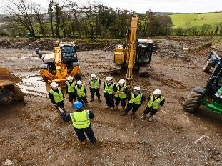
3.4 Ensure plant equipment and tools maintenance requirements are carried out and recorded
All plant and equipment must be inspected and maintained by a competent person
A risk assessment or safe work procedure must be undertaken prior to the commencement of the work.
Unsafe plant and equipment can be identified via:
Equipment inspections
Pre-operational checks
Hazard and incident reporting process

Slide 28
4.0 Report on the execution of tasks

Slide 29
4.1 Complete and submit written reports
Reports may be compromised of different types of data including:
The measurements used for the ordering of materials
The test results of materials
Photographs of the project under completion
Diary notes of the Project Manager providing insight into daily tasks, events and attainment of milestones

Slide 30
4.1 Complete and submit written and verbal reports
Recommended changes are sometimes needed in order to improve the safety, efficiency and effectiveness of the civil work program and tasks being undertaken. These areas may include:
Processes
Methods
Safety procedures
Materials
Activities
Schedules
Manpower
Sub-contractors

