Slide 1
Bsbwhs414 prac 2
Hazard number 2 – Inhalation of carcinogenic welding fumes

Slide 2
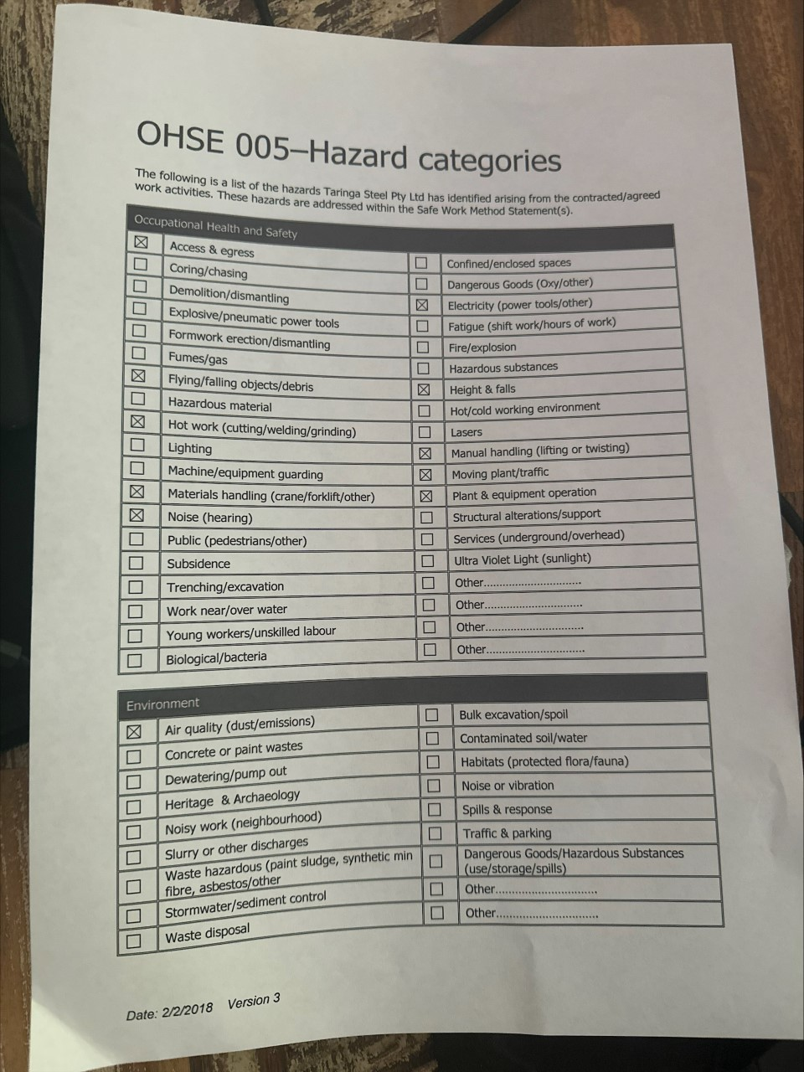
Hazard checklist

Slide 3
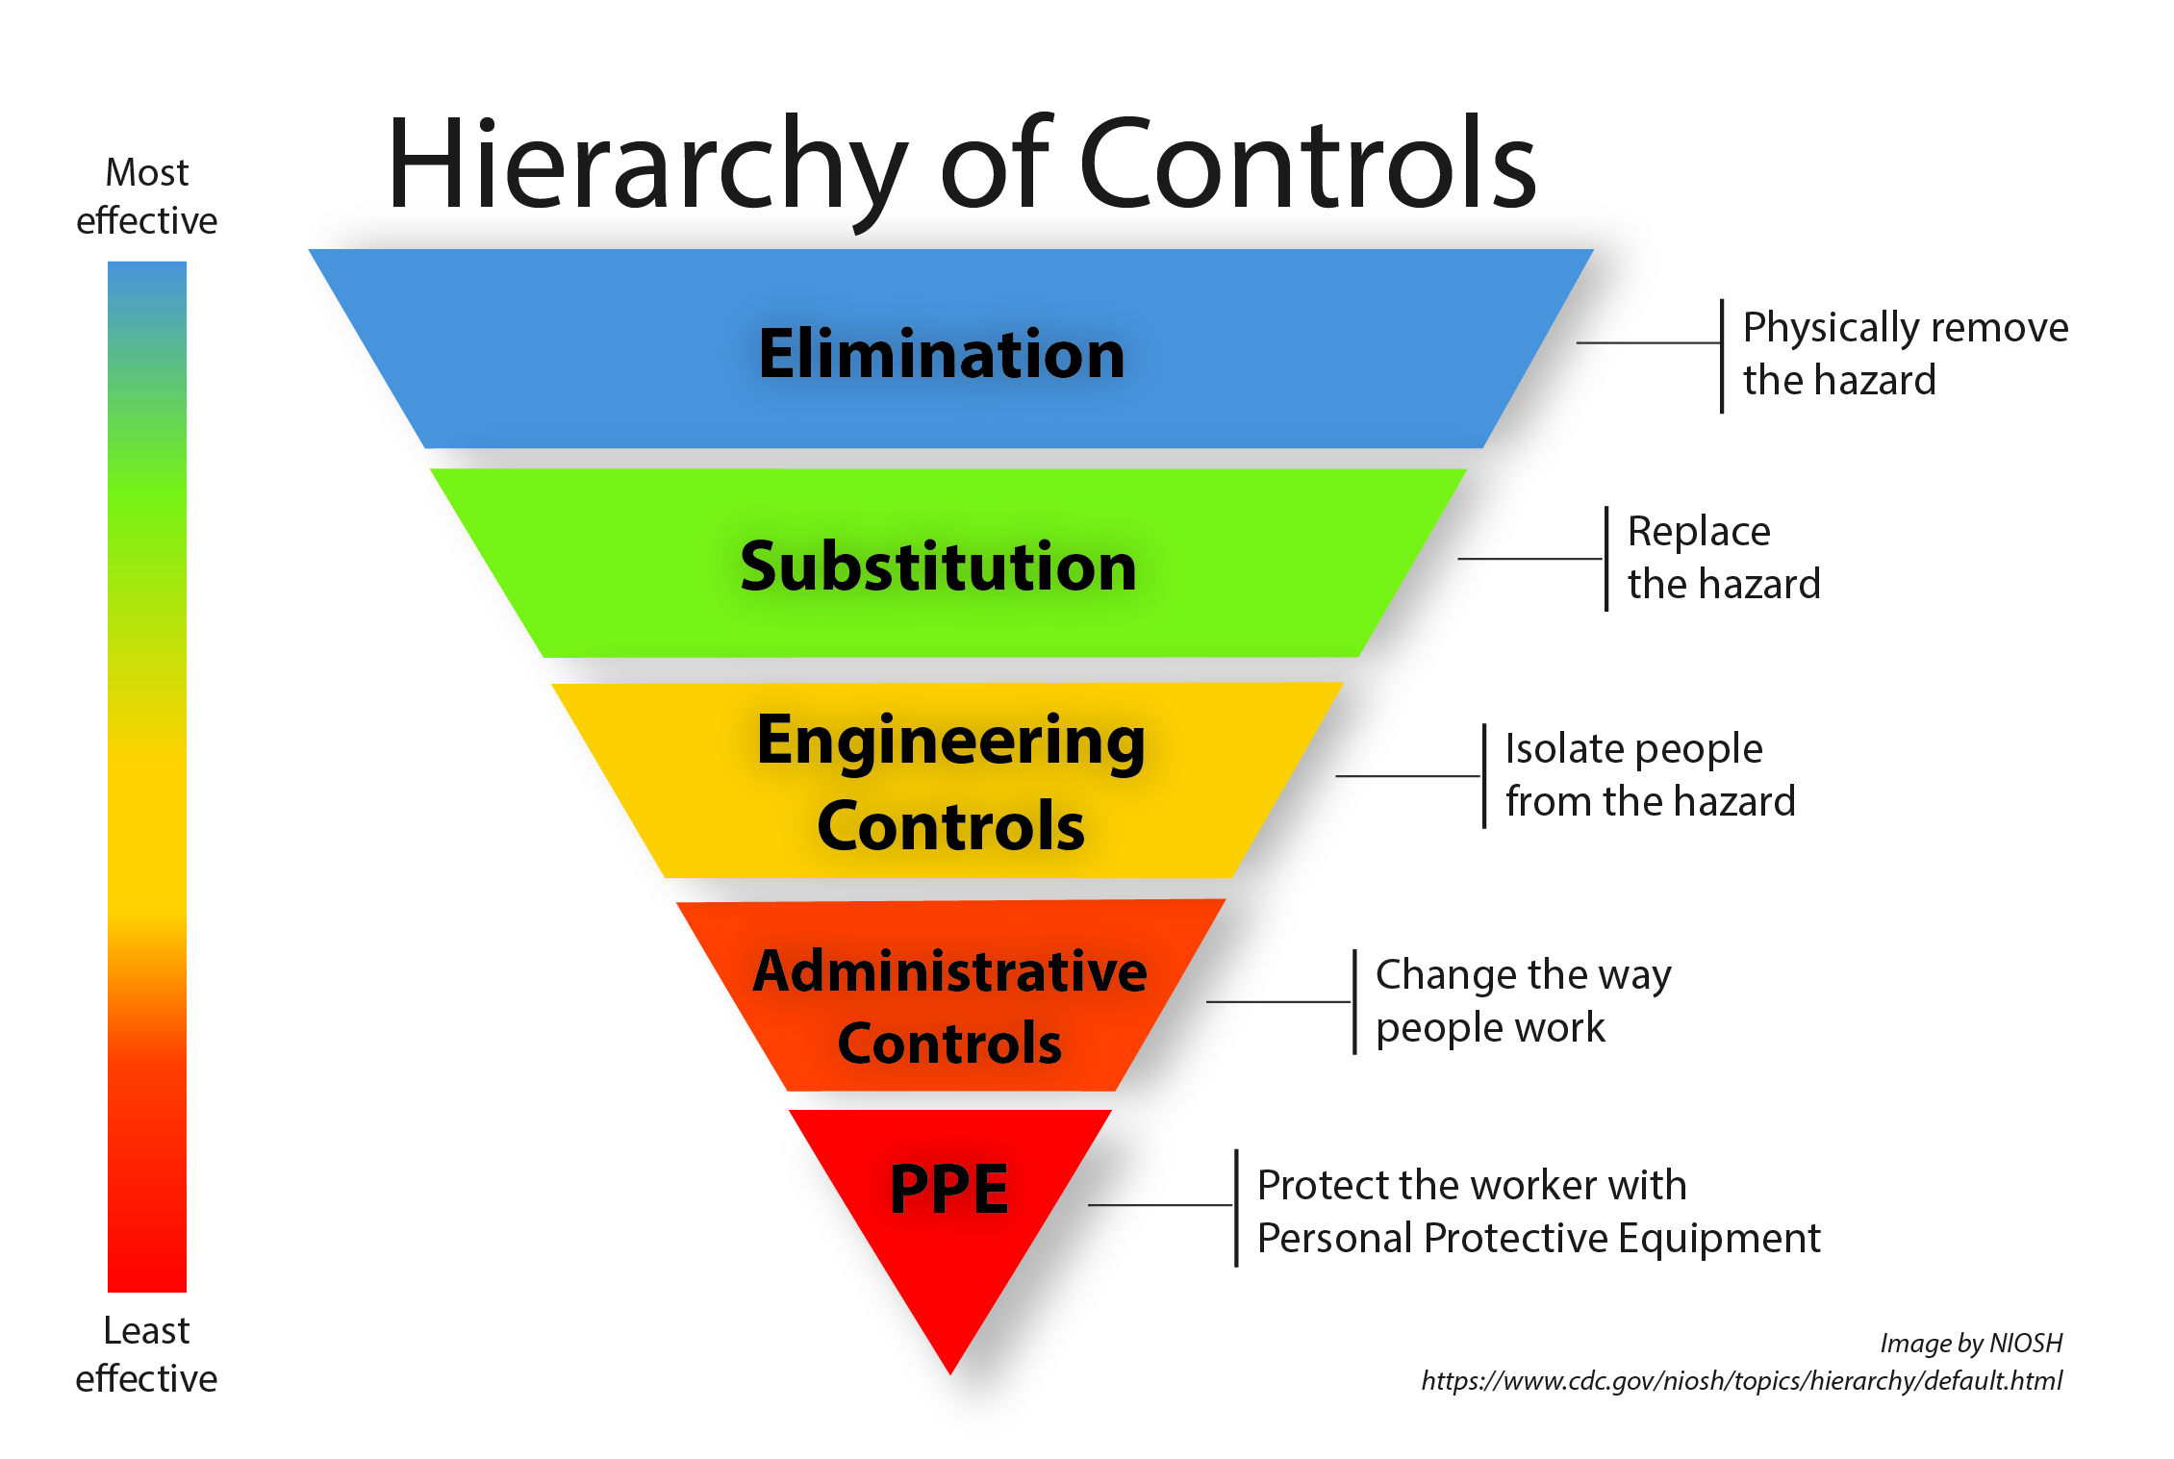
Hierarchy of controls

Slide 4
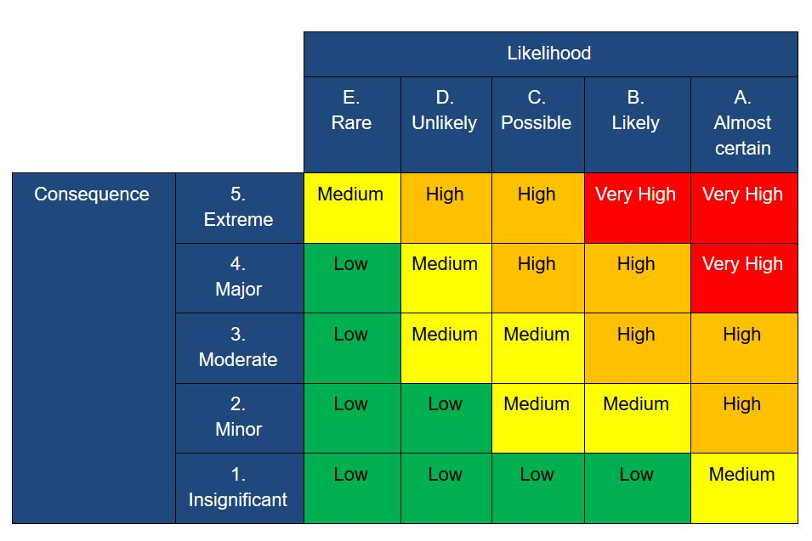
Risk matrix

Slide 5
Welding fume inhalation risk assessment.
Going off the risk matrix we put the risk of welding fume inhalation at a steel fabrication shop as a HIGH.
Using the hierarchy of control we can come to the conclusion that welding fumes cannot be eliminated in the workplace, though can be managed with several other control factors.
It is up to the pcbu to monitor the air quality the workshop employees are exposed to on work property.
It is also up to the employee to use any control measures the pcbu and safety committee have put in policy.
Section 19(3)(g) of the work health and safety act 2011 (qld) outlines that a pcbu must ensure, so far as reasonably practicable, that the health and safety of workers and the conditions at the workplace are monitored for the purpose of preventing illness and injury of workers arising from the conduct of the business or undertaking.
Section 28 of the work health and safety act 2011 (qld) outlines that workers are to comply, so far as they are reasonably able, with any reasonable instruction given by the pcbu to allow the pcbu to comply with whs laws, and cooperate with any reasonable policy or procedure of the pcbu relating to health or safety at the workplace that has been notified to workers (i.e. implement risk controls as specified by the pcbu)

Slide 6
Recommendations
My recommendations as the company Hsr as follows.
1 - Ventilation fans wherever applicable (these can be built into the ceilings to avoid pushing fumes towards other workers)
2 - The pcbu must monitor the air quality of the workplace
3 – Policies must be in place to avoid workers being exposed to welding fumes, and the pcbu must provide all control measures required (I.E. Respirators, Extraction fans, Having designated welding bays away from other workers, Welding outside)
4 – The pcbu must also monitor the msds of all welding supplies, and put control measures in place depending on the level of danger associated with different welding chemicals.

