Slide 1
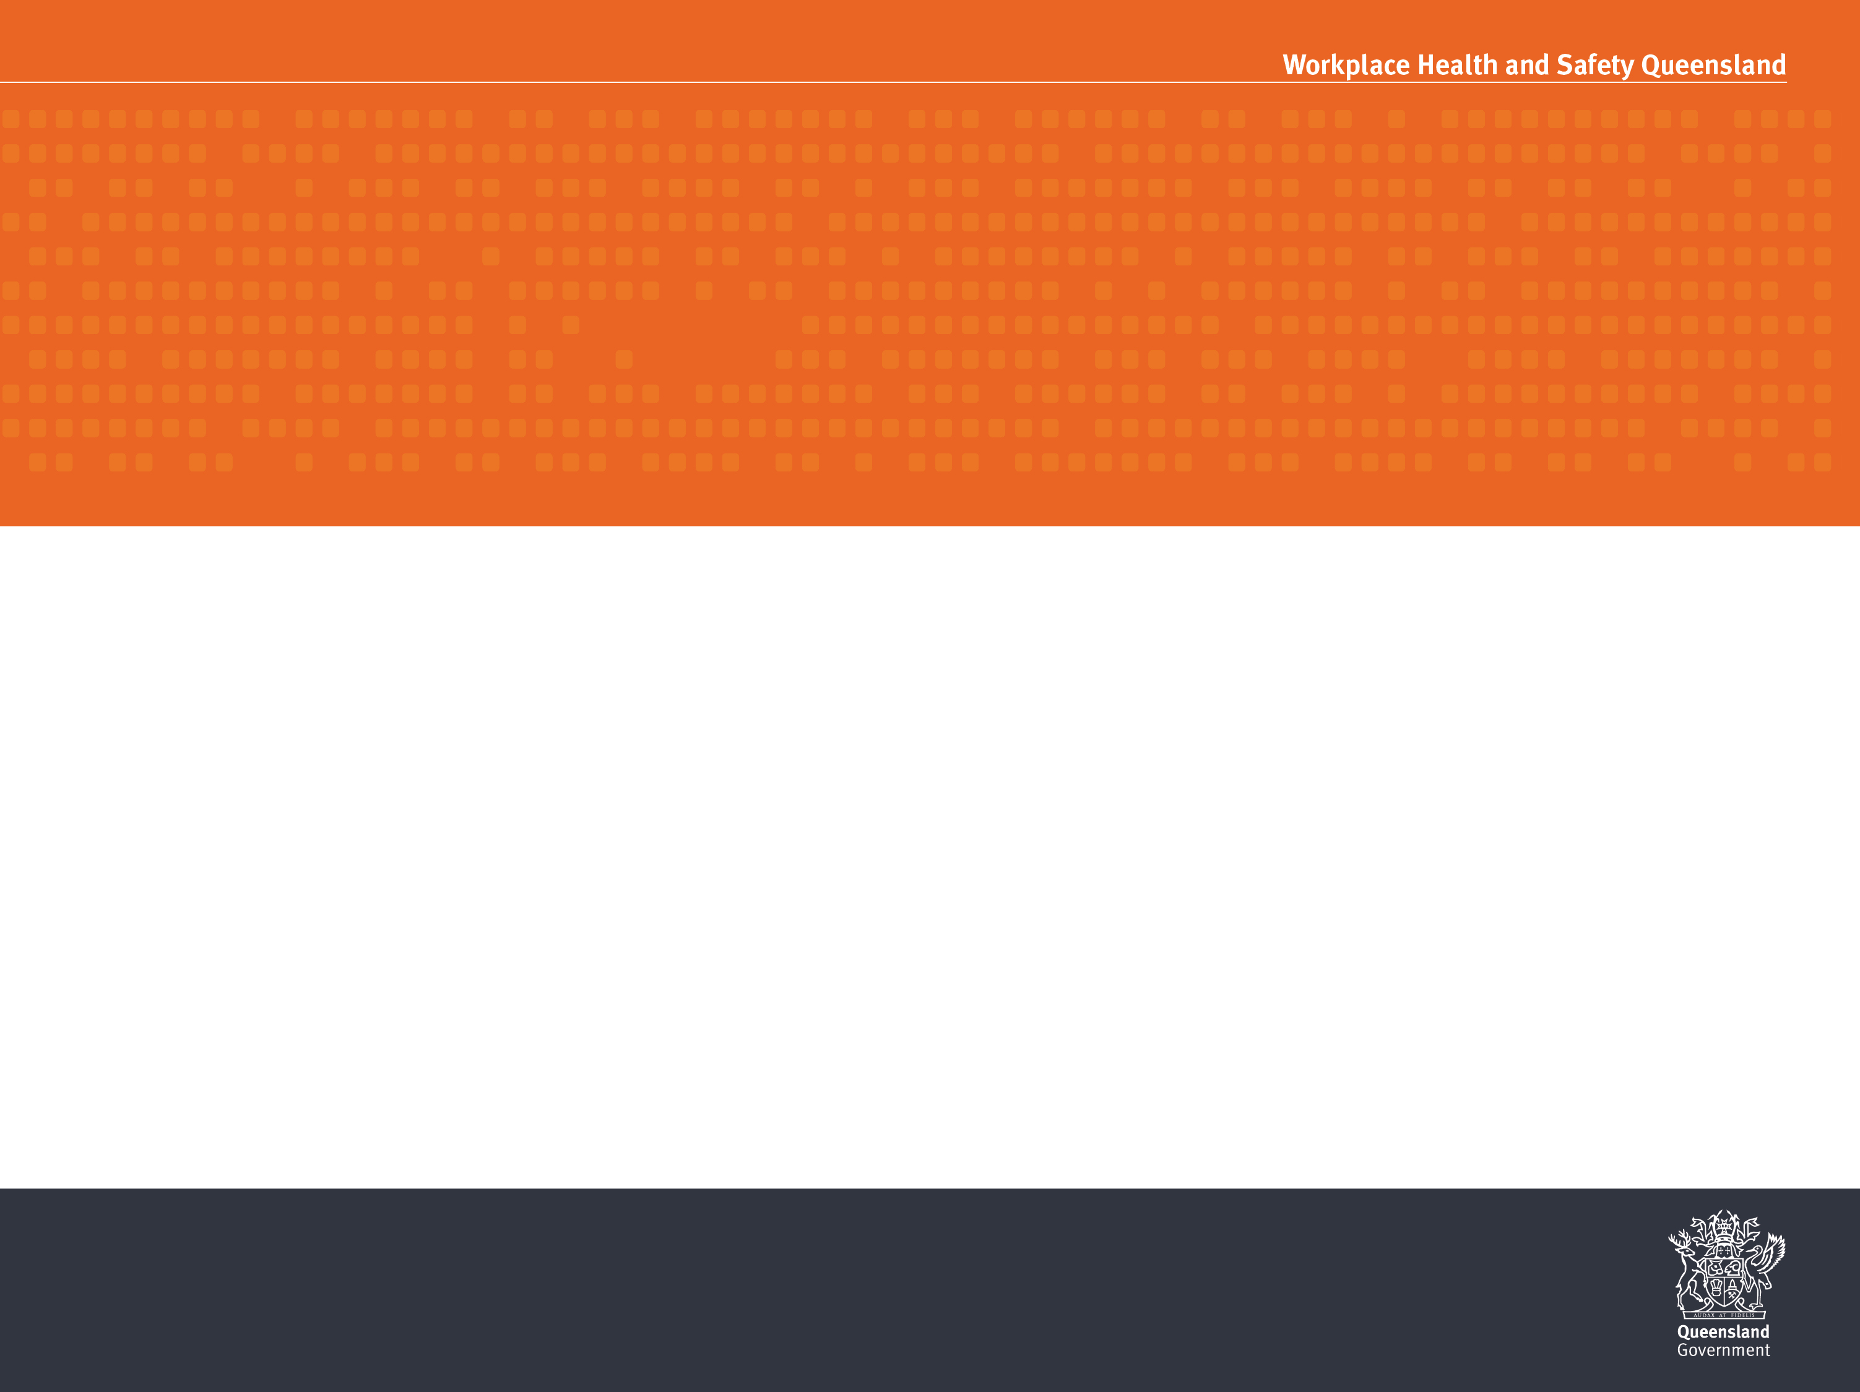
WORKING AT HEIGHTS – FALLS
WORK HEALTH AND SAFETY OFFICER

Slide 2
Assessment criteria
Describe the requirement for a Safe Work Method Statement when working at height.
Describe the hierarchy of control measures, when working at height.

Slide 3
Definitions
Fall means a fall by a person from one level to another.
Risk of a fall means a circumstance that exposes a worker while at work, or other person while at or in the vicinity of a workplace, to a risk of a fall that is reasonably likely to cause injury to the worker or other person. This includes circumstances in which the worker or other person is:
in or on plant or a structure that is at an elevated level
in or on plant that is being used to gain access to an elevated level
in the vicinity of an opening through which a person could fall
in the vicinity of an edge over which a person could fall
on or in the vicinity of a surface through which a person could fall
on or near the vicinity of a slippery, sloping or unstable surface.
high risk construction work means construction work that—
involves a risk of a person falling more than 2m

Slide 4
Duties
PCBU
Designers, manufacturers, suppliers, importers and installers
Officers
Workers

Slide 5
Working at height
Persons may be exposed to the risk of falling from a height when carrying out a construction activity on or near the following:
external faces, edges and the perimeter of buildings or structures;
penetrations in the work environment from holes cut or formed in the working surface;
roofs and floors that are in a fragile state;
means of access;
excavations;
erection and dismantling of plant and framework.

Slide 6
How to identify fall hazards
You must identify all locations and tasks that could cause injury due to a fall. This includes access to the areas where work is to be carried out. Tasks that need particular attention are those carried out:
on any structure or plant being constructed or installed, demolished or dismantled, inspected, tested, repaired or cleaned
on a fragile surface
on a potentially unstable surface
using equipment to work at the elevated level
on a sloping or slippery surface where it is difficult for people to maintain their balance
near an unprotected open edge
near a hole, shaft or pit into which a worker could fall

Slide 7
Inspect the workplace
Key things to look for include:
Surfaces
Levels
Structures
The ground
The working area
Entry and exit from working area
Edges
Holes, opening or excavations
Hand grip

Slide 8
Review available information
You should check your records of previous injuries and ‘near miss’ incidents related to falls.
Information and advice about fall hazards and risks relevant to particular industries and work activities is also available from regulators, industry associations, unions, technical specialists and safety consultants.

Slide 9
How to assess the risk
When assessing the risks arising from each fall hazard, the following matters should be considered:
the design and layout of elevated work areas, including the distance of a potential fall
the number and movement of all people at the workplace
the proximity of workers to unsafe areas where loads are placed on elevated working areas (for example, loading docks) and where work is to be carried out above people and there is a risk of falling objects
the adequacy of inspection and maintenance of plant and
the adequacy of lighting for clear vision
weather conditions—the presence of rain, wind, extreme heat or cold can cause slippery or unstable conditions
the suitability of footwear and clothing for the conditions
the suitability and condition of ladders, including where and how they are being used
the adequacy of current knowledge and training to perform the task safely
the adequacy of procedures for all potential emergency situations.

Slide 10
Control the risk
In managing the risks of falls, the WHS Regulation requires the following specific control measures to be implemented, where it is reasonably practicable to do so:
Can the need to work at height be avoided to eliminate the risk of fall?
Can the fall be prevented by working on solid construction?
Can the risk of a fall be minimised by providing and maintaining a safe system of work?

Slide 11
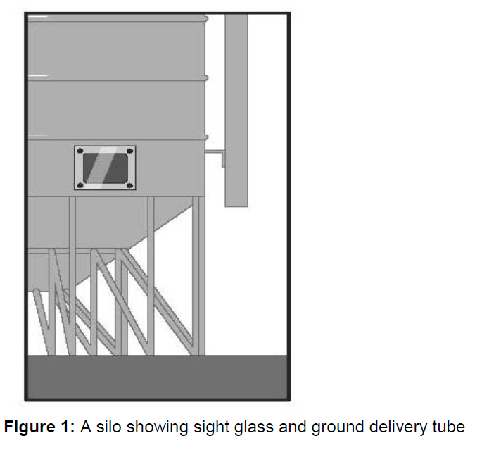
Work on the ground

Slide 12
Work on a solid construction
‘Solid construction’ means an area that:
is structurally capable of supporting workers, material and any other loads applied to it
is provided with barriers around its perimeter and around any openings from or through which a person could fall
has an even, accessible surface and gradient
has a safe means of entry and exit.

Slide 13
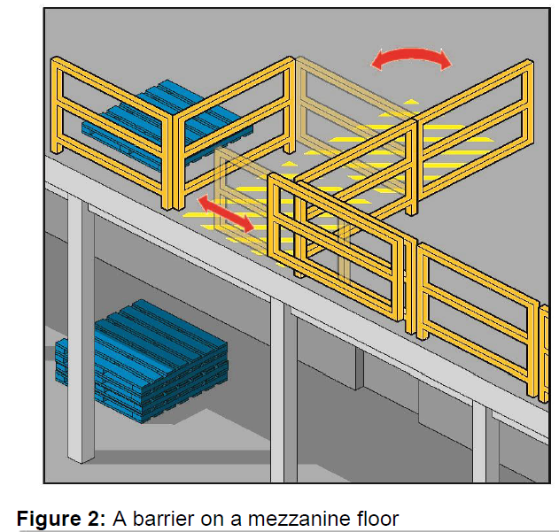
Barriers
Barriers (or edge protection) to prevent a person falling over edges and into holes should be provided on relevant parts of a solid construction.
These include:
the perimeters of buildings or other structures
mezzanine floors (see Figure 2)
openings in floors
the open edge of a stair, landing, platform or shaft opening (see Figure 3).

Slide 14
Fall prevention
A fall prevention device is any equipment that is designed to prevent a fall for temporary work at heights, and once in place does not require any further adjustment by workers using the device.

Slide 15
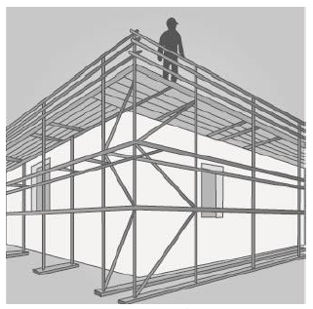
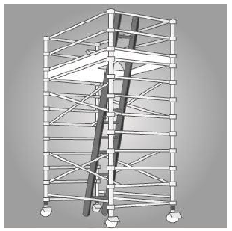
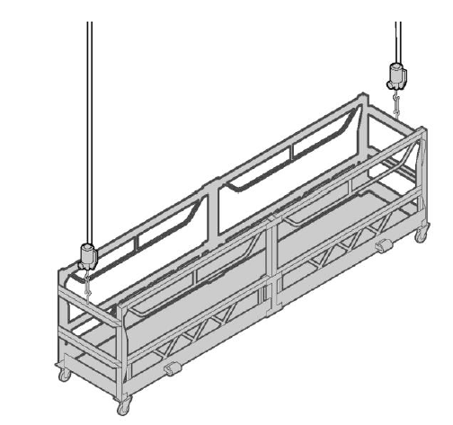
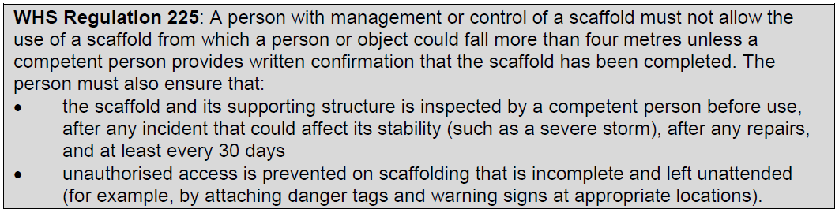
Scaffolding

Slide 16
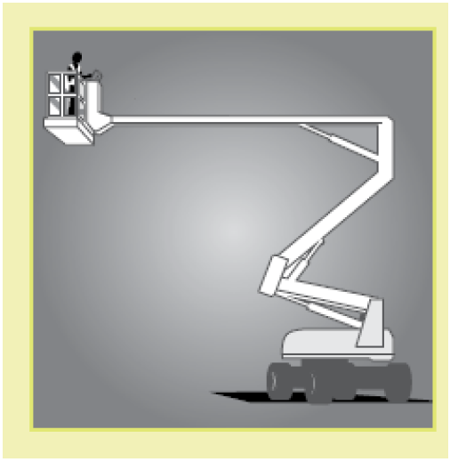
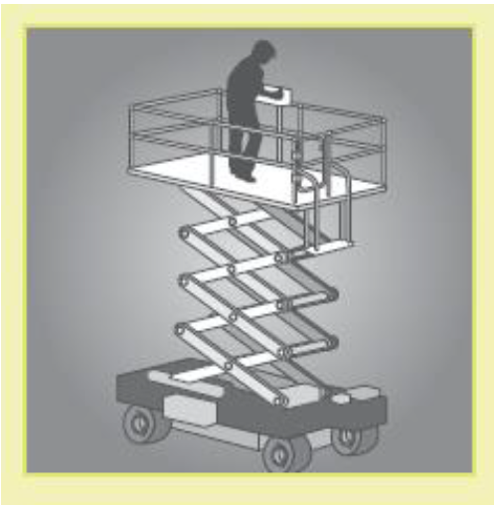
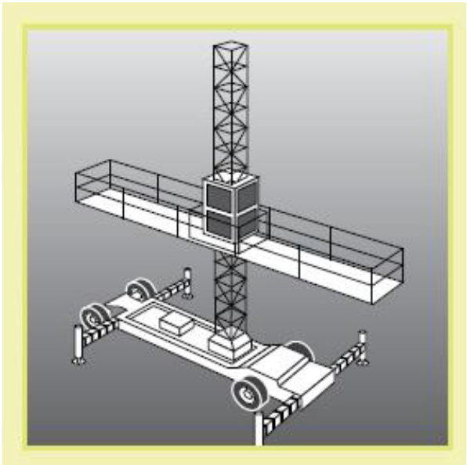
Elevating work platforms
Elevating Work Platforms (EWPs) include scissor lifts, cherry pickers, boom lifts and travel towers.

Slide 17
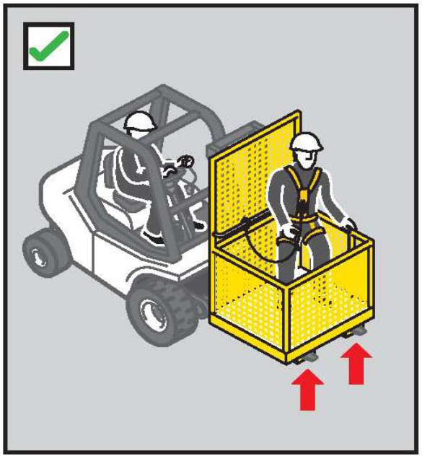
Workbox
A workbox is designed to be supported by a crane, hoist, forklift truck or other mechanical device to provide an elevated work area for persons working from the box.
Where reasonably practicable, other working platforms, such as an elevating working platform or scaffold, should be used as an alternative to the workbox.

Slide 18
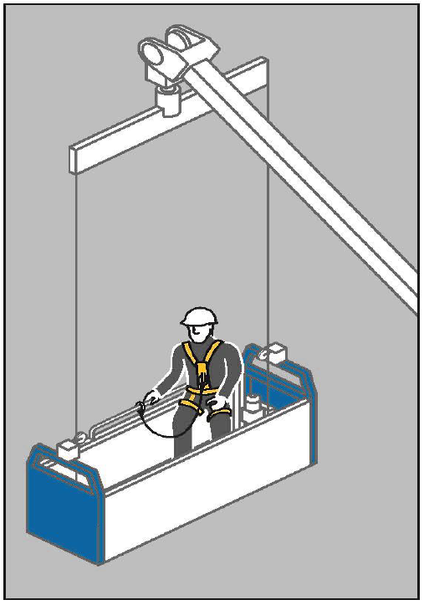
Building maintenance units
A building maintenance unit is a power-operated suspended working platform that is fixed permanently to a building or structure.
It is used for access for building maintenance or window cleaning.

Slide 19
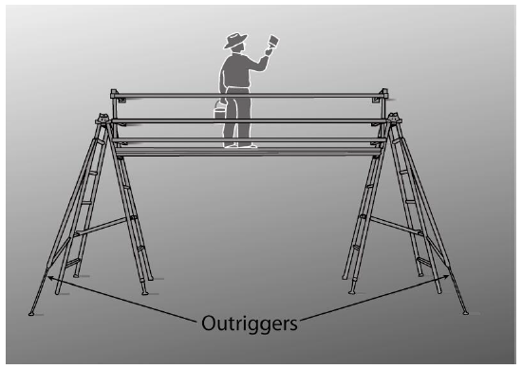
Platforms supported by trestle ladders
Trestle ladder scaffolds are only suitable for use at heights greater than two metres when guard rails and toe boards are incorporated to prevent people and material falling off the working platform.

Slide 20
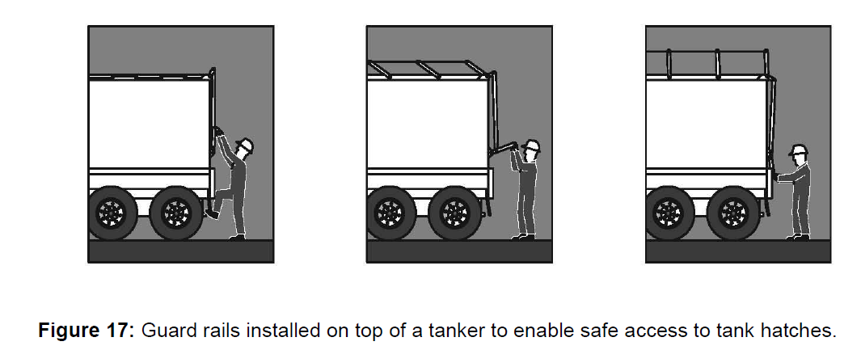
Perimeter guard rails
Guard rails may be used to provide effective fall prevention:
at the edges of roofs
at the edges of mezzanine floors, walkways, stairways, ramps and landings
on top of plant and structures where access is required (see Figure 17)
around openings in floor and roof structures
at the edges of shafts, pits and other excavations.
Guard rails should incorporate a top rail 900mm to 1100 mm above the working surface and a mid-rail and a toe board.

Slide 21
Safety mesh
Safety mesh is designed to prevent internal falls through a roof. If securely fixed, safety mesh provides fall protection for roof installers and offers long-term protection against falling for maintenance and repair workers.
Safety mesh does not prevent falls from the edge of a roof or through holes in a roof, so it should always be used in conjunction with appropriate edge protection, guard rails or fall-arrest systems.

Slide 22
Control measures after a person has fallen
The use of control measures to “catch” a person after the person has fallen should only be used where it is not possible to provide any other more reliable means of fall protection.

Slide 23
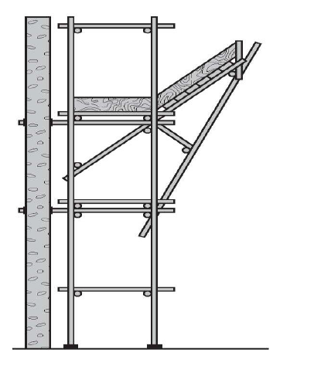
Catch platforms
A catch platform is a temporary platform located below a work area to catch a worker in the event of a fall. The platform should be of robust construction and designed to withstand the maximum potential impact load. Scaffolding components may be used to construct fixed and mobile catch platforms (see Figure 20).
Figure 20: An example of a catch platform below a work area.

Slide 24
Industrial safety nets
Safety nets can provide a satisfactory means of protection while allowing workers maximum freedom of movement. They should not be used to enter or exit a work area or as a working platform.

Slide 25
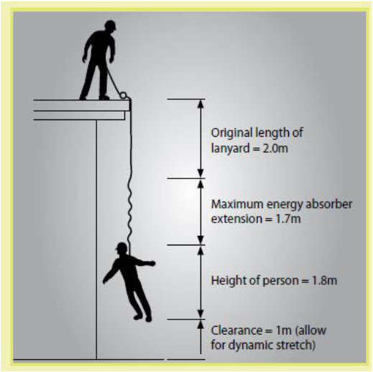
Industrial fall-arrest systems
Individual fall-arrest systems consist of some or all of the following components:
anchorages
lifelines
inertia reel
lanyard of fixed length
retractable lifelines
rope grabs
wire grabs
rail system
shock absorbers, both personal and industrial
harness
snap hooks (double or triple action to prevent rollout)
karabiners (double or triple action to prevent rollout)
rescue equipment

Slide 26
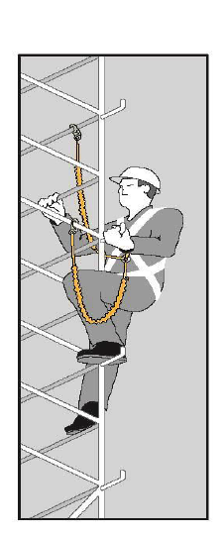
Anchorage lines or rails
Anchorage lines or rails are temporary or permanent fall-arrest systems, which can be installed to provide continuous fall protection for persons using ladders or climbing towers.
These can be used on plant, such as tower cranes, as well as buildings or structures.

Slide 27
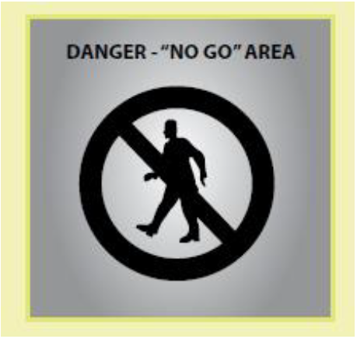
Administrative controls
Administrative controls may be used to support other control measures and may include ‘no go’ areas, permit systems, the sequencing of work and safe work procedures. Using administrative controls exclusively to minimise the risk of falls is only appropriate when it is not reasonably practicable to use a higher order control.

Slide 28
Safe work method statement
A safe work method statement is one of the tools used to manage workplace health and safety at a construction workplace and must be prepared before high risk construction work is carried out.

Slide 29


