Slide 1

CRANES, HOISTS AND LIFTING GEAR
WORK HEALTH AND SAFETY OFFICER

Slide 2
Assessment criteria
List at least three types of plant used in a workplace for each of the following - cranes, hoists and lifting gear.
Describe the statutory or minimum requirements relating to cranes, hoists and lifting gear.
Describe the control strategies to be adopted in the operation and use of cranes, hoists and lifting gear with reference to current standards.

Slide 3
Definitions
WHS Regulation 2011 schedule 19 defines a Crane as an appliance intended for raising or lowering a load and moving it horizontally including the supporting structure of the crane and its foundations, but does not include any of the following:
    (a) an industrial lift truck;
    (b) earthmoving machinery;
    (c) an amusement device;
    (d) a tractor;
    (e) an industrial robot;
    (f) a conveyor;
    (g) building maintenance equipment;
    (h) a suspended scaffold;
    (i) a lift.

Slide 4
Definitions
Australian Standard AS1418 defines the following:
Hoist means an appliance intended for raising or lowering a load or people, and includes an elevating work platform, a mast climbing work platform, personnel and materials hoist, scaffolding hoist and serial hoist, but does not include a lift or building maintenance equipment.
Mobile crane means a crane capable of travelling over a supporting surface without the need for fixed runways and relying on gravity for stability.
Non-slewing mobile crane means a mobile crane incorporating a boom or jib that cannot be slewed, and includes―
An articulated mobile crane; or
A locomotive crane;
But does not include vehicle tow trucks.

Slide 5
Planning
Matters to be considered:
Establishment of a management plan.
Selection of cranes.
Obtaining authorisations.
Requirements of regulatory authorities.
Site access and crane siting.
Protection and safety of public.
Proximity of power lines and other services.
Procedures for the setting up and dismantling of the crane and the method of lift.
Makeup of the crane crew, which may include: erection crew, crane operator, doggers, spotters, riggers, power line observers and persons under training or instruction
Communication system.
Weather conditions.
Ground conditions.
Proximity of excavations.
Selection of lifting gear.
Personal safety equipment.
Emergency procedures.
Inspection, maintenance and repair.
Lightning protection.
The documentation of work procedures where the lifting operation is not a routine type, eg. multiple crane lifting.
Consultation and co-ordination with other groups working in the area.
Night operations.

Slide 6
Crane selection
To be considered:
the mass of the load to be lifted
the nature of the load to be lifted
the speed and frequency of operation
the maximum load that will be imposed on the crane
the nature of the rigging or slinging to be used
the position from which the load is to be lifted
the position to which the load is to be placed
the movement limitations of the crane and the load
Other limitations of the crane
Where multiple crane lifting is involved -
  how the load is to be proportioned;
  how the load proportioning is to be maintained;
  whether the cranes have appropriate additional capacity over the proportioned load to be lifted; and
  the operating characteristics of the crane, e.g. speed of hoisting.
the environmental factors.

Slide 7
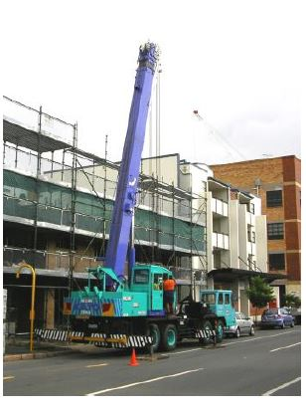
Maintenance, Inspection and repair
Inspection
Major Inspection
Worn or serviceable parts
Log maintenance

Slide 8
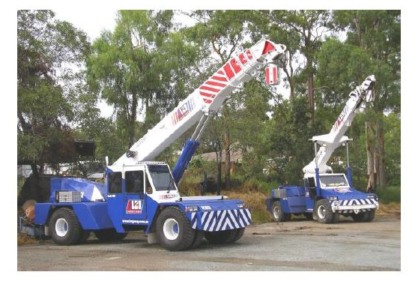
Safe crane operation

Slide 9
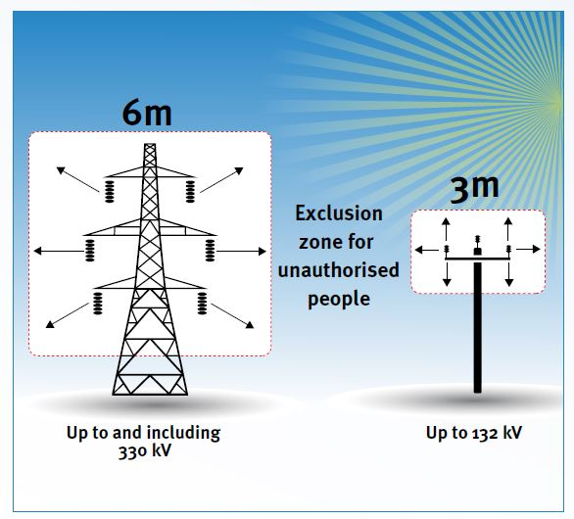
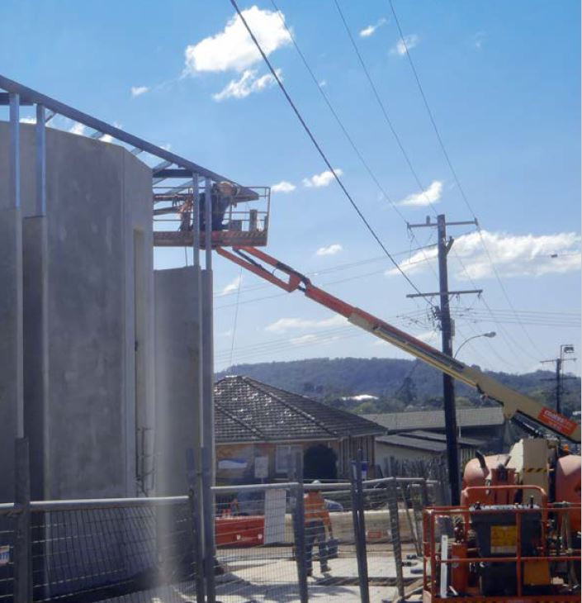
Operation near overhead power lines

Slide 10
Suspension of persons by crane
Requirements for a workbox
Requirements for the Crane Used With a Workbox
Operation of the Crane with Suspended Personnel

Slide 11
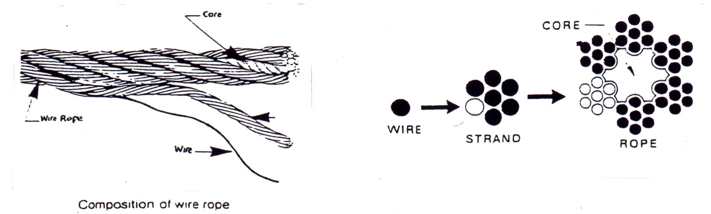
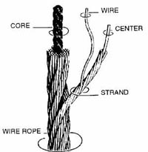
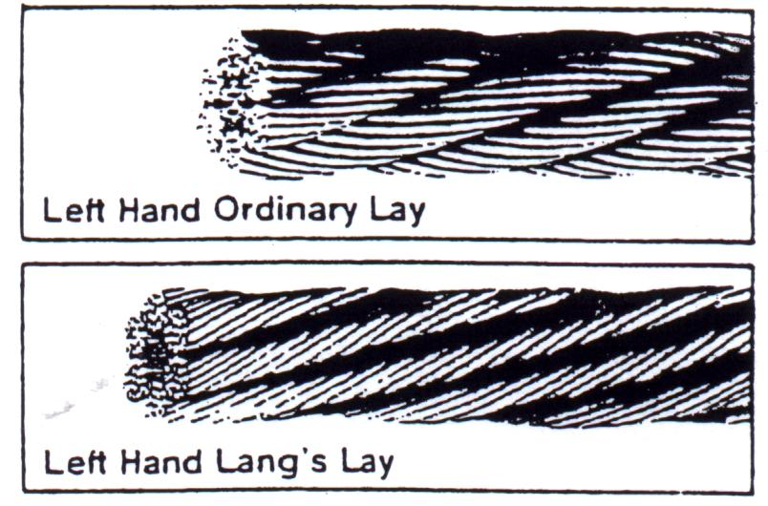
Steel wire rope

Slide 12
Chains
Inspection Criteria
  Stretched links or deformation
  Rust
  Bent or deformed link
  Peen Marks (Work Harding)
  Safe Working Load Tag
  Pitting
  10% wear on any component
  Identification markings
  Chemical attack
  Knots
  Pin Wear (Hammerlocks)
  Cracks
  Heat exposure

Slide 13
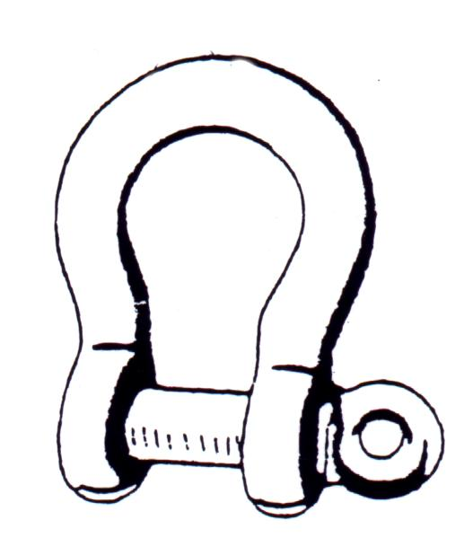
Shackles
Check for wear
Check for wear and straightness
Check that pin is always seated
Check that shackle is not ‘opening up’

Slide 14
Eye Bolts
Inspection Criteria
  Capacity of eyebolt in regard to weight to be lifted.
  Markings (either imperial or metric)
  Thread of eyebolt
  Eye and body of eyebolt
  Collar
  Cracks/Fatigue
  Nicks/Gouges
  Rust - in countersunk hole

Slide 15


