Slide 1

HAZARDOUS CHEMICALS
WORK HEALTH AND SAFETY OFFICER

Slide 2
Assessment Criteria
Identify what is a hazardous chemical under the Regulation.
Identify the physical and health hazard/s that may be presented by a hazardous chemical
Identify how a manufacturer/importer can communicate hazards to workers.
Describe the requirements for a compliant safety data sheet.
Describe the requirements for a container label for hazardous chemicals.
Describe the process for identifying appropriate risk control measures for hazardous chemicals
Identify relevant guidance material on risk control measures for hazardous chemicals
Describe specific notification requirements for hazardous chemicals.

Slide 3
Legislation
WHS Act 2011
WHS Regulation 2011
Managing Risks of Hazardous Chemicals in the Workplace Code of Practice 2013
Preparation of Safety Data Sheets for Hazardous Chemicals Code of Practice 2011
Labelling of Workplace Hazardous Chemicals Code of Practice 2011

Slide 4

What is a hazardous chemical?
A hazardous chemical is any substance, mixture or article that satisfies the criteria of one or more of the Globally Harmonised System of classification and labelling of chemicals (GHS) hazard classes, including a classification in Schedule 6 of the Regulation.

Slide 5
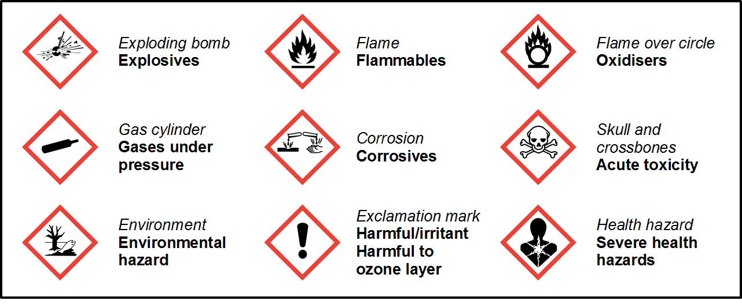
Globally harmonised system (GHS)

Slide 6
Safety Data Sheets (SDS)
The SDS is an important tool for communicating the inherent physical hazards and health hazards to workers and other persons that may be affected by its storage, handling or use. It also serves to inform the hazardous chemical risk management processes at a workplace.
There are specific duties in relation to the preparation and access of safety data sheets.

Slide 7
Content of the Safety Data Sheet
Section 1 – Identification: Product identifier and chemical identity
Section 2 – Hazard(s) Identification: GHS Classification of the hazardous chemical
Section 3 – Composition and Information on Ingredients
Section 4 – First Aid Measures
Section 5 – Fire Fighting Measures
Section 6 – Accidental Release Measures
Section 7 – Handling and Storage: Precautions for safe handling; any incompatibilities
Section 8 – Exposure controls and personal protection
Section 9 – Physical and Chemical Properties
Section 10 – Stability and Reactivity: Possibility of hazardous reactions, Conditions to avoid incompatible materials, Hazardous decomposition products
Section 11 – Toxicological Information: Information on possible routes of exposure; Exposure levels and health effects;
Section 12 – Ecological Information
Section 13 – Disposal considerations
Section 14 – Transport Information
(Note: contains dangerous goods classification information which is relevant to placards and manifest information)
Section 15 – Regulatory Information
Section 16 – Other information

Slide 8
Registers
A PCBU must ensure that a register of hazardous chemicals at the workplace is prepared and kept up to date.
Register must be readily available to workers involved in using, handling or storing hazardous chemicals and to anyone else who is likely to be affected by hazardous chemicals at the workplace.

Slide 9
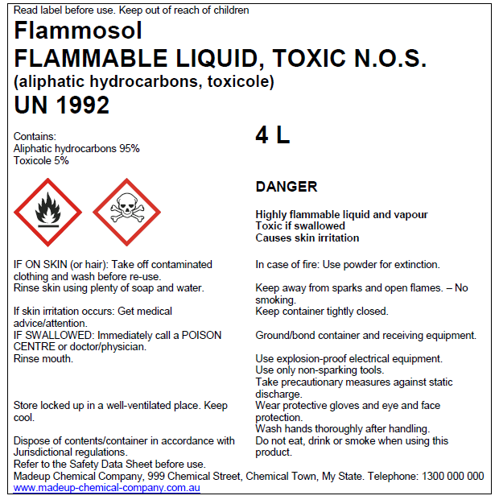
Labelling Containers
What is needed on a label?
Transport labelling versus workplace labelling requirements
Specific labelling situations
Unlabelled containers/unknown contents
Example GHS

Slide 10
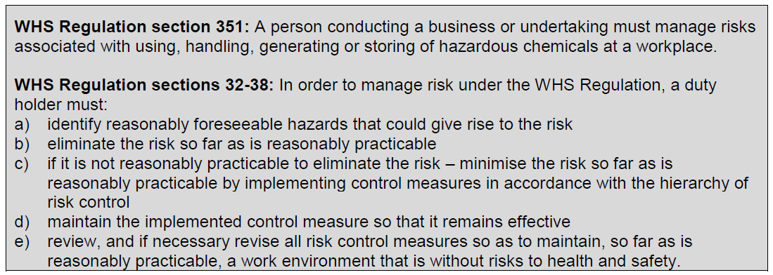
Risk management

Slide 11
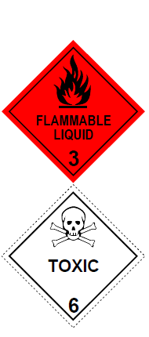
Safety Signs
Along with container labels and the provision of SDS, safety signs and placards contribute to the hazard communication system at a workplace.

Slide 12
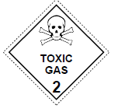
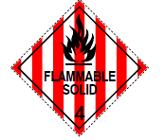
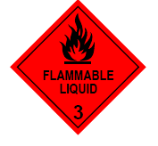
Placards
Placards are a special type of safety sign that contains information about the hazardous chemical stored in the container or storage area and are to be displayed in a prominent place, or next to a container or storage area for hazardous chemicals at a workplace. Placards serve to:
alert people (workers, contractors, visitors and emergency service personnel) to the presence of hazardous chemicals
identify hazardous chemicals stored in bulk (e.g. tanks)
identify areas where significant quantities of hazardous chemicals in packages are stored
identify the hazards of goods present, and indicate the required emergency actions for hazardous chemicals in tanks through the use of the HAZCHEM code.

Slide 13
Identification of reactions
Some hazardous chemicals are reactive in nature and can create new hazards if it interacts with other substances or materials (not just other hazardous chemicals).

Slide 14
Fire and explosion prevention
A PCBU must ensure an ignition source is not introduced into a hazardous area (from outside or within the space). A hazardous area should be identified and classified by a competent person and a plan detailing the extent of the areas be kept as a reference and be used to support the implementation of appropriate fire and explosion prevention measures.
Hazardous area is defined in the Regulation as an area in which an explosive gas/combustible dust is present in the atmosphere in a quantity that requires special precautions to be taken for the construction, installation and use of plant.

Slide 15
Ignition sources - control measures
identifying, classifying and managing hazardous areas
controlling emissions of flammable vapours, gases and mists (see below)
use of ventilation systems to control vapours during both normal and abnormal conditions (e.g. leak or spill)
eliminating ignition sources from hazardous areas (see below)
installing systems to detect leaks of flammable gases or vapours and enable response actions to be taken
using intrinsically safe or flameproof equipment
substituting flammable materials for ones that are less flammable or combustible
ensuring incompatible materials (e.g. oxidizers and oils) are separated or segregated
reducing quantities of flammable and combustible materials, including items that contribute to the fire load but that are not hazardous chemicals themselves (e.g. wooden pallets, oil)
ensuring equipment used in handling flammable hazardous chemicals is maintained in accordance with manufacturer's instructions
adopting good housekeeping practices to minimise accumulation of combustible dusts.

Slide 16
Keeping hazardous chemicals stable
Some hazardous chemicals are inherently unstable or highly reactive, or they can become unstable under certain conditions during use, often in a deliberate process.
Always check the product’s SDS for any conditions that may affect its stability and conditions to avoid.

Slide 17
Identification of contents
The hazardous chemical contents of storage and handling systems must be identified and specific requirements apply depending on the type of storage and handling system. For example:
packages require correct labelling (section 342)
bulk containers require tank placards displaying the proper shipping name, UN Number, Hazchem code and dangerous goods class label as specified in the ADG Code (section 350)
pipework is identified by a label, sign or another way on or near the pipework (section 343).

Slide 18
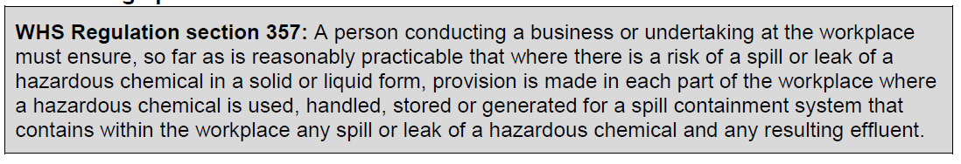
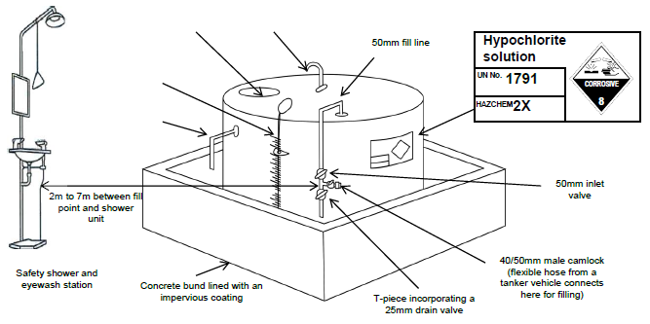
Containing spills

Slide 19
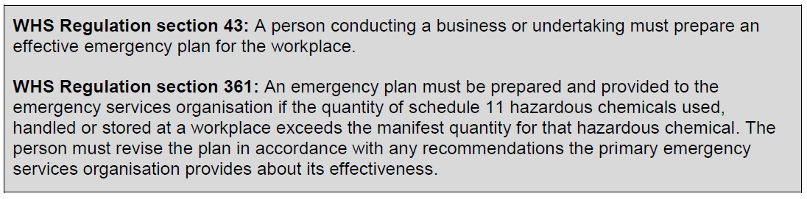
Emergency Plan

Slide 20
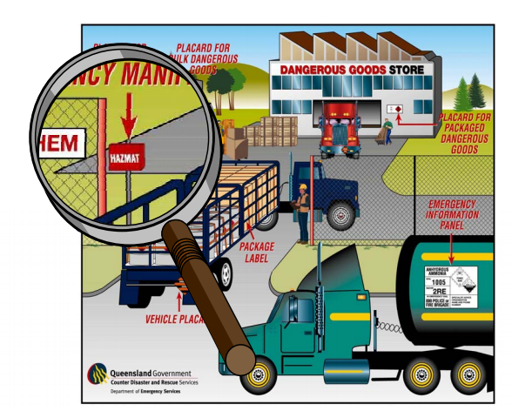
Manifests

Slide 21
Fire protection and equipment
Regulation section 359 requires a PCBU to ensure the workplace is provided with fire protection and firefighting equipment that is designed and built for the types of hazardous chemicals at the workplace:
in the quantities in which they are used, handled, generated or stored, and
the conditions under which they are used, handled, generated or stored, having regard to:
the fire load of the hazardous chemicals
the fire load from other sources
the compatibility of the hazardous chemicals with other substances and mixtures at the workplace.

Slide 22
Maintaining control measures
Maintenance of control measures may involve the following:
regular inspections of control measures
supervision to ensure workers are using the control measures properly
preventative maintenance and testing programs for chemical storage and handling systems
periodic air monitoring to ensure that engineering and administrative controls remain effective.

Slide 23
Notification requirements
Notification of hazardous chemicals above manifest quantities – Form 73
Notification of the presence of schedule 15 chemicals in excess of 10 per cent of the prescribed quantities for a major hazard facility – Form 69
Construction or operation of a hazardous chemicals pipeline that enters a public place – Form 70
Presence of an abandoned underground tank that has been used to store flammable gas or flammable liquid – Form 72

Slide 24


