Slide 1

BSBSMB403
Market the small business

Slide 2

Housekeeping
Emergency procedures
Mobiles and security issues
Break times and smoking policy
This course is interactive – ask questions
Practise respect and confidentiality
Ground rules

Slide 3
Objectives
Discover how to develop marketing strategies
Know how to determine a marketing mix for the business
Learn how to implement marketing strategies
Understand how to monitor and improve marketing performance
Gain the skills and knowledge required for this unit

Slide 4

Develop marketing strategies
1.1 Analyse the business and its key products or services to determine focus of marketing activities, in accordance with objectives of the business plan

Slide 5
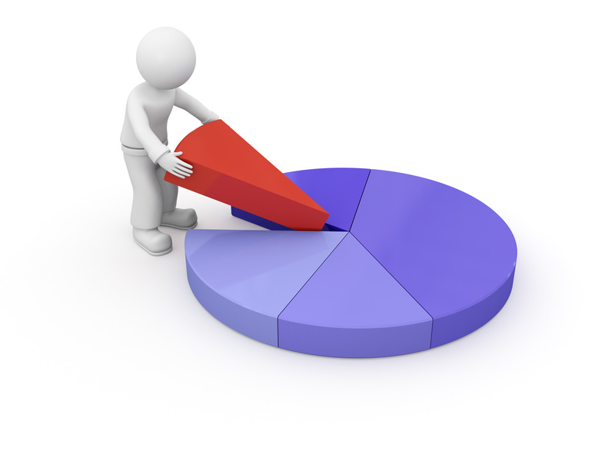
Analysing the business
To focus on results, you should:
Create an integrated annual marketing plan
Determine your content strategy
Determine ROI optimisation (return on investment).

Slide 6
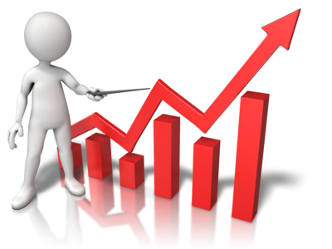
Analysing the business
You need to ask:
Where will most of your small business growth come from?
What approach to growth will you take?
How can you retain clients?
New products/services evaluations
What do you need to do differently?

Slide 7

Activity 1A

Slide 8
Develop marketing strategies
1.2 Analyse the business and its key products or services to determine focus of marketing activities, in accordance with objectives of the business plan

Slide 9
Customer base
You will need to consider your target audience.
Demographic bases | Age, family size, life cycle, occupation
Geographic bases | States, regions, countries
Behaviour bases | Product knowledge, usage, attitudes, responses
Psychographic bases | Lifestyle, values, personality

Slide 10
Activity 1B

Slide 11
Develop marketing strategies
1.3 Conduct a competitor analysis to inform development of marketing strategies

Slide 12
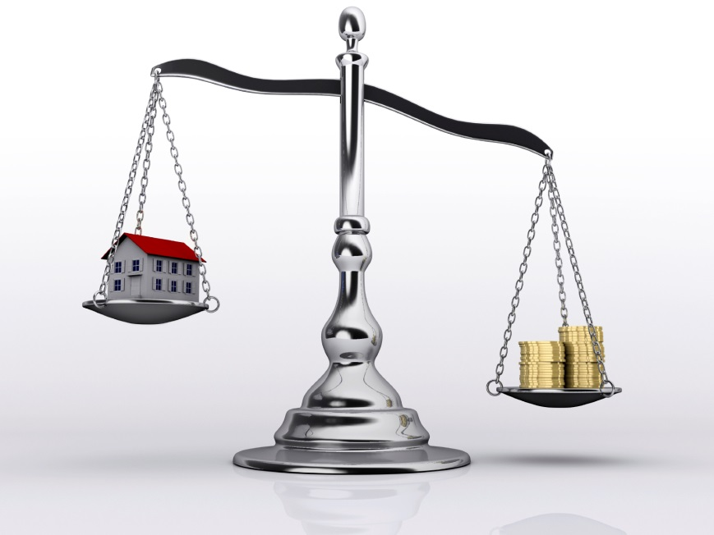
Competitor analysis
Competitor analysis is the process of comparing your organisation’s services against those in other organisations you are competing against.
You may have to compare your service’s:
Products
Speed
Efficiency
Customer satisfaction
Price.

Slide 13
Develop marketing strategies
1.4 Determine marketing objectives in consultation with relevant people and in accordance with the business plan

Slide 14

Marketing objectives
Marketing objectives may include:
Reaching potential clients
Increasing revenue
Increasing brand recognition
Achieving lower costs of production and distribution than competitors
Creating a very different product line or service so that the business becomes a class leader in the industry.

Slide 15

Consulting with relevant people
Relevant people may include:
Accountant or other specialist services
Family members, work team members, sub-contractors, community members
Franchise agency
Financial backers, clients
Owners and partners
Regulatory bodies
Trade or industry associations.

Slide 16
Develop marketing strategies
1.5 Ensure strategies are ethically and culturally appropriate and aligned with customer and industry expectations

Slide 17

Ethical considerations
Ethical considerations may include:
Privacy of clients and employees
Providing a safe workplace as defined by WHS legislation
Fair treatment of all people, regardless of age, gender, race, religion and views.

Slide 18

Cultural differences
Cultural differences may change the way people:
Eat and drink
Dress
Communicate with others, particularly members of the opposite sex
Pray
View the world.

Slide 19
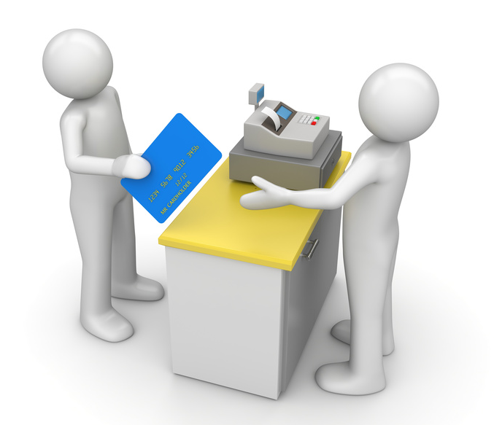
Customer and industry expectations
Customer expectations are what the customer believes is acceptable; if you don’t meet these expectations, they may negatively respond to the marketing. There is a range of ways to identify customer expectations. These include speaking to them through surveys, interviewing customers and researching competitors.

Slide 20
Activity 1E

Slide 21
Determine a marketing mix for the business
2.1 Assess product mix, volumes and pricing opportunities to determine marketing focus and optimise profit

Slide 22

Product mix, volumes and pricing options
The generally accepted marketing order is:
Product
Price
Place
Promotion.
For the product, consider the benefits of it, the presentation, packaging, style, quality and warranty.

Slide 23

Product mix, volumes and pricing options
Price is ultimately derived by the interaction of supply and demand. Products and services in a variable industry market make it more difficult to set pricing.
Your products or services will require distribution. You may have products or services suitable for retail stores or maybe they can be placed directly to consumers.

Slide 24

Volume
This will generally impact calculations and marketing strategies that deal with “Cost-Volume-Profit Analysis”.
This deals with how costs and profits change with a change in volume. It analyses the effects on profits of changes in such factors as variable costs, fixed costs, selling prices, volume, and the mix of products sold.

Slide 25

Optimising sales and profit
To “optimise” something is to “make the best or most effective use of it”.
Using the examples above of balancing your product mix, volumes and pricing, this should lead to optimising your sales and eventual profits. Obviously, just applying product mix, volumes and pricing will not guarantee optimisation of sales. This depends on other complimentary sales tools.

Slide 26
Activity 2A

Slide 27
Determine a marketing mix for the business
2.2 Evaluate costs and benefits of using different distribution channels or providing different levels of customer service, and consider results in determining marketing mix

Slide 28

Distribution channels
Distribution channels may include:
Dealer, re-seller, franchisee
Distributor, delivery service
Self-access, wholesale, retail.
Levels of customer service may include:
After sales service
One-on-one personal service
Sales assistance for problems/queries only.

Slide 29
Multi-level channels
Distribution channels may be single or multi-level.
Manufacturer or provider
Consumer
Manufacturer or provider
Retailer
Consumer
Manufacturer or provider
Wholesaler
Retailer
Consumer

Slide 30
Benefits
 | Benefits | Questions
Simple two-level channel structure | The most efficient methodology | If it were always good for doing business, the need for other channels of distribution would not be necessary?
Using multi-level distribution channels | Improved efficiency A better range of products Easier searching for goods as well as customers | In terms of efficiency there is an effect of diminishing returns as more channels are added to the list of distribution.

Slide 31
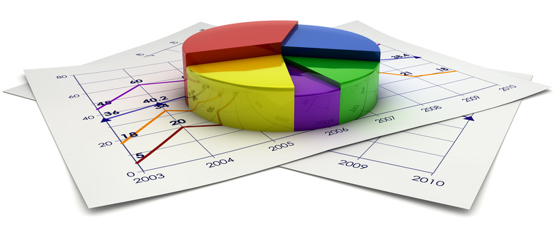
Selecting the right channels
The distribution channels selected by a small business owner should be:
Close to the desired market
Able to provide necessary services to buyers
Able to handle local advertising and promotion
Experienced in selling compatible product lines
Solid financially
Cooperative and reputable.

Slide 32
Activity 2B

Slide 33
Determine a marketing mix for the business
2.3 Determine marketing and promotional activities including the role of digital engagement to suit target market

Slide 34
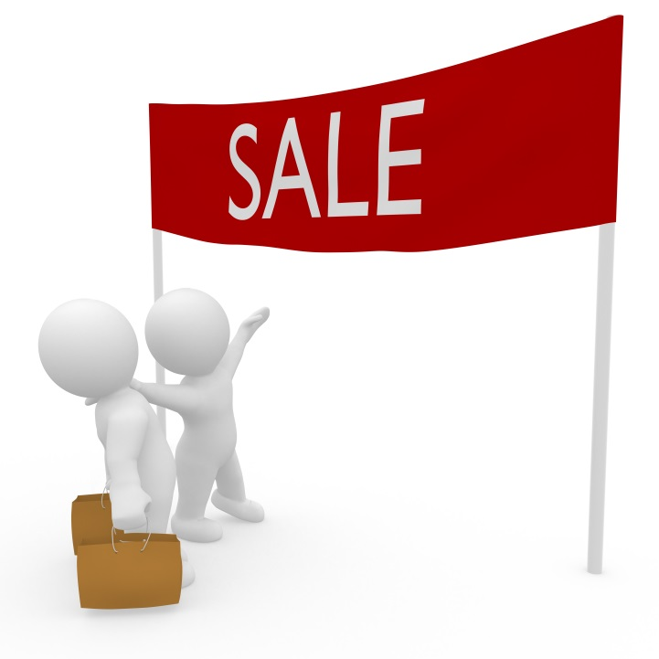
Marketing and promotional activities
Promotional activities to suit the target market are essentially the advertising and promotion section of your marketing plan.
How are you going to deliver your “selling propositions” to your prospective customers?

Slide 35

Advertising
In today's business environment, more money can be wasted on advertising than on anything else. Too many small businesses place poorly designed ads in media channels that don't reach their target markets.
They waste precious money and resources. If you will do your market research, you will know who your target is and the information you gather will help you decide the best way to reach them.

Slide 36

Marketing and promotional activities
The most important thing to consider in advertising is to plan campaigns:
Placing a single ad in any medium will be a wasted effort
Make sure you have regular placements with a consistent-looking ad
The message should be similar and each ad should have a nice feel.

Slide 37

Sales promotion
If it's appropriate to your small business, you may want to incorporate sales promotion activities into your advertising and promotion plan:
Offering free samples
Coupons
Point of purchase displays
Product demonstrations.

Slide 38

Promotion
Other forms of promotion may include:
Client days and receptions
Promotional discounts
Product launches
Trade shows, conferences and other events
Development of displays and signs
Media releases
Information sessions
Telephone promotions.

Slide 39
Determine a marketing mix for the business
2.4 Consider the customer journey and conversations in determining marketing mix

Slide 40

Customer journey
A customer journey map describes the customer’s decision making process which leads them to make a purchase.
The customer journey may involve:
Becoming aware of the product/service
Recognising the need for the product
Becoming interested
Researching the product/service
Actively considering it
Making a decision.

Slide 41

Business needs
Business needs may include:
Business definition
Understand business domain(s)
Organization goals
Core competence
Competitive stance.

Slide 42
Activity 2C

Slide 43
Implement marketing strategies
3.1 Brief those involved in the marketing effort on their roles and responsibilities, to ensure success of marketing strategies

Slide 44

Briefing people involved
Good staff communication is essential to business success. At the most basic level, employees who don't know what's expected of them seldom perform to their potential.
Leadership includes:
Providing direction
Instilling a marketing led ethos
Making customer focused decisions.

Slide 45
Implement marketing strategies
3.2 Brief those involved in the marketing effort on their roles and responsibilities, to ensure success of marketing strategies

Slide 46

Promotional activities
Promotional events allow you to connect directly with your existing and potential clients. Meeting them face-to-face can help you to make a lasting impression and creation relationships which you can build on later. Events can also create publicity for the organisation which they can use to get into local newspapers or can broadcast on social media.

Slide 47

Resources
Resources may include:
Employees and their skills, knowledge, experience and contacts
Equipment such as computers and printers
Templates or previous examples of communication
Information
Organisational systems.

Slide 48
Budget
Consider not just how much something will cost but how long it will take.
Platform | Time allocated | Money allocated
Social media | 10 hours | $0
Website updates | 8 hours | $150
Leaflets and brochures | 20 hours | $240
Briefings | 5 hours | $0

Slide 49
Implement marketing strategies
3.3 Consider digital devices, platforms and technologies for effectiveness in implementing marketing activities

Slide 50

Digital technology
Digital technology may include:
Your organisation website
Social media such as Facebook and Twitter
News websites
Networking websites
Digital videos
Digital radio.

Slide 51

Digital technology
For each platform, you will need to analyse:
Cost: Will you need to pay to create content or host it online?
Time: How much time would digital marketing take?
Reach: How many people are likely to see the marketing?
ROI: What will be your expected return on investment for the digital platforms?

Slide 52
Activity 3A

Slide 53
Monitor and improve marketing performance
4.1 Monitor marketing activities and evaluate business performance according to objectives and targets of the business plan

Slide 54

Monitoring marketing activities
Marketing activities:
Can be often omitted or not conducted in accordance with your evaluation strategy.
Controls and checks should be put in place so that a ‘regular’ monitoring process works.
Using software or simple calendars to remind you to ‘monitor’ will at least alert you to the need.

Slide 55

Monitoring marketing activities
Some monitoring guidelines:
Monitor product, pricing and distribution decisions against organisational policy
Monitor marketing results against targets
Monitor marketing revenue and costs against budget.

Slide 56
Activity 4A

Slide 57
Monitor and improve marketing performance
4.2 Analyse performance gaps and take corrective action or set new targets

Slide 58
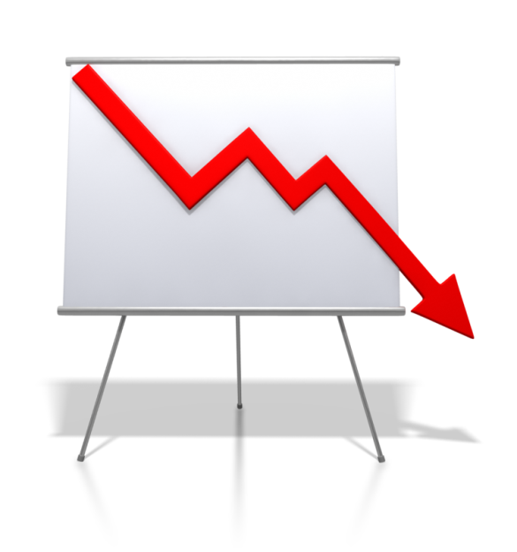
Performance gaps
A "performance gap" exists when the actual performance on a KPI is below the planned or expected level of performance.
Consider:
Do you have gaps in market coverage?
Is measurement managed automatically?
Is measurement integrated into your marketing strategy?

Slide 59
Monitor and improve marketing performance
4.3 Encourage all relevant people to propose ways to improve marketing performance

Slide 60

Improving marketing performance
Tips to encourage people:
Set innovation goals
Listen more and tell less
Recognise risk-takers
Reward failure
Ask for suggestions
Throw down a challenge
Measure innovation
Invest in training.

Slide 61

Benchmarking
Benchmarking relies on using at least one external organisation as the “benchmark”. This will be the standard by which you will compare your assessments and GAP performance identification for both the way the process is run and the results obtained from that process. This benchmark style can be either within or outside your industry.

Slide 62

Benchmarking
The benefit of benchmarking:
Provides valuable insights into what drives a particular performance
Organisations use benchmarking to evaluate, such as hiring, customer service and equipment maintenance
Benchmarking can be done for nearly every process, including marketing.

Slide 63
Monitor and improve marketing performance
4.4 Seek and analyse customer reaction to all aspects of the marketing mix, using culturally appropriate processes, to improve targeting and outcomes

Slide 64

Customer reaction
Customer reaction may be determined through:
Customer meetings, focus groups
Identification of new business opportunities
Informal discussion
Sales to contact ratio
Survey/other feedback mechanisms
Trend analysis.

Slide 65

Customer reactions
Reactions may relate to:
Factors such as service speed
Accuracy of orders
Price
Product choice
Availability
Hours of operation or contact
Location
Employees.

Slide 66

Culturally appropriate processes
Be aware of the impact of culture. For example, if someone avoids eye contact with you when speaking, perhaps that’s the impact of culture – not that they are rude, shy or uninterested. Acknowledge it, understand it, and ask about it. You will need to learn and adjust to each other to ensure communication is effective and appropriate.

Slide 67
Activity 4B

Slide 68
Monitor and improve marketing performance
4.5 Conduct ongoing research of customer requirements and expectations in both on-line and off-line environments to identify opportunities for change and improvement

Slide 69

Ongoing research
Market research is important for every business – and not just as a one-off activity. Regardless of whether you’re starting or growing a business, ongoing research will help you keep up with market trends and changes which lead to maintaining a competitive edge.
Set your ongoing research objectives so that future research can be as simple or as in depth as you would like to make it.

Slide 70

Ongoing research
There are different types of data:
Primary data: Information which you have collected yourself
Secondary data: Existing information (e.g. sales statistics).
Secondary data can be found in internal company records or official sources.

Slide 71

Business improvement
The goals of process improvement are always the same:
To better serve customers
To improve your ability to anticipate, manage and
Respond to changes in the marketplace
To maximise business opportunities
To reduce inefficiencies and errors.

Slide 72
Monitor and improve marketing performance
4.6 Identify and respond to opportunities to aid business development through new technologies and different ways of marketing

Slide 73

Responding to changes
Changes affecting organisations may include:
Globalisation of markets
Media and information
Deregulation of many sectors
Economic outlook
Competitiveness.

Slide 74

Changing workforces
Changing workforce can lead to:
More educated workforce
Diverse workforce
Ageing workforce
Increasing amount of women in the workplace
Approaches to managing Baby Boomers, Gen X and Y.

Slide 75

Employment relationships
Employment relationships may include:
Employees are more empowered
Attraction, recruitment and retention
Changing psychological contract
More workers on contract.

Slide 76
Activity 4C

Slide 77
Skills and Knowledge Activity

Slide 78
Major Activity
This activity should take anywhere between 1-2 hours to complete and can be found at the end of your workbook.
Your instructor will let you know whether they wish for you to complete it in session time or your own time.

Slide 79

Summary and Feedback
Did we meet our objectives?
How did you find this session?
Any questions?

Slide 80

Congratulations!
You have now finished the unit…
‘Market the small business’

