Slide 1

TRENCHING AND EXCAVATIONS
WORK HEALTH AND SAFETY OFFICER

Slide 2
Assessment Criteria
Understand legislative requirements in relation to excavations and trenches.
Identify hazards associated with excavations and implement controls to protect workers and others.

Slide 3
What is excavation work?
Excavation work generally means work involving the removal of soil or rock from a site to form an open face, hole or cavity using tools, machinery or explosives.
A person conducting a business or undertaking must manage risks associated with all kinds of excavations at the workplace, no matter how deep.
Specific duties apply in relation to the higher-risk excavations such as trenches, shafts and tunnels. However, these requirements do not apply to a mine, a bore to which a relevant water law applies or a trench used as a place of interment.
Any construction work (including any work connected with an ‘excavation’) that is carried out in or near:
a shaft or trench with an excavated depth of greater than 1.5 metres
a tunnel
is considered to be ‘high risk construction work’ for which a safe work method statement (SWMS) must be prepared.

Slide 4
Duties
PCBU
PCBU who has management or control of a workplace
Principal contractor
Designers
Officers
Workers

Slide 5
Trench - Definition
A horizontal or inclined way or opening:
the length of which is greater than its width and greater than or equal to its depth; and
that commences at and extends below the surface of the ground
that is open to the surface along its length.

Slide 6
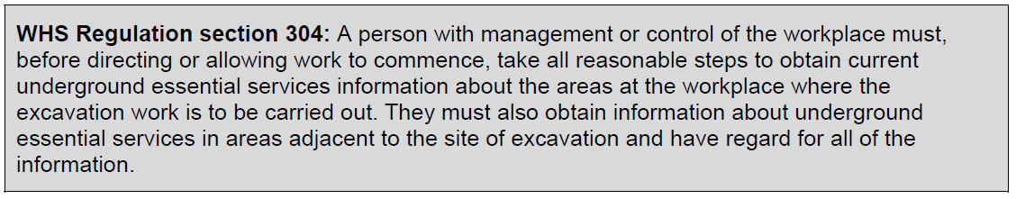
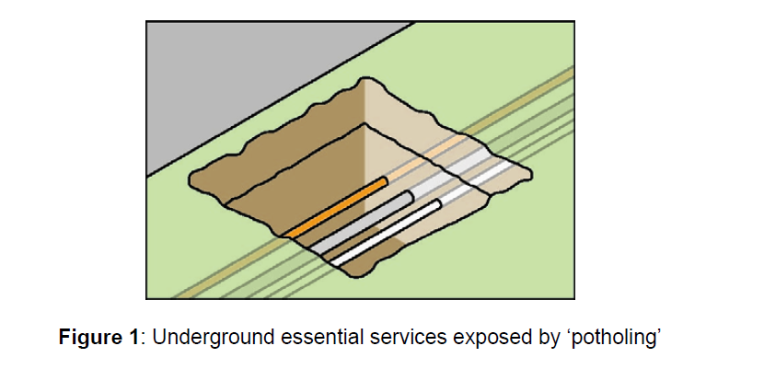
Underground services

Slide 7
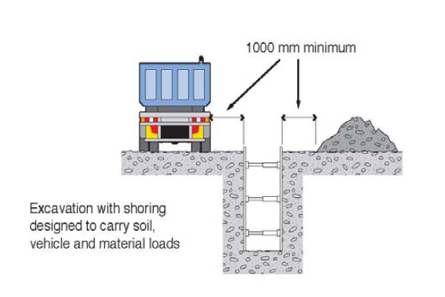
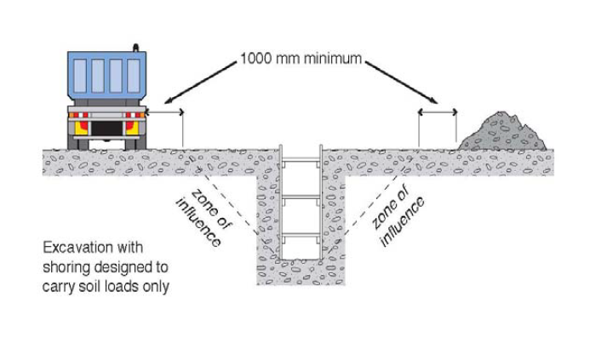
Earthmoving plant near the opening

Slide 8
Protecting workers
Never allow workers to enter a trench or shaft which is greater than 1.5 metres deep unless it has been safely battered back, or it has been properly shored, or the workers are fully protected within a trench shield

Slide 9
Confined space precautions
The risk of atmospheric contamination through a build up of gases and fumes must be controlled in excavation work. Gases and fumes heavier than air can collect in tunnels and excavations for example: gases (such as sulphur dioxide), engine fumes (such as carbon monoxide and carbon dioxide) and leakage from gas bottles, fuel tanks, sewers, drains, gas pipes and LPG tanks.
Plant that uses a combustion engine (e.g. air compressors, electrical generators) should never be used in a confined excavation such as a trench if workers are in the trench.

Slide 10
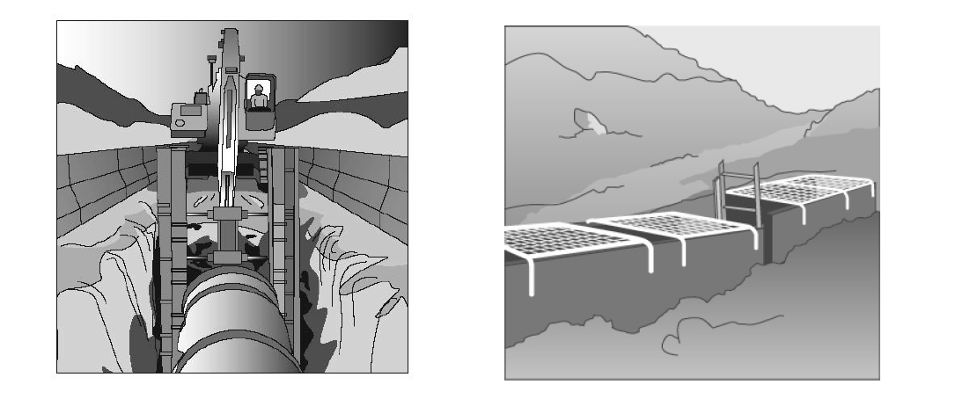
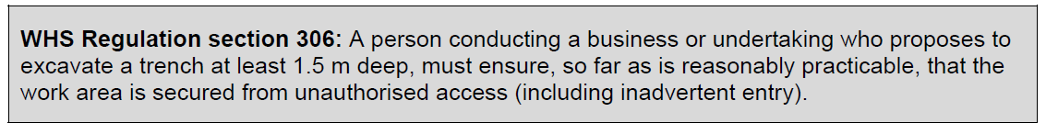
Protecting others near the trench

Slide 11
Safe access to trench
Shafts are often constructed to provide access or ventilation to a tunnel. Comparatively shallow shafts can be sunk for investigating or constructing foundations, dewatering or providing openings to underground facilities.

Slide 12
Never work alone
Never allow anyone to work alone in a trench or shaft. Make sure there is always another person close by who can provide help or get help if necessary.

Slide 13
Regular inspections
The condition of soil surrounding excavations can change quickly due to the soil drying out, changes in the water table or water saturation of the soil. The soil condition and the state of shoring, battering and trench walls should be frequently checked by a competent person for signs of earth fretting, slipping, slumping or ground swelling. Where necessary, repair the excavation or strengthen the shoring system from above before allowing work below ground to continue.

Slide 14
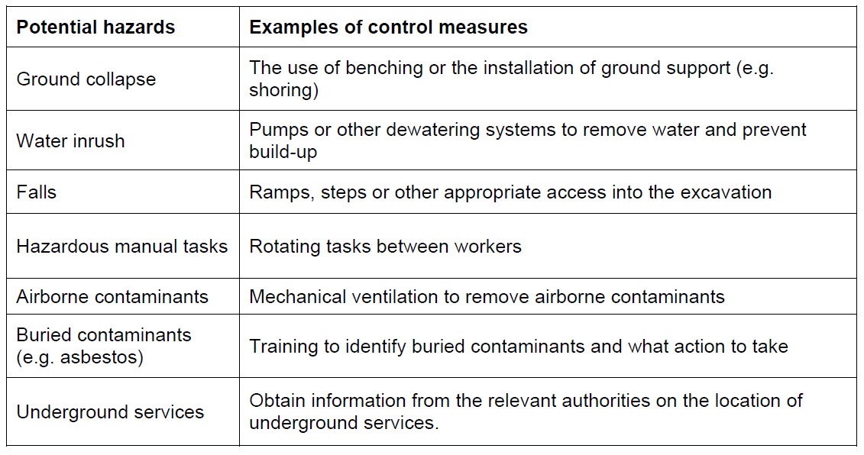
Control measures

Slide 15
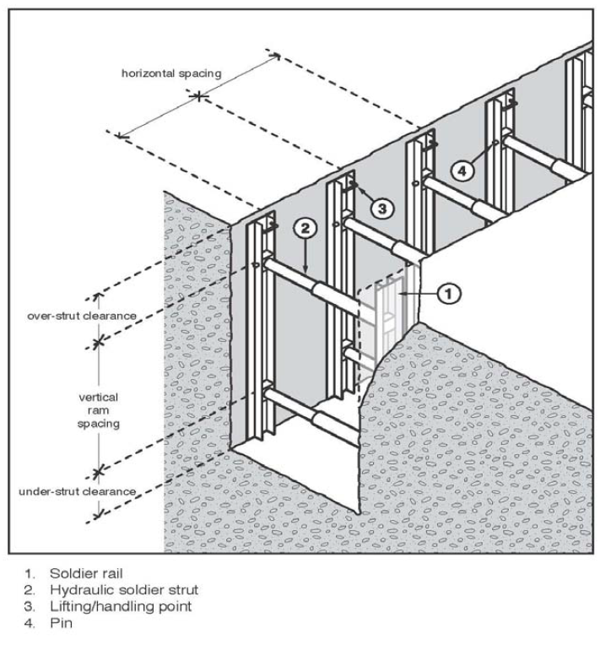

Shoring systems

Slide 16
Ground conditions
In their natural condition, soils have varying degrees of cohesive strength and frictional resistance. Examples of materials with virtually no cohesive strength are dry sand, saturated sand and gravels with minimum clay content. Ground encountered in excavations can generally be categorised as one of three types:
hard, compact soil
soil liable to crack or crumble
loose or running material.

Slide 17
Information, training and supervision
Training specific to the excavation work and to the site should also be provided to workers by a competent person. Workers operating certain types of plant at the workplace must possess a valid licence to operate that plant.
Workers in a supervisory role (e.g. leading hand or foreman) should be experienced and trained in excavation work to ensure the work is carried out in accordance with SWMS.

Slide 18


