Slide 1

CHCECE016
Establish and maintain a safe and healthy environment for children

Slide 2

Support each child’s health needs
1.1 Discuss individual children’s health requirements and routines with families at enrolment and then on a regular basis

Slide 3

Children’s health requirements and routines
Examples of individual health requirements may include:
Nut allergies
Medication allergies
Medication administration
Asthma
Nutritional requirements
Nutritional intolerances
Physical disabilities
Mental disabilities.

Slide 4
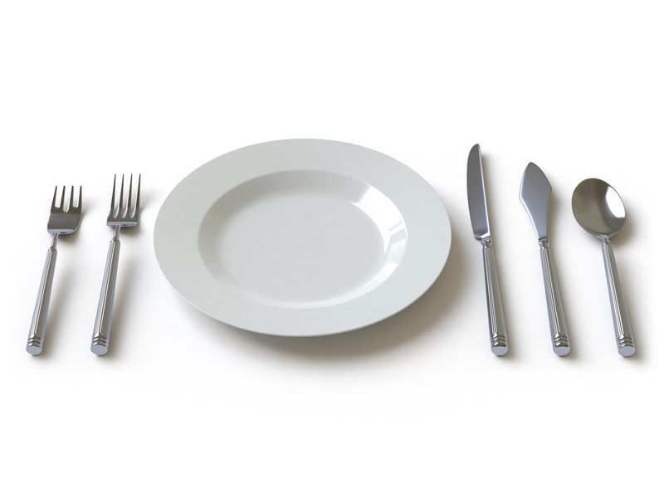
Routines
Routines may include:
Taking medication
Meal times
Sleep times
Physical activity
Mental activity.

Slide 5

Activity 1A

Slide 6
Support each child’s health needs
1.2 Ensure that any concerns or questions about a child’s health needs are conveyed to their family

Slide 7

Concerns about child’s health needs
Concerns about the child’s health needs may include:
Being unable to provide nutritional requirements
Child is malnourished
Medication appears excessive
Medication administration procedures.

Slide 8
Activity 1B

Slide 9
Support each child’s health needs
1.3 Consult with relevant authorities to ensure that health information is current

Slide 10

Checking health information
Once you have obtained the child’s information for the family, you must now check it with the relevant authorities to ensure it is accurate.
This will ensure you are promoting
the child’s health, in line with
Standard 2.1 of the National
Quality Framework.

Slide 11
National Quality Standards
 | Concept | Descriptor
2.1 | Health | Each child’s health and physical activity is supported and promoted
2.1.1 | Wellbeing and comfort | Each child’s wellbeing and comfort is provided for, including appropriate opportunities to meet each child’s need for sleep, rest and relaxation.
2.1.2 | Health practices and procedures | Effective illness and injury management and hygiene practices are promoted and implemented
2.1.3 | Healthy lifestyle | Healthy eating and physical activity are promoted and appropriate for each child.

Slide 12
Activity 1C

Slide 13
Support each child’s health needs
1.4 Ensure that individual medical management plans for children with a specific health care need are in place and readily available at the service

Slide 14
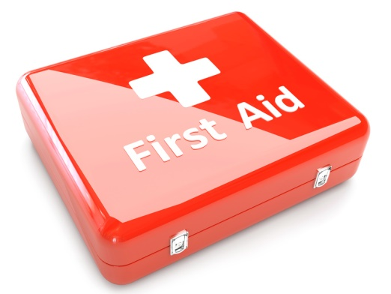
Medical management plans
Examples of conditions that may require a medical management plan include:
Anaphylaxis
Asthma
Diabetes
Epilepsy
Allergic reactions.

Slide 15
Activity 1D

Slide 16
Provide for each child’s comfort
2.1 Ensure that groupings of children are configured to provide for each child’s comfort and to minimise the risk of overcrowding
2.2 Make sure physical spaces are available for children to engage in rest and quiet activities

Slide 17

Grouping children
The size of groups will depend on the amount of staff you have and the space you have in your facility.
A good guide is:
Two year olds – six children per adult
One-year-olds and below – four children per adult.

Slide 18

Making space for rest
Children may not be active the entire time, so they will need an adequate physical space, with soft blankets/bedding available for comfort.
This space should be separate from the play area and be quiet, so children are not disturbed and can get adequate rest.

Slide 19
Activity 2A

Slide 20
Provide for each child’s comfort
2.3 Offer a range of active and restful experiences to children and support them to make appropriate decisions regarding participation

Slide 21

Active experiences
Active experiences will keep child’s minds and bodies engaged and require more energy to participate in than restful experiences.
They can be individual or group activities, depending on the nature of them. You will need to supervise these activities closely, to minimise the risk of any hazards occurring and to manage any conflict that may occur when children are playing together.

Slide 22
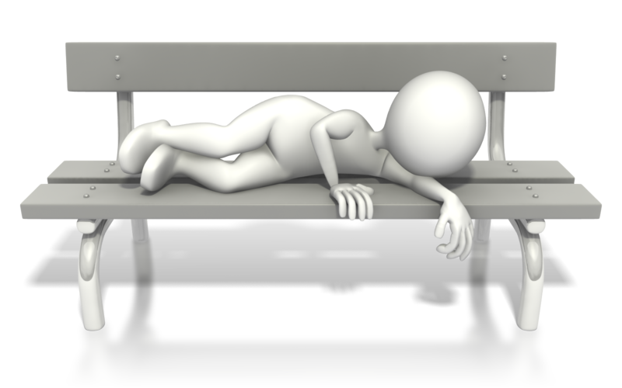
Restful experiences
Restful experiences are less engaging and don’t require as much mental or physical engagement from the child. They are a chance for the children to regain energy lost from their participation in active experiences.

Slide 23
Activity 2B

Slide 24
Promote and implement effective hygiene practices
3.1 Ensure that the service accesses information on current hygiene practices
3.2 Maintain written procedures and schedules to ensure a regular regime of washing children’s toys and equipment

Slide 25
Promote and implement effective hygiene practices
3.3 Provide families with information and support that helps them to follow the service’s hygiene procedures
3.4 Ensure that information about correct hand washing procedures are displayed in relevant areas of the service

Slide 26

Effective hygiene practices
Effective hygiene practices include:
Hand washing and drying
Cleaning equipment and toys
Dental care
Cleaning facilities clean (bathroom, rest areas, play areas, kitchens)
Wiping children’s noses hygienically
Hygienic toileting and nappy change procedures
Keeping unwell children away from child care.

Slide 27
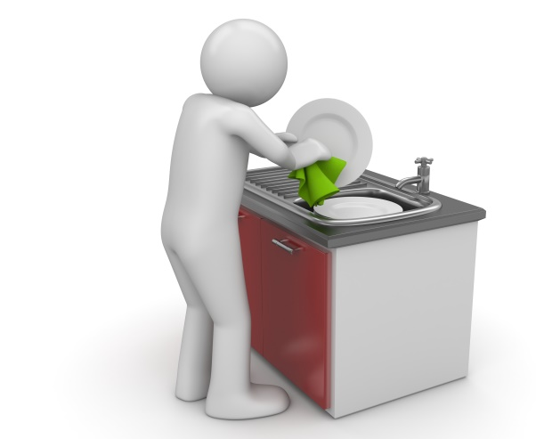
Scheduling washing of children’s toys and equipment
Washing of hard plastic toys can be the following way:
Scrub the toy in warm, soapy water, using bush to reach more difficult to access places
Rinse the toy in clean water
Place the toy a solution of mild bleach and water – leave to soak for 10 minutes
Rinse the toy in cool, clean water
and leave to air dry.

Slide 28
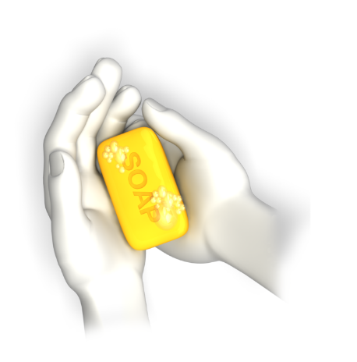
Hand washing procedure
The following is recommended by the National Health and Medical Research Council:
Wet hands with running water
Spread liquid soap over hands
Rub hands all over
Wash hands all over, including wrists, palms, back of hands, under finger nails and between fingers
Rinse hands all over to remove all suds from soap
Turn off tap using disposable paper towel
Pat hands dry using a new paper towel.

Slide 29
Activity 3A

Slide 30
Take steps to control the spread of infectious diseases
4.1 Configure groupings of children to minimise the risk of illness and injuries

Slide 31

Configuring groupings of children
Ensure that you have groupings of children of similar ages, so there is a limited chance of younger children being injured by bigger children.
Bigger children may unintentionally knock babies over or tread on their fingers during their play.

Slide 32
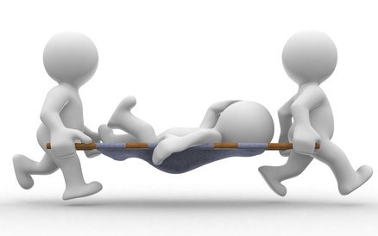
Common childhood diseases
Common childhood disease include:
Chickenpox
Whooping cough
Erythema infectiosum (‘fifth’ disease)
Roseola infantum (three-day-fever)
Hand, foot and mouth disease
Scarlet fever

Slide 33
Activity 4A

Slide 34
Take steps to control the spread of infectious diseases
4.2 Source information about recognised health and safety guidelines

Slide 35
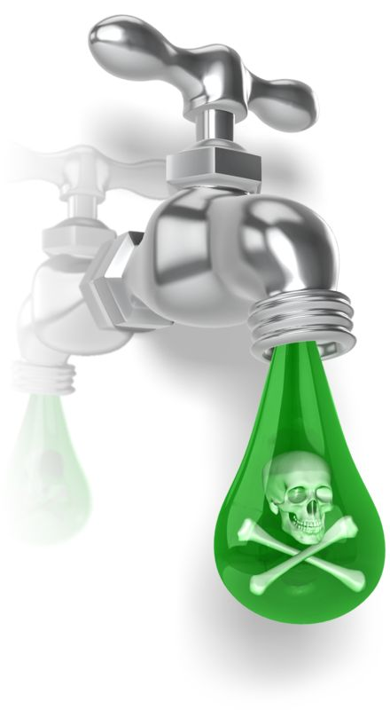
Health and safety guidelines
You will need to know about:
Infection control
Infectious diseases
Immunisation
Administering medications and procedures
Managing children with conditions
Dealing with other medical conditions
Managing emergencies.

Slide 36

Health and safety guidelines
You will need to know about:
Indoor safety
Outdoor safety
Environmental hazards
Travel/excursions
Child protection
Staff health and safety
Pregnant child care health and safety.

Slide 37

National Quality Framework (NQF)
The benefits of the NQS are:
Improved educator to child ratios
Greater individual care and attention for children
Educators with increased skills and qualifications
Better support for children’s learning and development
A national register to help parents assess the quality of education and care services in their area.

Slide 38
Activity 4B

Slide 39
Take steps to control the spread of infectious diseases
4.3 Ensure that service procedures are followed, in relation to notifying families of illness or injuries that affect children while in education and care
information

Slide 40
Take steps to control the spread of infectious diseases
4.4 Advise families and public health authorities where necessary of cases of infectious diseases at the service and provide them with relevant

Slide 41
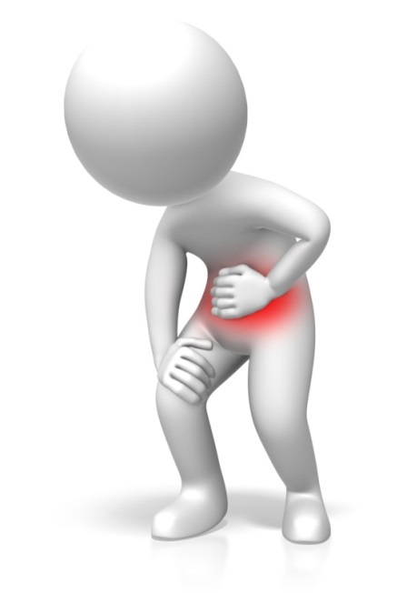
Notify families of illness and injuries
When a child has an illness or is injured in your care, you must be upfront and notify their family about it. Tell them how this illness or injury might affect their ability to be in education or care.
You must include details of when the incident occurred, the circumstances surrounding it and the outcome. You can do this when the families collect their child, as long as it’s not an emergency.

Slide 42

Advising families and public health authorities
The information you need to communicate includes:
Origin of infection
When the case occurred
Where it occurred
Who was affected
Date of diagnosis
The type of infection
The severity of the infection.

Slide 43

Notifiable diseases
Notifiable disease may be:
Bloodborne diseases
Gastrointestinal diseases
Quarantinable diseases
Sexually transmissible infections
Vaccine preventable diseases
Vectorborne diseases
Zoonoses.

Slide 44
Activity 4C

Slide 45
Take steps to control the spread of infectious diseases
4.5 Ensure current records of children’s immunisation status are up-to-date and a procedure is in place to maintain the currency
4.6 Provide information to families and educators about child and adult immunisation recommendations

Slide 46

Immunisation status
There are certain ages where vaccinations are required for children:
At birth
Two months
Four months
Six months
Twelve months
Eighteen months
Four years.

Slide 47
Activity 4D

Slide 48
Ensure adequate supervision of children
5.1 Arrange equipment, furniture and activities to ensure effective supervision while also allowing children to access private and quiet spaces

Slide 49

Arrange equipment, furniture and activities
You must ensure these areas are free from hazards, including:
Choking hazards
Sharp objects
Exposed electrical outlets
Open window
Unlocked doors into hazardous areas
Tripping hazards
Low, open windows
Stairs/steps
Protruding sharp edges.

Slide 50
Activity 5A

Slide 51
Ensure adequate supervision of children
5.2 Ensure new or relief educators are informed of supervision arrangements and of what they are required to do in relation to supervising children

Slide 52

Informing about supervision arrangements
In an education settings, new or relief teachers will need to be informed of supervision arrangements and the requirements for specific children, so their care is kept consistent.
There are also various legislative requirements that educators must be aware of.

Slide 53
Activity 5B

Slide 54
Ensure adequate supervision of children
5.3 Undertake a risk assessment for each excursion including implications for supervision

Slide 55

Undertake a risk assessment
For each excursion children are taken on in your care, you will need to conduct a risk assessment and take the necessary precautions to control or prevent identified risks.
This can be done by using the risk assessment and risk matrix templates on the following pages.
Think of the implications for supervision – high risk activities will inevitably justify a higher degree of supervision and fewer children per adult.

Slide 56
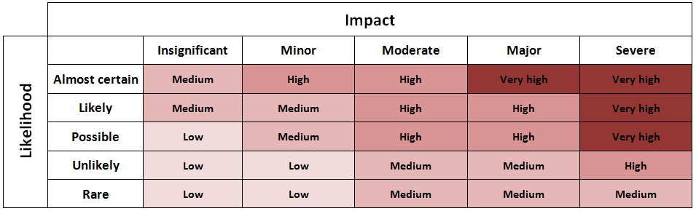
Undertake a risk assessment

Slide 57
Activity 5C

Slide 58
Take precaution to protect children from harm
6.1 Ensure safety checks are consistently implemented and action is taken as a result of the checks

Slide 59

Safety checks
In relation to risk assessment, you must regularly assess the safety of the environment for children. Be aware that, just because the environment was safe last time children were there, it may not stay this way.
For example, there may be new objects in the area since you were last there. There may be external forces that have changed the nature of the environment.

Slide 60
Activity 6A

Slide 61
Take precaution to protect children from harm
6.2 Check risk minimisation plans are in place for children enrolled at the service who have a specific health care need, allergy or relevant medical condition

Slide 62

Risk minimisation plans
Risk minimisation plans are those which outline identified and unavoidable risks and detail the appropriate actions to take to minimise risks.
In the field of child care and early education, you will need to have risk minimisation plans in place for children with specific health care needs, allergies or relevant medical conditions.

Slide 63
Activity 6B

Slide 64
Take precaution to protect children from harm
6.3 Ensure simple warning signs are located where potentially dangerous products are stored

Slide 65
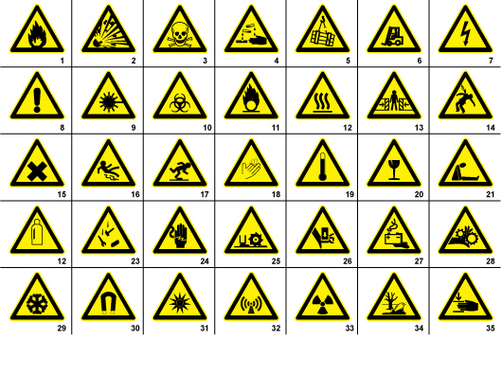
Warning signs

Slide 66
Activity 6C

Slide 67
Take precaution to protect children from harm
6.4 Confirm safety of any drinks, food and cooking utensils and appliances used as part of the program

Slide 68

Safety of any drinks, food and cooking utensils and appliances
All drinks, food and cooking utensils and appliances used as part of your program must be safe to use for both adults and children.
You need to be aware of cross-contamination issues when dealing with food and drinks, as well as the utensils and appliances used to prepare them.
Ensure that appliances are electrically tested and that they are out of reach of children.

Slide 69

Personal hygiene requirements
Minimum personal hygiene requirements are specified by the food safety program and must, at a minimum, meet legal requirements as set out in Food Safety Standard 3.2.2, Division 4:13 and/or state legislation/regulations.
The Australia New Zealand Food
Safety Standards Code sets out
guidelines for working safely with
food.

Slide 70
Activity 6D

Slide 71
Take precaution to protect children from harm
6.5 Ensure that basic training and testing on how to move and fit car seats, restraints and booster seats (applicable to the age of relevant child) is available to all educators

Slide 72
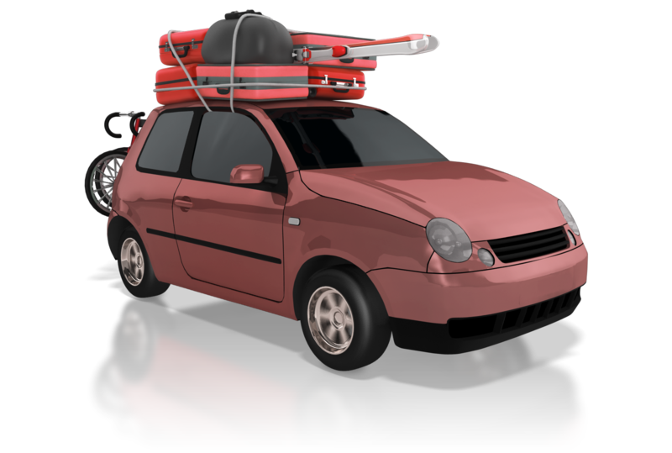
Moving and fitting car seats, restraints and booster seats
You must ensure that:
The seatbelt/harness is secure and untwisted
Rearward facing seats have handlebars facing in the correct direction
The child seat is sitting squarely on the car seat
The headrest is in the correct position
The seatbelt follows the correct
route guides
The seatbelt buckle is in the
correct place.

Slide 73
Types of child seat to use
Specific regulations include:
Up to six months – The child must be restrained in an approved rear-facing child restraint, specially designed for newborn babies
Six months to four years old – The child must sit in a rear-facing or forward-facing child restraint
Four years old to seven years old – The child must sit in either a forward-facing child restraint or a booster seat
Seven years old to 16 years old – The child must use a booster seat or a seatbelt, correctly adjusted and fastened.

Slide 74
Activity 6E

Slide 75
Take precaution to protect children from harm
6.6 Keep records of pest/vermin inspections and/or eradications

Slide 76

Records of pest/vermin inspections and/or eradications
The types of information required are:
Date of inspection
Areas inspected
Pests/vermin discovered (if applicable)
Site of infestations
Methods of eradication
Methods of pest/vermin disposal
Use of any pesticides.

Slide 77
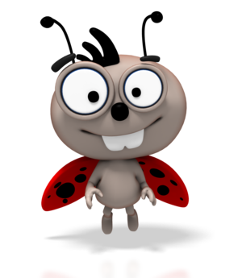
Signs of pest/vermin presence
Signs to look out for include:
Animal droppings
Gnawing or chewing of food packaging
or equipment
New holes within the workplace
Visible sightings of pests/vermin
Noise of pest activity within and
around the work premises.

Slide 78
Activity 6F

Slide 79
Take precaution to protect children from harm
6.7 Develop and maintain a written process for monitoring who enters and leaves the premises at all times

Slide 80

Monitoring who enters and leaves the premises
You will need to develop a process for monitoring people entering and leaving your premises.
This can be a simple sign in sheet that requires people to enter their details when leaving and entering the premises.

Slide 81
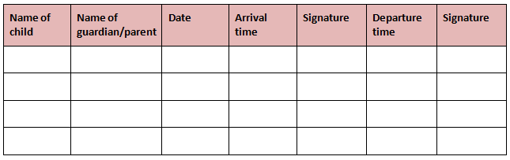
Monitoring who enters and leaves the premises

Slide 82
Activity 6G

Slide 83
Take precaution to protect children from harm
6.8 Provide detailed information to families regarding any excursion being undertaken

Slide 84

Informing families of excursions
You will need to inform them of details such as:
Where you intend to go
When you intend to go
When you intend to return
Methods of transport
The total amount of children and adults
Any risks/hazards that may occur
Required clothing/equipment
Cost of the excursion (if applicable).

Slide 85
Activity 6H

Slide 86
Develop plans to effectively manage incidents and emergencies
7.1 Ensure emergency procedures are displayed prominently throughout the premises

Slide 87
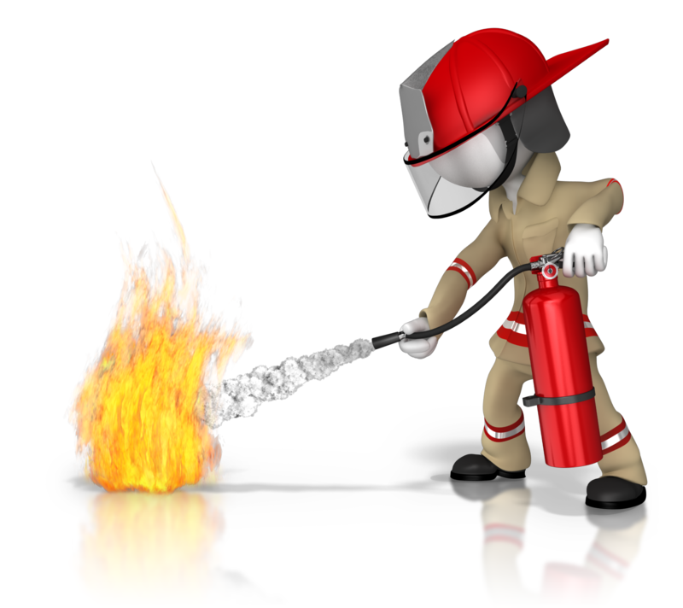
Displaying emergency procedures
Emergency procedures may include:
First Aid
Fire evacuation.

Slide 88
Activity 7A

Slide 89
Develop plans to effectively manage incidents and emergencies
7.2 Make certain that all educators have ready access to a phone or similar means of communication
7.3 Ensure emergency numbers are located near telephone

Slide 90
Phoning in emergencies
Educators should have ready access to a phone on the premises. This is to be used to phone in emergencies and to contact parents, when necessary.
Emergency numbers should be located near telephones. This includes the emergency services number (000), for Police, Fire and
Ambulance services. You should also
have the emergency contact numbers
of parents and guardians for all of the
children in your care.

Slide 91
Activity 7B

Slide 92
Develop plans to effectively manage incidents and emergencies
7.4 Communicate information to families about the service’s emergency procedures and incident management plans

Slide 93

Communicating emergency information
The type of information you need to communicate about emergency procedures includes:
What the procedures are
When they will need to be used
What incident management plans
are.

Slide 94
Activity 7C

Slide 95
Develop plans to effectively manage incidents and emergencies
7.5 Discuss and practise emergency drills with children, educators and any other people on the premises
7.6 Ensure that emergency equipment is available and tested and staff are trained in the use of it

Slide 96

Emergency drills
You will need to discuss and practice emergency drills with children, educators and any other people on the premises. This will ensure they are competent in the event of an actual emergency, which will minimise the risk.
The Building Fire Safety Regulation 2008
requires one fire drill to be conducted per
year – however, once per term at a school
is a good guide. These fire drills should be
kept as realistic as possible, so as to create
the best preparation environment possible.

Slide 97
Activity 7D

Slide 98
Develop plans to effectively manage incidents and emergencies
7.7 Maintain a portable record of children’s emergency contacts in case of emergencies

Slide 99

Maintain a portable record of children’s emergency contacts
As previously mentioned, children’s emergency contacts should be recorded on your premises.
It is also a good idea to keep a portable record of this information – for instance, this will be useful to take with you on excursions and use if there are any emergencies.
This portable record can be kept in a
small phone book or a sheet of paper,
depending on how many children you
have in your care.

Slide 100
Activity 7E

Slide 101
Summative Assessments
Summative assessments consist of:
Skills Activity
Knowledge Activity
Performance Activity.
Your assessor will provide you with further guidance on how and where to complete these assessments.

Slide 102

Summary and Feedback
Did we meet our objectives?
How did you find this session?
Any questions?

