Slide 1

RISK MANAGEMENT
WORK HEALTH AND SAFETY OFFICER

Slide 2
Assessment Criteria
Identification
Risk assessment
Risk control
Monitoring and review

Slide 3
Key terms
Hazard means a situation or thing that has the potential to harm a person. Hazards at work may include: noisy machinery, a moving forklift, chemicals, electricity, working at heights, a repetitive job, bullying and violence at the workplace.
Risk is the possibility that harm (death, injury or illness) might occur when exposed to a hazard.
Risk control means taking action to eliminate health and safety risks so far as is reasonably practicable, and if that is not possible, minimising the risks so far as is reasonably practicable. Eliminating a hazard will also eliminate any risks associated with that hazard.

Slide 4
Responsibilities
Persons conducting a business or undertaking (PCBU) will have health and safety duties to manage risks if they:
engage workers to undertake work for them, or if they direct or influence work carried out by workers
may put other people at risk from the conduct of their business or undertaking
manage or control the workplace or fixtures, fittings or plant at the workplace
design, manufacture, import or supply plant, substances or structures for use at a workplace
install, construct or commission plant or structures at a workplace.

Slide 5
Responsibilities
Officers (for example company directors) must exercise due diligence to ensure that the business or undertaking complies with the Act and Regulations. This includes taking reasonable steps to:
gain an understanding of the hazards and risks associated with the operations of the business or undertaking
ensure that the business or undertaking has and uses appropriate resources and processes to eliminate or minimise risks to health and safety.
A person can have more than one duty and more than one person can have the same duty at the same time.

Slide 6
Reasonably practicable
Refer WHS Act 2011 s18
Deciding what is ‘reasonably practicable’ to protect people from harm requires taking into account and weighing up all relevant matters, including:
the likelihood of the hazard or risk concerned occurring
the degree of harm that might result from the hazard or risk
knowledge about the hazard or risk, and ways of eliminating or minimising the risk
the availability and suitability of ways to eliminate or minimise the risk, and
after assessing the extent of the risk and the available ways of eliminating or minimising the risk, the cost associated with available ways of eliminating or minimising the risk, including whether the cost is grossly disproportionate to the risk.

Slide 7
Managing risks
You must do whatever you can (in other words, whatever is ‘reasonably practicable’) to eliminate or minimise health and safety risks arising from your business or undertaking.
This process is known as risk management and involves four steps:

Slide 8
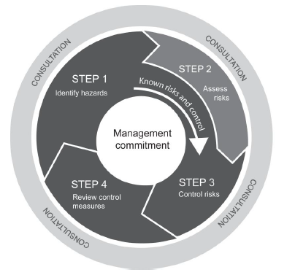
Managing risks
identify hazards – find out what could cause harm
assess risks if necessary – understand the nature of the harm that could be caused by the hazard, how serious the harm could be and the likelihood of it happening
control risks – implement the most effective control measure that is reasonably practicable in the circumstances
review control measures to ensure they are working as planned.

Slide 9
How to identify hazards
Identifying hazards in the workplace involves finding things and situations that could potentially cause harm to people. Hazards generally arise from the following aspects of work and their interaction:
physical work environment
equipment, materials and substances used
work tasks and how they are performed
work design and management.

Slide 10
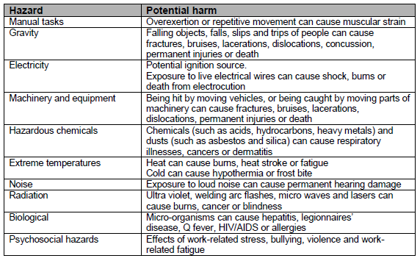
Common workplace hazards

Slide 11
How to find hazards
Inspect the workplace
Things to look out for include the following:
Does the work environment enable workers to carry out work without risks to health and safety (for example, space for unobstructed movement, adequate ventilation, lighting)?
How suitable are the tools and equipment for the task and how well are they maintained?
Have any changes occurred in the workplace which may affect health and safety?

Slide 12
How to find hazards
Consult your workers
Ask your workers about any health and safety problems they have encountered in doing their work and any near misses or incidents that have not been reported.
Worker surveys may also be undertaken to obtain information about matters such as workplace bullying, as well as muscular aches and pains that can signal potential hazards.

Slide 13
How to identify hazards
Review available information
Information and advice about hazards and risks relevant to particular industries and types of work is available from regulators, industry associations, unions, technical specialists and safety consultants.
Manufacturers and suppliers can also provide information about hazards and safety precautions for specific substances (safety data sheets), plant or processes (instruction manuals).

Slide 14
How to assess risks
A risk assessment involves considering what could happen if someone is exposed to a hazard and the likelihood of it happening. A risk assessment can help you determine:
how severe a risk is
whether any existing control measures are effective
what action you should take to control the risk
how urgently the action needs to be taken.
A risk assessment can be undertaken with varying degrees of detail depending on the type of hazards and the information, data and resources that you have available. It can be as simple as a discussion with your workers or involve specific risk analysis tools and techniques recommended by safety professionals.

Slide 15
When should a risk assessment be carried out?
A risk assessment should be done when:
there is uncertainty about how a hazard may result in injury or illness
the work activity involves a number of different hazards and there is a lack of understanding about how the hazards may interact with each other to produce new or greater risks
changes at the workplace occur that may impact on the effectiveness of control measures.
A risk assessment is mandatory under the WHS Regulation for high risk activities such as entry into confined spaces, diving work and live electrical work.

Slide 16
When should a risk assessment be carried out?
A risk assessment is not necessary in the following situations:
Legislation requires some hazards or risks to be controlled in a specific way – these requirements must be complied with.
A code of practice or other guidance sets out a way of controlling a hazard or risk that is applicable to your situation and you choose to use the recommended controls. In these instances, the guidance can be followed.
There are well-known and effective controls that are in use in the particular industry, that are suited to the circumstances in your workplace. These controls can simply be implemented.

Slide 17
How to do a risk assessment
Work out how severe the harm could be
Work out how hazards may cause harm
Work out the likelihood of harm occurring

Slide 18
How to control risks
The most important step in managing risks involves eliminating them so far as is reasonably practicable, or if that is not possible, minimising the risks so far as is reasonably practicable.

Slide 19
HIGHEST
MOST
Level 1
Eliminate the hazards
Level of health and safety protection
Reliability of control measures
Level 2
Substitute the hazard with something safer
Isolate the hazard from people
Reduce the risks through engineering controls
Level 3
Reduce the exposure to the hazard using administrative actions
Use personal protective equipment
LOWEST
LEAST

Slide 20
Level 1 control measures
The most effective control measure involves eliminating the hazard and associated risk. The best way to do this is by, firstly, not introducing the hazard into the workplace.

Slide 21
Level 2 control measures
If it is not reasonably practicable to eliminate the hazards and associated risks, you should minimise the risks using one or more of the following approaches:
Substitute the hazard with something safer
Isolate the hazard from people
Use engineering controls

Slide 22
Level 3 control measures
These control measures do not control the hazard at the source. They rely on human behaviour and supervision, and used on their own, tend to be least effective in minimising risks. Two approaches to reduce risk in this way are:
Use administrative controls
Use personal protective equipment (PPE)

Slide 23
Cost of control measures
Cost (in terms of time and effort as well as money) is just one factor to consider when determining the best control option.
The cost of controlling a risk may be taken into account in determining what is reasonably practicable, but cannot be used as a reason for doing nothing.

Slide 24
How to ensure controls remain effective
Accountability for health and safety
Maintenance of plant and equipment
Up-to-date training and competency
Up-to-date hazard information
Regular review and consultation

Slide 25
How to review controls
Control measures should be reviewed regularly.
There are certain situations where you must review your control measures under the WHS Regulation and, if necessary, revise them. A review is required:
when the control measure is not effective in controlling the risk
before a change at the workplace that is likely to give rise to a new or different health and safety risk that the control measure may not effectively control
if a new hazard or risk is identified
if the results of consultation indicate that a review is necessary
if a health and safety representative requests a review.

Slide 26
Keeping records
Keeping records of the risk management process demonstrates potential compliance with the WHS Act and WHS Regulation. It also helps when undertaking subsequent risk assessments.
There are specific record-keeping requirements in the WHS Regulation for some hazards, such as hazardous chemicals. If such hazards have been identified at your workplace, you must keep the relevant records for the time specified.
You should ensure that everyone in your workplace is aware of record-keeping requirements, including which records are accessible and where they are kept.

Slide 27


