Slide 1

PRESSURE EQUIPMENT
WORK HEALTH AND SAFETY OFFICER

Slide 2
Assessment Criteria
Describe the statutory or minimum requirements relating to pressure equipment and pressure vessels at a workplace.
Describe control measures that eliminate or minimise the hazards associated with pressure equipment and pressure vessels.
Describe the testing and inspection requirements associated with pressure equipment and pressure vessels

Slide 3
Definitions
pressure equipment means boilers, pressure vessels and pressure piping.
pressure vessel—
(a) means a vessel subject to internal or external pressure; and
(b) includes—
(i) interconnected parts and components, valves, gauges and other fittings up to the first point of connection to connecting piping; and
(ii) fired heaters; and
(iii) gas cylinders; but
(c) does not include a boiler or pressure piping.

Slide 4
Registration and Licensing
Design Registration
Registration of Plant
High Risk Work Licensing Requirements

Slide 5
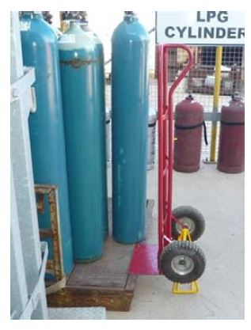
Hazards

Slide 6
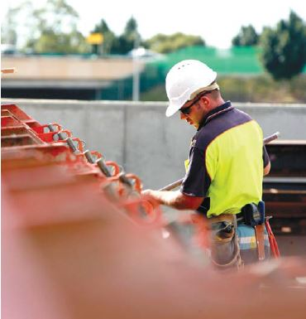
Inspection

Slide 7
Care and Handling
Avoidance of oil, grease and water
Closing valves for transportation
Cylinders for toxic gases
Keep cylinders cool
Avoidance of shock
Correct orientation

Slide 8
Boilers and Gas Cylinders
Marking and labelling
Operation instructions
Inspection criteria

Slide 9


