Slide 1

PRE-STRESSING AND POST-TENSIONING CONCRETE
WORK HEALTH AND SAFETY OFFICER

Slide 2
Assessment Criteria
Describe the statutory or minimum requirements in relation to pre-stressing and post tensioning.
List the safety precautions required when pre-stressing concrete elements by either pre-tensioning or post-tensioning techniques
Describe the control strategies to be adopted during work activities where pre-stressing activities are being conducted.

Slide 3
Pre-stressed concrete
The principle behind pre-stressed concrete is that compressive stresses induced by high-strength steel tendons in a concrete member before loads are applied will balance the tensile stresses imposed in the member during service.

Slide 4
Compressive strength added
Pre-tensioning: steel is stretched before the concrete is placed
Post-tensioning: steel is stretched after the concrete hardens

Slide 5
Concrete elements
Pre-stressed concrete is a composite material which utilises the natural compressive strength of concrete, while overcoming its weakness in tension by pre-compressing the concrete before it is subjected to its full design loadings.
In post-tensioned elements, the tendons are stressed after the concrete has been cast and allowed to reach a specified strength. These tendons are contained in metal sheathing or plastic ducts embedded in the concrete between the element's ends.

Slide 6
Preplanning and coordination
Preplanning stages
Manufacture
Transport
Erection
Tensioning
Grouting

Slide 7
Responsibilities
Product design engineer
Principal contractor
Post-tensioning contractor
Formwork installation contractor
Pre-caster
Erector
Worker

Slide 8
Specific Issues
Working platforms
Formwork
Provisions for stressing
Pre-stressing safety considerations
Uncoiling, cutting and placing strands
Pushing strands into ducts
Concrete pour
Barricades
Stressing operations
Grouting

Slide 9
Pre-tensioned concrete
Procedures / Safety Plan to ensure the safety of all persons during production, including details of no‑go zones and protective barriers to prevent injury in the event of equipment failure:
Personnel
Tensioning of tendons
Pre-tensioning - associated works

Slide 10
Materials
Supply of tendons: The manufacturer / processor of the tendons shall hold a valid certificate of approval issued by the Australian Certification Authority for Reinforcing Steel (ACRS).
Welding is not be permitted on or near tendons nor shall any heat be applied to tendons.

Slide 11
Traceability
Wire, strand, bars and anchorages shall be labelled in accordance with the requirements of AS 4672 or AS 1314.
Individual lengths of wire, strand or bar shall be traceable from the point of manufacture of coils or lots to their final location by a unique identification number.

Slide 12
Handling, storage and fabrication
Materials shall be stored and handled in such a manner so that they are not damaged, contaminated or their physical properties altered.
This includes:
storage under a waterproof shelter,
being supported above ground level; and
kept free of all foreign matter on the surface.

Slide 13
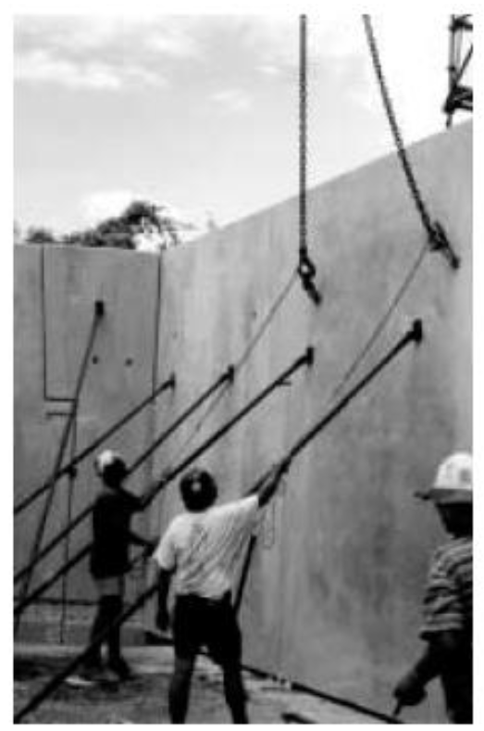
Safety

Slide 14
Tensioning of tendons
Tensioning shall be performed only by personnel experienced in this type of work and in accordance with the Quality Plan. Concrete shall not be drilled or any portion cut or chipped away or otherwise disturbed after pre-stressing, unless prior approval has been obtained.

Slide 15


