Slide 1

FIRST-AID IN THE WORKPLACE
WORK HEALTH AND SAFETY OFFICER

Slide 2
Assessment Criteria
Describe the Basic Concepts relating to First Aid
Describe the First Aid Requirements utilising a Risk Management approach
Describe the functions and requirements of First Aid Personnel
Describe the various consultation and information sources

Slide 3
First Aid
First Aid is the immediate treatment or care given to a person suffering from an injury or illness until more advanced care is provided or the person recovers.

Slide 4
First Aider
First aider is a person who has successfully completed a nationally accredited training course or an equivalent level of training that has given them the competencies required to administer first aid.

Slide 5
First Aid Equipment & Facilities
First aid equipment includes first aid kits and other equipment used to treat injuries and illnesses.
First aid facilities include first aid rooms, health centres, clean water supplies and other facilities needed for administering first aid.

Slide 6
High Risk Workplace
High risk workplace means a workplace where workers are exposed to hazards that could result in serious injury or illness and would require first aid.
Examples of workplaces that may be considered high risk are ones in which workers:
use hazardous machinery (e.g. mobile plant, chainsaws, power presses and lathes)
use hazardous substances (e.g. chemical manufacture, laboratories, horticulture, petrol stations and food manufacturing)
are at risk of falls that could result in serious injury (e.g. construction and stevedoring)
carry out hazardous forms of work (e.g. working in confined spaces, welding, demolition, electrical work and abrasive blasting)
are exposed to the risk of physical violence (e.g. working alone at night, cash handling or having customers who are frequently physically aggressive)
work in or around extreme heat or cold (e.g. foundries and prolonged outdoor work in extreme temperatures).

Slide 7
Low Risk Workplace
Low risk workplace means a workplace where workers are not exposed to hazards that could result in serious injury or illness such as offices, shops or libraries. Potential work-related injuries and illnesses requiring first aid would be minor in nature.

Slide 8
Duties of PCBU
The PCBU must ensure
  (a) the provision of first aid equipment for the workplace; and
  (b) that each worker at the workplace has access to the equipment; and
  (c) access to facilities for the administration of first aid.
  (d) an adequate number of workers are trained to administer first aid at the workplace; or
  (e) workers have access to an adequate number of other persons who have been trained to administer first aid.
Having regard to
  (a) the nature of the work being carried out at the workplace; and
  (b) the nature of the hazards at the workplace; and
  (c) the size and location of the workplace; and
  (d) the number and composition of the workers and other persons at the workplace.

Slide 9
Duties of Officers
Officers, such as company directors, have a duty to exercise due diligence to ensure that the business or undertaking complies with the Act and Regulations. This includes taking reasonable steps to ensure that the business or undertaking has and uses appropriate resources and processes to eliminate or minimise risks to health and safety.

Slide 10
Duties of Workers
Workers have a duty to take reasonable care for their own health and safety and must not adversely affect the health and safety of other persons. Workers must comply with any reasonable instruction and cooperate with any reasonable policy or procedure relating to health and safety at the workplace, such as procedures for first aid and for reporting injuries and illnesses.

Slide 11
Step 1 – Identify potential causes of workplace injury and illness
Does the nature of the work being carried out pose a hazard to people’s health and safety?
Have these hazards been identified in work that is being carried out?
Has incident and injury data been reviewed?
Has consultation with workers and their health and safety representatives occurred?
Is specialist or external assistance required?
Step 2 – Assess the risk of workplace injury and illness
How often does a hazard have the potential to cause harm?
What type of injuries would the hazards cause?
How serious are the injuries?
Does the number and composition of workers and other people affect how first aid should be provided?
Could the size and location of the workplace affect how first aid is provided?
Step 3 – What first aid is required?
First Aiders
How many first aiders are needed?
What competencies do they require?
What training do they need?
First Aid Kits and Procedures
What kits/modules are needed and where should they be located?
Is other first aid equipment needed?
Who is responsible for maintaining the kits? What procedures are needed for my workplace?
First Aid Facilities
Is a first aid room or health centre required?
Step 4
Review first aid to ensure effectiveness

Slide 12
Providing First Aid
Risk management approach
Consult workers
Consult, co-operate and co-ordinate activities with other duty holders
Workers must be provided with information and instruction about first aid:
the location of first aid equipment and facilities
the names and location of persons trained to administer first aid
the procedures to be followed when first aid is required.

Slide 13
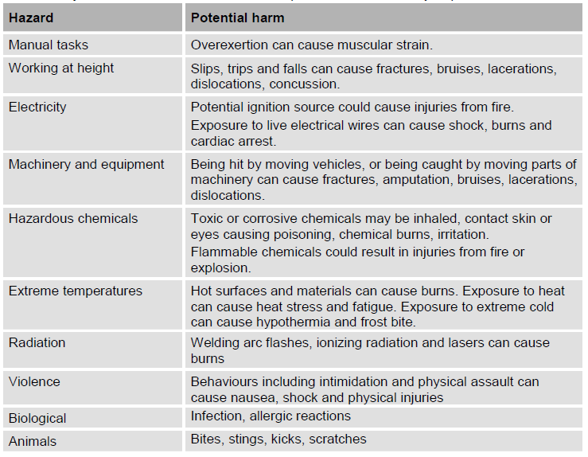
Determining First Aid Requirements
The nature of the work and workplace hazards
Size and location of the workplace
The number and composition of workers and
other people

Slide 14
First aid kit
Contents of First Aid kit should be based on a risk assessment
Design of kit should be suited to workplace.
Quick access to the kit is vital.
Kit to be restocked and maintained.

Slide 15
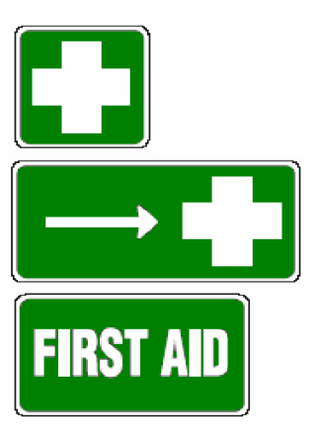
First Aid Signs
First Aid Signs may be constructed to suit individual requirements but should comply with relevant Australian standard.

Slide 16
Other First Aid Equipment
Automatic defribillators
Eye wash and shower equipment

Slide 17
First Aid Facilities
First Aid Room
A first aid room is recommended for:
  Low risk workplaces with 200 workers or more
  High risk workplaces with 100 workers or more
Health Centre

Slide 18

First Aider Training
Nationally endorsed first aid units of competency:
Apply first aid provides competencies required to recognise and respond to common life-threatening injuries or illnesses, including life-support using cardiopulmonary resuscitation (CPR), and to manage the casualty and incident until the arrival of medical or other assistance.
Apply advanced first aid – provides additional competencies required to apply advanced first aid procedures. This type of training is suitable for some high risk workplaces.
Manage first aid in the workplace (occupational first aid) – provides competencies required to apply advanced first aid procedures and to manage a first aid room.
Provide first aid in remote situations – provides the competencies required to administer first aid in a remote and/or isolated situation, including preparing for aero-medical evacuation. This type of training is suitable for high risk workplaces that are likely to have a major delay in accessing emergency services.

Slide 19
Number of Trained First Aiders
Recommended ratios:
low risk workplaces – one first aider for every 50 workers
high risk workplaces – one first aider for every 25 workers.

Slide 20
Additional Training
Refresher training should be attended on a regular basis
Refresher training in CPR should be undertaken annually
First Aid Qualifications should be renewed every three years
Additional training for specific situations

Slide 21
First Aid Procedures
A PCBU should develop and implement first aid procedures to ensure workers have a clear understanding of first aid in their workplace.

Slide 22
Record Keeping
A first aid recording system should be maintained at the workplace for a number of reasons:
To identify areas or processes that are likely to give rise to injury or illness;
To review safety procedures for preventing further problems;
To implement safer and healthier work practices;
To identify were first aid facilitates are and services are needed most; and
For standard workers compensation purposes.
First aid treatment records are subject to requirements under Health Records legislation and is confidential.

Slide 23

Reviewing First Aid Requirements

Slide 24
Prohibited Medications
Medications Labelled:
Pharmacy Medicine or “Caution S2”
Pharmacy Only Medicine or “Caution S3”
Prescription Only Medicine or “Caution S4”
Controlled Drug or ”Caution S8”
For example;
Analgesics
Paracetamol or aspirin
Eye Treatments-Albalon, Antistine - Privine, Visine, Murine
Burns Cream- Mediderm,Derb-Aid, Medi-Crème, Silervazine

Slide 25


