Slide 1

Conducting A Tours
By Abby Baguley

Slide 2

Meet and Greet
Welcome visitors with good body language
Acknowledge customers with eye contact and a greeting
Give an outline of the day’s plan
Ask if anyone has a disability or health issue.
Safety or emergency requirements
Handing out school maps to visitors/new students

Slide 3

Workplace, Health and Safety
Guests and students on flex days have to sign in at office
Payment fees must be finalised end of term 3
Canvas, boots, shoes above the ankle or slip on shoes not permitted
The correct uniform must be worn
Black and white polish able or suede shoes only

Slide 4
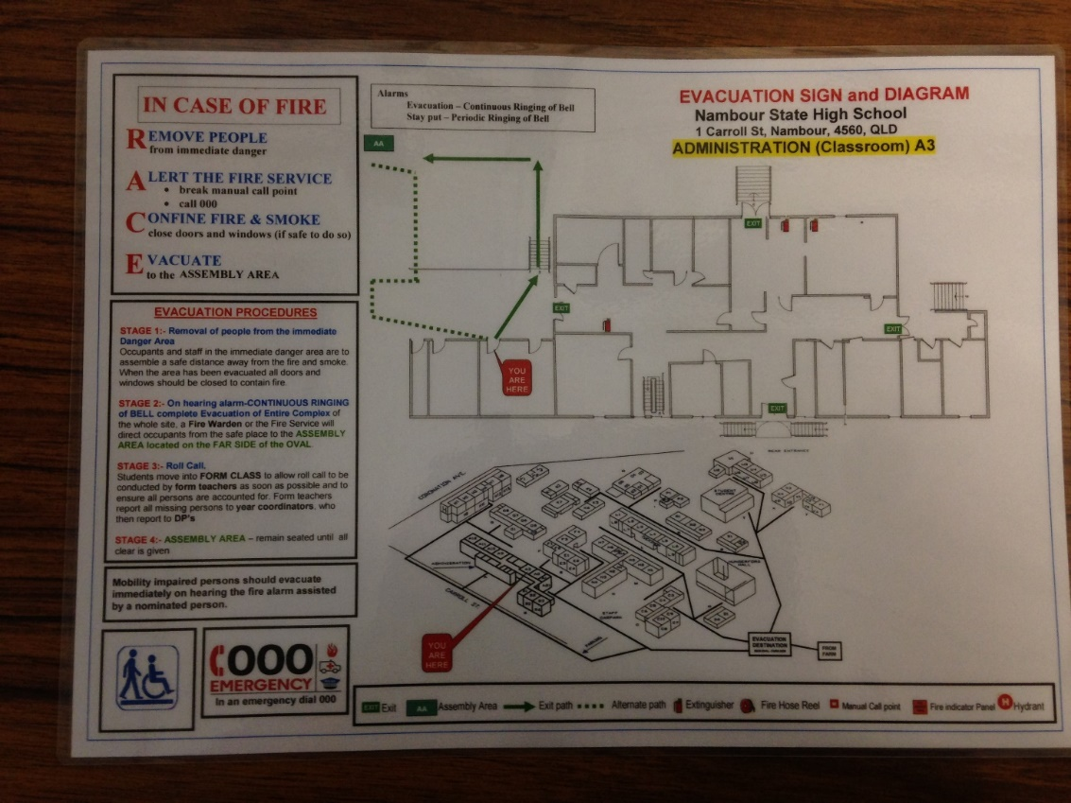
In case of an Emergency
You will find an evacuation map
in everyone class room.
Two types of alarms:
1. Series of short sounds similar to
emergency vehicles.
2. Extended tone and a sharp sound.

Slide 5

Age & Needs
No wheelchair assess
SEP Program
Intensive English Unit
Spilt into 2 campuses and 3 age groups

Slide 6
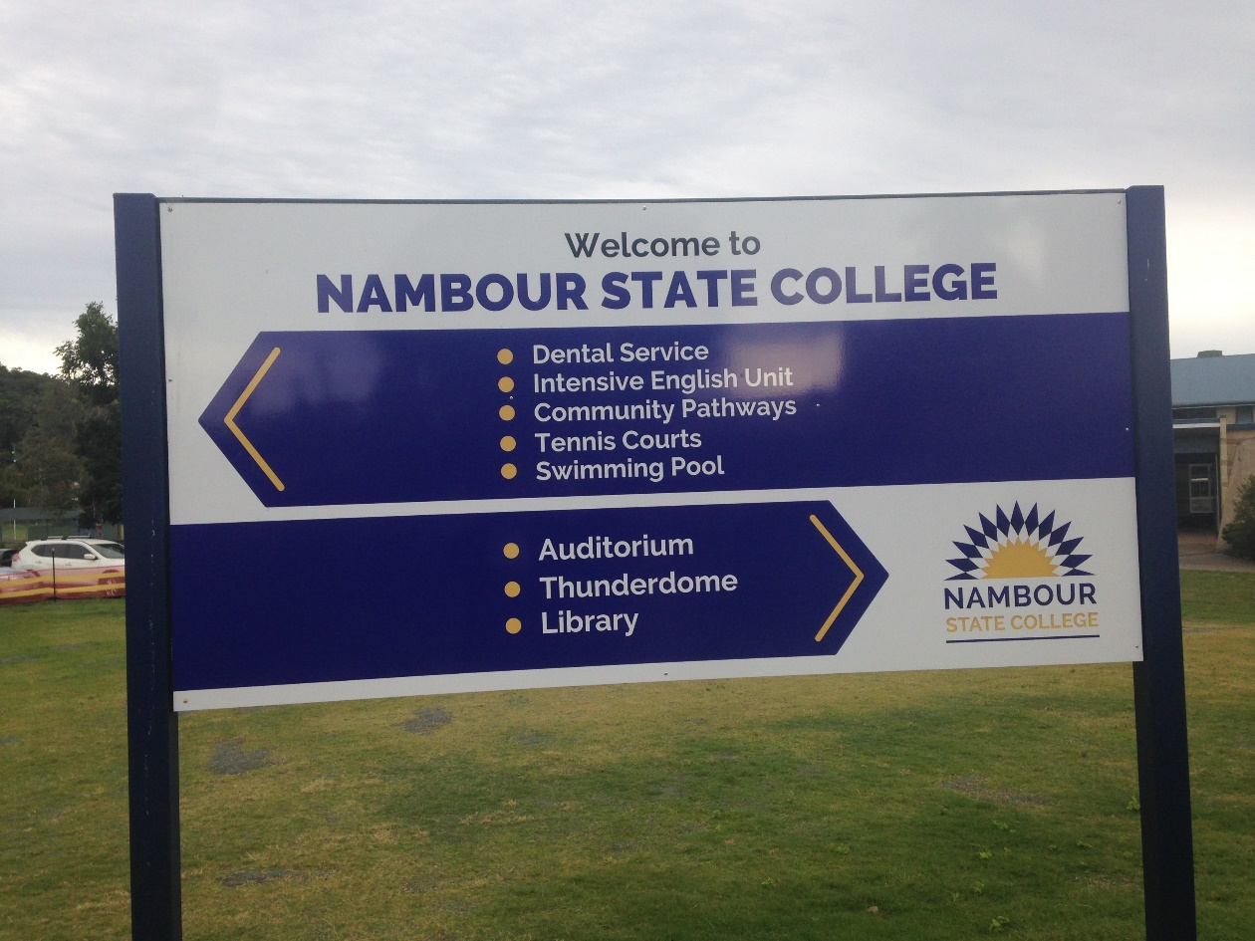
Thank you any questions?

