Slide 1
RIICWM401D supervise civil works
Presentation 1

Slide 2

1.1 INTRODUCTION
Welcome to this unit RIICWM401D: Supervise Civil Works.
Throughout this unit we will be looking at the requirements for:
Planning for work based activities.
Preparing for tasks and activities.
Initiating work.
Monitoring work.
Adjusting work activities.
Reporting on civil works tasks.

Slide 3

1.1 INTRODUCTION
This unit is a general civil works supervision unit and should be used in conjunction with specialist units targeted at specific skills and knowledge areas within the civil works career field.

Slide 4
1.1.1 CIVIL WORKS
Civil works covers a number of areas including:
Types Of Civil Works:
Road And Pavement Construction And Maintenance. | Flexible pavement construction. Rigid pavement construction. Stabilisation of materials. Pavement maintenance.

Slide 5
1.1.1 CIVIL WORKS
Types Of Civil Works:
Bituminous Surfacing. | Asphalt paving and compaction. Application of bituminous spray treatment. Application of polymer modified binders. Selection and use of bituminous emulsions. Application of slurry surfacing. Pavement profiling, using a profiler. Manufacture and delivery of hot mix asphalt. Manufacture of cold mix. Manufacture of polymer modified binders. Manufacture of bituminous emulsion. Manufacture of slurry surfacing.

Slide 6

1.1.1 CIVIL WORKS
Types Of Civil Works:
Civil Structures. | Civil concrete structure construction. Civil steel structure construction. Civil timber structure construction. Civil masonry, crib and gabion construction. Inspection of civil structures. Maintenance of civil structures.
Civil works can also include tunnel construction and demolitions.

Slide 7
1.1.2 CIVIL WORKS TASKS
The tasks involved in civil construction will include, but are not limited to the following:
Types of Civil Works Tasks:
Site preparation. | Extraction.
Load and haulage. | Placement and distribution.
Surface finishing. | Line, grade and level control.
Water application. | Compaction.
Sediment control. | Installation of underground services.

Slide 8

1.2 COMPLIANCE DOCUMENTATION
Documentation is essential to all aspects of every worksite.
From environmental plans through to extraction plans, documentation exists that outlines what to do, when to do it and how it is to be done.
Compliance documentation is the name given to the documents that require you to undertake tasks in a particular way or to meet a given standard.

Slide 9
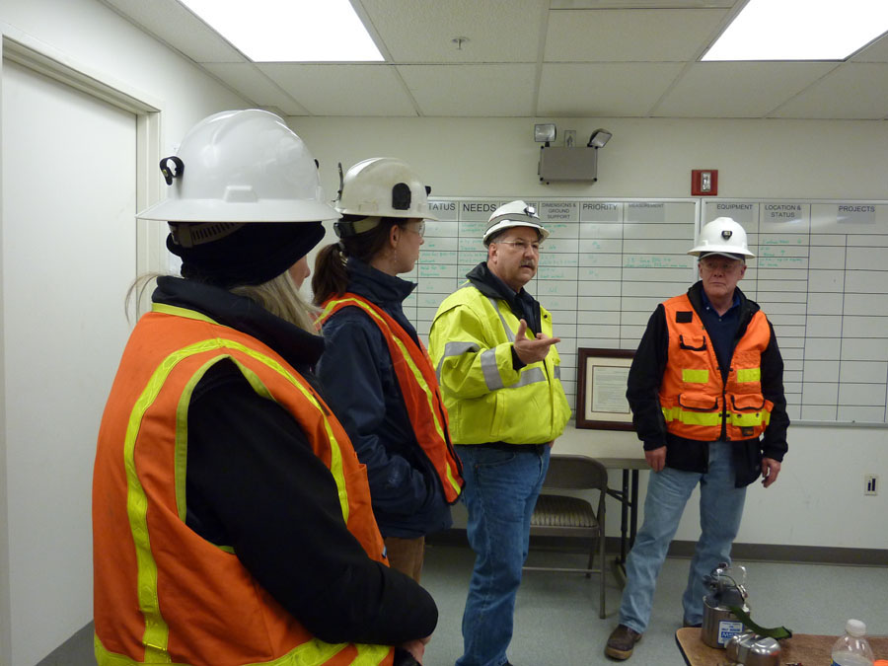
1.2 COMPLIANCE DOCUMENTATION
Every civil construction worksite will have site-specific requirements that will be outlined during your initial induction.
Staff should be notified of changes to compliance documentation during tool box meetings, staff newsletters or other established forms of communication used on the site.

Slide 10


1.2 COMPLIANCE DOCUMENTATION
As a civil construction supervisor, you will be working extensively with compliance documentation, both in your work activities and for the work activities of those people you are supervising.

Slide 11

1.2 COMPLIANCE DOCUMENTATION
The range of compliance documents on your worksite may include:
Legislative, organisational and site requirements and procedures, e.g. for Occupational Health & Safety/Work Health & Safety (OHS/WHS), environmental protection, licensing requirements, personnel/workers training records.
Site specific policies and procedures.
Codes of Practice.
Employment and Workplace Relations legislation.

Slide 12

1.2 COMPLIANCE DOCUMENTATION
Australian Standards.
Australian guidelines and specifications.
Manufacturer's guidelines and specifications, e.g. machinery pre-start checklists, service requirements, vehicle operators’ manuals, vehicle specifications (operating capabilities and limits).
Equal Employment Opportunity and Disability Discrimination legislation.

Slide 13

1.2.1 interpret compliance documentation
When interpreting these documents for others ensure you are giving the other person detailed information as to what is expected of them.
As a supervisor on a civil construction site, you must be able to interpret compliance documentation for yourself and for members of your team.

Slide 14
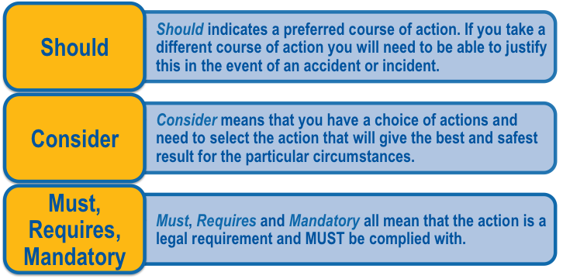
1.2.1 interpret compliance documentation
When interpreting documents it is vital that you understand the difference between words such as should, consider and must.

Slide 15

1.2.1 interpret compliance documentation
Your statutory compliance requirements and procedures must be met.
These statutory requirements and procedures are the minimum level of performance, responsibilities and duties that are set by local, state and federal government.
Each statutory compliance requirement will change between states, between sites and between tasks completed on the site.

Slide 16

1.2.1 interpret compliance documentation
It is essential that each supervisor inform themselves of the requirements that must be met for each particular task and location.
While some of the compliance requirements may be similar, such as compliance with OHS/WHS requirements, others will vary greatly depending on the environmental conditions, work processes and tasks being undertaken.

Slide 17

1.3 ADMINISTRATIVE REQUIREMENTS
Each organisation has different expectations of the supervisory staff regarding the administrative requirements that need to be completed.
These requirements, procedures and tasks will vary depending upon the level of your duties and your site responsibilities.
Most organisations will have specific familiarisation training that is undertaken when you start supervisory roles.
This training will detail exactly what level of administrative tasks are expected of you and how these tasks are to be completed.

Slide 18

1.3.1 CONTRACT REQUIREMENTS
Civil works are always conducted under contract.
Depending upon your level of responsibility you may need to have a very detailed knowledge of the contract, or if you are a front line supervisor you may need to have a general knowledge of what is required and how it is required to be delivered.
Your duty statements will detail what level of contract management you will need to have.

Slide 19

1.3.1 CONTRACT REQUIREMENTS
Interpretation of the project contract requirements and procedures should be very straightforward.
You are required to follow all requirements and procedures. The procedures that are involved with the contract will detail how to complete these tasks.
Most large civil construction projects will have a representative from the contracting body onsite to monitor how the contracted organisation (your company) is managing the project.

Slide 20

1.3.1 CONTRACT REQUIREMENTS
It is this person that will need to be spoken with if problems arise with the contract.
Never approach this surveillance officer unless you have the authority to deal directly with them.
Always use your own line management system to bring problems to the attention of your supervisors first.

Slide 21

1.3.1 CONTRACT REQUIREMENTS
It is a good idea to always ensure variations to the contract procedures and requirements are documented before they are implemented.
Remember, the contract is a legally binding document that states how a task must be completed.

Slide 22

1.3.1 CONTRACT REQUIREMENTS
If the surveillance officer changes these requirements in the field, ask for written confirmation of the changes before implementing the changes.
This is particularly important on sites where there is more than one surveillance officer.
For details on the contract, speak with the site contract manager.

Slide 23
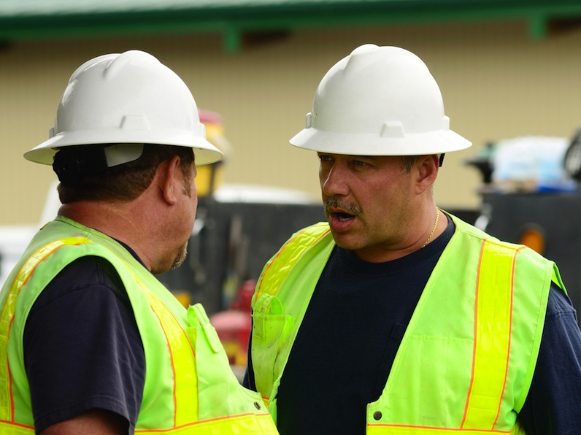
1.3.1 CONTRACT REQUIREMENTS
This person will be the main contact for any issues with the contract.
Alternatively you can speak with the site quality assurance manager.
All procedures and policies that relate to the contract should be contained in the contract management policies and procedures manuals.

Slide 24

1.4 ACCESS AND SHARE TASK INFORMATION AND REQUIREMENTS
Each task on a civil works program will have specific information and requirements that must be met.
As a supervisor it is your responsibility to know and understand the organisational and site operational requirements and to be able to share these requirements with the members of your team.

Slide 25
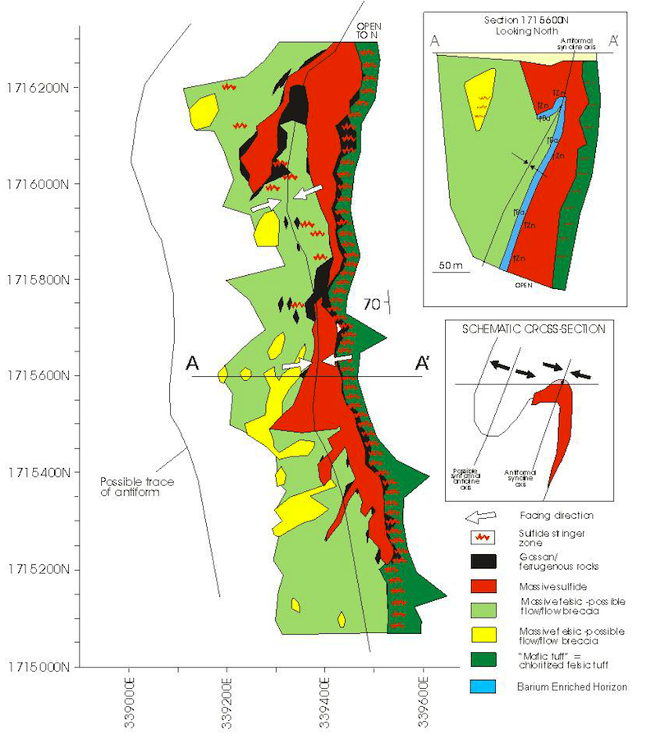
1.4.1 SITE GEOLOGICAL AND GEOTECHNICAL DATA
This data could include rock and soil types and characteristics.

Slide 26
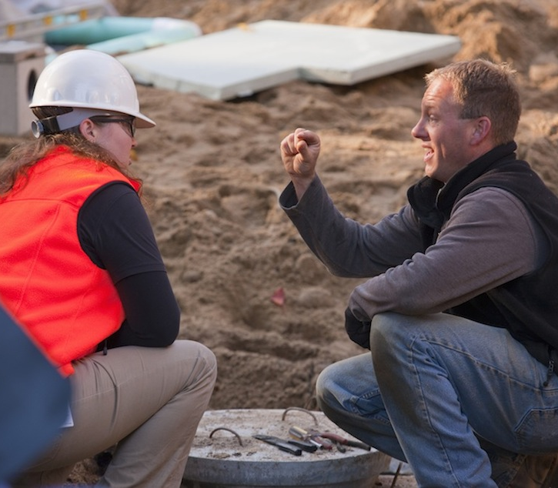
1.4.1 SITE GEOLOGICAL AND GEOTECHNICAL DATA
Knowing the type of soil and rock you are dealing with allows you to determine the correct machinery, resources and work methods to achieve the required tasks.
Information on geological and geotechnical factors that affect the site also allows for better time management and project management by understanding how long it will take to complete tasks.

Slide 27
1.4.1.1 ROCK AND SOIL TYPES
Identification of the different types of rock and soil is essential to the successful completion of most civil construction projects.
Soil and rock types may include:
Rock Types: | Metamorphic | Rocks are heavy and hard.
 | Igneous | Rocks are volcanic and can be hard, but may also be very light
 | Sedimentary | Rocks and shales could peel out when cut and removed.
Soil Types: | Sandy | Soils will require a lot of stabilisation
 | Clay | Soils are harder to work with due to the physical hardness of the soil and the ability of these soils to hold water for long periods of time.
Soil and rock types will have been identified during the site engineering surveys. Interpretation of this data allows for successful planning and preparation on the worksite.

Slide 28
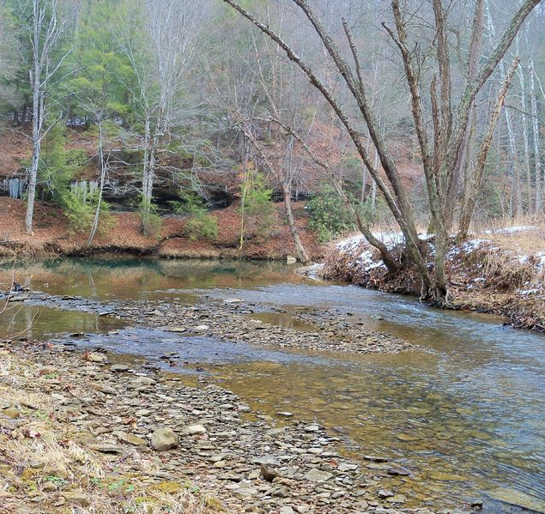
1.4.2 SITE HYDROLOGICAL DATA
This data is the information relating to water on, in, near or under your site.
It will include surface water and ground water but could also include rivers, creeks, dams, dry waterbeds, wetlands and other areas where water is or could be.

Slide 29
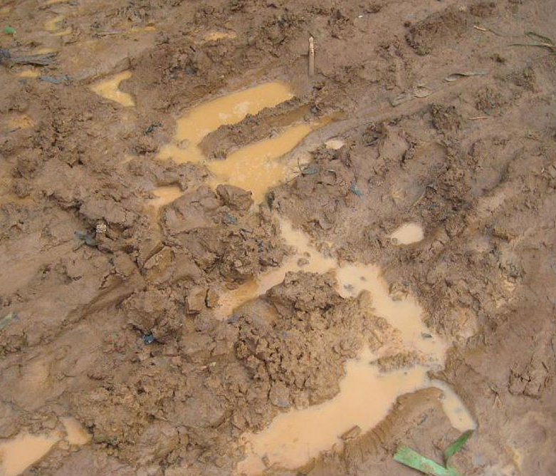
1.4.2 SITE HYDROLOGICAL DATA
The hydrological data is used to ensure correct drainage of the site, for protection of the waterways and water dwelling flora and fauna.
Having an understanding of what the water on the site is doing allows you to anticipate drainage issues and erect erosion and sediment controls before drainage becomes a problem.

Slide 30
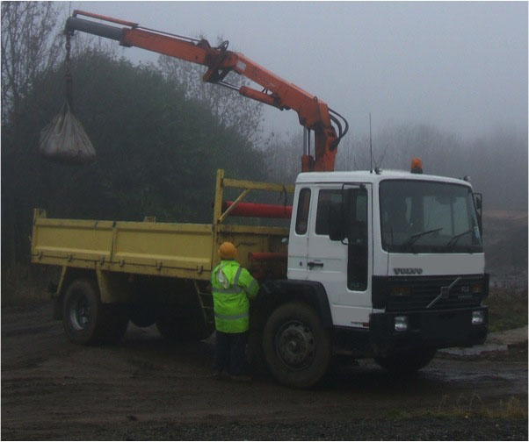
1.4.3 SITE METEOROLOGICAL DATA
This data includes rainfall, humidity, temperature, wind and night conditions such as frosts and fogs. Having a good understanding of this data allows you to plan your daily activities more successfully.
On civil construction worksites, meteorological data can have a huge impact on the tasks and activities that are undertaken.
To access meteorological data use a reputable website such as www.bom.gov.au.

Slide 31
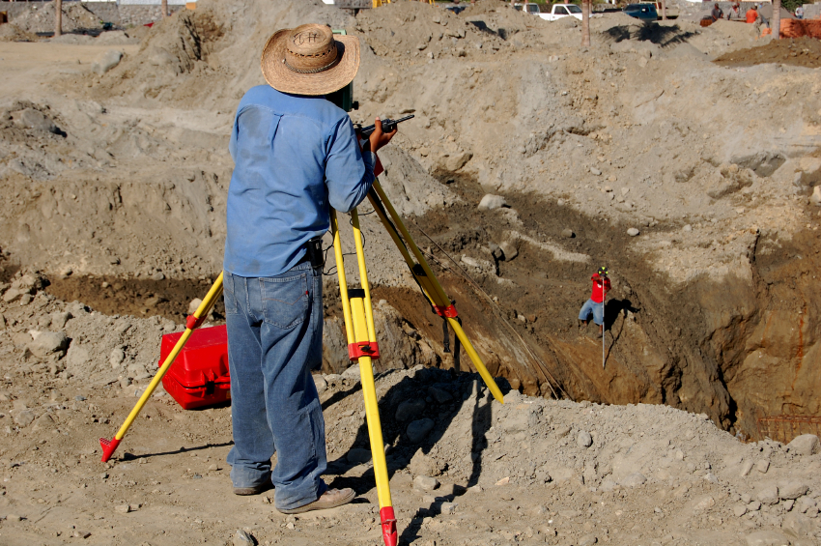
1.4.4 ENGINEERING SURVEY PRINCIPLES AND DATA
Engineering surveys are a very important aspect of supervising civil works. Without appropriate surveys for setting out works, monitoring progress and for conforming completed components, the job will be made much more difficult.

Slide 32
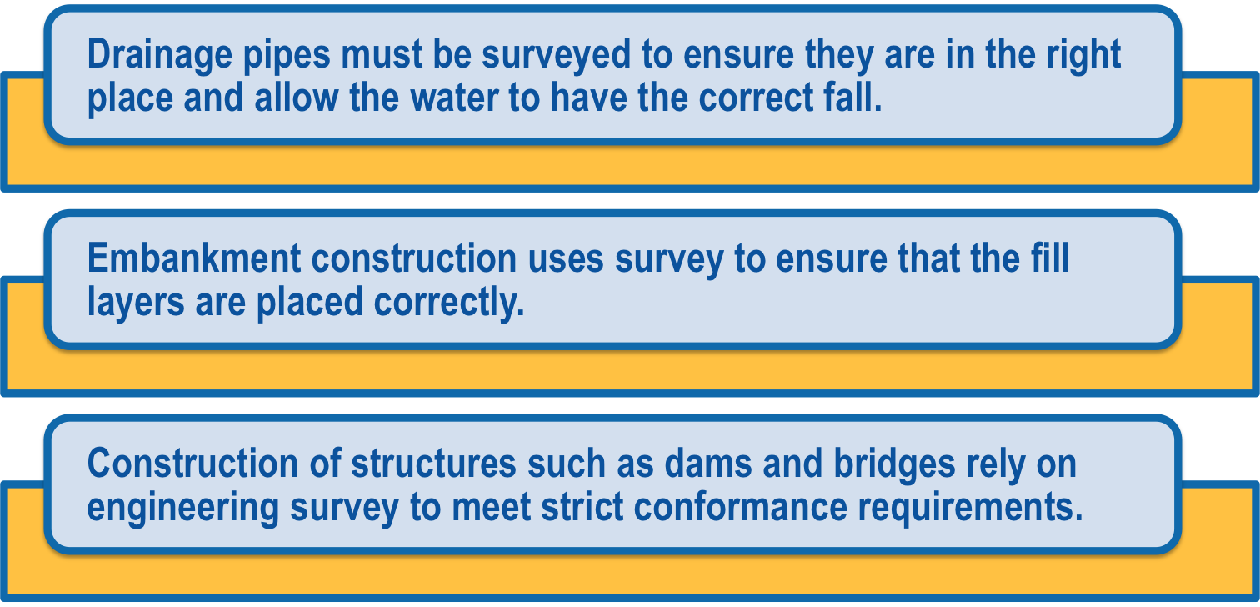
1.4.4 ENGINEERING SURVEY PRINCIPLES AND DATA
A lot of civil works tasks rely on accurate survey and level points to achieve the work targets. For example:
Site engineering survey data is used in monitoring the progress of the job. Survey and levelling reports contribute to part of the lot records. These are also used as a historical record for the project.

Slide 33
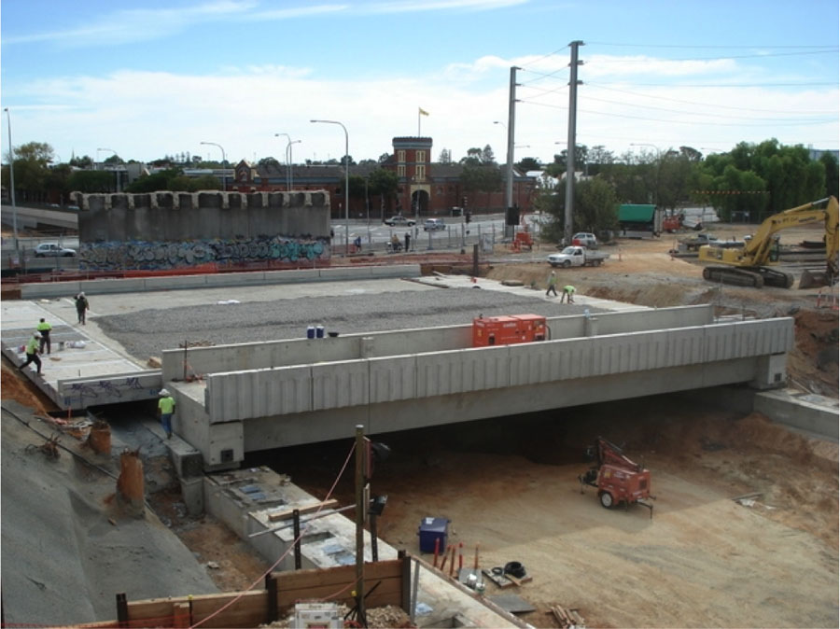
1.4.4.1 LARGE STRUCTURES AND INFRASTRUCTURE WORKS
In the case of large structures that may have a design life long beyond the duration of the project such as pavements, dams and bridges, survey data can prove valuable where defects and faults may occur in the future.
Survey data for large infrastructure works is monitored after the end of the works to assess the need for maintenance or to indicate potential problems.

Slide 34
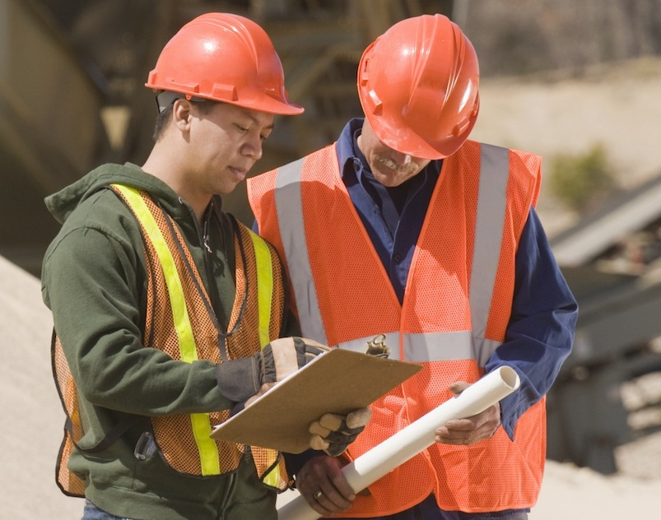
1.4.4.1 LARGE STRUCTURES AND INFRASTRUCTURE WORKS
This is most evident where changing conditions may occur such as in the case of dams that may not have water to full capacity all the time, during drought conditions or following spill over events.
The survey data provides an ongoing record of the integrity and stability of the structure.

Slide 35

1.4.5 MATERIAL PROPERTIES AND TEST RESULTS
Sources of materials should be identified before work commences.
Often this identification will be done while engineering surveys are being completed or will be done by the purchasing or procurement department if materials need to be purchased.
Interpretation of these results and requirements will allow you to ensure the correct materials are being used in the correct manner for the required results.

Slide 36
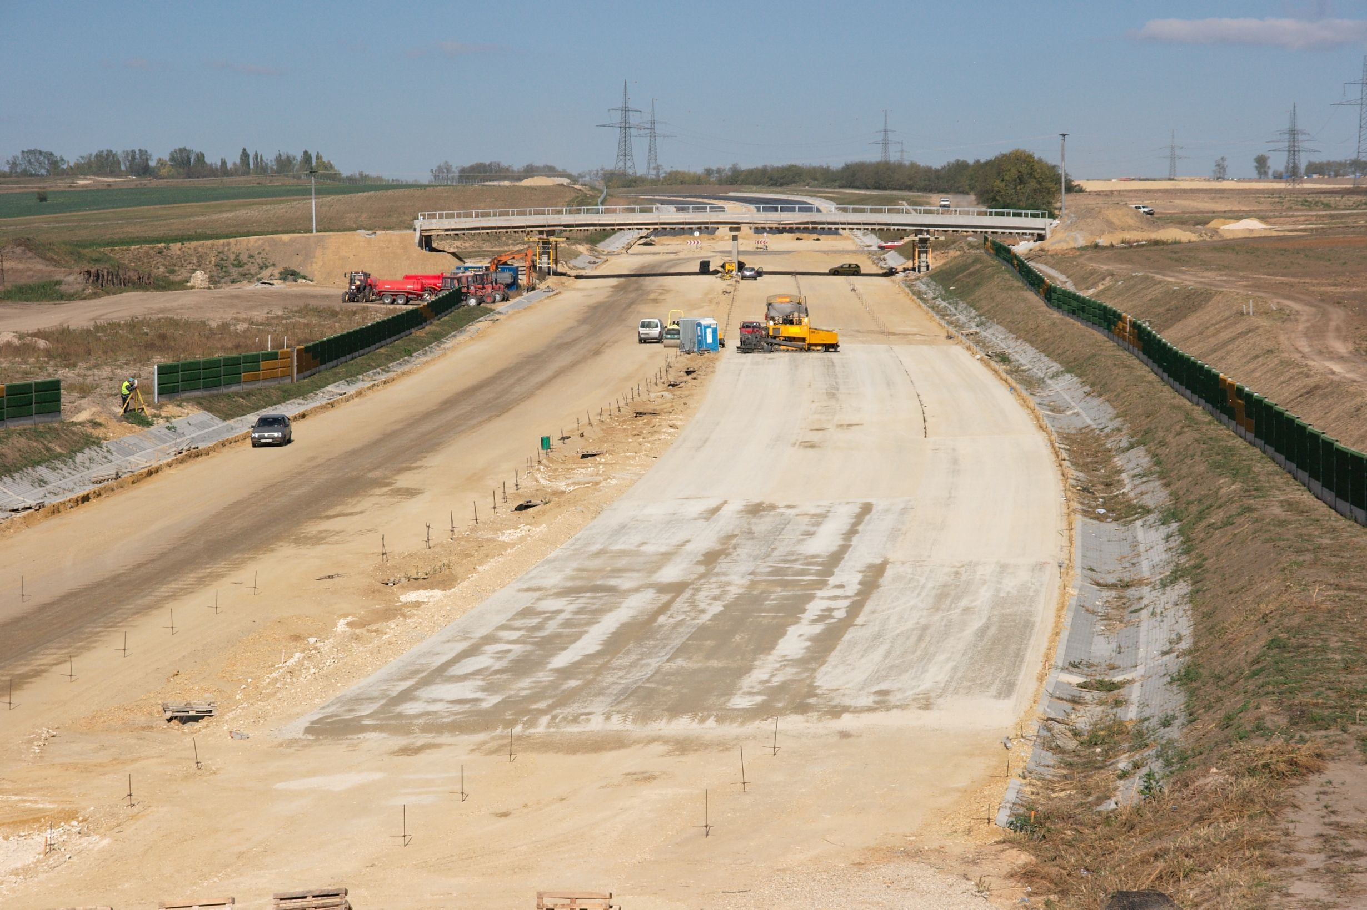
1.4.6 ROAD GEOMETRY
Road geometry is the phrase used to describe the shape, slope and gradient of the road.
The slope and gradient of the road will be expressed as either a percentage or a comparison i.e. 500:1 meaning for every 500 metres along the road, the road will rise for 1 metre.
Road geometry will be determined by the engineers and designers and will be contained in the specifications.

Slide 37

1.4.6 ROAD GEOMETRY
You will need to identify the geometry from the plans and relay the geometry requirements to the grader or other plant operators.
Road geometry is an important aspect of road building as it is the geometry that determines how water is drained off the surface, how vehicles will drive around curves in the road and the general safe usability of the road.

Slide 38
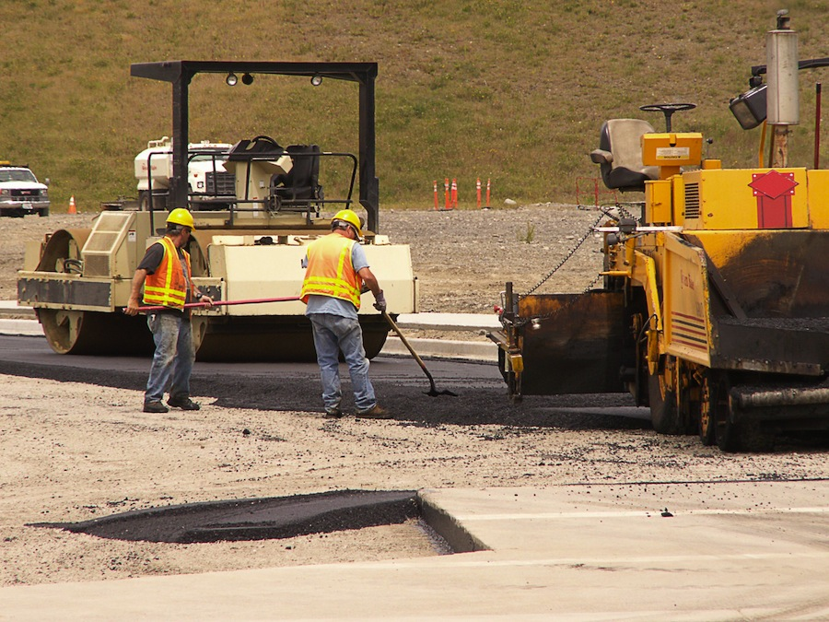
1.4.7 TYPES OF ASPHALT
Asphalt is a common product used for surfacing and maintaining roads or areas where high traffic (both vehicle and pedestrian) may occur.
The most common type of asphalt used in civil construction is dense graded asphalt.
This is also known as hot mix, AC (asphalt concrete), and BC (bitumen concrete).

Slide 39
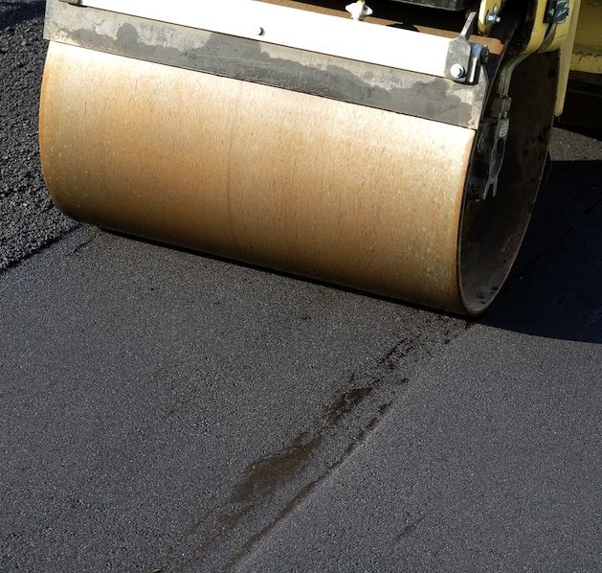
1.4.7 TYPES OF ASPHALT
Application of the asphalt is done at temperatures over 70 degrees Celsius. Asphalts must be placed and compacted hot to ensure that the product can be worked correctly and so that the performance is kept at a high level.
As the asphalt cools down, it hardens which significantly reduces the workability of the product.
Layer thickness is important. Usually, asphalt is placed in layers so that the correct compaction can be achieved.

Slide 40
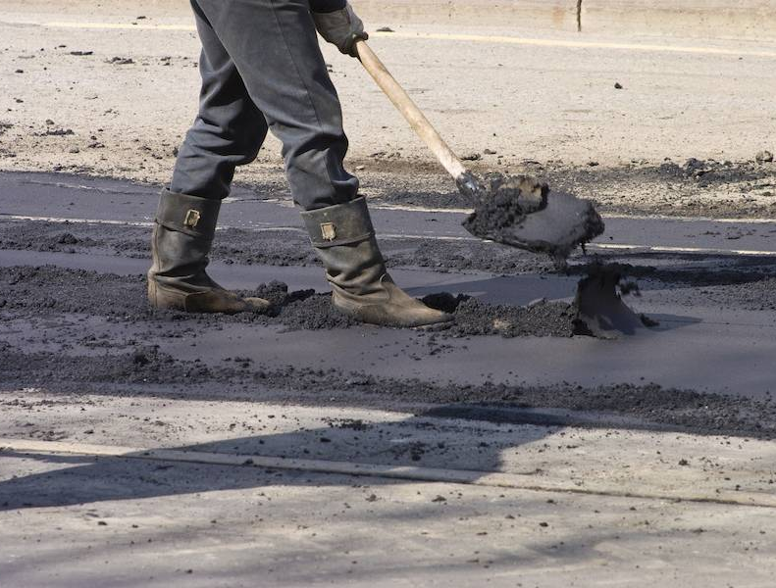
1.4.7 TYPES OF ASPHALT
The asphalt mix design will account for different characteristics and different applications. Asphalt may have bitumen or polymer binders. The correct mix design must be applied to the task to reduce the risk of defects and failure and to correctly meet specification requirements.
When using any asphalt products, it is important to know and understand the safety requirements for working with hot products. Bitumen and asphalt burns can be very severe, so everyone must be aware of the handling requirements.

Slide 41

1.4.8 SITE HAZARDS, CONSTRAINTS AND CONDITIONS
These could include known hazards, constraints and conditions or the hazards that have the potential to occur.
Hazard identification should be an activity that is undertaken by every member of the team, but as a supervisor it is your responsibility to ensure you and your team are undertaking regular hazard identification actions.
Constraints and conditions are those factors that will or may impact on the activities.
The impact could be through actions that need to be taken, areas that need to be avoided or resource and material choices.

Slide 42
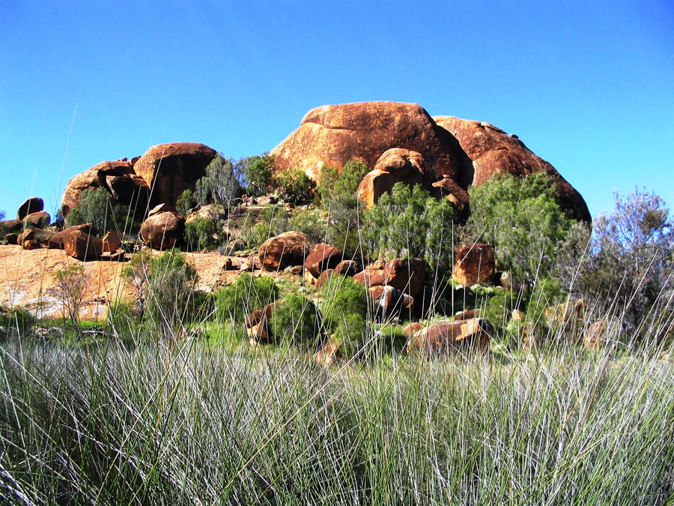
1.4.9 SITE CULTURAL AND HERITAGE INFORMATION
This data is the information that relates to the history of the area in which you are working.
Often when the local population object to the construction of the project, they will use cultural, environmental or heritage grounds.
Cultural and heritage data may form some of the constraints and conditions on the site that affect what resources are used, the areas where access needs to be restricted and other factors.

Slide 43

1.4.9 SITE CULTURAL AND HERITAGE INFORMATION
A cultural and heritage officer may be appointed to work on some large sites.
This person is then able to assess the cultural and heritage value of any objects found on the site.
As a supervisor you need to be aware of the impact the cultural and heritage data can have on the conditions in which your team is working.

Slide 44
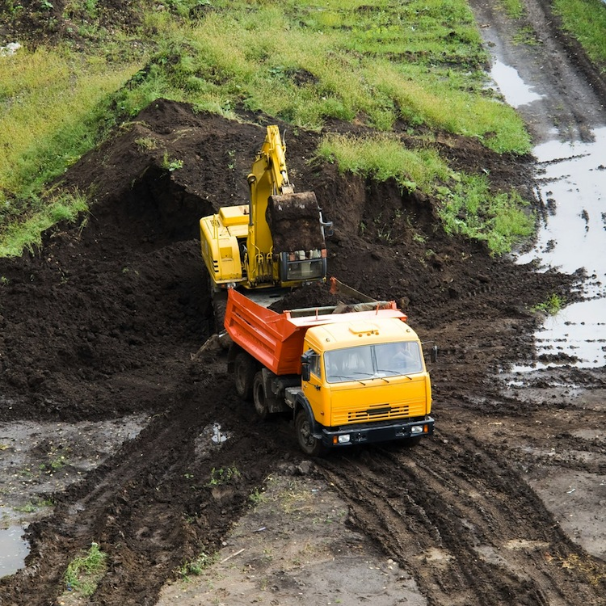
1.4.10 CIVIL CONSTRUCTION SEQUENCING
Knowing the sequence of work activities allows you to plan effectively. For example:
Earthworks:
Mark out the work area.
Clear and grub – which is vegetation removal.
Topsoil removal.
Creation of contours, drains or next step in the
construction process.

Slide 45
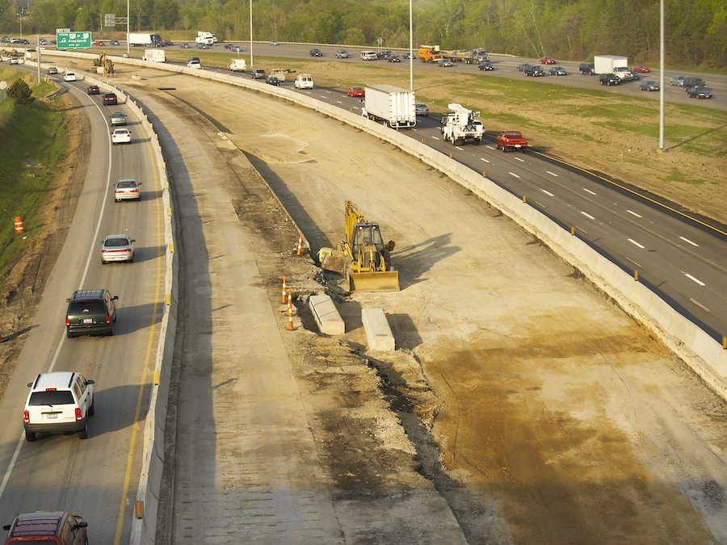
1.4.10 CIVIL CONSTRUCTION SEQUENCING
Roadwork Construction:
Would follow the earthworks steps, but then include:
Formation of drain lines or contours.
Cut and fill to the needed level.
Compaction activities.
Pavement layers.

Slide 46
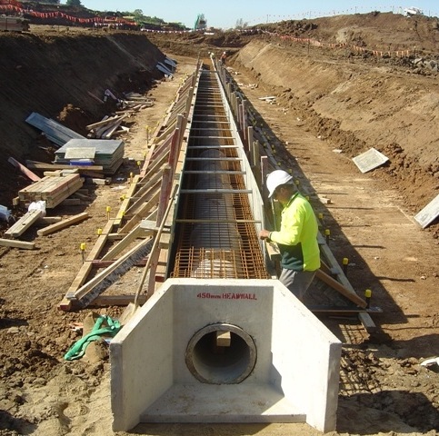
1.4.10 CIVIL CONSTRUCTION SEQUENCING
Drainage:
Would include the steps for earthworks then:
Form drain lines.
Form out the area to be worked in – that is build
the frame to hold the drain system.
Lay pipes, box drains or culverts.
Back fill.
Landscape appropriately.

Slide 47

1.4.11 QUANTITY CALCULATION
As a supervisor, you may be required to complete a variety of calculation tasks to determine quantities for materials required on the worksite.
The most common calculations will be for:
Area.
Volume.
Percentage.
Grade.
Resource consumption figures.

Slide 48
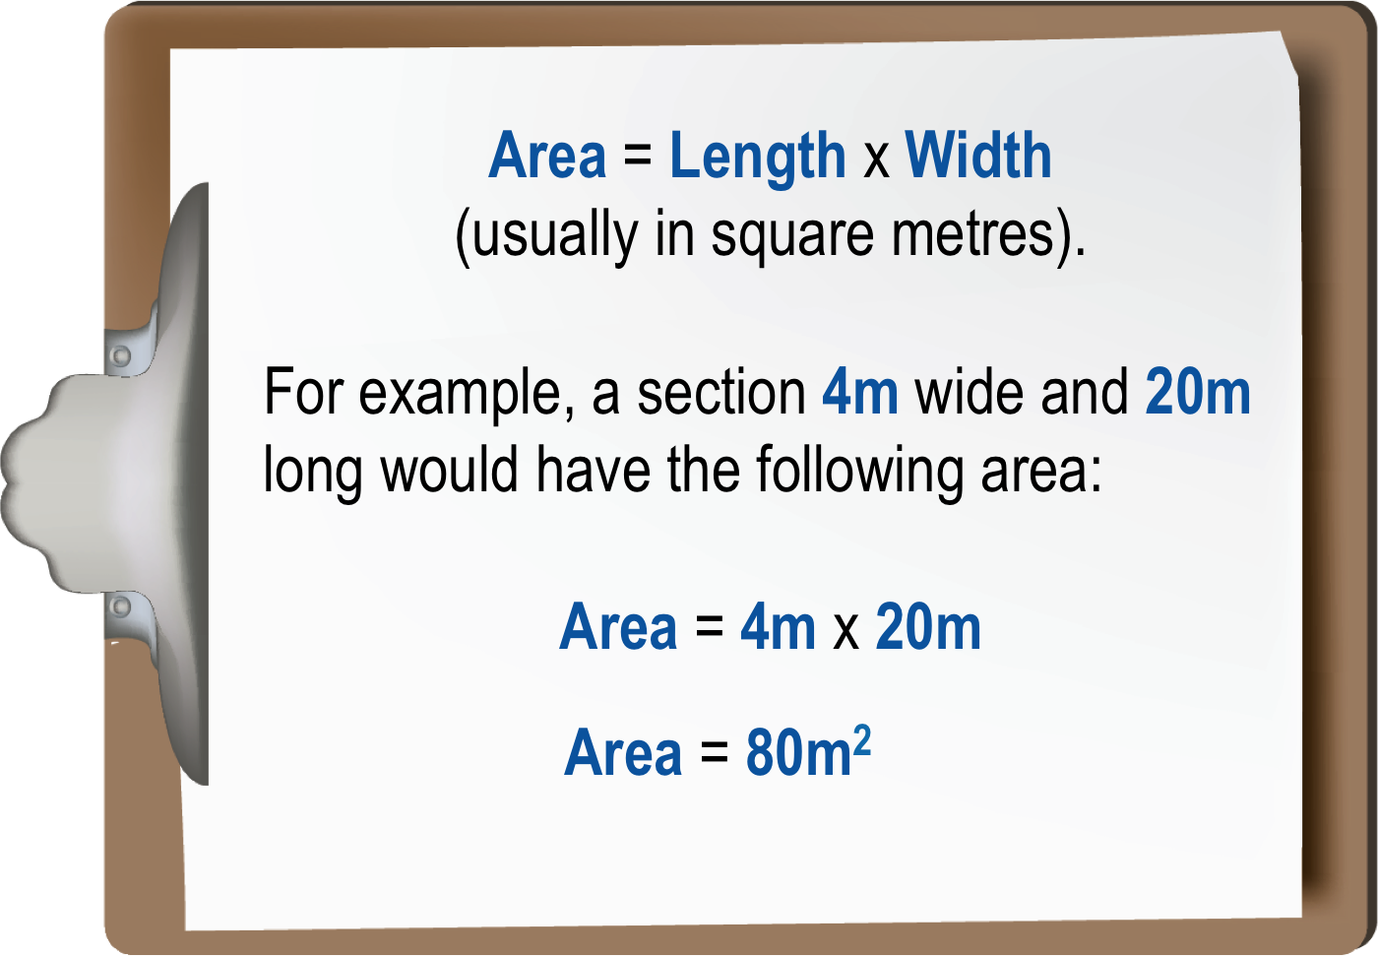
1.4.11 QUANTITY CALCULATION
Area
If you were given an area, and you know one of the dimensions (e.g. width or length), you can work out the other factor.

Slide 49
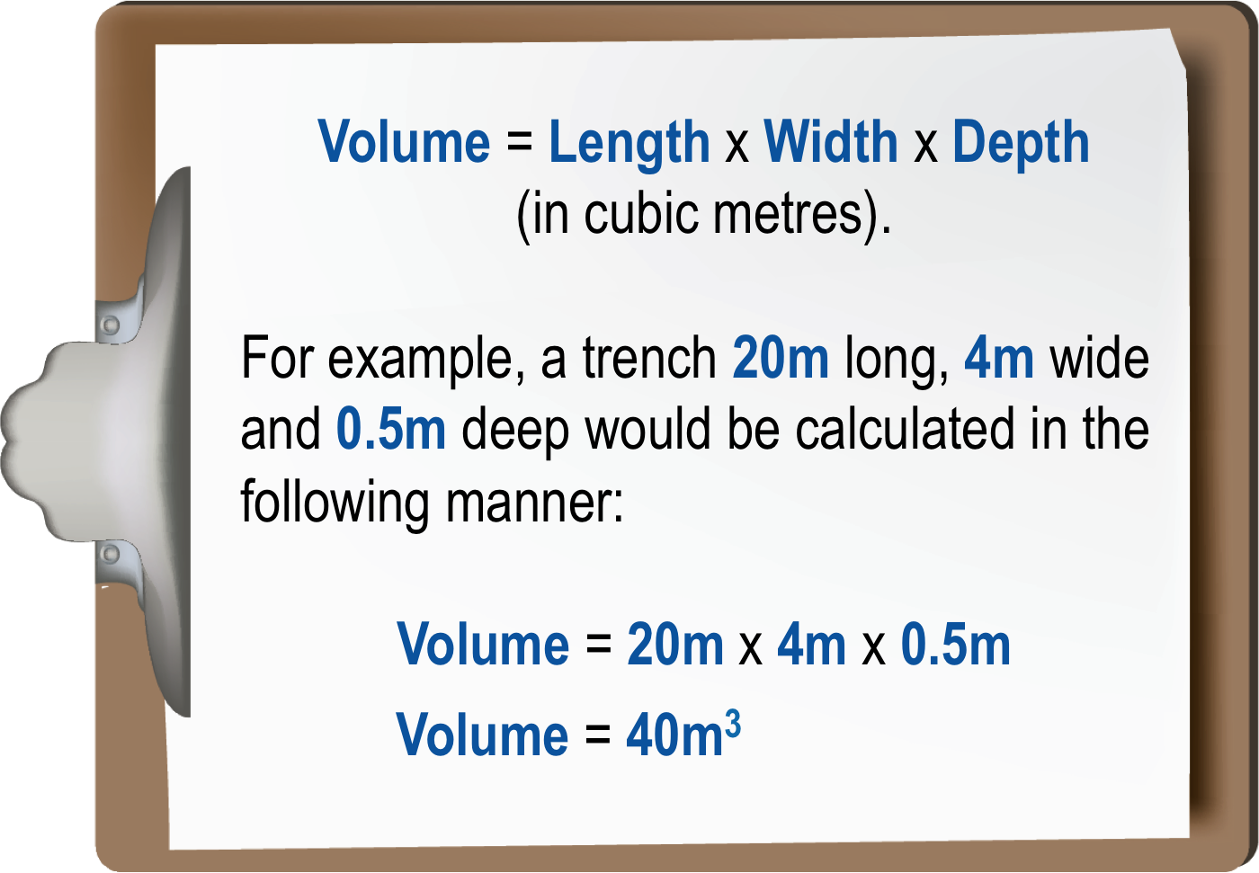
1.4.11 QUANTITY CALCULATION
Volume
Another common calculation is for volume. This is calculated by multiplying length x width x depth or height. That is, depth if it is hole or height if it is a pile.

Slide 50
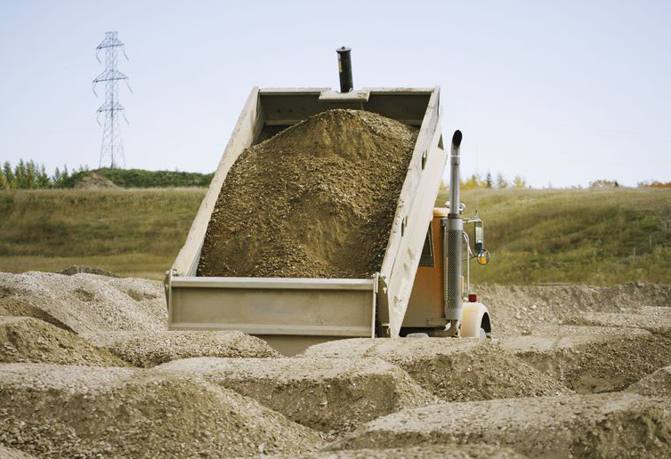
1.4.11 QUANTITY CALCULATION
Tonnage Requirements
Once you have determined the volume of materials required, you will be able to work out the tonnage requirements, or tonnage usage.
To do this, multiply the volume required (in cubic metres) by the common materials weight in tonnes.

Slide 51
1.4.11 QUANTITY CALCULATION
The weights for common materials are shown in the table below.
Common Material Weights:
Bronze | 8.5t / cubic metre | Lead | 11.4t / cubic metre
Clay | 1.9t / cubic metre | Lime (stone) | 2.6t / cubic metre
Coal | 864kg / cubic metre | Sand, beach, dry | 2.0t / cubic metre
Concrete | 2.4t / cubic metre | Sand, beach, wet | 2.3t / cubic metre
Earth | 1.9t / cubic metre | Sand, river, wet | 1.5t / cubic metre
Granite | 2.6t / cubic metre | Shale | 2.6t / cubic metre
Gypsum | 2.3t / cubic metre | Terracotta | 1.8t / cubic metre
Iron Ore | 5.4t / cubic metre | Zinc | 7.0t / cubic metre
Note: Clay is more cohesive and harder to excavate, push and spread than topsoil.

Slide 52
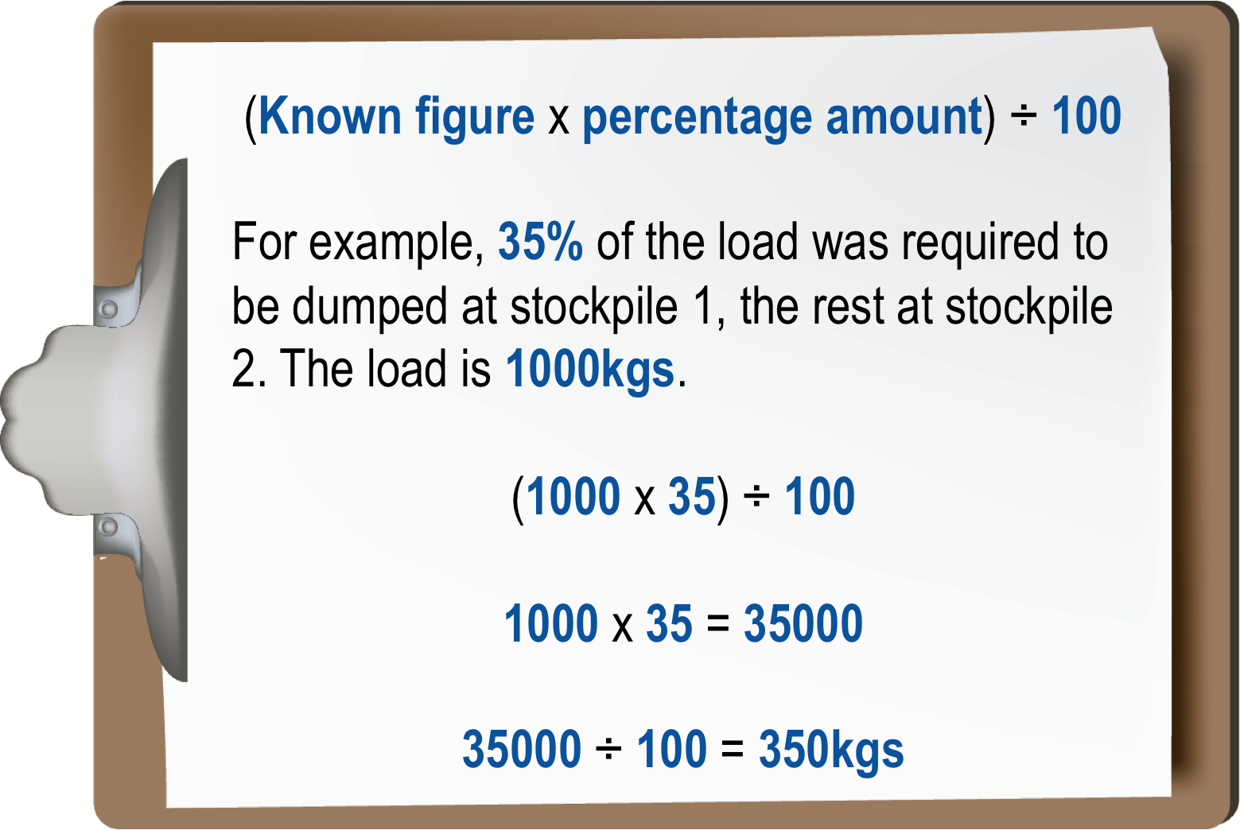
1.4.11 QUANTITY CALCULATION
Percentage
A percentage of a known figure is relatively easy to determine.
Therefore 350 kg would be left at stockpile 1, while 650kgs would be in stockpile 2, (simple subtraction of 350 from 1000).

Slide 53
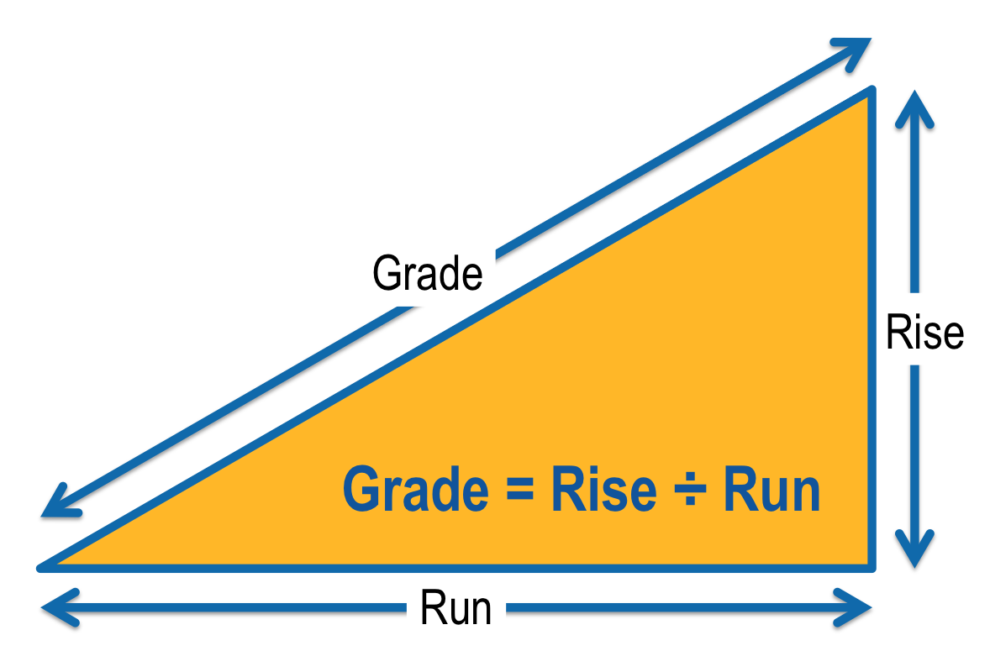
1.4.11 QUANTITY CALCULATION
Grade
Grade is generally calculated using levelling equipment. The basic formula for grade is rise over run. That is, how high the road rises compared to a known distance.

Slide 54

1.4.11 QUANTITY CALCULATION
There are other calculations that may be required depending on the type of work activity being performed, such as resource consumption figures.

Slide 55

1.4.11 QUANTITY CALCULATION
Resource Consumption
Resource consumption, including required supply rates, refers to how much material is used or consumed and how quickly it can be resupplied, either from another location on the worksite or from an external supplier.
It is important to know supply times from external suppliers as there may be a delay to the works if materials are not available when needed.

Slide 56
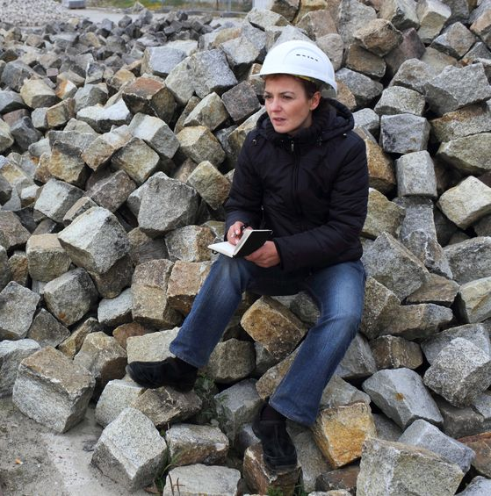
1.4.11 QUANTITY CALCULATION
Daily production figures will often be used as a guideline to work out consumption rates. Be aware, however, that not all materials are consumed at the same rate and supply rates may differ from worksite to worksite.
If you are unsure about how to correctly calculate any of these quantities or interpret resource consumption figures, your manager will be able to help you.
Different civil works applications will also use different formulas for determining calculations.

Slide 57

1.4.12 ESTIMATION PRINCIPLES
On civil construction sites you will need to use different estimation techniques on occasions.
The principle of estimation is to attempt to make an educated guess as to what amounts, distances or other unit of measurement is required.
Commonly materials or time are the main factors that will require estimation.

Slide 58

1.4.13 TASK SPECIFICATIONS
This information is how the activity is to be completed, based on your client’s requirements. It can be conveyed in site or task drawings, plans and documents.
Project specifications may give an acceptable range of data, but they may also be highly specific in what must be achieved.
When interpreting and sharing this information with members of your team, ensure you are just as clear and detailed about what must be achieved and how the requirements are to be met.

Slide 59

1.4.14 CONTRACTORS AND OTHER ORGANISATIONS
Different contractors and other organisations will have an impact on the activities undertaken on the site.
As a supervisor it is important that you understand the roles these others will play in the construction project and how their activities will impact the activities of your team.

Slide 60
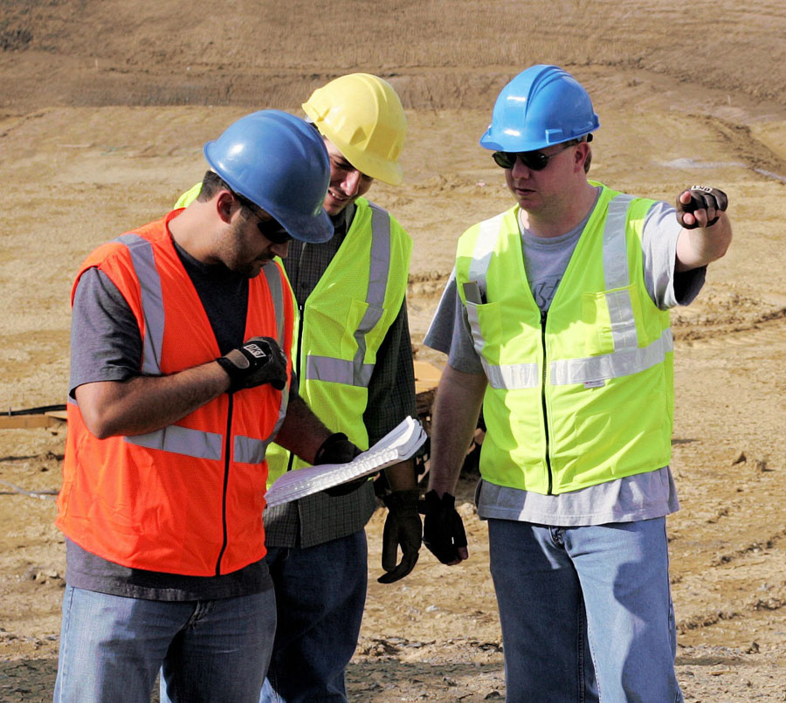
1.4.14 CONTRACTORS AND OTHER ORGANISATIONS
On most projects there are various teams working on different stages of the project, with each team relying on the others to complete tasks on time so the next task can start on time.
Without a good working relationship between the various work teams, it can be extremely difficult to achieve a good end result without a significant amount of stress and anxiety.

Slide 61
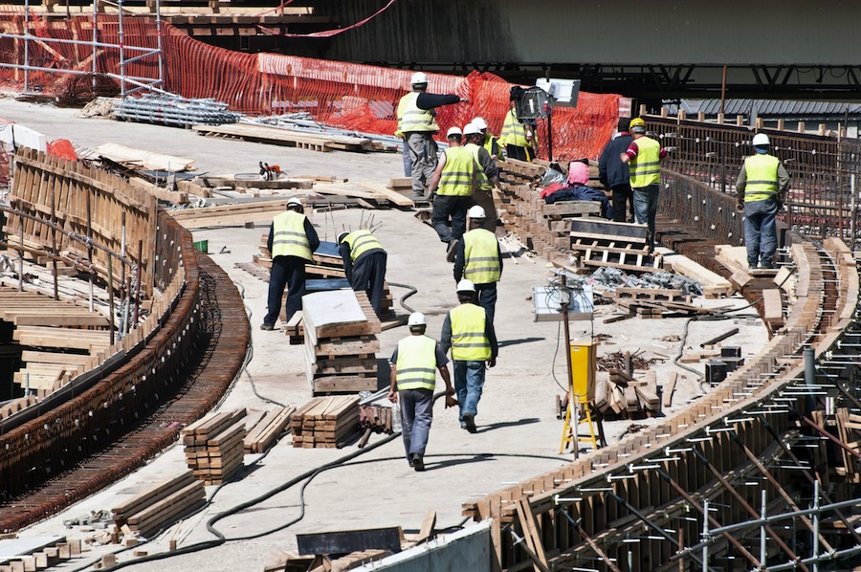
1.4.15 COORDINATION, TIMING AND BUDGETING
Coordination, timing and budgeting requirements need to be managed on a worksite to ensure all actions and activities are within the required costs and timeframes. Budgeting is a constant factor with all civil construction projects to ensure the project finishes within the financial constraints.

Slide 62

1.5 PREPARE JOB PLAN IN CONJUCTION WITH TEAM MEMBERS
Job plans are used in order to complete the tasks assigned to your team. There are a number of aspects to be considered when creating a job plan.

Slide 63
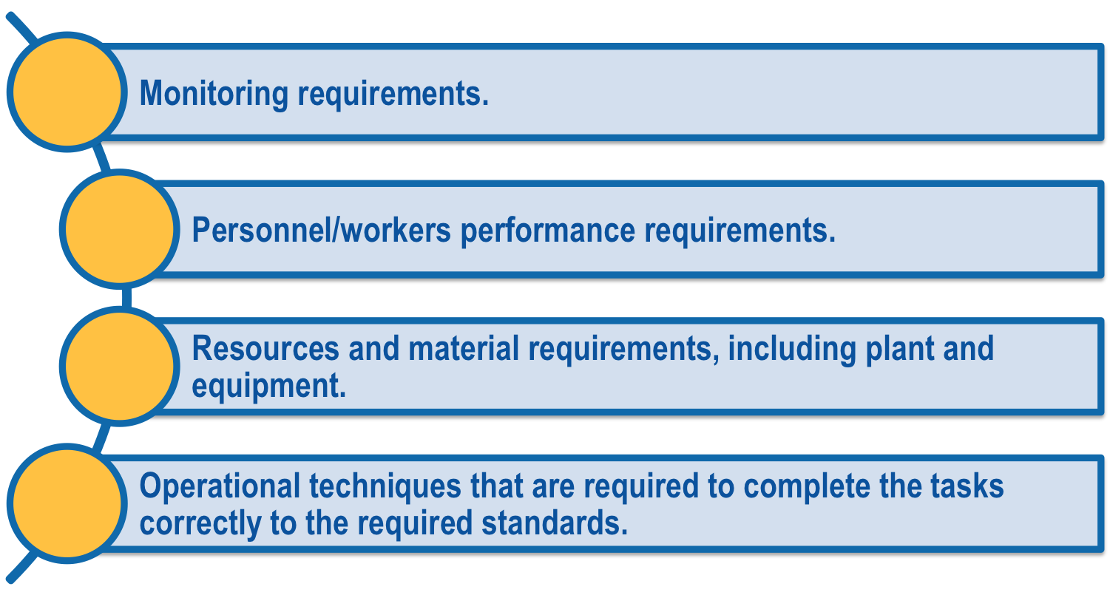
1.5.1 TASK REQUIREMENTS
Task requirements should include:

Slide 64
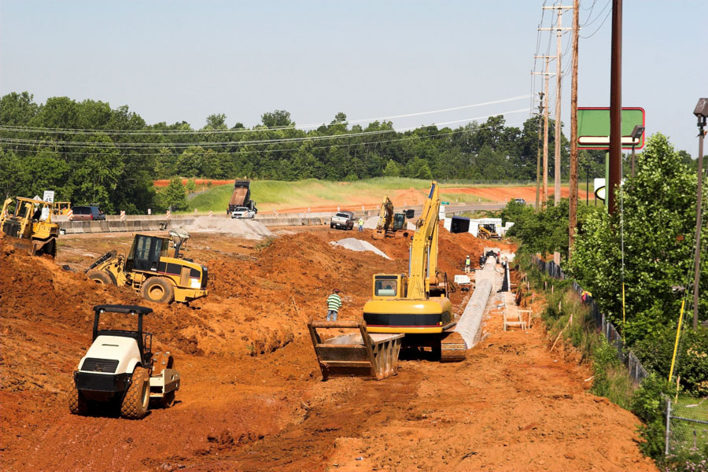
1.5.1 TASK REQUIREMENTS
Operational techniques will vary greatly from task to task and site to site due to the varying specifications and site requirements.
Flexibility in the application of techniques is essential to ensuring you are achieving the best possible results.
By selecting and assigning the most appropriate plant, equipment and personnel/workers to completing the tasks you will have better end result.

Slide 65

1.5.1 TASK REQUIREMENTS
When evaluating which people should be working where, look at the strengths, skills, competencies and abilities of each person and assign them to tasks they are able to complete.
Sometimes it is necessary to assign a person to a task they are not yet competent in completing, so that they can develop the skills required.
If you need to do this, ensure you have a competent person assisting them to ensure the task is completed adequately.

Slide 66
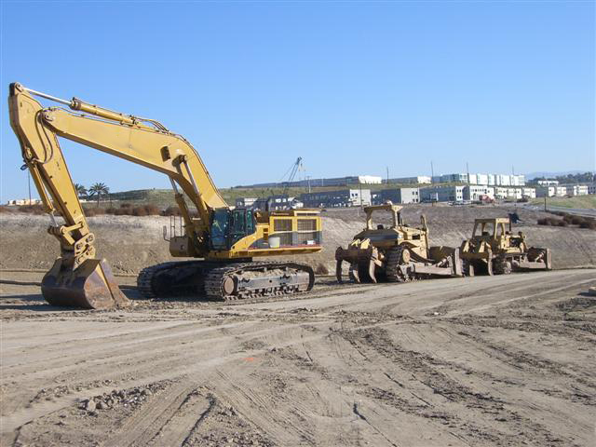
1.5.1 TASK REQUIREMENTS
Assigning plant and equipment to tasks is a straightforward process of ensuring best fit between the task and the available equipment, plant or machinery.
Knowing the capabilities of each item of plant or equipment that is being used on the site will allow you to select the most appropriate item to use in the civil works construction tasks.

Slide 67

1.5.2 COMMUNICATION REQUIREMENTS
Communication requirements could relate to internal or team communications and also external communications to suppliers, testing agents, surveillance officers, media or community liaison personnel/workers.
How communications must be conducted will be detailed in your organisational communications plan and procedures.

Slide 68

1.5.3 REPORTING REQUIREMENTS
Reporting requirements will impact how you conduct tasks and activities.
Knowing these requirements allows you to plan for time to complete the reports or for time to collect and collate the information required to go into the reports.

Slide 69

1.5.4 RISK ASSESSMENTS AND MANAGEMENT REQUIREMENTS
Conducting risk assessments on the tasks and activities is essential to ensure the health and wellbeing of your team members.
How these assessments are to be conducted will be determined by the organisational policies and procedures.
Each site will have specific requirements that must be met and procedures that must be adhered to.

Slide 70

1.5.5 OHS/WHS REQUIREMENTS
These will work closely with the risk assessment and management process.
Ensure you know the OHS/WHS requirements for the tasks your team members are undertaking to ensure you are able to inform the team as to what is required of them.
Each site will have slightly different requirements and it is essential you identify and apply these in accordance with the needs of the site.

Slide 71
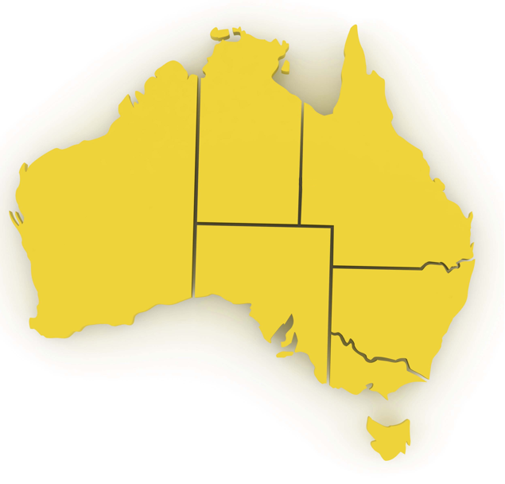
1.5.1.1 HARMONISATION OF WORK HEALTH & SAFETY LEGISLATION
In response to industry calls for greater national consistency, the Commonwealth, states and territories have agreed to implement nationally harmonised Work Health & Safety (WHS) legislation to commence on 1 January 2012.
While not all states and territories have actually implemented the model WHS legislation as of the start of 2012, it is important to be aware of these changes, as all states and territories will eventually implement them.

Slide 72

1.5.1.1 HARMONISATION OF WORK HEALTH & SAFETY LEGISLATION
Harmonisation aims to develop consistent, reasonable and effective safety standards and protections for all Australian workers through uniform WHS laws, regulations and codes of practice.

Slide 73

1.5.1.1 HARMONISATION OF WORK HEALTH & SAFETY LEGISLATION
Key Elements Of The Work Health & Safety Legislation
The following key elements of the WHS legislation will impact the way you do your job, and the responsibilities of your workplace:
There is a primary duty of care requiring persons conducting a business or undertaking (PCBU) to ensure, so far as is reasonably practicable, the health and safety of workers and others who may be affected by the carrying out of work.
1
2
A requirement that officers of corporations and unincorporated bodies exercise due diligence to ensure compliance.
3
Workers must exercise reasonable care that their acts or omissions do not adversely affect the health and safety of persons at a workplace.

Slide 74

1.5.1.1 HARMONISATION OF WORK HEALTH & SAFETY LEGISLATION
The legislation also outlines requirements for:
The reporting requirements for notifiable incidents.
Licences, permits and registrations (e.g. for
persons engaged in high risk work or users of
certain plant or substances).
Provision for worker consultation, participation and
representation at the workplace.
Provision for the resolution of health and safety
issues.
Protection against discrimination.

Slide 75

1.5.1.1 HARMONISATION OF WORK HEALTH & SAFETY LEGISLATION
Many specific details relating to WHS will be negotiated within the workplace in accordance with the legislation.
It is important that you speak with your Health and Safety Representative or supervisor for more information on how these elements will effect your day-to-day operations, or if you have any concerns relating to health and safety.

Slide 76

1.5.6 ENVIRONMENTAL REQUIREMENTS
The protection of the environment is a task that needs to be undertaken by all members of the site.
You will need to know the environmental protection requirements so you are able to create job plans that adhere to these requirements.
Each site will have slightly different requirements and it is essential you identify and apply these in accordance with the needs of the site.

Slide 77
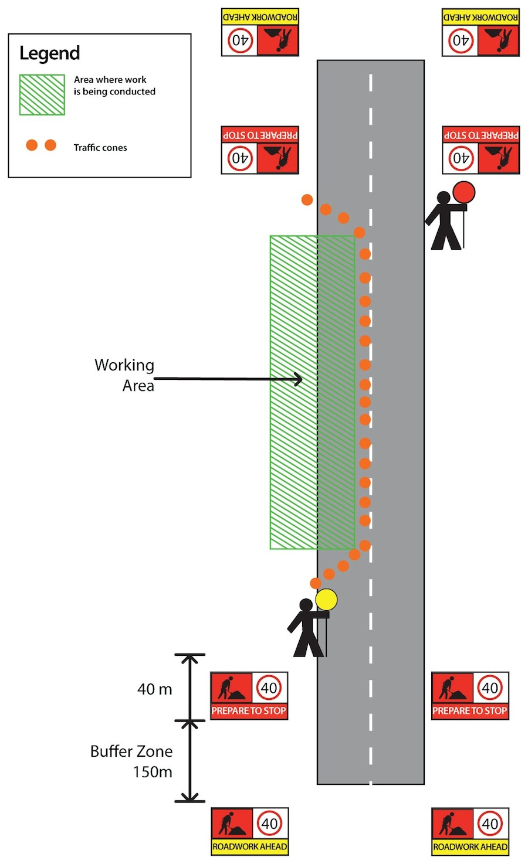
1.5.7 TRAFFIC MANAGEMENT REQUIREMENTS
Traffic management requirements could include contracting a traffic management company or having your own trained staff undertaking traffic management.
Traffic management plans account for signage requirements, site access or isolation needs and activities being undertaken.

Slide 78

1.5.7 TRAFFIC MANAGEMENT REQUIREMENTS
The design and creation of traffic management plans is a specialised area that requires additional training.
On some worksites these plans may need to be submitted to an authorising body, such as the RTA for approval before they can be used.
Each traffic management plan will differ, so always double check that you are using the correct plan or drawing before passing on the information to your team members.

Slide 79

1.5.8 QUALITY REQUIREMENTS
Each civil construction activity will have quality requirements.
These requirements will be outlined in the task or site specifications. You must know and apply these quality requirements to the task.
Some of the common quality requirements include testing of materials and tasks, compactions, scheduling, and inspection by Quality Assurance (QA) staff.
If you are unsure of the quality management requirements on your worksite speak to your quality assurance manager or site QA officer.

Slide 80
1.5.9 TASK RESOURCE REQUIREMENTS
The following are examples of Task Resource Requirements:
Task Resource Requirements:
Personnel/workers requirements | Do you have enough trained and competent people to complete the tasks in the timeframe given to you?
Plant, machinery and equipment requirements | Do you have access to the machinery needed to complete the tasks?
Coordination requirements | This is how each component of the plan will work together to achieve the end result.

Slide 81
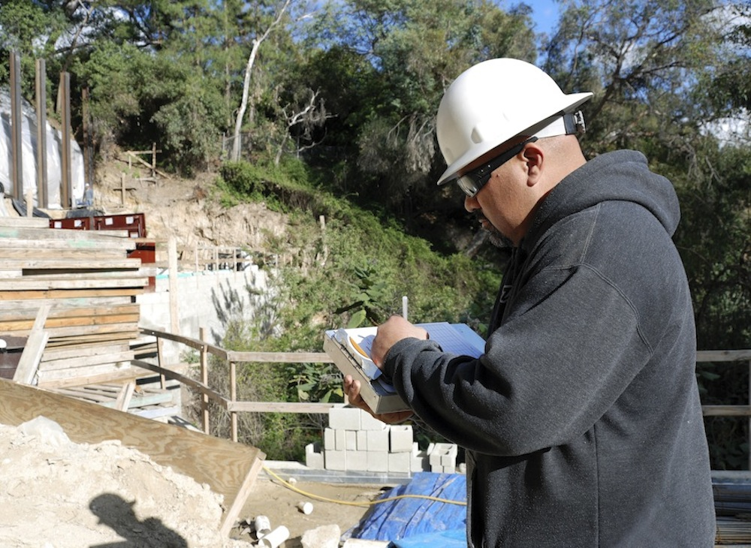
1.5.10 ACTIVITY SCHEDULING
Every plan will consist of many small parts that must be achieved in a set order to gain the end result. Activity scheduling is an art form that a supervisor should develop.

Slide 82
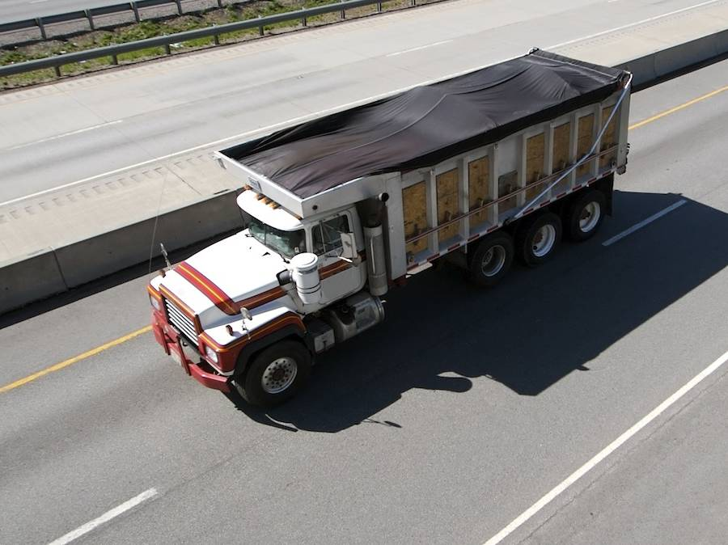
1.5.11 MATERIAL DELIVERY SCHEDULING
Just-in-time deliveries are the most commonly used method of material delivery on a civil construction worksite.
This is a system of material ordering and delivery that has very little waiting time.
The advantage to just-in-time deliveries is less material wastage and loss and smaller storage areas required.
The disadvantage of a just-in-time system is the chance that a material is not able to be delivered when you need it.

Slide 83

1.5.11 MATERIAL DELIVERY SCHEDULING
Good communications are required with suppliers to minimise the likelihood of supply problems.
Material quality and delivery procedures will be determined by the site requirements.
It is important to apply site procedures at all times.

Slide 84

1.5.12 SUB-CONTRACTOR SUPPORT REQUIREMENTS
Often sub-contractors can be used to supply deficiencies within the available people, plant, equipment and machinery.
If you are using sub-contractors you must have the support structures in place to ensure efficient use of the sub-contractor. These support structures could include contracts, supervisory staff, materials or other requests made by the sub-contractor.

Slide 85
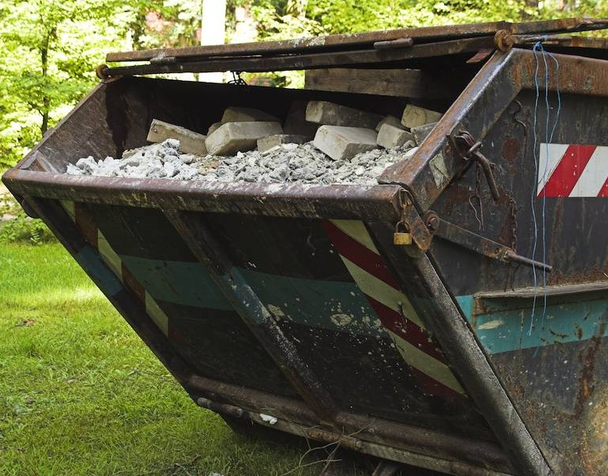
1.5.13 WASTE DISPOSAL REQUIREMENTS
Each civil construction project will create waste materials.
Sometimes this waste material can be reused onsite. Other times it will need to be disposed of.
In your plan you must know the waste materials that will be created and what you will do with them.

Slide 86

1.5.14 DRAFTING AND ADMINISTERING JOB PLANS
Drafting and administering job plans is a process of documenting the plan in a manner that is accessible to anyone who may need to use it and distributing the plan to those people who need to be aware of what is required of them.
Job plans are living documents. They need to have the flexibility to change if required.
While plans should not be changed on a whim, they do need to be able to adjust to unforeseen circumstances such as breakdowns. Having a backup plan is a good idea.

Slide 87

1.5.14 DRAFTING AND ADMINISTERING JOB PLANS
Work planning techniques are highly individual. What works for one person or one team, may not work for another.
It is a task that must be practiced with a willingness to adjust processes until you are able to find a combination of factors that suit your planning style and the needs of your work team.

Slide 88

1.5.15 CONSULTING WHEN CREATING PLANS
When creating a job plan, try to include relevant team members in the process. This will allow you to draw on a great variety of experiences that can make the planning process easier to complete.
Relevant team members could include:
Other managers, supervisor or leading hands.
Suppliers.
Sub-contractors.
Team members doing the tasks and activities.
Supervisors or managers of external teams you need
to coordinate with.

Slide 89

1.5.15 CONSULTING WHEN CREATING PLANS
By consulting with others while you are creating a job plan you are:
Developing and strengthening your team by
showing them you value their experiences and
judgement.
Allowing for the various contractors and other
teams to place their priorities and tasks into the
plan.
Allowing for greater commitment to the plan
and the timeframes.

