Slide 1
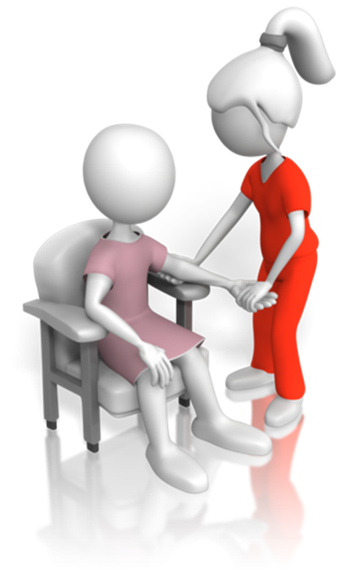
CHCCCS011
Meet personal
support needs

Slide 2

Housekeeping
Emergency procedures
Mobiles and security issues
Break times and smoking policy
This course is interactive – ask questions
Practise respect and confidentiality
Ground rules

Slide 3
Objectives
Discover how to determine personal support requirements
Know how to maximise participation
Learn how to provide personal support
Understand how to complete reporting and documentation
Gain skills and knowledge required for this unit

Slide 4

Determine personal support requirements
1.1 Review individualised plan and confirm required equipment, processes and aids

Slide 5

Review the individualised plan
Personal hygiene
Personal appearance
Dressing
Mobility
Living environments
Meals
Medication
Other care

Slide 6

Activity 1A

Slide 7
Determine personal support requirements
1.2 Identify requirements outside of scope of own role and seek support from relevant people

Slide 8
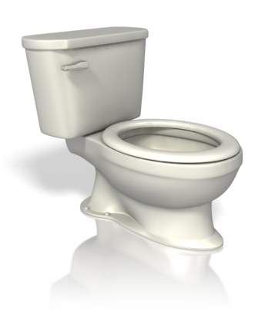
Personal support
Assisting with personal hygiene
Hydration and nutrition, including dysphagia
Maintenance of skin integrity and pressure area prevention
Mobility and transfer including in and out of vehicles and falls recovery techniques
Monitoring medication as appropriate to
work role
Nail care
Pain, rest and sleep
Respiration
Technical care activities according to the personal care support plan and organisation policies, protocols and procedures.

Slide 9

Advanced and specific processes and aids
Aids and processes outside the skills and knowledge of general caregivers may include:
Intravenous injection
CPR
Resuscitation
Insertion and maintenance of catheters
Administering medication
Use of ventilators.

Slide 10
Activity 1B

Slide 11
Determine personal support requirements
1.3 Consider the potential impact that provision of personal support may have on the person and confirm with supervisor

Slide 12

Impact and effect of support
Providing support can have negative effects as well as positive ones. Negative effects may be:
Embarrassment
Fear
Disempowerment
Humiliation
Discomfort.

Slide 13
Activity 1C

Slide 14
Determine personal support requirements
1.4 Consider specific cultural needs of the person

Slide 15

Cultural differences and needs
The cultural needs of different people will affect:
How you act and conduct yourself around them
How you speak and communicate with them
How you provide their care
What care you can provide
What you can feed them
Participation in religious or
cultural activities

Slide 16
Activity 1D

Slide 17
Determine personal support requirements
1.5 Consider specific physical and sensory needs of the person

Slide 18
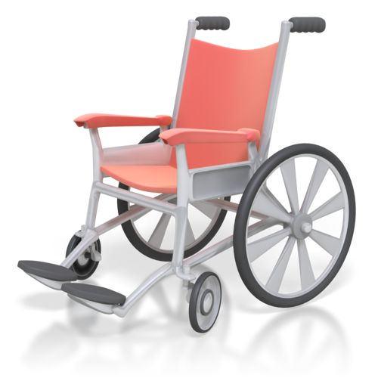
Tools and equipment
There are many tools and aids designed to help provide care to clients; they are generally designed for the comfort of the client, to promote independence and to help the client or the caregiver to provide an efficient service.

Slide 19

Assist with specific daily tasks
Showering
Bed baths
Shaving
Dressing, undressing and grooming
Toileting and the use of continence aids
Eating and drinking using appropriate feeding aids
Oral hygiene
Mobility and transfer, including in and out of vehicles and falls recovery techniques
Falls recovery

Slide 20
Activity 1E

Slide 21
Determine personal support requirements
1.6 Identify risks associated with the provision of support and confirm with supervisor

Slide 22

Risks
There can be several risks posed to both the client and the caregiver within the care industry.
These risks need to be assessed as far as possible, especially where there is a real chance of danger.
Ideally, your organisation should
provide steps that can be implemented
as a preventative measure and actions
to take in case of accident or injury.

Slide 23
Activity 1F

Slide 24
Maximise participation
2.1 Discuss and confirm person’s own preferences for personal support in a positive way

Slide 25

Client preferences
Clients have the right to assert their preferences about any aspect of their care, whether they are in residential or private accommodation. Clients should be given the opportunity to make decisions and voice their preferences wherever possible.
When clients have preferences that are applicable to a situation, they should be confirmed with both the client and the supervisor, where required.

Slide 26
Confirming procedures
It is important to confirm procedures with the clients before they are implemented; this may involve:
Explaining what the procedure is
Explaining why the client needs it
Explaining what will happen during the procedure
Asking if the client has any preferences
Answering clients’ questions and addressing their concerns
Confirm that the client understands and that they are happy.

Slide 27
Activity 2A

Slide 28
Maximise participation
2.2 Consider and confirm the person’s level of participation in meeting their personal support needs

Slide 29

Client participation
Participation may be:
Making decisions about their care plans
Identifying needs
Looking after themselves
Retaining independence.

Slide 30
Activity 2B

Slide 31
Maximise participation
2.3 Provide the person with information to assist them in meeting their own personal support needs

Slide 32

Providing information
In order to understand their conditions and make the best decisions for themselves, clients need access to information about their care needs and health requirements.
This can enable them to prepare for the
future and feel more comfortable and
confident about any changes they should
expect.

Slide 33
Activity 2C

Slide 34
Provide personal support
3.1 Safely prepare for each task and adjust any equipment, aids and appliances

Slide 35

Using equipment safely
There are many aids, processes, appliances and pieces of equipment available to use when caring for clients.
These may:
Need specialist training or qualification to use/do
Be required for a particular task
Not be necessary, but make a task easier
Be client-operated
Be carer-operated.

Slide 36
Activity 3A

Slide 37
Provide personal support
3.2 Take account of identified risks in the provision of personal support and technical support activities

Slide 38

Working around risks
Risks associated with clients can be:
Evidence of self-neglect
Behaviours of concern
Impaired judgement and problem solving abilities
Impaired cognitive functioning
Sudden or unexpected change in health status, including sensory loss.

Slide 39

Technical care
Technical skills may refer to:
Simple dressing
Catheter care (not including insertion or removal of tubes)
Application of prostheses
Application of anti-thrombotic stockings
Assistance with breathing tubes (under
direct supervision of a health professional)
Simple eye care.

Slide 40
Activity 3B

Slide 41
Provide personal support
3.3 Identify and respond to routine difficulties during support routines, and report more complex problems to supervisor

Slide 42

Encountering problems with care
You may occasionally encounter difficulty in providing support for clients; this may be because of the client’s attitude or behaviour, or because you cannot carry the tasks out for some reason.
Where difficulties arise, you should document what the problem is, why you are having it and how this could affect the client. You should
then consult your supervisor to
resolve the issue, in line with
organisational protocols.

Slide 43
Activity 3C

Slide 44
Provide personal support
3.4 Identify changes in the person’s health or personal support requirements and report to supervisor

Slide 45

Changing needs
Changes to clients’ personal care requirements can be related to:
Sensory difficulties
Mobility issues
New conditions
Injuries
New requirements
Worsening of existing conditions
New or changed preferences

Slide 46

Health concerns
You may identify health concerns related to individual clients through the course of your work.
Variations to a client’s health generally signifies that their care needs to be adapted or monitored, whereas concerns need to be addressed with the client and a supervisor.

Slide 47

Report to supervisor
Verbal:
  telephone call
  face-to-face
Written:
  reports
  case notes
  hazard and incident reports
  care plans
  notes
  emails.

Slide 48
Activity 3D

Slide 49
Provide personal support
3.5 Work with the person and supervisor to identify required changes to processes and aids

Slide 50
Equipment changes
From time to time, you may identify the need to change the processes and aids used in your workplace.
In these instances, you will likely have to work with both clients and staff to determine a suitable adaptation.
Many changes will be related to breakages of equipment or the need for new equipment; for example, if a hoist breaks, you will need to source another one that meets the needs of the clients.

Slide 51
Activity 3E

Slide 52
Provide personal support
3.6 Maintain confidentiality, privacy and dignity of the person

Slide 53
Privacy
Examples of how privacy should be maintained and promoted include:
Training all staff properly about privacy
Restricting access to records and information about the client to appropriate personnel
Respect clients’ personal relationships with others
Respect clients’ sexual relationships and give them relevant privacy
Give the client a choice in interpreters, where required

Slide 54

Confidentiality
Confidentiality is required by law in certain respects; the privacy of patient and client records is the most important aspect of confidentiality in the care industry.
Failure to maintain privacy of customer records is punishable by law and organisations can be sued by the patient.

Slide 55
Activity 3F

Slide 56
Complete reporting and documentation
4.1 Comply with the organisation’s reporting requirements, including reporting observations to supervisor

Slide 57

Reporting
There are certain things that need to be reported in the care industry, such as:
Accidents and injuries
Clients’ progress
Medical care and medication
Mandatory notification.

Slide 58
Activity 4A

Slide 59
Complete reporting and documentation
4.2 Complete and maintain documentation according to organisation policy and protocols

Slide 60
Complete documentation
As explained in the previous section, reports need to be completed in line with organisational specifications; this includes the formatting and how you submit it.
This applies to all documentation used in the workplace.
A uniform approach to completing documentation ensures that documentation can be easily accessed and read by everyone.

Slide 61

Maintain documentation
Maintaining documentation generally applies to the way information is presented and the way it is stored.
The previous sections have covered various elements of presenting information, in line with organisational requirements and procedure.

Slide 62
Activity 4B

Slide 63
Complete reporting and documentation
4.3 Store information according to organisation policy and protocols

Slide 64

File information
As explained in the previous section, there are particular specifications made about the storage of reports, documents and information. These may be made by the law or the organisation; both should be adhered to and organisational specifications should meet legislative requirements and stipulations.
Anyone working in this department should
be sufficiently trained on all areas to do
with data storage, including time frames, confidentiality and data protection.

Slide 65
Activity 4C

Slide 66
Skills and Knowledge Activity

Slide 67
Major Activity
This activity should take anywhere between an 1-2 hours to complete and can be found at the end of your workbook.
Your instructor will let you know whether they wish for you to complete it in session time or your own time.

Slide 68

Summary and Feedback
Did we meet our objectives?
How did you find this session?
Any questions?

Slide 69

Congratulations!
You have now finished the unit…
‘Meet personal support needs’

