Slide 1
Sustainable
Work Practices in Open Spaces
SISXRES001 Conduct sustainable work practices in open spaces

Slide 2
Stakeholders Responsible for Environmental and
Social Sustainability
Local, State and Federal government
Non-government organisations (NGOs)
Sport, recreation and fitness professionals
Suppliers (e.g., equipment)
Participants
Notes:
PC1.3

Slide 3
Authorities for Environmental Change in Open Spaces
Local Council
Relevant State and Federal government Departments
Environmental Protection Agency
Land owner (where relevant)
Non-government organisations (NGOs) (where relevant)
Notes:
PC3.3

Slide 4
Legislation, Regulations & Land Management
permits in national parks or on land under control of traditional owners
  Sometimes must need written permission because of the environmental sensitivity of a place or the risk to public safety
  Check with national park directly
restrictions on camp site operations and use of open fires
  Open fires prohibited in some parks
  Fires may be permitted in pre-existing fireplaces or fire pits at designated camp sites marked
  Always check with camp site manager
Notes:
PC1.2, , PE3, KE2

Slide 5
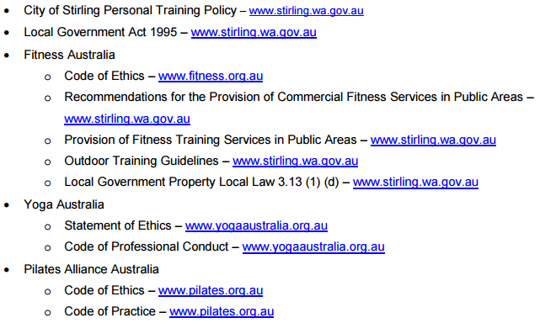
Legislation, Regulations & Land Management
Example of City of Stirling’s policies and legislation
Reference: City of Stirling, 2015, p. 11
Notes:
PC1.2, , PE3, KE2, KE5

Slide 6
Fitness Training Services in Public Areas (Fitness Australia)
Principles to guide the development of appropriate policy and regulation
  Maintenance of Professional Standards in Service Delivery
  Access for all
  Protection of the physical space
  Risk management
  Realistic, consistent, coordinated regulation
  Maintenance of outdoor physical activity options for Australians
Notes:
PC1.2, KE5
Fitness Australia. Position Statement: Provision of Fitness Training Services in Public Areas
https://fitnessaustralia.s3.amazonaws.com/uploads/uploaded_file/file/220/Provision-of-fitness-training-services-in-public-areas.pdf

Slide 7
Fitness Training Services in Public Areas (Fitness Australia)
Policy Recommendations for Federal, State and Local Government Authorities
  Mandatory Professional and/or Business Registration with Fitness Australia To ensure appropriate professional
  Mandatory Public Liability and Professional Indemnity Insurance for the life of the permit
  Realistic terms that encourage compliance
  Portability of permit use with other municipalities
  Collaboration with Fitness Australia to assist information provision and processes
Notes:
PC1.2, KE5
Fitness Australia. Position Statement: Provision of Fitness Training Services in Public Areas
https://fitnessaustralia.s3.amazonaws.com/uploads/uploaded_file/file/220/Provision-of-fitness-training-services-in-public-areas.pdf

Slide 8
Risk Management
fitness trainers are bound by industry standards and have a duty of care to monitor and control risks to participants and ensure public safety is not impacted by their activities
  Fitness Australia Code of Ethics
  State Industry Codes of Practice
  Fitness Australia’s Safety First, OH&S Guide
  Local Council Policies for fitness training in outdoor environments
    http://fitness.org.au/articles/policies-guidelines/council-outdoor-policies/4/20/20
Notes:
PC1.2
http://fitness.org.au/articles/policies-guidelines/council-outdoor-policies/4/20/20

Slide 9
Open Space Definition
land that has been reserved for the purpose of formal and informal sport and recreation, preservation of natural environments, provision of green space and/or urban storm water management
Reference: Healthy Spaces and Places, Design Principle - Parks and Open Space 2009
Notes:
PC1.1

Slide 10
Open Space Definition
Two central categories
  Function (primary use and expected activities) identifies three primary types of open spaces:
    Recreation spaces
    Sport spaces
    Nature spaces
  Catchment hierarchy (typical size and how far a user might travel to visit the site) includes four categories:
    Local open space
    Neighbourhood open space
    District open space
    Regional open space
Reference: Department of Sport and Recreation Western Australia (2012, November). Classification Framework for Public Open Space.
Notes:
PC1.1
Reference: Department of Sport and Recreation Western Australia (2012, November). Classification Framework for Public Open Space. Online: http://www.dsr.wa.gov.au/support-and-advice/facility-management/developing-facilities/public-open-space/classification-framework-for-public-open-space

Slide 11
Undeveloped Open Space Definition
refers to natural, or near-natural land with no or little development (such as clearing of natural vegetation, roads, or residential, industrial, commercial, agricultural settlement)
contributes to a diversity of landscapes and recreation settings, providing relief from urban development and often buffering between areas of recreational use and other development
Reference: Open Space for Sport and Recreation (QLD). ONLINE: http://www.nprsr.qld.gov.au/recreation/pdf/open-space/open-space-planning-principles-implementation-sec4-418.pdf
Notes:
PC1.1

Slide 12
Public Open Spaces Networks
can provide a focus for community recreation and sport activities
can also promote community identity and cohesiveness
Notes:
PC1.1

Slide 13
Open Spaces
major role in improving human health, both physical and mental, reducing crime, stimulating economic growth and even boosting property values
gives a sense of ownership and belonging to local communities, and these attributes are known to improve the wellbeing of individuals and communities
Notes:
PC1.1

Slide 14
Public open space in rural areas
be accessible from logical and convenient locations
provide for the likely movement pattern of people within the area (given the terrain and the location of facilities - shops, toilets, drinking water supplies, shade, formed trails, horse yards and cyclepaths)
be cognisant of the location of natural and historic/cultural features
be actively managed to maintain the quality of sites and facilities
Reference: Open Space for Sport and Recreation (QLD). ONLINE: http://www.nprsr.qld.gov.au/recreation/pdf/open-space/open-space-planning-principles-implementation.pdf
Notes:
PC1.1

Slide 15
Public Open Spaces Networks Rural Areas
stock routes
camping and water reserves
sport and recreation reserves
scenic reserves
land from developer contributions
cemeteries
municipal parks and gardens
roadside rest areas
public halls (providing facilities associated with open space usage)
unformed roads
disused quarries
utility easements
weirs and dams
show grounds
esplanades
Notes:
PC1.1

Slide 16
Open Spaces
Ecologically sustainable recreation can be defined as the use of areas/settings for recreation purposes both:
  within the capacity of those areas/settings to sustain natural processes; and
  so that the benefit of the use to the present generation does not diminish the potential to meet the needs and aspirations of future generations.
Reference: Open Space for Sport and Recreation (QLD). ONLINE: http://www.nprsr.qld.gov.au/recreation/pdf/open-space/open-space-planning-principles-implementation-sec4-418.pdf
Notes:
PC1.1

Slide 17
Open Spaces
Playlots / pocket parks
Local parks
District parks
Linear parks/linkages
Regional parks/recreation areas
Outdoor sporting areas/sports grounds
Notes:
PC1.1
AUS-SPEC adopts the following user catchment hierarchy of classification categories in order of increasing significance:
Playlots/pocket parks: Small open space areas which provide unrestricted space to service the immediate neighbourhood. They have a target user age group of 0 to 9 years, and are generally positioned within a 300 to 500 metre radius of every home. They generally provide items of play equipment and park furniture.
Local parks: Areas of local significance which provide space for informal, non-competitive, recreation and relaxation for local residents. These respond strongly to local resident needs and are suited to specific purpose trips, e.g. Playground usage. They are approximately 1 hectare in size.
District parks: Areas for informal recreation which may also include formal playing fields for competitive sport. They attract and support longer duration visits than local parks. They cater for family or group outings and are generally equipped with barbecue and picnic facilities and children’s play equipment which is more sophisticated than that provided in pocket or local parks. They also sometimes include other facilities such as fitness tracks and carparking. They are approximately 3 hectares in size and within 2 kilometres of most households.
Linear parks/linkages: Linkages between other parks and public access facilities and which often link nodes or smaller open space areas, or provide extensive linkages along areas such as foreshore or creeks. These open space areas often contain off-road walking and cycle tracks and create excellent habitat corridors for the wildlife of the area.
Regional parks/recreation areas: Large expansive open space areas, with a mix of natural heritage areas and developed landscaped settings. These parks have the scope to attract visitors from all parts of the town or metropolitan area and the visitor will often spend more than several hours enjoying the experiences of the park.
Outdoor sporting areas/sports grounds: Open space areas which cater for structured competitive sport within the set dimensions required by the respective sporting code. They can be a component of other parkland areas and are often contained within district parks. Carparking and associated amenity facilities are generally provided

Slide 18
Open Spaces
Playlots/pocket parks
  Small open space areas which provide unrestricted space to service the immediate neighbourhood.
  have a target user age group of 0 to 9 years
  generally positioned within a 300 to 500 metre radius of every home.
  generally provide items of play equipment and park furniture.
Notes:
PC1.1
AUS-SPEC adopts the following user catchment hierarchy of classification categories in order of increasing significance:
· Playlots/pocket parks: Small open space areas which provide unrestricted space to service the immediate neighbourhood. They have a target user age group of 0 to 9 years, and are generally positioned within a 300 to 500 metre radius of every home. They generally provide items of play equipment and park furniture.

Slide 19
Open Spaces
Local parks
  Areas of local significance which provide space for informal, non-competitive, recreation and relaxation for local residents.
  respond strongly to local resident needs and are suited to specific purpose trips, e.g. Playground usage.
  approximately 1 hectare in size.
Notes:
PC1.1
AUS-SPEC adopts the following user catchment hierarchy of classification categories in order of increasing significance:
Local parks: Areas of local significance which provide space for informal, non-competitive, recreation and relaxation for local residents. These respond strongly to local resident needs and are suited to specific purpose trips, e.g. Playground usage. They are approximately 1 hectare in size.

Slide 20
Open Spaces
District parks
  Small open space areas which provide unrestricted space to service the immediate neighbourhood.
  have a target user age group of 0 to 9 years, and are generally positioned within a 300 to 500 metre radius of every home.
  generally provide items of play equipment and park furniture.
Notes:
PC1.1
AUS-SPEC adopts the following user catchment hierarchy of classification categories in order of increasing significance:
District parks: Areas for informal recreation which may also include formal playing fields for competitive sport. They attract and support longer duration visits than local parks. They cater for family or group outings and are generally equipped with barbecue and picnic facilities and children’s play equipment which is more sophisticated than that provided in pocket or local parks. They also sometimes include other facilities such as fitness tracks and carparking. They are approximately 3 hectares in size and within 2 kilometres of most households.

Slide 21
Open Spaces
Linear parks/linkages
  Linkages between other parks and public access facilities and which often link nodes or smaller open space areas, or provide extensive linkages along areas such as foreshore or creeks.
  These open space areas often contain off-road walking and cycle tracks and create excellent habitat corridors for the wildlife of the area.
Notes:
PC1.1
AUS-SPEC adopts the following user catchment hierarchy of classification categories in order of increasing significance:
Linear parks/linkages: Linkages between other parks and public access facilities and which often link nodes or smaller open space areas, or provide extensive linkages along areas such as foreshore or creeks. These open space areas often contain off-road walking and cycle tracks and create excellent habitat corridors for the wildlife of the area.

Slide 22
Open Spaces
Regional parks/recreation areas
  Large expansive open space areas, with a mix of natural heritage areas and developed landscaped settings.
  These parks have the scope to attract visitors from all parts of the town or metropolitan area and the visitor will often spend more than several hours enjoying the experiences of the park.
Notes:
PC1.1
AUS-SPEC adopts the following user catchment hierarchy of classification categories in order of increasing significance:
Regional parks/recreation areas: Large expansive open space areas, with a mix of natural heritage areas and developed landscaped settings. These parks have the scope to attract visitors from all parts of the town or metropolitan area and the visitor will often spend more than several hours enjoying the experiences of the park.

Slide 23
Open Spaces
Outdoor sporting areas/sports grounds
  Open space areas which cater for structured competitive sport within the set dimensions required by the respective sporting code.
  They can be a component of other parkland areas and are often contained within district parks.
  Carparking and associated amenity facilities are generally provided
Notes:
PC1.1
AUS-SPEC adopts the following user catchment hierarchy of classification categories in order of increasing significance:
Outdoor sporting areas/sports grounds: Open space areas which cater for structured competitive sport within the set dimensions required by the respective sporting code. They can be a component of other parkland areas and are often contained within district parks. Carparking and associated amenity facilities are generally provided

Slide 24
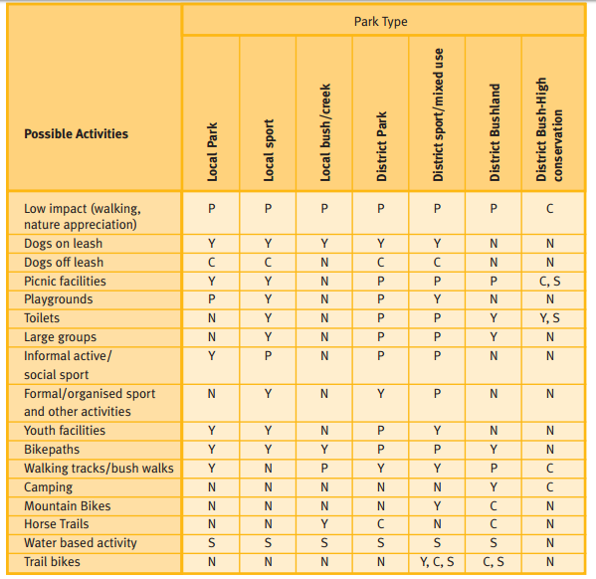
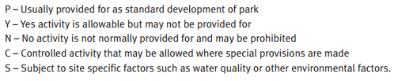
Open Spaces
Activity Management for Different Park Types
Reference: (p. 32) http://www.nprsr.qld.gov.au/recreation/pdf/open-space/open-space-planning-principles-implementation.pdf
Notes:
PC1.1

Slide 25
Benefits Gained Through Access to Open Spaces and Participation in Physical Activity
Physical Health Benefits
  physical activity is a major modifiable risk factor in the reduction of mortality and morbidity from many chronic diseases
  prevention of weight gain (when coupled with healthy nutrition) and improved weight management
  some evidence for improved immunity
  increased energy
  improvements in sleep quality
  improved fitness, strength, flexibility and coordination
  development of a wide range of motor skills
  healthy development of bones in children
ROSS Planning. (2015, February). Issues and opportunities for public open space in the Surf Coast Shire: Open Space Strategy 2015 - 2025 Discussion Paper February 2015
Notes:
PC2.2, KE4
ROSS Planning. (2015, February). Issues and opportunities for public open space in the Surf Coast Shire: Open Space Strategy 2015 - 2025 Discussion Paper February 2015. ONLINE: http://www.surfcoast.vic.gov.au/files/bd331459-32f3-476f-8301-a42800f31045/Item_31_Appendix_1_-_Issues_and_Opportunities_Discussion_Paper_for_Public_Exhibition.pdf

Slide 26
Benefits Gained Through Access to Open Spaces and Participation in Physical Activity
Mental Health Benefits
  the prevention and treatment of anxiety, depression and depressive symptoms
  reductions in stress
  improved mood and sense of well-being
  improved concentration, enhanced memory and learning, and better performance
  reduced feelings of fatigue
  improved self-esteem
  improved self-perception
ROSS Planning. (2015, February). Issues and opportunities for public open space in the Surf Coast Shire: Open Space Strategy 2015 - 2025 Discussion Paper February 2015
Notes:
PC2.2, KE4
ROSS Planning. (2015, February). Issues and opportunities for public open space in the Surf Coast Shire: Open Space Strategy 2015 - 2025 Discussion Paper February 2015. ONLINE: http://www.surfcoast.vic.gov.au/files/bd331459-32f3-476f-8301-a42800f31045/Item_31_Appendix_1_-_Issues_and_Opportunities_Discussion_Paper_for_Public_Exhibition.pdf

Slide 27
Benefits Gained Through Access to Open Spaces and Participation in Physical Activity
Social benefits
  increased social cohesion, social and community networks and social capital
  improved family and community connectedness
  development of communication, interpersonal, leadership and co-operation skills
  creation of friendships
  lessons in how to deal with winning and losing
  better concentration at school
  reductions in other unhealthy behaviours (such as tobacco smoking, drug use)
  helps build social skills among children
ROSS Planning. (2015, February). Issues and opportunities for public open space in the Surf Coast Shire: Open Space Strategy 2015 - 2025 Discussion Paper February 2015
Notes:
PC2.2, KE4
ROSS Planning. (2015, February). Issues and opportunities for public open space in the Surf Coast Shire: Open Space Strategy 2015 - 2025 Discussion Paper February 2015. ONLINE: http://www.surfcoast.vic.gov.au/files/bd331459-32f3-476f-8301-a42800f31045/Item_31_Appendix_1_-_Issues_and_Opportunities_Discussion_Paper_for_Public_Exhibition.pdf

Slide 28
Benefits Gained Through Access to Open Spaces and Participation in Physical Activity
Environmental benefits
  opportunities for the community to experience natural and cultural environments
  protection of adjacent environments by localising impacts and facilitating management of visitation effects
  educational and interpretive opportunities and increased environmental and cultural awareness and appreciation
  increased community ownership which helps to preserve natural and cultural values
  opportunities for community participation in conservation and re-vegetation work
  protection and conservation of biodiversity
  connectivity and movement for flora and fauna through wildlife corridors
ROSS Planning. (2015, February). Issues and opportunities for public open space in the Surf Coast Shire: Open Space Strategy 2015 - 2025 Discussion Paper February 2015
Notes:
PC2.2, KE4
ROSS Planning. (2015, February). Issues and opportunities for public open space in the Surf Coast Shire: Open Space Strategy 2015 - 2025 Discussion Paper February 2015. ONLINE: http://www.surfcoast.vic.gov.au/files/bd331459-32f3-476f-8301-a42800f31045/Item_31_Appendix_1_-_Issues_and_Opportunities_Discussion_Paper_for_Public_Exhibition.pdf

Slide 29
Benefits Gained Through Access to Open Spaces and Participation in Physical Activity
Environmental benefits
  facilitation of carbon-free transport (through linear open space)
  greater relationship between nature and infrastructure as users value the surrounding scenery
  improvements in local neighbourhoods when traffic is reduced
  contribution to food security though local, community food systems
  greening the urban environment and associated urban heat island mitigation
  local solutions to climate change
ROSS Planning. (2015, February). Issues and opportunities for public open space in the Surf Coast Shire: Open Space Strategy 2015 - 2025 Discussion Paper February 2015
Notes:
PC2.2, KE4
ROSS Planning. (2015, February). Issues and opportunities for public open space in the Surf Coast Shire: Open Space Strategy 2015 - 2025 Discussion Paper February 2015. ONLINE: http://www.surfcoast.vic.gov.au/files/bd331459-32f3-476f-8301-a42800f31045/Item_31_Appendix_1_-_Issues_and_Opportunities_Discussion_Paper_for_Public_Exhibition.pdf

Slide 30
Benefits Gained Through Access to Open Spaces and Participation in Physical Activity
Environmental benefits
  Minimising the ecological footprint
  Reduced pollution
    Reducing dependence on vehicle use by increasing use of active green transport (e.g, cycling, walking)
Notes:
PC2.2, KE4
Government of Western Australia. More than winning: The real value of sport and recreation in Western Australia.
https://www.clearinghouseforsport.gov.au/__data/assets/pdf_file/0019/316405/MoreThanWinning.pdf

Slide 31
Benefits Gained Through Access to Open Spaces and Participation in Physical Activity
Economic benefits
  creation of employment in the sport and recreation industries
  attraction of tourism through active destinations
  support for local business when pedestrian activity is improved through creation of open spaces and places
ROSS Planning. (2015, February). Issues and opportunities for public open space in the Surf Coast Shire: Open Space Strategy 2015 - 2025 Discussion Paper February 2015
Notes:
PC2.2, KE4
ROSS Planning. (2015, February). Issues and opportunities for public open space in the Surf Coast Shire: Open Space Strategy 2015 - 2025 Discussion Paper February 2015. ONLINE: file:///C:/Users/Dr%20Dion/Downloads/Item_31_Appendix_1_-_Issues_and_Opportunities_Discussion_Paper_for_Public_Exhibition.pdf.

Slide 32
Relationship between biophysical and socio‑cultural elements in an environment
The biophysical environment
  Includes geomorphology, soils, topography, vegetation, climate and energy
  Provides man with air, water, food and shelter
  Exposed to hazards including floods, drought, hunger, disease and death
  Can be destroyed (e.g., high population density) or improved by human activities
Woube, M. (2005). Effects of Resettlement Schemes on the Biophysical and Human Environments. Boca Raton, FL: Universal Publishers.
Notes:
KE7

Slide 33

Relationship between biophysical and socio‑cultural elements in an environment
Human Ecology Theory: Relationships Between the Biophysical Environment and Sociocultural System Elements
  way of looking at the interactions of humans with their environments and considering this relationship as a system
Harper, C. (2012). Environment and Society: Human Perspectives on Environmental Issues, 5th ed. New York: Routledge, p. 13.
Notes:
KE7

Slide 34
Relationship between biophysical and socio‑cultural elements in an environment
Unless balanced socio-economic systems are maintained, the bio-physical environment can have a negative impact on the human environment and vice versa (p. 17)
Notes:
KE7
Woube, M. (2005). Effects of Resettlement Schemes on the Biophysical and Human Environments. Boca Raton, FL: Universal Publishers.

Slide 35
Global Environment Issues
climate change
energy
land management
waste and consumption
water
Notes:
KE3

Slide 36
Global Environment Issues
Climate change / Global Warming
  refers to an increase in average global temperatures
  Natural events and human activities are believed to be contributing to an increase in average global temperatures.
  caused primarily by increases in “greenhouse” gases such as Carbon Dioxide (CO₂).
  A warming planet thus leads to a change in climate which can affect weather in various ways
Reference: http://www.globalissues.org/article/233/climate-change-and-global-warming-introduction#WhatisGlobalWarmingandClimateChange
Notes:
KE3

Slide 37
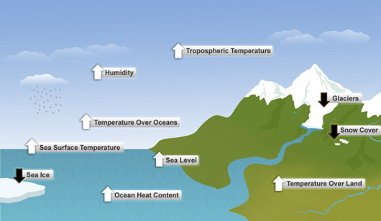
Global Environment Issues
Climate change / Global Warming
  Indicators for a warming world
Reference: http://www.globalissues.org/article/233/climate-change-and-global-warming-introduction#WhatisGlobalWarmingandClimateChange
Notes:
KE3
Global Issues. ONLINE: http://www.globalissues.org/article/233/climate-change-and-global-warming-introduction#WhatisGlobalWarmingandClimateChange

Slide 38
How Climate Change Will Affect the Provision and Management of Open Spaces
Higher temperatures – including more extremely hot days and a greater frequency and severity of drought
Decreased flows in water-supply catchments
Shifts in conditions affecting biodiversity  Increased incidence or severity of bushfires
Coastal hazards, related to the effect of ocean warming on sea levels combined with storms of possibly increased intensity
Damage to infrastructure, for example from coastal erosion, flooding and extreme heat.
Reference: ROSS Planning. (2015, February). Issues and opportunities for public open space in the Surf Coast Shire: Open Space Strategy 2015 - 2025 Discussion Paper February 2015
Notes:
PC2.3, PE4, KE3, KE4

Slide 39
Global Environment Issues
Energy / Electricity Generation
  We need new sources of energy for sustainability
    Wind energy
    Solar (sun / light) energy
    Biomass energy (plants / crops)
    BioGas Energy (animal manure)
    GeoThermal Energy
      steam / hot water beneath the earth’s surface
    Hydropower (moving water)
    Offshore wind, wave and tidal energy
Reference: Natural Resources Defense Council. http://www.nrdc.org/energy/renewables/default.asp
Notes:
KE3
Wind energy: http://www.nrdc.org/energy/renewables/wind.asp
Solar (sun / light) energy: http://www.nrdc.org/energy/renewables/solar.asp
Biomass energy (plants / crops) : http://www.nrdc.org/energy/renewables/biomass.asp
BioGas Energy (animal manure): http://www.nrdc.org/energy/renewables/biogas.asp
GeoThermal Energy: http://www.nrdc.org/energy/renewables/geothermal.asp
steam / hot water beneath the earth’s surface
Hydropower (moving water): http://www.nrdc.org/energy/renewables/hydropower.asp
Offshore wind, wave and tidal energy: http://www.nrdc.org/energy/renewables/offshore.asp

Slide 40
Global Environment Issues
Land management
  Globalization and urbanization are aggravating
  competing demands on land.
  Land degradation
    the loss of land productivity through one or more processes (e.g., water erosion; deforestation; soil compaction, etc.)
    interrupts the regulating and provisioning services of ecosystems, in particular nutrient cycling, the global carbon cycle and the hydrological cycle.
  Tropical deforestation and land clearing is currently the most significant threat to global biodiversity.
Notes:
KE3

Slide 41
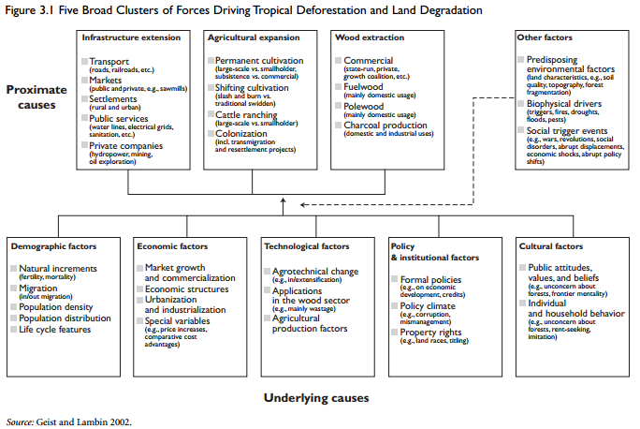
Global Environment Issues
Page 20. http://siteresources.worldbank.org/INTARD/Resources/Sustainable_Land_Management_ebook.pdf
Notes:
KE3
World Bank. (2006). Sustainable Land Management: Challenges, Opportunities, and Trade-offs. ONLINE: http://siteresources.worldbank.org/INTARD/Resources/Sustainable_Land_Management_ebook.pdf

Slide 42

Global Environment Issues
Waste and consumption
  ‘Waste’ - what people throw away when they feel they no longer have a need for it
  Our consumption levels directly impact the kind of world we’ll leave for future generations
Reference: Environment Victoria.
ONLINE: http://environmentvictoria.org.au/content/why-waste-matters
Notes:
KE3

Slide 43
Global Environment Issues
Water
  Dirty water is the world's biggest health risk
    One billion people around the world don't have access to clean, safe water
  If the proportion of people without access to safe water and basic sanitation were halved, countries around the world would save $7.3 billion per year in health care costs, and the annual global value of adult working days gained because of less illness would be almost $750 million
  Other water related concerns
    Inefficient water use, water scarcity, pollution, competition for water, climate change
Reference: Natural Resources Defense Council. http://www.nrdc.org/international/safewater.asp
Notes:
KE3

Slide 44
Common ways in which sport affects the environment
Development of fragile ecosystems or scarce land for sport
Noise and light pollution from sport
Consumption of non-renewable resources (fuel, metals, etc.)
Consumption of natural resources (water, wood, paper, etc.)
Emission of greenhouse gases by consuming electricity and fuel
Ozone layer depletion (from refrigerants)
Soil and water pollution from pesticide use
Soil erosion during construction and from spectators
Waste generation from construction of facilities, and from spectators
Reference: United Nations Environment Programme. http://www.unep.org/sport_env/impactSport_Env.aspx
Notes:
PC2.3, PE4, KE4

Slide 45
Common Environmental Threats to Sports Programs
Air pollution : May cause respiratory illness and difficulty in breathing
Indoor air quality: Same as above
Toxic chemicals: May cause severe physiological reactions
Pesticides: Same as above
Water pollution/bacteria: Same as above
Noise pollution: May cause hearing difficulties and stress
Cigarette smoke: Exposure to this will reduce the supply of oxygen to the body
Ozone layer depletion: Will increase UV radiation exposure and skin problems including cancer
Climate change: Unpredictable and extreme weather patterns may make it difficult to engage in sport
Habitat/biodiversity loss: May lead to loss of natural areas to practice sport
Reference: United Nations Environment Programme. ONLINE: http://www.unep.org/sport_env/impactSport_Env.aspx
Notes:
PC2.3, PE4, KE4

Slide 46
Key Issues for Sport and Recreation in Implementing Sustainability
Protecting the recreation resource from adverse impacts created by overuse, inappropriate use or adjacent uses
Managing impacts on the recreation experience so that it is not diminished or modified to the extent it ceases to provide the same quality and type of experience.
Considering the need to constrain use of areas, type of activities, timing of activities and infrastructure provided
Sustainability and the need to sometimes restrict access to a resource or opportunity can sometimes be at odds with principles of social equity.
Reference: Open Space for Sport and Recreation (QLD). ONLINE: http://www.nprsr.qld.gov.au/recreation/pdf/open-space/open-space-planning-principles-implementation-sec4-418.pdf
Notes:
PC2.3, PE4, KE3, KE4
Protecting the recreation resource from adverse impacts created by overuse, inappropriate use or adjacent uses. Examples: a creekbank at a popular swimming hole trampled by overuse; a quiet bushland park compromised by an adjacent noisy extractive industry.
Managing impacts on the recreation experience so that it is not diminished or modified to the extent it ceases to provide the same quality and type of experience. Example: a wilderness experience compromised by crowding, littering, site trampling etc.
Considering the need to constrain use of areas, type of activities, timing of activities and infrastructure provided. Example: closing four wheel drive tracks in wet season.
Sustainability and the need to sometimes restrict access to a resource or opportunity can sometimes be at odds with principles of social equity. Example: access to some remote wilderness sites is limited, by its very nature, to those who are able bodied and experienced enough.

Slide 47
Minimal Impact Techniques and Procedures
Notes:
PE2, PE3, KE3, KE5, KE6

Slide 48
Minimal Impact Techniques and Procedures
education on appropriate behavioural patterns
site hardening
technological solutions
education
restricting or limiting access
staged authenticity
Notes:
PE2, PE3, KE3, KE5, KE6

Slide 49
Minimal Impact Techniques and Procedures for …
activity-specific guidelines
energy use
group size
interaction with wildlife
local customs and courtesies
noise
setting of camps
souveniring
use of tracks
waste disposal
Notes:
PE2, PE3, KE3, KE5, KE6

Slide 50
Permissible Outdoor
Fitness Training Activities
Strength-based and aerobic fitness activities (with or without free-weights, fitballs, skipping ropes, medicine balls etc.)
Non-contact boxing and pad training
Organised aerobic activity (fitness and sports drills)
Yoga, Tai Chi and Pilates activities
Walking and running
Notes:
PC2.1, 2.2, PE2, PE3, KE3, KE5, KE6
Fitness Australia Recommendations for the Provision of Commercial Fitness Services in Public Areas

Slide 51
Prohibited Outdoor
Fitness Training Activities
Aggressive and intimidating activities that involves shouting, loud voice calls or instructions
Activities in children’s playgrounds
Groups containing over 18
Dragging of logs, tyres, heavy ropes and other equipment that may damage the natural environment
Any activity that is deemed to be aggressive or intimidating in nature whether real or perceived by participants or the general public
Outdoor recreational activities conducted with amplified music or megaphones which cause offensive noise as defined by the relevant State or Territory Environment Protection Legislation.
Notes:
PC2.1, 2.2, PE2, PE3, KE3, KE5, KE6
Fitness Australia Recommendations for the Provision of Commercial Fitness Services in Public Areas

Slide 52
Prohibited Outdoor
Fitness Training Activities
Soliciting of funds directly from park visitors or the public
Erection of advertising signs, and banners, temporary or otherwise without Council’s written consent
Erection of signs, stakes, rope or tape, temporary or otherwise without Council’s written consent
Suspending boxing or kicking boxing bags or any other equipment from trees and/or structures in the reserves
Utilising trees, seating, picnic tables, rotundas and other park infrastructure for exercise training
Notes:
PC2.1, 2.2, PE2, PE3, KE3, KE5, KE6
Fitness Australia Recommendations for the Provision of Commercial Fitness Services in Public Areas

Slide 53
Group Personal Training vs Traditional Group Exercise
an effective small group training program has fewer than 10 participants and the instructor does not work out with the clients
traditional group exercise – instructor usually ‘works out’ while instructing the clients
  E.g., ‘spin’ class, ‘pump’, etc.
Reference: Ross, J. https://www.acefitness.org/blog/2395/small-group-training-the-future-of-the-workout
Notes:
PC2.1, 2.2, PE2, PE3, KE3, KE5, KE6

Slide 54
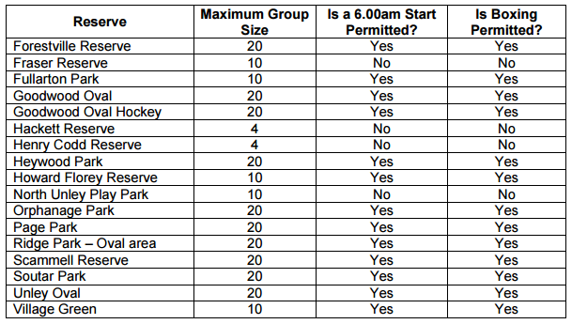
Group Size: Council Regulations
keep to a sustainable level
Only take small groups into remote areas
Council may have different group sizes for different locations
Reference: The City of Unley: Commercial Fitness Training Activities on Community Land, p. 6.
Notes:
PC2.1, 2.2, PE2, PE3, KE3, KE5, KE6
Reference: The City of Unley: Commercial Fitness Training Activities on Community Land. ONLINE: http://www.unley.sa.gov.au/getmedia/f747632a-a2cc-40b0-aa31-f6f38676762f/Commercial_Fitness_Training_Activities_on_Community_Land_Policy.aspx

Slide 55
Energy Use
Switch off things (e.g., computers) when you are done
Unplug seldom used appliances
Use a power strip
Set computer to sleep or hibernate mode
Use screensavers
Set your thermostat appropriately
Turn off lights when you leave the room
Notes:
PE2, PE3, KE3, KE5, KE6

Slide 56
Interaction with Wildlife
Never feed animals. Feeding wildlife damages their health, alters natural behaviors, and exposes them to predators and other dangers
  human foods cause disease and encourage competition between species
  Some species adapt readily to humans in their domain, resume their normal behaviours and may have become "habituated.“
  some animals flee from humans, abandoning their young or critical habitat.
  Some are attracted and endangered by human food and rubbish
Observe wildlife from a respectful distance
Protect wildlife and your food by storing rations and trash securely
Avoid wildlife during sensitive times: mating, nesting, raising young, or winter
Notes:
PE2, PE3, KE3, KE5, KE6

Slide 57
Local Customs & Courtesies
Be briefed and observe the local customs and courtesies
Staying out of and not photographing sacred sites
Learning some local language and cultural etiquette
Disregard the ‘us and them’ mentality
  Can lead to stereotyping of individuals
Wear clothing that is accepted by the local culture
Notes:
PE2, PE3, KE3, KE5, KE6

Slide 58
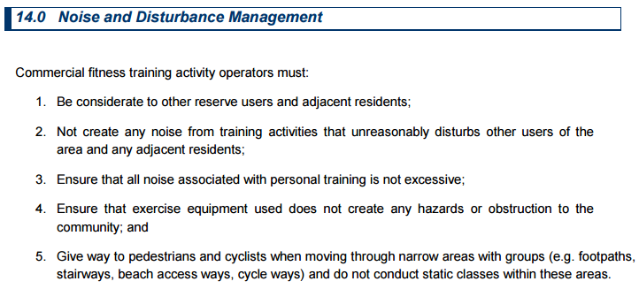
Noise
Example of noise and disturbance management
Reference: City of Stirling, 2015, p. 12
Notes:
PE2, PE3, KE3, KE5, KE6
City of Stirling (2015). Personal Training and Commercial Group Fitness ‘Guidelines’. ONLINE: http://fitness.org.au/articles/policies-guidelines/council-outdoor-policies/4/20/20

Slide 59
Setting of Camps
Camp on durable surfaces
Pitch your tent on an established site rather than creating a new one
Camp at least 50 metres from lakes and streams
Dispose of waste properly
Use a portable device like a fire pan and try to avoid open fires
Use biodegradable soaps at least 200 feet from water sources
Unless bins have been provided take all of your rubbish out with you
  Aluminum foil as it does not totally burn
Notes:
PE2, PE3, KE3, KE5, KE6

Slide 60
Souveniring
Taking an object from the environment to keep as a reminder of the activity or place
The largest threat to cultural resources is unintentional damage caused by visitors.
Encourage participants to leave things alone and where they are, shells driftwood etc.
Notes:
PE2, PE3, KE3, KE5, KE6

Slide 61
Use of Tracks
Stay on the designated track
Only use purpose built or dual use trails for biking and horse riding (some trails are ‘walking only’ trails, which are not built to withstand the impact of bikes and horses)
Don’t trespass on private land
Keep to the middle of the Track, even when it is underwater
Don’t skid
Don’t ride muddy trails.
Leave no trace of energy bar wrappers, punctured tubes, etc.
Reference: Trails WA. ONLINE: http://trailswa.com.au/environment/
Notes:
PE2, PE3, KE3, KE5, KE6

Slide 62
Waste Disposal
State and territory governments have primary responsibility for regulating and administering waste, including planning for waste management and waste avoidance, minimisation and reuse, licensing and regulation of waste transport, storage, treatment, resource recovery and disposal, and managing the impacts of waste management activities.
Reference: Australian Government: Department of the Environment.
http://www.environment.gov.au/topics/environment-protection/nwp/reporting/policies-and-governance
Notes:
PE2, PE3, KE3, KE5, KE6

Slide 63
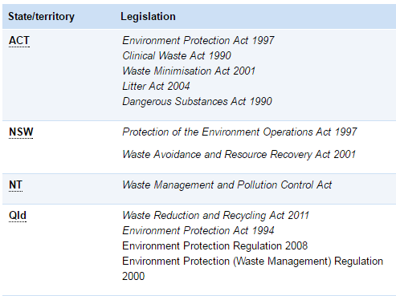
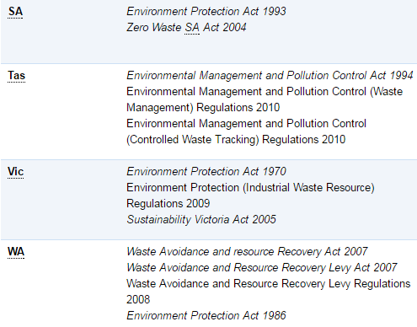
Waste Disposal
State and territory waste management and resource recovery legislation
Reference: Australian Government: Department of the Environment.
http://www.environment.gov.au/topics/environment-protection/nwp/reporting/policies-and-governance
Notes:
PC1.3, 3.2, PE2, PE3, KE3, KE5, KE6

Slide 64
Waste Disposal
Sport, recreation and fitness centres may store hazardous substances or products that contain harmful elements. Care must be taken to dispose of them.
  Solvent-based paints
  Pesticides and other garden chemicals
  Batteries (for example car, mobile phone or regular household batteries)
  Motor oils (for example from cars or mowers)
  Petrol and kerosene
  Cleaning and polishing chemicals
  Swimming pool or spa bath chemicals
  Pharmaceuticals (all medicines)
  Obsolete computer equipment
  Thermometers, barometers, thermostats, fluorescent tubes and compact fluorescent globes (CFLs)
Notes:
PE2, PE3, KE3, KE5, KE6

Slide 65
Waste Disposal
Handling and storage suggestions
  Keep the goods in their original containers if possible. If containers are leaking, use new containers but never use food containers like soft drink bottles.
  Don’t mix chemicals when decanting a substance into a new storage container.
  Make sure all labels, including warning labels and manufacturer’s instructions, remain intact on the packaging.
  Store goods upright with lids secured tightly and out of the reach of young children.
  Keep all ignition sources, such as matches, well away from the storage area.
  Keep the storage area cool and dry.
  Buy the smallest amount for your needs.
Reference: https://www.betterhealth.vic.gov.au/health/healthyliving/hazardous-waste
Notes:
PE2, PE3, KE3, KE5, KE6

Slide 66
Waste Disposal
Disposing of Hazardous Waste
  Check out local services when recycling or disposing of:
    Computers
    Mobile phones and phone batteries
    Rechargable batteris
    Car batteries
    Gas cyinders (LPG)
    Used motor oils
    Laset and printer ikjet cartridges
    Flourescent tubes and compact fluorescent globes (CFLs)
    Plastic shopping bags
    Unused medicines
Reference: https://www.betterhealth.vic.gov.au/health/healthyliving/hazardous-waste
Notes:
PE2, PE3, KE3, KE5, KE6

Slide 67
Waste Disposal
Clinical Waste: waste that has the potential to cause disease
  animal waste
  discarded sharps
  human tissue waste
  laboratory waste
Related Waste
  waste that constitutes, or is contaminated with, chemicals, cytotoxic drugs, human body parts, pharmaceutical products or radioactive substances
Notes:
PE2, PE3, KE3, KE5, KE6

Slide 68
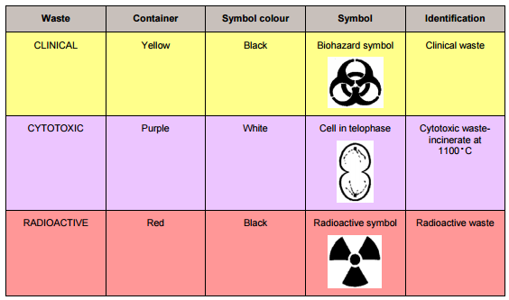
Waste Disposal
Clinical Waste and Related Waste Signage
  waste that constitutes, or is contaminated with, chemicals, cytotoxic drugs, human body parts, pharmaceutical products or radioactive substances
Notes:
PE2, PE3, KE3, KE5, KE6

Slide 69
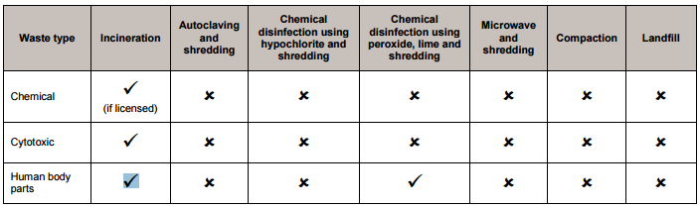
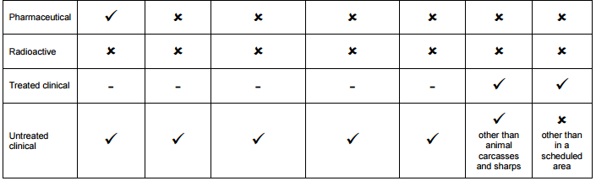
Waste Disposal
Clinical Waste and Related Treatment and Disposal Methods (Queensland)
Reference (p. 10-11)- https://www.ehp.qld.gov.au/assets/documents/regulation/pr-gl-clinical-and-related-waste.pdf
Notes:
PE2, PE3, KE3, KE5, KE6
Queensland Government (2015, March). Guideline Clinical and related waste. ONLINE: https://www.ehp.qld.gov.au/assets/documents/regulation/pr-gl-clinical-and-related-waste.pdf

Slide 70
Information Collection Techniques for Monitoring Environmental and Social Impact
Notes:
PC3.1, 3.2, FS4, FS5, PE4, KE8

Slide 71
Information Collection Techniques
logbooks
sighting forms
basic measurements (temperature, weather conditions, estimations of percentage cover, water)
Photography
Surveys
Notes:
PC3.1, 3.2, FS4, FS5, PE4, KE8

Slide 72
Information Collection Techniques
Environmental Impact Assessment (EIA)
  A tool used to identify the environmental, social, and economic impacts of a project prior to decision making.
  aims
    to predict environmental impacts at an early stage in project planning and design
    find ways and means to reduce adverse impacts
    shape projects to suit the local environment
    present the predictions and options to decision makers.
Notes:
PC3.1, 3.2, FS4, FS5, PE4, KE8
Randall, J. & Jowett, E. (2010). The Green Recovery and Reconstruction Toolkit (GRRT): Environmental Impact Assessment Tools and Techniques. ONLINE: http://green-recovery.org/wordpress/wp-content/uploads/2010/11/Module-3-Content-Paper.pdf

Slide 73
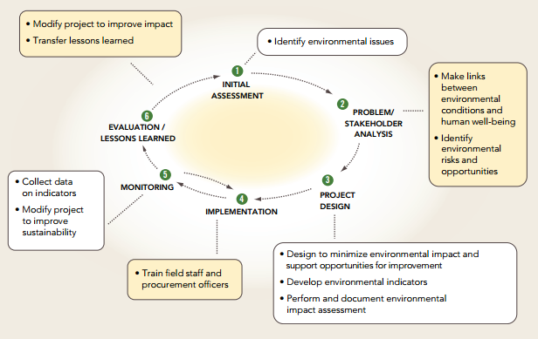
Information Collection Techniques
Environmental Impact Assessment (EIA)
  Project management cycle and environmental intervention points
Reference: The Green Recovery and Reconstruction Toolkit (GRRT): Environmental Impact Assessment Tools and Techniques, p. 8
Notes:
PC3.1, 3.2, FS4, FS5, PE4, KE8
Randall, J. & Jowett, E. (2010). The Green Recovery and Reconstruction Toolkit (GRRT): Environmental Impact Assessment Tools and Techniques. ONLINE: http://green-recovery.org/wordpress/wp-content/uploads/2010/11/Module-3-Content-Paper.pdf

Slide 74
Information Collection Techniques
Social Impact Assessment (SIA)
  efforts to assess or estimate, in advance, the social consequences that are likely to follow specific policy actions (including programs/ projects and the adoption of new policies), and specific government actions
  process of analysing the impact of public/government intervention on the social aspects of the human environment
Notes:
PC3.1, 3.2, FS4, FS5, PE4, KE8

Slide 75
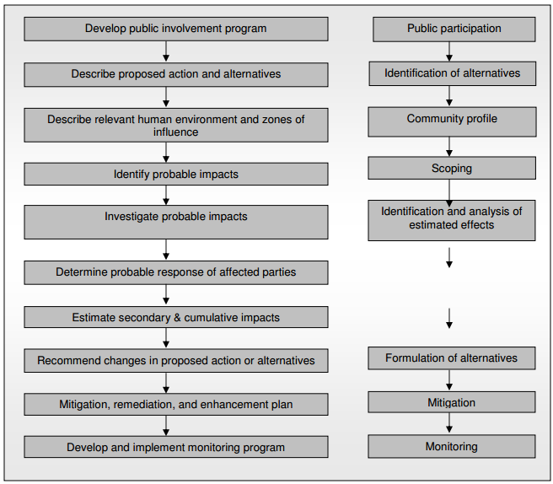
Information Collection Techniques
Stages in Social Impact Assessment
Notes:
PC3.1, 3.2, FS4, FS5, PE4, KE8
Centre for Good Governance (2006). A Comprehensive Guide for Social Impact Assessment, p. 11. ONLINE: http://unpan1.un.org/intradoc/groups/public/documents/cgg/unpan026197.pdf

Slide 76
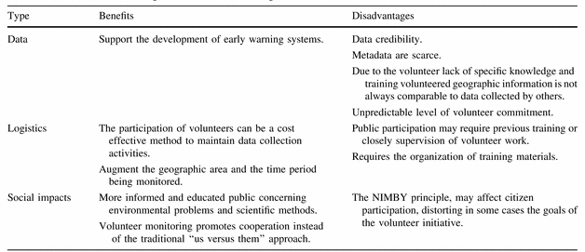
Information Collection Techniques
Volunteer Monitoring
  Citizens participate in different activities ranging from scope definition to data collection and dissemination
  Process where concerned citizens, government agencies, industry, academia, community groups and local institutions collaborate to monitor, track and respond to issues
  Can be done electronically
Reference: Cristina Gouveia & Alexandra Fonseca, 2008, p. 187.
Notes:
PC3.1, 3.2, FS4, FS5, PE4, KE8
Cristina Gouveia & Alexandra Fonseca.New approaches to environmental monitoring: the use of ICT to explore volunteered geographic information. GeoJournal (2008) 72:185–197. ONLINE: http://link.springer.com/article/10.1007/s10708-008-9183-3#page-1

Slide 77
Monitoring Framework
a list of identified impacts and issues
targets and outcomes sought
an explanation of how management of the impact will be monitored
  for example, regular communication with state government agencies or local governments
the names of each party responsible for implementation of each monitoring strategy
timing and frequency
  documenting how often monitoring of the impact should take place for example, monthly, annually, throughout pre-construction, construction, and operations phases, life of the project
performance indicators
  need to be informative, relevant, measurable, reliable, widely recognised, simple to report and easily understood.
Reference: State of Queensland, Department State Development, Infrastructure and Planning, July 2013, Social impact assessment guidelines. Page 11.
Notes:
PC3.1, 3.2, FS4, FS5, PE4, KE8
State of Queensland, Department State Development, Infrastructure and Planning, July 2013, Social impact assessment guideline. Page 11.ONLINE: http://www.statedevelopment.qld.gov.au/resources/guideline/social-impact-assessment-guideline.pdf

Slide 78
‘Take nothing but pictures, leave nothing but footprints’
Notes:
Government of Western Australia. More than winning: The real value of sport and recreation in Western Australia.
https://www.clearinghouseforsport.gov.au/__data/assets/pdf_file/0019/316405/MoreThanWinning.pdf

