Slide 1
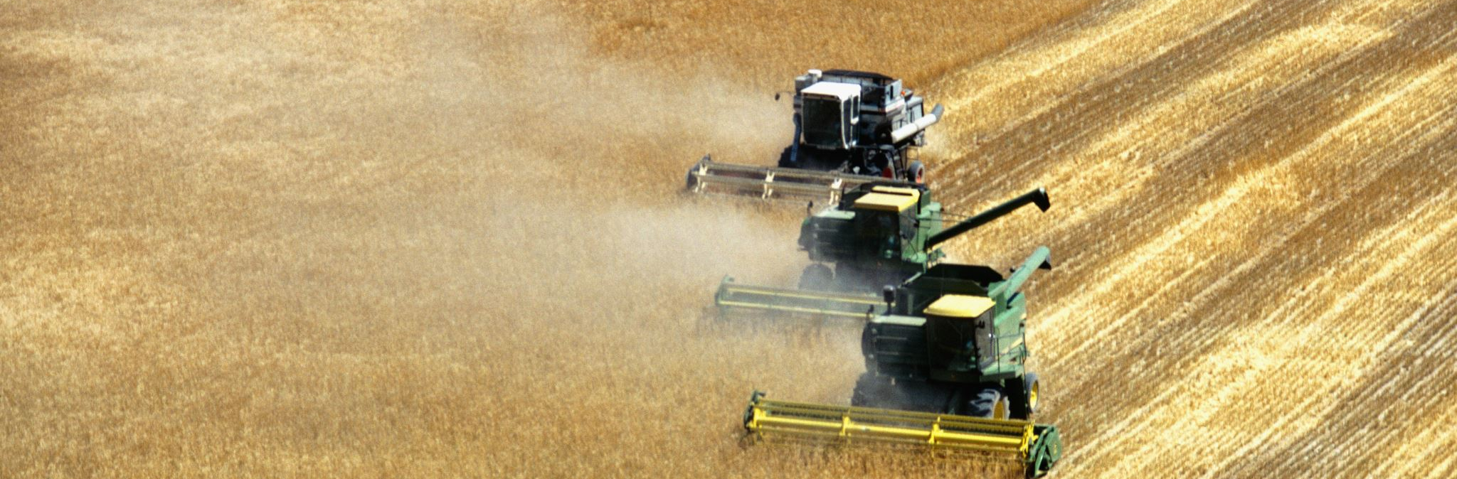

AUSTRALIAN CENTRE FOR AGRICULTURE
WHSMS PLAN

Slide 2

work health and safety management system
ROLES , RIGHTS AND RESPONSIBLITIES
PCBU
Under section 19 of the Work Health and Safety Act 2011 (Qld
Ensure the health & Safety of workers & others at the Workplace.
Implement & Maintain Safe Systems of Work
Provide Adequate Facilities for Workers Welfare
Ensure Safe use, handling & storage of machinery, structures and substances
WORKERS
Under section 28 of the Work Health and Safety Act 2011 (Qld
Take Reasonable care of their own health & safety
Comply with reasonable instructions from the PCBU
Use PPE as Required
Report hazards and injuries
WORKERS RIGHTS
Right to safe work environment
Right to receive proper training & information
Right to be consulted on health & safety matters
Right to Cease Unsafe Work
OTHERS
Under Section 29 of the Work Health Safety Act 2011 (QLD)
Safety Responsibilities – Any Other Persons at a worklplace e.g Visitors or Customers, must take reasonable care of their own safety and ensure their actions do not adversely effect others healthe and safety
Compliance and Cooperation – They must comply with reasonable safety instructions given by PCBU

Slide 3


RETURN TO WORK
KEY ELEMENTS
1.Assessment and Planning
Conduct an Initial Assessment of Workers condition
Develop an Individualised Return to Work Plan in Consultation with Medical Professionals
2. Communication and Support
Maintain Regular Communication with Injured Worker
Provide Support & Resources for a smooth transition back to work

Slide 4
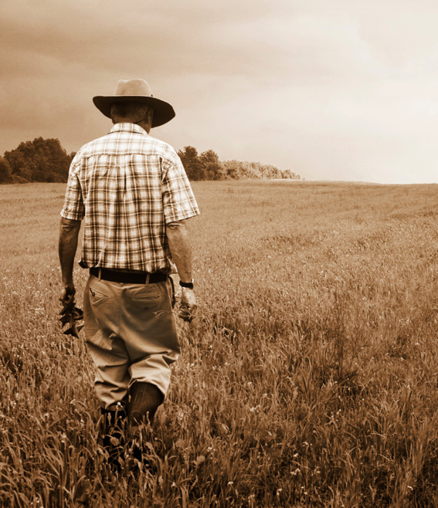
Injury Management
Key Elements
1 Early Intervention
Early Intervention – By Identifying Key Hazards/ Risks on site and Implementing Controls using the Hierarchy of control to protect workers health and Safety
A focus on recovery at and return to work – Ensuring Injured workers have the full Support and care needed to return to full duties at work
2. Ongoing Monitoring & Review
Regularly Review the injured Workers Progress
Adjust the return-to-work plan as needed based on medical advice and worker feedback - Open line of Communication

Slide 5

HAZARD/INJURY/INCIDENT REPORTING KEY ELEMENTS
The following Key Elements helps ensure that hazards & Injuries are properly reported, addressed and prevented in the future
Description of the Incident
Identification of the Individual/s Involved
Hazard Identification
Root Cause Analysis
Immediate Action taken
Corrective and preventive Actions
Reporting and Documentation
Follow up Actions
Signatures and approvals

Slide 6

RECORD KEEPING KEY ELEMENTS
Workplace Record Keeping is Essential for Compliance, Efficiency and Effective Management
Proper Workplace Record keeping not only ensures compliance but also supports effective decision making and protects the organisation in case of disputes or audits
These documents are required to be filed for 30 years in safe storage accessible only to authorised personnel in accordance with the Privacy Amendment (Enhancing Privacy Protection) Act 2012 (Cth)

Slide 7

Q&A TIME

