Slide 1

CONFINED SPACES
Work Health and Safety Officer

Slide 2
Assessment Criteria
  List at least five examples of confined spaces.
  Describe the statutory and minimum requirements relating to confined spaces.
  List at least three major hazards associated with working in confined spaces relating to a given workplace.

Slide 3
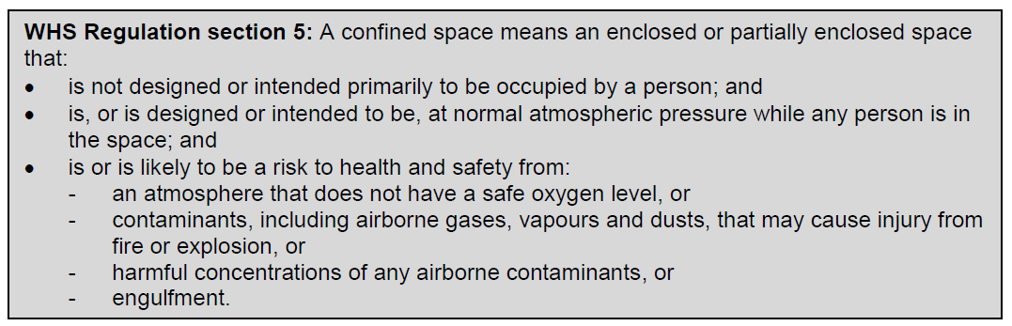
What is a confined space?
Examples of confined spaces that may be found on a construction site include some types of excavations or trenches, drainage or sewerage pipes, and crawl spaces.

Slide 4
What is NOT a confined space?
What is not a confined space for the purposes of the WHS Regulation?
A confined space does not include a mine shaft or the workings of a mine.
The following kinds of workplaces are also generally not confined spaces for the purposes of the WHS Regulation:
places that are intended for human occupancy and have adequate ventilation, lighting and safe means of entry and exit, such as offices and workshops
some enclosed or partially enclosed spaces that at particular times have harmful airborne contaminants but are designed for a person to occupy (e.g. abrasive blasting or spray painting booths)

Slide 5
What is NOT a confined space?
What is not a confined space for the purposes of the WHS Regulation?
enclosed or partially enclosed spaces that are designed to be occasionally occupied by a person if the space has a readily and conveniently accessible means of entry and exit via a doorway at ground level, for example:
- a cool store accessed by a LPG forklift to move stock – although the use of a LPG forklift in a cool store can be hazardous, the door at ground level means that once the alarm is raised, escape and rescue can happen quickly
- a fumigated shipping container with a large ground level opening will facilitate easy escape and rescue.
Trenches are not considered confined spaces based on the risk of structural collapse alone, but will be confined spaces if they potentially contain concentrations of airborne contaminants that may cause impairment, loss of consciousness or asphyxiation.

Slide 6
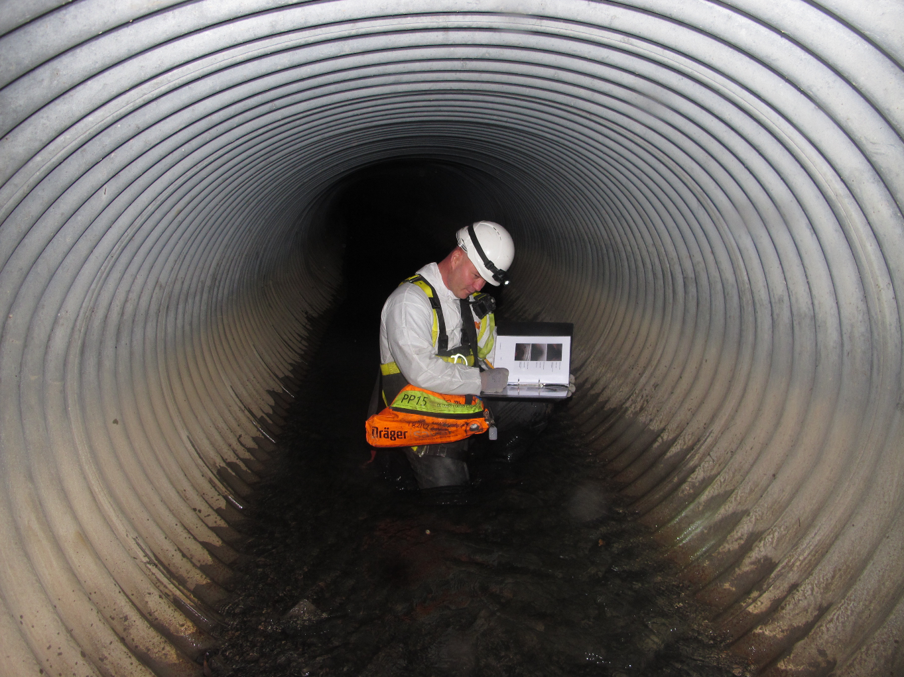
Duties
PCBU
Designers, manufacturers and suppliers of plant or structures
Officers
Workers

Slide 7
What is required in managing risks?
WHS Regulation s34-s38: In order to manage risk under the WHS Regulation, a duty holder must:
identify reasonably foreseeable hazards that could give rise to the risk
eliminate the risk so far as is reasonably practicable
if it is not reasonably practicable to eliminate the risk – minimise the risk so far as is reasonably practicable by implementing control measures in accordance with the hierarchy of control
maintain the implemented control measure so that it remains effective
review, and if necessary revise, risk control measures so as to maintain, so far as is reasonably practicable, a work environment that is without risks to health and safety.

Slide 8
How to determine whether a space is a confined space
A confined space is determined by the structure and a specific set of circumstances. The same structure may or may not be a confined space depending on the circumstances when the space is entered. Entry to a confined space is considered to have occurred when a person’s head or upper body enters the space.
A space may become a confined space if work that is to be carried out in the space would generate harmful concentrations of airborne contaminants.

Slide 9
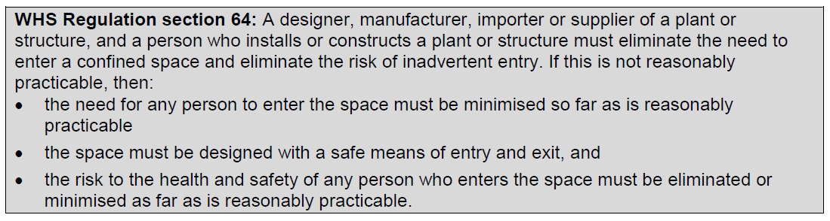
Roles of designers, manufacturers and suppliers

Slide 10
How to identify hazards
Identifying hazards involves finding all of the things and situations that could potentially cause harm to people. The types of substances previously stored in a confined space (however briefly) will indicate the sorts of hazards that may be present. Substances stored in a confined space may result in a lack of oxygen, airborne contaminants or a flammable atmosphere within the confined space. Other hazards may arise from work activities, products or by-products in or around the confined space.

Slide 11
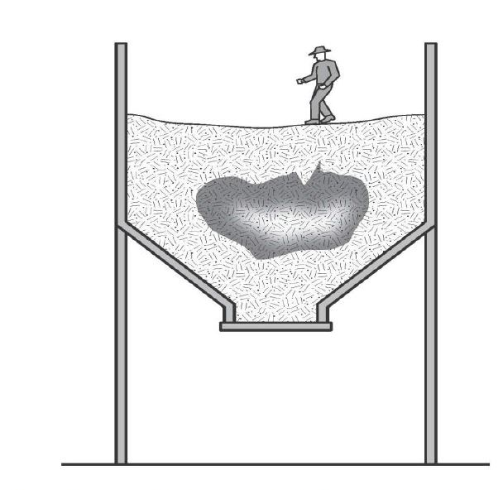
What hazards are associated with a confined space?
Restricted entry or exit
Harmful airborne contaminants
Unsafe oxygen level
Fire and explosion
Engulfment

Slide 12
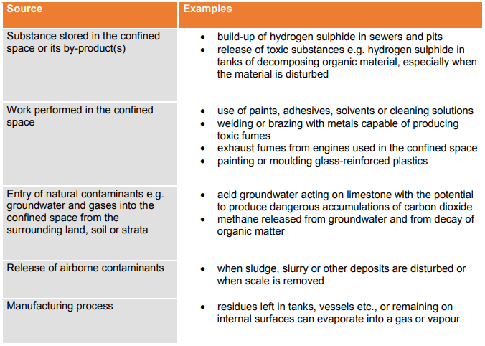
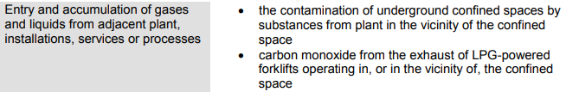
Harmful airborne contaminants

Slide 13
Other hazards
Uncontrolled introduction of substances
Biological hazards
Mechanical hazards
Electrical hazards
Skin contact with hazardous substances
Noise
Manual tasks
Radiation
Environmental hazards
Hazards outside the confined space
Additional physiological and psychological demands

Slide 14
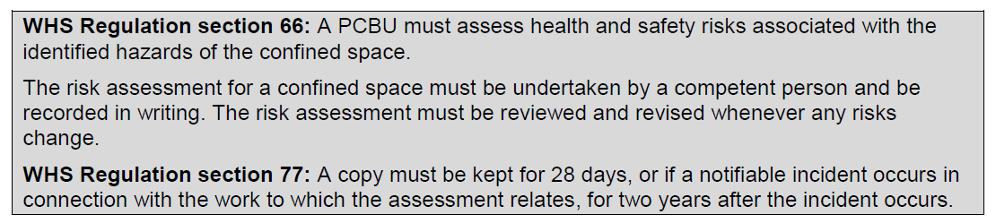
How to assess risks

Slide 15
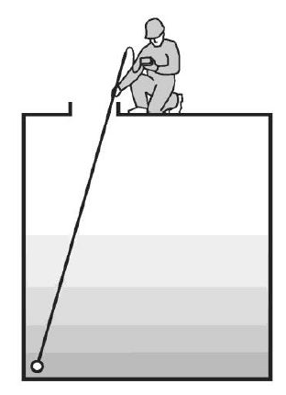
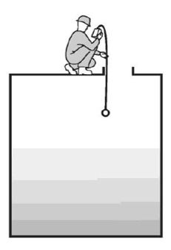
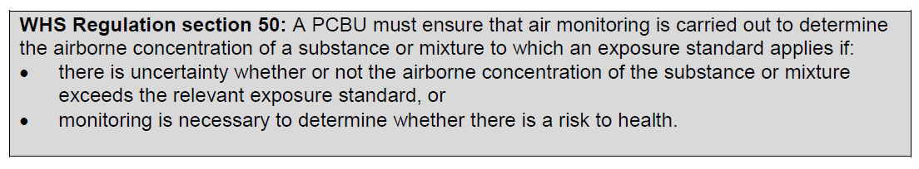
Atmospheric testing and monitoring

Slide 16
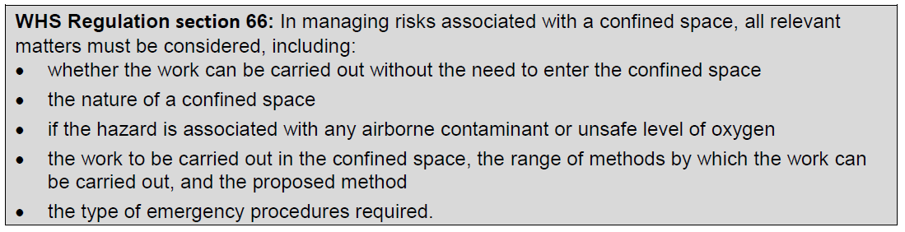
How to control risks

Slide 17
Eliminating the need to enter a confined space
Risks associated with work in a confined space must be eliminated so far as is reasonably practicable, and therefore the first question is: can the work be carried out without entering the confined space?
Work could be carried out from outside the confined space by:
installing fixed or temporary cleaning devices for example spray balls using high-pressure hoses inserted through an access hatch to clean the inside of a tank
using remote cameras or a mirror attached to a probe for internal inspection of vessels
using remotely operated rotating flail devices, vibrators or air purgers to clear blockages in silos
using a hook, long-handled clasp or magnet on a string to retrieve an object dropped into a confined space.

Slide 18
Minimise the risks
If entering a confined space cannot be avoided, then a safe system for working inside the space must be implemented. The identified hazards will help determine what controls are needed to minimise any risk associated with work in the confined space. Under the WHS Regulation, the following matters must be considered:
The nature of the space
The concentration of oxygen or airborne contaminants
The work and work method
Emergency procedures

Slide 19
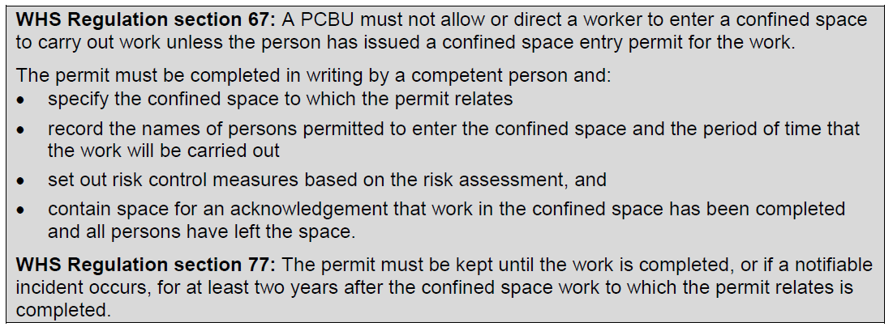
Entry Permits

Slide 20
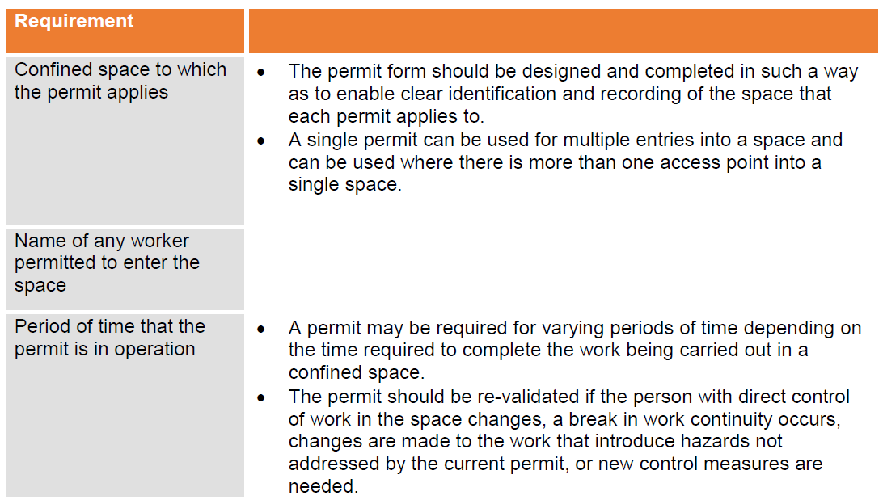
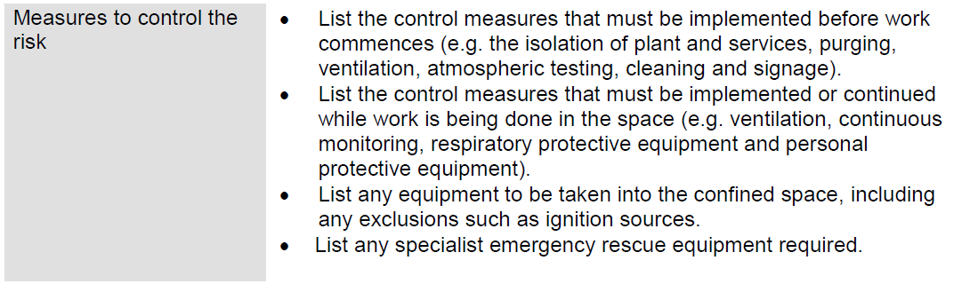
Entry Permits

Slide 21

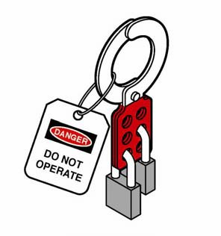
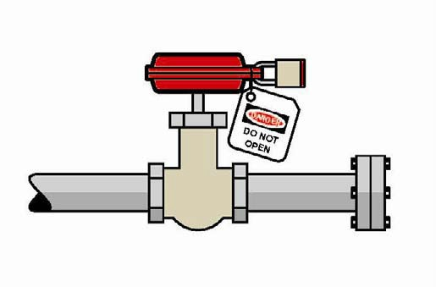
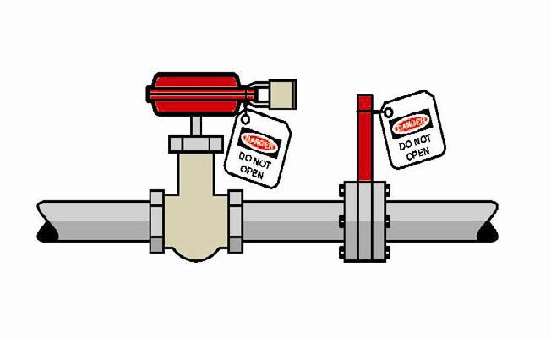
Isolation
All potentially hazardous services must be isolated prior to any person entering the confined space.
Isolate to prevent:
the introduction of contaminants or conditions through piping, ducts, vents, drains, conveyors, service pipes and fire protection equipment
the activation or energising of machinery in the confined space
the activation of plant or services outside the confined space that could adversely affect the space (for example heating or refrigerating methods)
the release of any stored or potential energy in plant
the inadvertent use of electrical equipment.
If liquids, gases or vapours could enter the confined space the pipe work should be physically isolated.

Slide 22
Atmosphere
A safe atmosphere must be ensured, so far as is reasonably practicable, during work in a confined space. A safe atmosphere in a confined space is one that:
has a safe oxygen level
is free of airborne contaminants or any airborne contaminants are in concentrations below their allowable exposure standard (if any)
any flammable gas or vapour in the atmosphere is at concentrations below five per cent of its LEL.

Slide 23
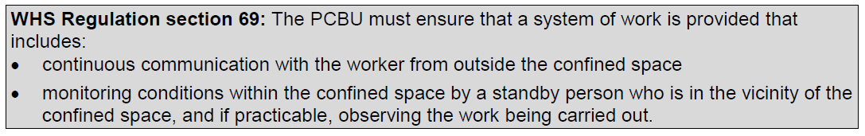
Communication and safety monitoring

Slide 24
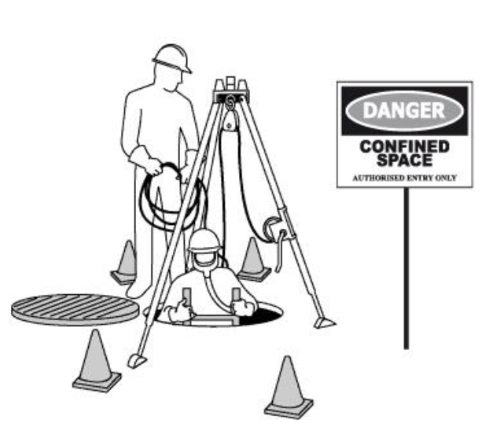
Entry and exit procedures
For the entire period the confined space entry permit is valid, procedures should be in place to indicate when any worker is in the space (e.g. by using tags, a system of signing in and out on the entry permit, or having a standby person record who is in the space).

Slide 25
Signs and barricades
Before any work in relation to a confined space starts, signs must be erected to prevent entry of persons not involved in the work.
Signs must warn against entry by people other than those who are listed on the confined space entry permit, and must be placed at each entrance to the confined space. Signs must be in place while the confined space is accessible, including when preparing to work in the space, during work in the space and when packing up on completion of the work.
Signposting alone should not be relied on to prevent unauthorised entry to a potential confined space. Security devices (e.g. locks and fixed barriers) should be installed.

Slide 26
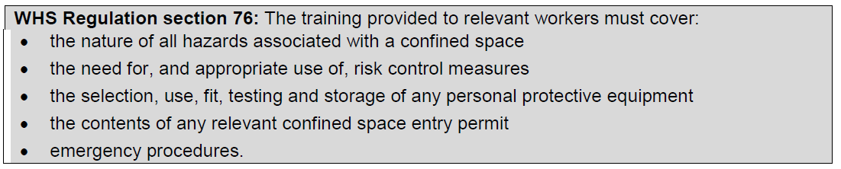
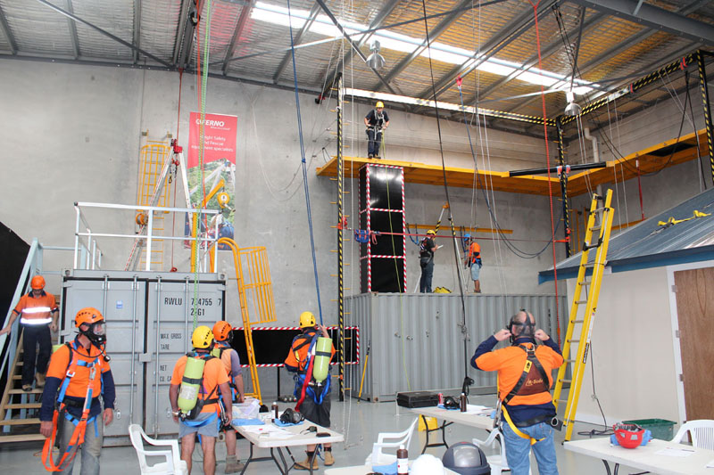
Information, Instruction and Training

Slide 27
Maintenance of control measures
Proper maintenance of control measures is an integral part of any safe system of work. Maintenance may involve visual checks, inspections, testing of equipment, preventative maintenance and remedial work. Equipment that should be regularly inspected includes:
atmospheric testing and sampling equipment
personal protective equipment including respirators
ventilation equipment
safety harness and lines
emergency rescue equipment.

Slide 28
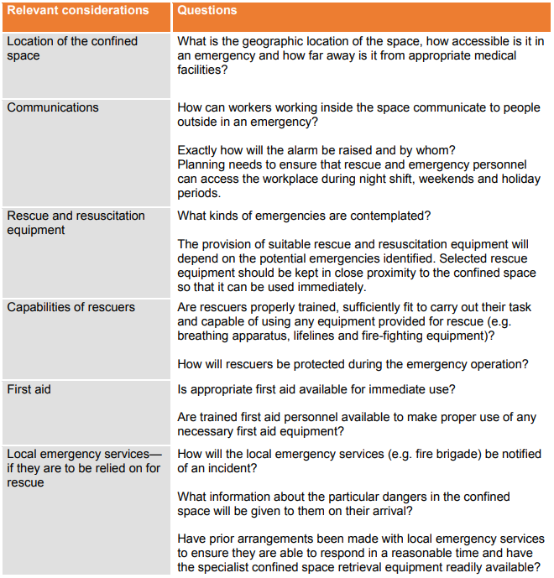
Emergency procedures

Slide 29
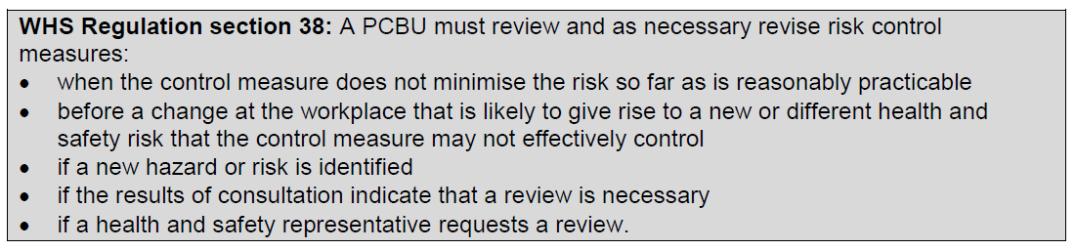
How to review and maintain control measures

Slide 30


