Slide 1

FORMWORK
WORK HEALTH AND SAFETY OFFICER

Slide 2
Assessment Criteria
Describe the statutory requirements relating to formwork.
List the hazards that are associated with the processes of formwork.
Describe the control measures that are available to eliminate or minimise the risk associated with these hazards.

Slide 3
What is Formwork?
Formwork is a temporary structure that supports part or the whole of a permanent structure until it is self-supporting. Once assembled, the components form the temporary structure.
Formwork means the surface used to contain and shape wet concrete until it is self-supporting. This includes:
the forms on or within which the concrete is poured; and
the frames and bracing which provide stability.

Slide 4
Duties
PCBU
Designers, manufacturers, suppliers and importers
People installing, constructing or commissioning plant or structures
Officers
Workers

Slide 5
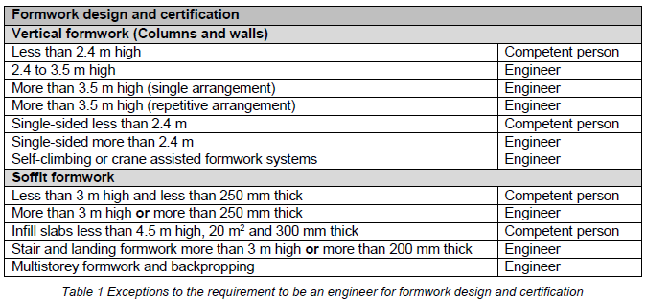
Design and Certification

Slide 6
Hazards
Hazards associated with work involving the erection, alteration and/or dismantling of formwork include:
formwork collapse (before, during and after placement of concrete);
falls from heights;
slips and trips;
falling objects ;
noise;
dust; and
manual tasks.

Slide 7
Managing the risks
Hazards associated with work involving the erection, alteration and/or dismantling of formwork include:
formwork collapse (before, during and after placement of concrete)
falls from heights – see the Managing the risk of falls at workplaces Code of Practice.
slips and trips
falling objects
noise – see the Managing noise and preventing hearing loss at work Code of Practice.
dust
manual tasks – see the Hazardous manual tasks Code of Practice.

Slide 8
Steel Fixing
Steel fixing is the positioning and assembly of steel bars and mesh sheeting with ligatures to form reinforcement for concrete structures such as concrete slabs, columns, drainage and communication pits, walls and concrete barrier structures. It is the mould created prior to pouring the concrete

Slide 9
Concrete Pumping
A concrete pump is a machine used for transferring liquid concrete by pumping.
Boom pumps are used on most of the larger construction projects as they are capable of pumping at very high volumes and because of the labour saving nature of the placing boom. They are a revolutionary alternative to line-concrete pumps.

Slide 10


