Slide 1

BSBITU401
Design and develop complex text documents

Slide 2

Housekeeping
Emergency Procedures
Mobiles, Security Issues
Break times / Smoking policy
This course is “interactive” – ask questions
Respect, Confidentiality, Practice
Ground Rules

Slide 3
Activities
NOTE:
If this course is being conducted in a workplace environment, the instructor will need to clarify to the class what are the acceptable organisation requirements in place with respect to activities.

Slide 4
Objectives
Learn how to prepare to produce word processed documents
Know how to design complex documents
Understand how to add complex tables and other data
Discover how to produce documents
Gain the skills and knowledge required for this unit.

Slide 5

Prepare to produce word processed documents
1.1. Use safe work practices to ensure ergonomic, work organisation, energy and resource conservation requirements are met

Slide 6
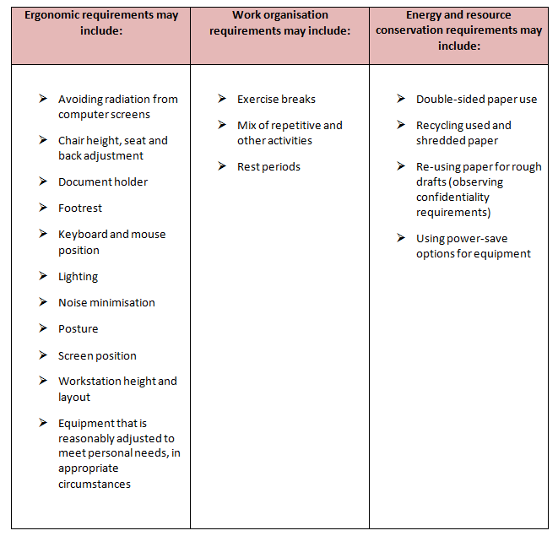

Slide 7

Consider:
Work surface height
Chair
Keyboard placement
Screen placement
Desk-top layout
Document holder
Posture and environment
Lighting
Glare and reflection

Slide 8

Conservation requirements may include:
Double-sided paper use
Recycling used and shredded paper
Re-using paper for rough drafts (observing confidentiality requirements)
Using power-save options for equipment

Slide 9
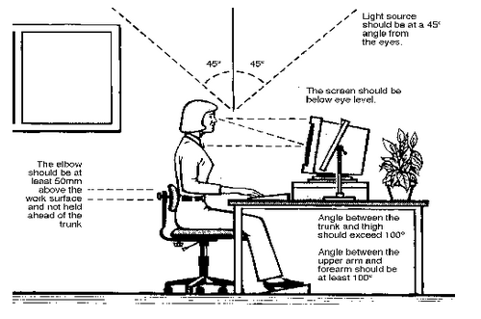

Slide 10

Activity 1A

Slide 11
Prepare to produce word processed documents
1.2. Identify document purpose, audience and presentation requirements, and clarify with relevant personnel as required

Slide 12

Complex Documents may include:
Call outs
Captions
Concordance files
Different odd and even pages
Document protection
Drawings
Forms with fields
Hyperlinks
Linked and/or embedded objects

Slide 13
Activity 1B

Slide 14

Other complex documents may include:
Meeting agenda
Minutes
Press release
Project proposal

Slide 15
Prepare to produce word processed documents
1.3. Identify organisational requirements for text-based business documents to ensure consistency of style and image

Slide 16

Organisational requirements may include:
Company colour scheme
Company logo
Consistent corporate image
Content restrictions

Slide 17

Ensure consistency of style and image
Everything should have the same “look” and “feel”
Use the same types of materials such as paper, packaging, business card, etc
Use and insist on the same logo at all times

Slide 18
Activity 1C

Slide 19
Prepare to produce word processed documents
1.4. Evaluate complex technical functions of software for its usefulness in fulfilling requirements of the task
1.5. Match document requirements with software functions to provide efficient production of documents

Slide 20

Complex technical functions may include:
Alignment
Data transfer
Display features
Embedding
Exporting
Fields

Slide 21
Activity 1D

Slide 22
Design complex documents
2.1. Design document structure and layout to suit purpose, audience and information requirements of task

Slide 23

Design choices may include:
Balance
Diversity
Relative positioning of graphics and headings
Simplicity
Text flow
Typography

Slide 24

Structure and layout may include:
Colour
Columns
Drawing
Graphics
Headings
Letter and memo conventions
Page layout
Typeface
White space

Slide 25

Alignment
This can be achieved, for example, in document structure and layout by aligning the various elements on individual pages with the tops of say, photographs or images, being in ‘alignment’ with the top of the first line of corresponding text.

Slide 26

Graphics
Graphics are considered pictures in the context of document structure and layout
They can be realistic, cartoons, drawings of people, places, or objects.

Slide 27

An image or identity
Documents can be designed with watermarks, logos and a host of other ‘identities’.

Slide 28
Activity 2A

Slide 29
Design complex documents
2.2. Design document to enhance readability and appearance, and to meet organisational and task requirements for style and layout

Slide 30
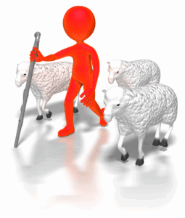
Use unique images
How can you accomplish this when there are ‘hundreds’ of visuals associated with your products or services and that of your competitor?

Slide 31

Some Options
Hire a professional
Do it yourself
Change it
Keep it simple
Plug it in

Slide 32
Important
White space
Design document to enhance readability and appearance
Colour combinations
Layout arranged according to related topics and logical sequences

Slide 33

Appendices and Annexes
An Appendix or Annexure consists of supplementary material supporting and complementing the various elements in the body of the document.

Slide 34
Activity 2B

Slide 35
Design complex documents
2.3. Use complex software functions to enable efficient manipulation of information and other material, and ensure consistency of design and layout

Slide 36

Consistency of design and layout may include:
Annotated references
Borders
Bullet/number lists
Captions
Consistency with other business documents
Footnotes/endnotes

Slide 37

Efficient manipulation of information
Manipulation, in the context of document design of complex documents, represents the ‘sometimes’ comprehensive process a document goes through from beginning to end

Slide 38

Annotated References
An annotated reference example would be a bibliography
A bibliography can be created or ‘manipulated’ after a document has been produced by adding a list of citations to the document.

Slide 39
Activity 2C

Slide 40
Design complex documents
2.4. Use manuals, user documentation and online help to overcome problems with document design and production

Slide 41

Manuals are found:
Online
On your computer
A website
Physically in a box or folder
On a CD or DVD

Slide 42

The sections of a user manual often include:
A cover page
A title page and possibly a copyright page
A preface, containing details of related documents and information on how to navigate the user guide
A contents page

Slide 43
User documentation quality check list
One element of evaluation for software is the quality of the user documentation supplied with the software. User documentation may be provided as a user manual in electronic form, as a paper insertion in the submission, or in the form of online help.

Slide 44

Outsourcing technical documentation and help
The rates charged for an external documentation service provider may be high

Slide 45
Activity 2D

Slide 46
Add complex tables and other data
3.1. Insert a standard table into document, changing cells to meet information requirements

Slide 47

Standard Word Table
It is simply a container that works very much like a series of drawers providing separate space for each of your important items so that things are easy to find

Slide 48
Add complex tables and other data
3.2. Format rows and columns as required

Slide 49
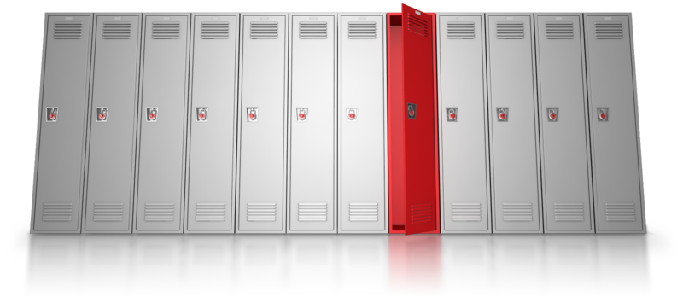
Formatting rows and column may include:
Auto distribute
Fills/shading
Lines and borders
Merge cells
Sorting contents
Split cell
Text direction

Slide 50
Add complex tables and other data
3.3. Insert images and other data, formatting as required

Slide 51

Other data may include:
Clip art
Data from other software applications
Digital photographs
Files
Graphics
Quotes
References
Scanned photographs and logos
Tables, graphs and charts

Slide 52
Activity 3A

Slide 53
Produce documents
4.1. Use complex operations to develop documents, and achieve required results

Slide 54

Complex Operations
Complex operations in the development of documents could include a variety of options and functions
Many, you have already covered

Slide 55
Activity 4A

Slide 56
Produce documents
4.2. Preview, adjust and print documents in accordance with organisational and task requirements

Slide 57

Printing may include:
Print merge
Print to file
To fit specific number of pages
With comments
With drawing objects
With field codes
With hidden text

Slide 58
Activity 4B

Slide 59
Produce documents
4.3. Name and store documents in accordance with organisational requirements and exit application without information loss/damage

Slide 60

Naming and storing documents may include:
Authorised access
File names according to organisational procedure e.g. Numbers rather than names
File names which are easily identifiable in relation to the content
File/directory names which identify the operator, author, section, date etc.

Slide 61

File Names
A file name extension is a set of characters added to the end of a file name that determine which program should open it.
It is called an extension because it appears at the end of the file name, following a full stop.

Slide 62

What are your storage needs?
All organisations, large and small, need more space for data storage.

Slide 63

Remember
Avoid large folder structures
Use shortcuts and shortcut links instead of multiple copies
Colour-code your folders
Quickly get to the items you use every day
Consider storing documents online

Slide 64

Storage
CD or some other storage media
Flash memory thumb drives
External hard drives
Online storage

Slide 65
Activity 4C

Slide 66
Produce documents
4.4. Prepare documents within designated timelines and for speed and accuracy

Slide 67

Designated timelines may include:
Timeline agreed with internal/external client
Timeline agreed with supervisor/person requiring spreadsheet
Organisational timeline e.g. Deadline requirements

Slide 68

Organisational timeline
The application and discipline of compliance to timelines are like other organisation specifications and will depend entirely on your organisation requirements.

Slide 69

Designated timelines may be:
Daily
As requested
By month end
Monthly
Within agreed period
Within organisational deadline

Slide 70
Activity 4D

Slide 71
Skills and Knowledge Activity

Slide 72
Major Activity
This activity should take anywhere between an 1-2 hours to complete and can be found at the end of your workbook.
Your instructor will let you know whether they wish for you to complete it in session time or your own time.

Slide 73

Summary and Feedback
Did we meet our objectives?
How did you find this session?
Any questions?

Slide 74

Congratulations!
You have now finished the unit…
‘Design and develop complex text documents’

